Slide 1
Exploring Options for Mini-Grant Support to Enhance Readiness for Payment Reform
Health Management Associates August 8, 2018

Slide 2
MinI-Grant focus: to improve readiness for payment reform
Data integration and analytics
Clinical integration including coordination of care and developing care guidelines
Organizational integration to pursue value-based payment

Slide 3
About the Accountable Care Atlas
Over 160 competencies
Organized into a logical sequence
Based on relationships to other competencies
Includes phases and work areas
Developed by a non-profit involving 95 national organizational stakeholders
Found in the public domain https://www.accountablecarelc.org/sites/default/files/Master%20Atlas.pdf
Notes:
The Accountable Care Atlas is a collection of over 160 competencies organized into a logical sequence for implementation. They are organized based in relation to other competencies. We knew it would be important to show that holistic organization rather than just a list of competencies, with the goal of showing how they relate to each other, because we understand that healthcare is complex and that there’s a lot of interrelatedness. We also included, and we’ll dive into this more into in a minute, phases and work areas to help break it up, to make it more useable and intuitive.

Slide 4
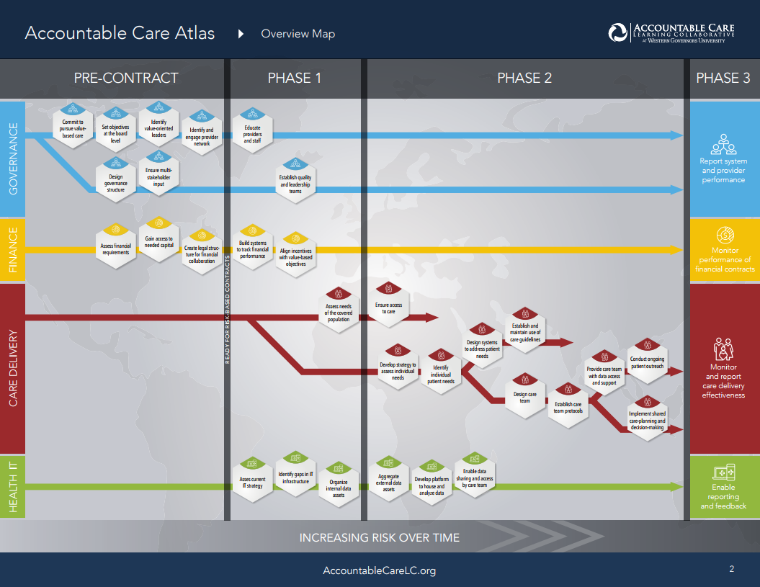

Slide 5
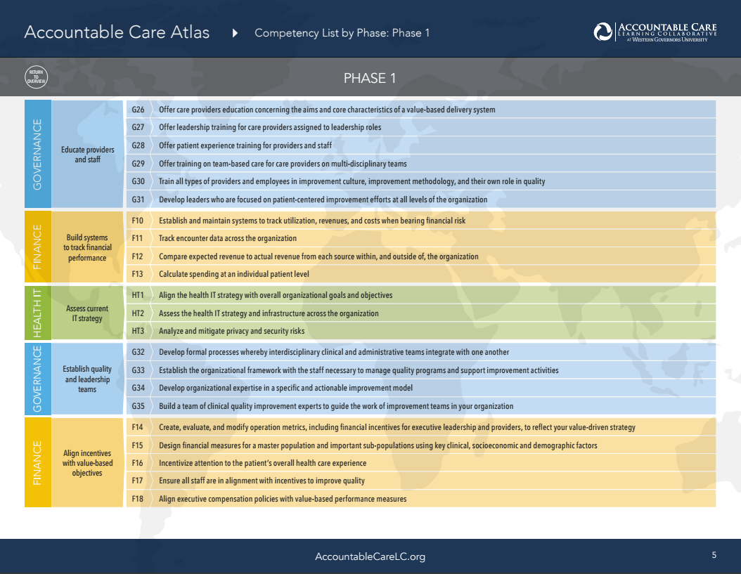

Slide 6
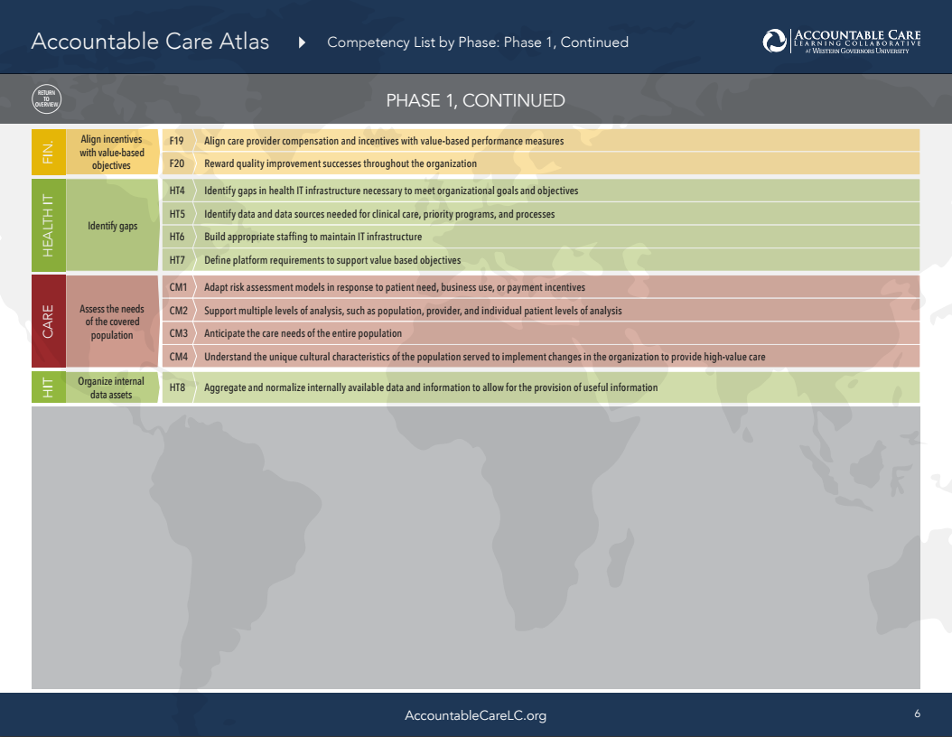

Slide 7
Use of the Atlas
Identify your position on the continuum of pursuit of value-based payment
Recognize competencies that may have been overlooked at your current phase or that will propel you to the next phase
Agree on important next steps within the scope of the mini-grant program that can be achieved within the time line and budget
Prioritize competencies to be addressed in the RFP response

Slide 8
Improve pay-for-performance revenue
Create a performance dashboard using EHR derived data
Compare those results to those from the health plan’s provider portal; identify and rectify discrepancies
Calculate unearned revenue potential
Develop workflows to close gaps in care in order to hit targets
Develop financial modeling of the various options
Target metrics with a ROI in mind
Implement the model of care
Reinvest net earnings in pursuing other metrics

Slide 9
Example: Independent practices decide to pursue an integration strategy for the purpose of pursuing shared savings
Potential competencies to focus on during this grant period
Develop alignment of mission, vision, and strategy with value-based care and patient-centeredness objectives.
Review individual and aggregated benchmarked historical quality, utilization and cost data from payers
Identify leaders who have proven reputation and abilities among peers to achieve value outcomes, carry out quality-improvement initiatives, and manage financial accountability for outcomes.
Explore and choose a governance option for developing the ability to distribute shared savings and other performance-based payments to providers.
Learn the principles for negotiating value-based contracts for various categories of alternative payment methodologies and develop a contracting strategy

Slide 10
Improve management of High cost high need (HCHN) members
Work with payers to receive a list of HCHN members attributed to your practice
Establish a working relationship with health plan care management department in which you share care plans and become their “boots on the ground” partner
Develop a check list, case conferencing approach to analyzing high cost members to determine root causes (unmet BH needs, SDOH, suboptimal control of chronic disease, etc.)
Negotiate a care coordination fee and a pay-for-performance opportunity with metrics such as increasing 7 day follow-up after hospital or ED discharge, reducing projected future ED visits and/or re-hospitialization

Slide 11
Move from fee-for-service to primary care capitation
Perform analysis to determine a capitation rate that is equivalent to the historical fee-for-service revenue
Develop a model of care that offers increased access to primary care services (nurse call line, virtual visits (phone and patient portal, telehealth, use of “non-billable care team members)
Develop financial modeling, offsetting the expense of an expanded care team with revenue derived from managing a larger panel of patients
Negotiate the primary care capitation with clear delineation of services that are including in the bundle
Monitor financial performance

