Slide 1
Delaware’s State Innovation Model (SIM) Update
June 2, 2016

Slide 2
Recent HCC SIM Grant Activities
Activities
Workforce
Contracted with Christiana Care Health System for Component A (Consortium Facilitation)
Vendor for Component B (Curriculum Development) expected to be announced soon
Practice Transformation
Increase in sites enrolled
Vendors met with DCHI Clinical Committee
Enrollment continues

Slide 3
Pace of Enrollment

Slide 4
Enrollment by Practice Size

Slide 5
Recent DCHI focus areas
Preparing to launch first Healthy Neighborhood in Sussex County and continuing conversations in other Wave 1 Neighborhoods (Wilmington/Claymont, Dover/Smyrna)
Issued paper on “Increasing access to claims data to support health innovation”
Planning and publicizing first community forum on June 7 in Georgetown
Engaged with practice transformation vendors and Clinical Committee members on learnings thus far
Refining behavioral health integration approach with providers and payers and identifying pilot PCP and BH practices
Released Common Scorecard v2.0 to testing practices; continuing to prepare for statewide release in the Fall

Slide 6
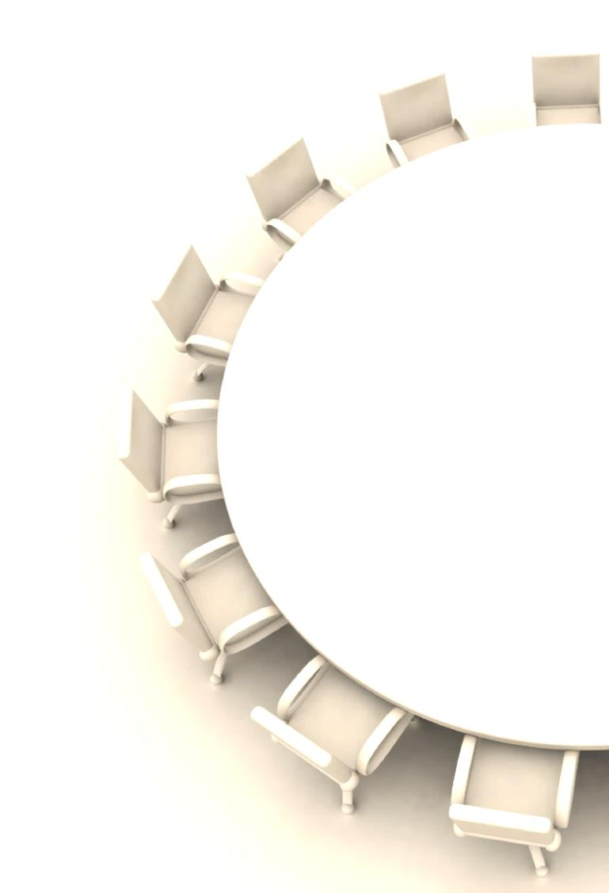
Summary of May DCHI Board meeting
Received update that DHIN Board formally approved revised DCHI bylaws and new Board members
Approved new members for Healthy Neighborhoods, Clinical and Payment Committees
Shared update that state-led evaluation for SIM grant has developed logic model and will convene an advisory panel
Discussed progress on practice transformation, with plans to include updates in future Board meetings
Endorsed “Increasing access to claims data to support health innovation” paper
Discussed plans for DCHI community forums over the next six months, with the first scheduled for June 7
Provided input on format and agenda for May 25 Cross Committee meeting

Slide 7
May 25 Cross-Committee meeting debrief
Content covered:
Progress update on Board activities
Committee updates through self-directed gallery walk and moderated panel addressing audience questions
Brief presentations on access to claims data and behavioral health integration
Attendance: ~70 attendees across Board, Committees, broader set of SIM contributors and public
Feedback: Initial audience survey results suggest continued belief the forum is a valuable use of time and way to provide feedback to DCHI
Preference for engaging directly with Committee members through presentations and Q&A session
Appreciation for greater detail and specificity provided in the brief presentations
Suggestion to include more time for open discussion
Continued value in DCHI convening all stakeholders in one place

Slide 8
Upcoming DCHI Committee Meetings
Consumer Advisory
June 2, 1:00pm
Edgehill Shopping Center
Please check the DCHI website (www.DEhealthinnovation.org) for the latest information about all DCHI Board and Committee meetings
Community Forum
June 7, 7:00pm
CHEER Center, Georgetown
Payment Model Monitoring
June 8, 4:30pm
UD STAR Campus
Healthy Neighborhoods
June 15, 1:00pm
UD STAR Campus
Clinical
June 21, 1:00pm
UD STAR Campus

