Slide 1
Department of Health and Social Services Division of Management Services
Joint Finance Committee Hearing
Fiscal Year 2016
Kevin F. Kelley
Division Director
Tuesday, February 24, 2015
Notes:
Good morning Representative Smith, Senator McDowell, and members of the Joint Finance Committee. I am Kevin Kelley, Director of the Division of Management Services (DMS). With me today is Zel Cannon, our Deputy Director and Debbie Wallace, Manager of the DHSS Budget, Policy and Revenue Management unit. I wish to begin by thanking you for this opportunity to share the details regarding DMS’ Governor’s Recommended Budget.

Slide 2
Overview
High-quality leadership/technical expertise
Efficient and cost-effective management
“DMS – Doing Our Best To Help You Do Yours”
Notes:
The mission of our Division is to provide high-quality leadership and technical expertise in DHSS through efficient and cost-effective management of human, financial, information and facility resources. Our strategic focus is to leverage departmental resources so that our divisions can focus on serving the citizens of Delaware. Additionally, we serve as a liaison between other state and federal agencies, legislators, and multiple community partners on various matters.

Slide 3
DMS Units
Fiscal Management
Budget and Revenue Management
Contracts Management and Procurement
Coordination of Birth to Three Program – Early Intervention and Quality Control
Information Resource Management (IRM)
Human Resource Management
Labor Relations
Audit & Recovery Mgt. Services (ARM$)
Facility Operations
Notes:
Division of Management Services consists of nine (9) distinct functional units.
Fiscal Management
Budget and Revenue Management
Contracts Management and Procurement
Coordination of the Birth to Three – Early Intervention Program and Quality Control
Information Resource Management
Human Resource Management
Labor Relations
Audit & Recovery Management Services (ARM$)
Facility Operations
Great work is occurring in all of our units, but today we are focusing on just a few of our FY 2014 highlights.

Slide 4
Birth to Three
Continued timely service
95% of families reported that they perceived positive changes in their child
Notes:
We work to ensure quality services are provided by the Birth to Three program mandated under the Federal Individuals with Disabilities Education Act-Part C. We served 3,435 children and their families in FY 2014. Of those served, 94% of families were assisted within 45 days of referral to the program. Families served by the Birth to Three Early Intervention System are surveyed annually to assess how they value the Program. The most recent survey indicated that 95% of families reported that they perceived positive changes in their children after participating in the Program.

Slide 5
Information Resources Management (IRM)
Leveraging Federal Funds to Enhance Service Delivery:
Eligibility Modernization Project
DE Medicaid Enterprise System
Medicaid Decision Support System / Data Warehouse
Notes:
As of today, IRM maintains and operates 138 systems and is currently managing 71 projects. Many of these systems and projects are significantly funded by federal grants. The multi-million dollar projects being developed include:
The Delaware Eligibility Modernization System (DEMS) project involving a comprehensive re-design and implementation of major functionality improvements as well as major hardware and software technology upgrades. The new system will provide integrated eligibility/enrollment functionality for Medicaid, the Children’s Health Insurance Program (CHIP), and public assistance programs. The project is on budget and schedule to meet the Affordable Care Act mandates. The final phase is scheduled to be completed by July 2016.
Delaware Medicaid Enterprise System (DMES) project is to replace the current Medicaid Management System (MMIS). The existing MMIS system does not allow the state to meet the standards and conditions issued by the Centers for Medicare and Medicaid Services (CMS) in April 2011. DMES is scheduled to be operational by July 2016.
The Medicaid Decision Support System / Data Warehouse (DSS/DW) project when completed will be capable of warehousing all claims data. This project is to be completed by the end of FY 2015.

Slide 6
ARM$ Claims Generated
Notes:
The Audit & Recovery Management Services unit (ARM$) is responsible for identifying and investigating possible eligibility fraud, as well as collecting and recouping overpayments in Child Care/Purchase of Care and public assistance programs. ARM$ does not investigate Medicaid provider fraud; provider fraud cases are investigated by the Medicaid Fraud Control Unit and the Attorney General’s Office.
ARM$ is not only a fiscal operation but also serves as an ongoing quality check on our programs after individuals are deemed eligible for services. Of the cases investigated/audited, 86% resulted with a finding of “no error”.
From FY 2009 to FY 2014, ARM$ has increased its number of claims by 217%.

Slide 7
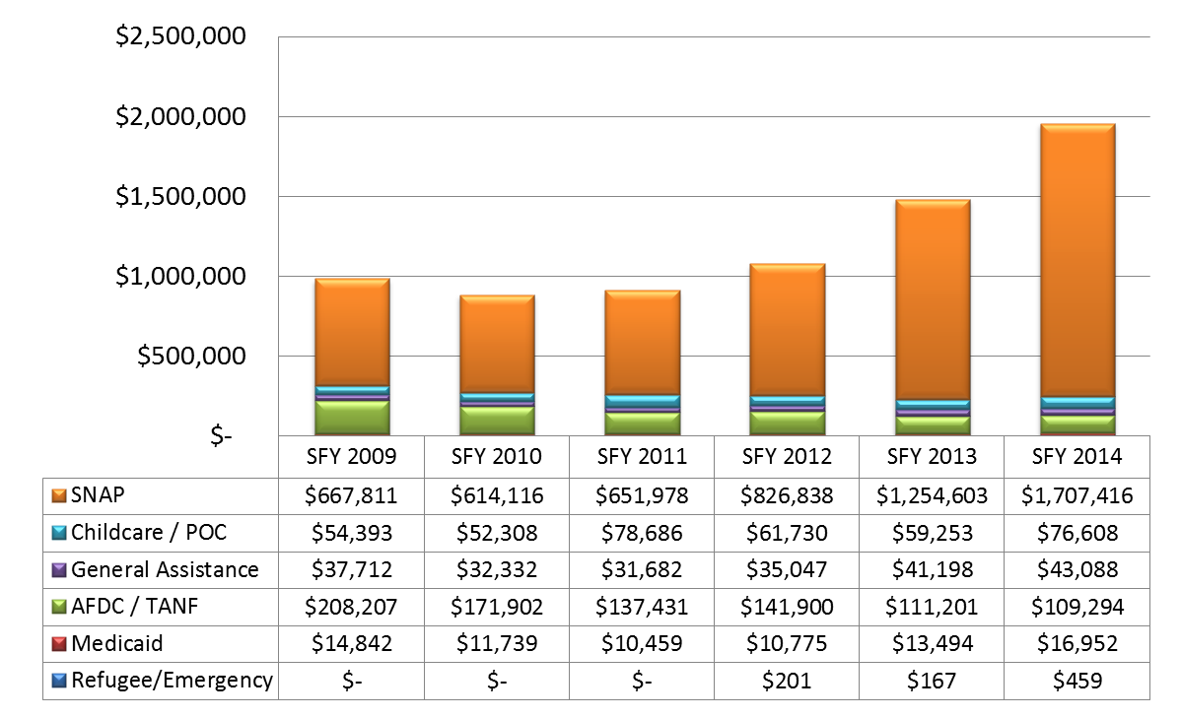
ARM$ Collections
Total $982,964
Total $882,398
Total $910,236
Total $1,076,492
Total $1,479,916
Total $1,953,818
Notes:
Also, of the 14% of cases deemed to have had an overpayment, 75 cases met the requirements to be forwarded to the Attorney General’s Office for criminal prosecution. A total of $101,991 was ordered in restitution on these cases during FY 2014.
From FY 2009 to FY 2014, ARM$ has increased its number of collections by 99%. I commend the ARM$ staff for its diligent efforts which have increased collections from FY 2013 to FY 2014 by over $470,000 or 32%. These increases have been gained through automated data matches, more effective investigations and efficient collections activities.

Slide 8
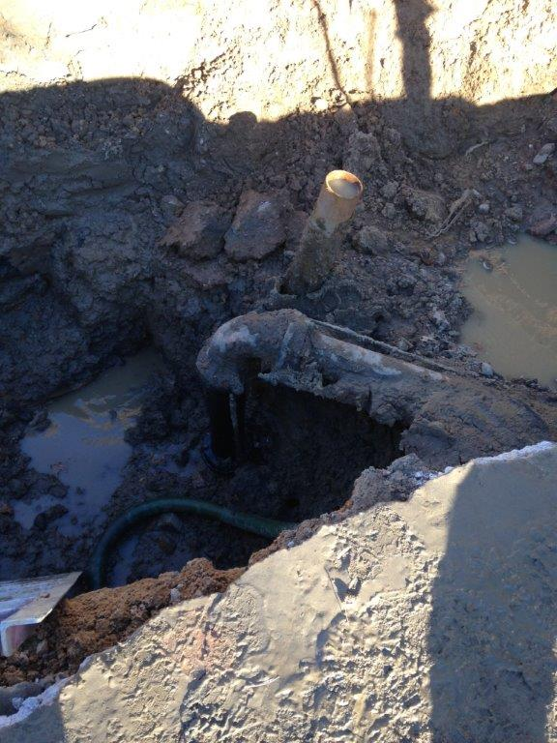
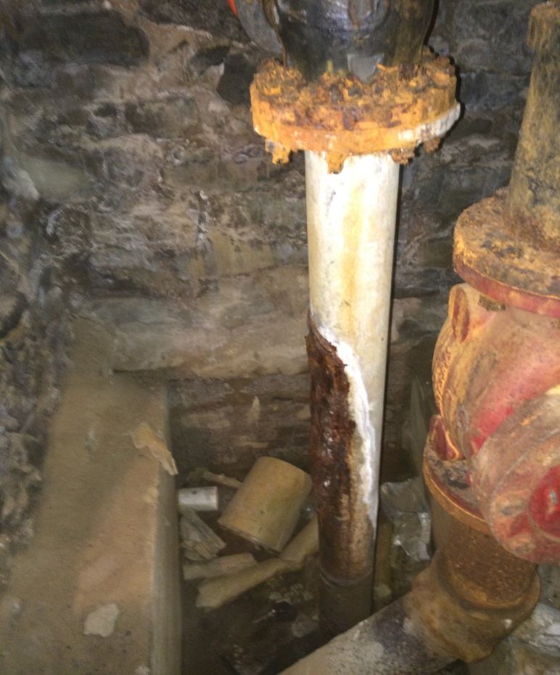
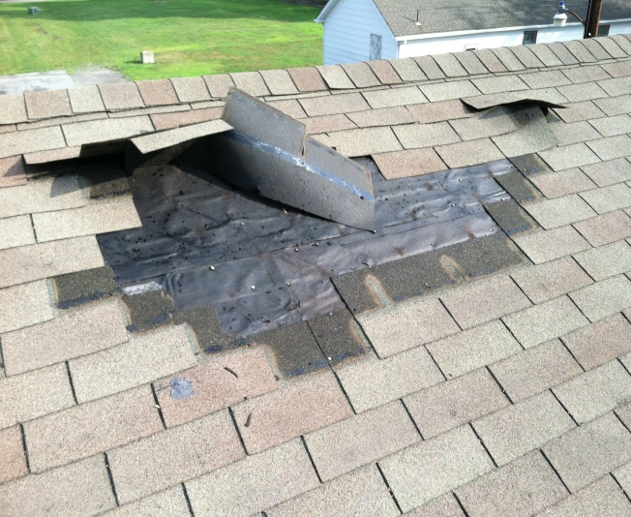
Facility Operations
Notes:
Facility Operations maintains 156 buildings and infrastructure, which include five (5) long-term care facilities. They also provide security, grounds keeping, custodial services for many of DHSS locations. These functions are accomplished by 265 full-time equivalents (FTE’s). With the average age of the buildings being 57 years old, it is a daunting task to guarantee safe and adequate facilities for all served and employed at our locations.
In FY 2014, Facility Operations completed 476 Maintenance & Restoration (M&R) projects. M&R projects typically involve painting, carpet replacement and minor building exterior repairs as well as those required for the electrical system and heating, ventilating and air conditioning systems.
The Asset Information Management (AIM) system was initiated for making and tracking Facility Operation work orders in FY 2014. The system allows an individual to receive feedback on his/her requested work as well as allows management to quickly determine how and where the workforce is deployed.

Slide 9
FY ‘16 Governor’s Recommended Budget for Administration
$98.4 – Lease Escalators
$2,358.3 – Eligibility Modernization System Maintenance and Operation
$288.5 - One-time for Telephones*
$6.5 – One-time Department-wide security initiative*
*in OMB’s Contingencies and One-Time Items
Notes:
The FY 2016 Governor’s Recommended Budget includes:
$98.4 for Lease Escalators for 26 lease locations within the department; and
$2,358.3 for Eligibility Modernization System Maintenance and Operation. Maintenance and Operations included specialized contractual IT resources [$1976.2] , hardware maintenance [$150.4], and software licensing [231.7].
$288.5 – One-time funding for department-wide telephone installation in OMB’s Contingencies and One-Time Items.
$6.5 – One-time department-wide security initiatives (panic buttons) in OMB’s Contingencies and One-Time Items.

Slide 10
THANK YOU!!
Notes:
In conclusion, DMS continues to collaborate with the divisions to leverage, reevaluate and realign resources to achieve the delivery of customer driven services.
I would like to publicly acknowledge our dedicated and talented staff for its excellent work and support of our services and programs.
Thank you for your time and now I would be happy to take your questions.

