Slide 1

26 Days Before Enrollment Begins: Where Delaware Stands
DHSS Secretary Rita Landgraf
Delaware Health Care Commission, Sept. 5, 2013
Notes:
This is an historic time in Delaware – and for our country.
In 26 days, the opportunity for affordable health insurance – and the care that goes with it – will be extended to 90,000 Delawareans who do not have that coverage today.
When enrollment begins Oct 1, the meaning of the marketplace will be clear: We will bring affordable coverage to more Delawareans and that will mean a healthier Delaware for all.
Since the Health Care Commission last met, we have made excellent progress for our marketplace.
In a few minutes, you will hear from Marketplace Director Michelle Amadio with an update on the marketplace guides and the rate review process by the federal government.
Alex Parkowski of ab+c will update you on the media and outreach campaigns.
I will update you on events that have taken place in the last few weeks.

Slide 2
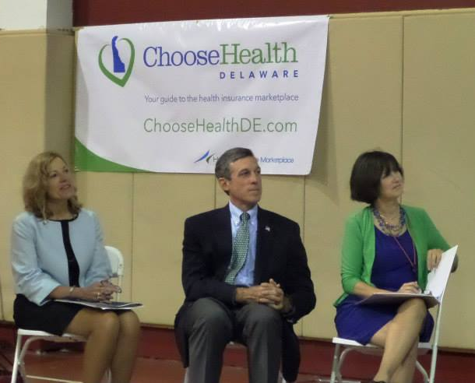
Tuesday’s Kickoff Event
Hosted by DHSS and DOI
At the Latin American Community Center
100+ people
Rep. Carney attended
4 guide organizations updated on their roles
Heavy media coverage
Notes:
On Tuesday, we had the formal public kickoff for the marketplace at the Latin American Community Center.
Speakers included Rep. Carney, Commissioner Stewart, a representative from Mayor Williams’ office, representatives of the four marketplace guide organizations, a woman who lost her health insurance in 2011 and was recently hired as a marketplace guide, Maria Matos and myself.
It was a full program, giving the public a complete introduction to the marketplace.
Media coverage – as many you read, saw and heard – was heavy.
As Rep. Carney said, “If there’s any place in the country where we can make this work, it’s right here in Delaware.”

Slide 3
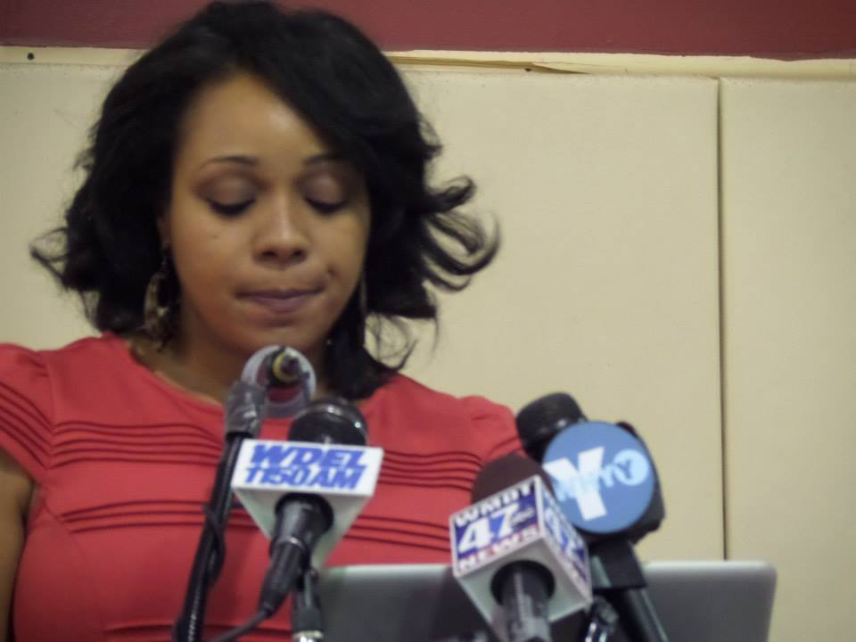
Tuesday’s Kickoff Event
Gia Cotman, a marketplace guide with Brandywine Women’s Health Associates, was the highlight of the kickoff, talking about a time in her life when she didn’t have health insurance. “I’ve been through it, and I think it will help me to communicate to [people] why [health insurance] is so important.”
“I was unemployed and uninsured,” she said after losing her job in September 2011.
Notes:
Gia Cotman, a marketplace guide with Brandywine Women’s Health Associates, spoke at Tuesday’s kickoff. Gia lost her health insurance in 2011 when she lost her job.
She told those at the kickoff, “I’ve been through it, and I think it will help me to communicate to people why health insurance is so important.”
Gia and her two children now have health insurance coverage.

Slide 4
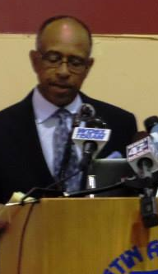
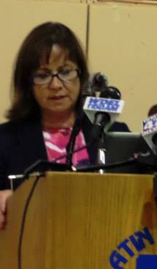
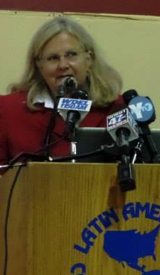
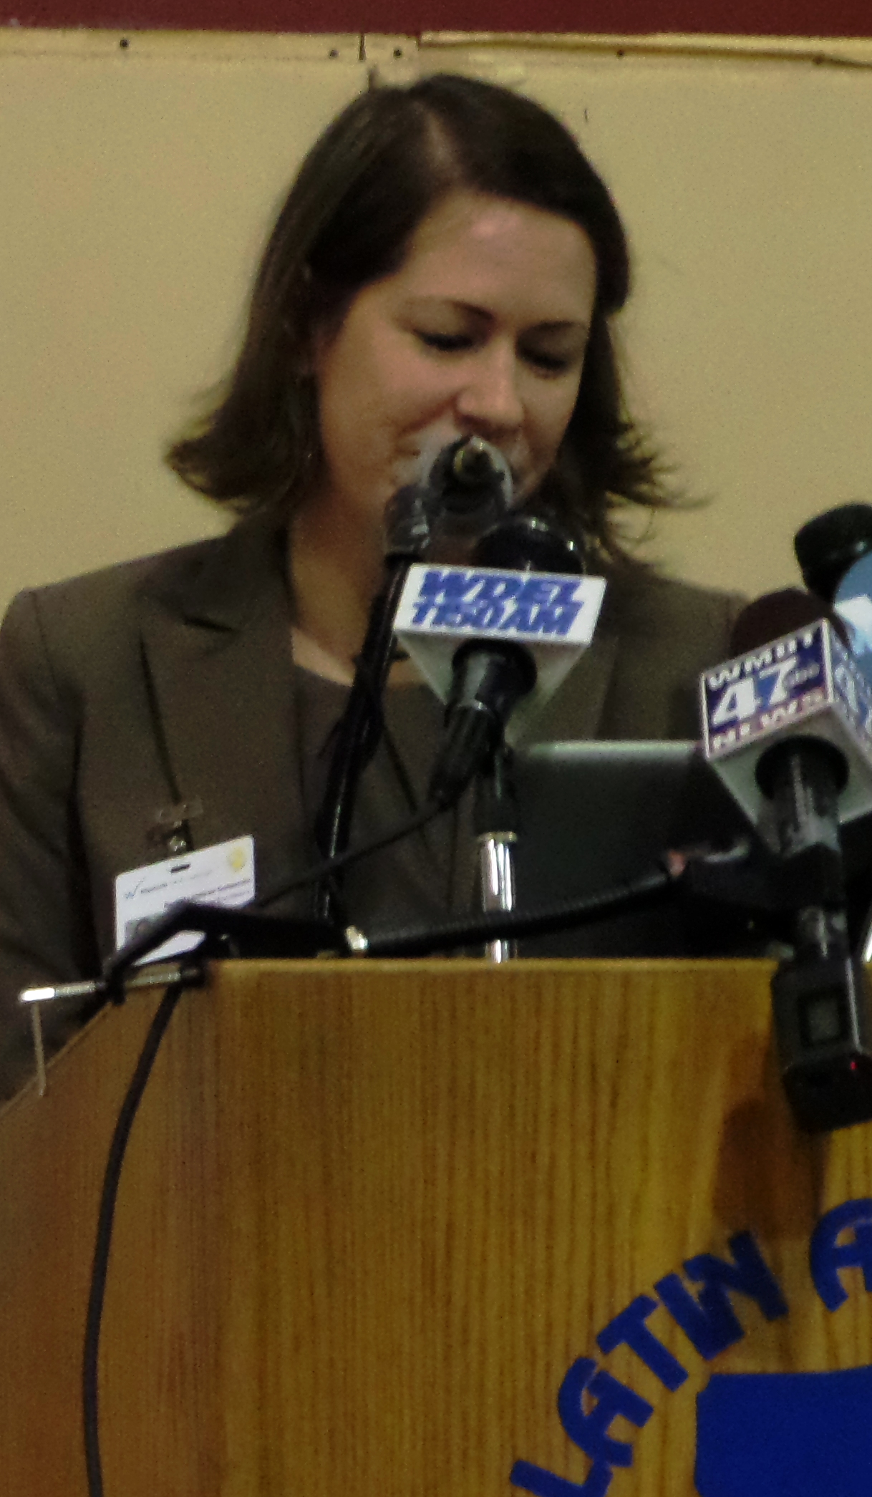
Tuesday’s Kickoff Event
The kickoff also was a public introduction of the 4 marketplace guide organizations:
Brandywine Women’s Health Associates
Notes:
You will hear more from Michelle Amadio about the marketplace guides, but Tuesday was also their chance to tell the public about their demographic and geographic priorities.
From left:
Dr. Cecil Gordon, whose practice, Brandywine Women’s Health Associates, will do outreach with individuals and small business owners in northern New Castle County.
Dr. Janice Nevin from Christiana Care, whose guides will concentrate on Christiana Care’s hospitals and ERs.
Susan Myers, representing the Delmarva Foundation, whose guides will work with small business owners across the state, and with individuals in Kent and Sussex.
And Rachel Linstead Goldsmith of Westside Family Healthcare, which will do outreach to individuals across the state.

Slide 5
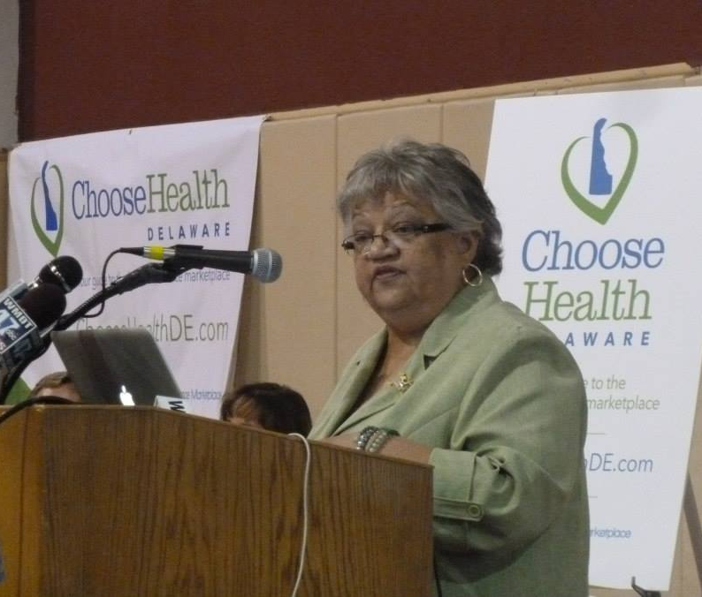
Outreach to Latino Population
Maria Matos, president and CEO of the Latin American Community Center, provided the facility and the welcome.
Approximately 22% of Delaware’s uninsured population is Latino.
“The cost of private family coverage equals almost two weeks of take-home pay," she said.
Notes:
In addition to the Young Invincibles, which Alex will talk more about in a few minutes, we also must do extensive outreach in the Latino community.
That’s one of the reasons we held the opening kickoff event at the Latin American Community Center. Latinos make up an estimated 22%-25% of Delaware’s uninsured population.

Slide 6
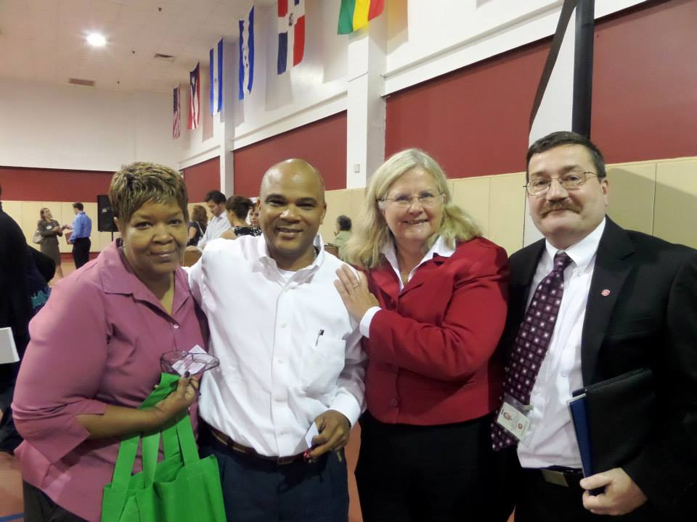
Outreach to Latino Population
Asked State Hispanic Commission to partner on outreach
ChooseHealthDE.com in English and Spanish
Bilingual marketplace guides
Components of media campaign and outreach in Spanish and English
24/7 Federal Call Center ready to answer questions in 150 languages
Notes:
To help facilitate that outreach, I met last week with the State Hispanic Commission to ask for their partnership in getting out the message of the marketplace.
In addition:
ChooseHealthDE.com is now available in English and Spanish.
Many of the guide organizations will employ bilingual guides.
Our media and outreach campaigns will be in English and Spanish.
And the Federal Call Center is ready to answer questions in 150 languages.

Slide 7
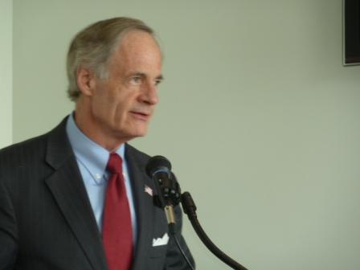
Stakeholder Roundtables
3 stakeholder roundtables hosted with Sen. Carper, DHSS and DOI:
Sussex, La Red, Aug. 26: 36 attendees
New Castle, DelTech, Aug. 28: almost 100 attendees
Kent: Dover Public Library, Aug. 29: 25 attendees
Notes:
At the suggestion of Sen. Carper, his office, DHSS and DOI organized a series of stakeholder roundtable sessions in each county.
More than 150 people attended the sessions – and all featured high levels of engagement and commitment by the stakeholders.
As Sen. Carper said, “This is an all-hands-on-deck moment in our history.”

Slide 8
Stakeholder Roundtables
Stakeholders heard directly from:
Sen. Carper and his staff
Secretary Landgraf and her staff
Commissioner Stewart, Linda Nemes and DOI staff
Saw presentations on:
An overview of the marketplace
The media and outreach strategies
Shared their thoughts on outreach, offered comments on the ACA and the marketplace, and asked frank questions
Notes:
The two-hour sessions have led to additional speaking requests and many partnerships.
This is the Delaware way – reaching out to one group, one small business owner, one person at a time.

Slide 9
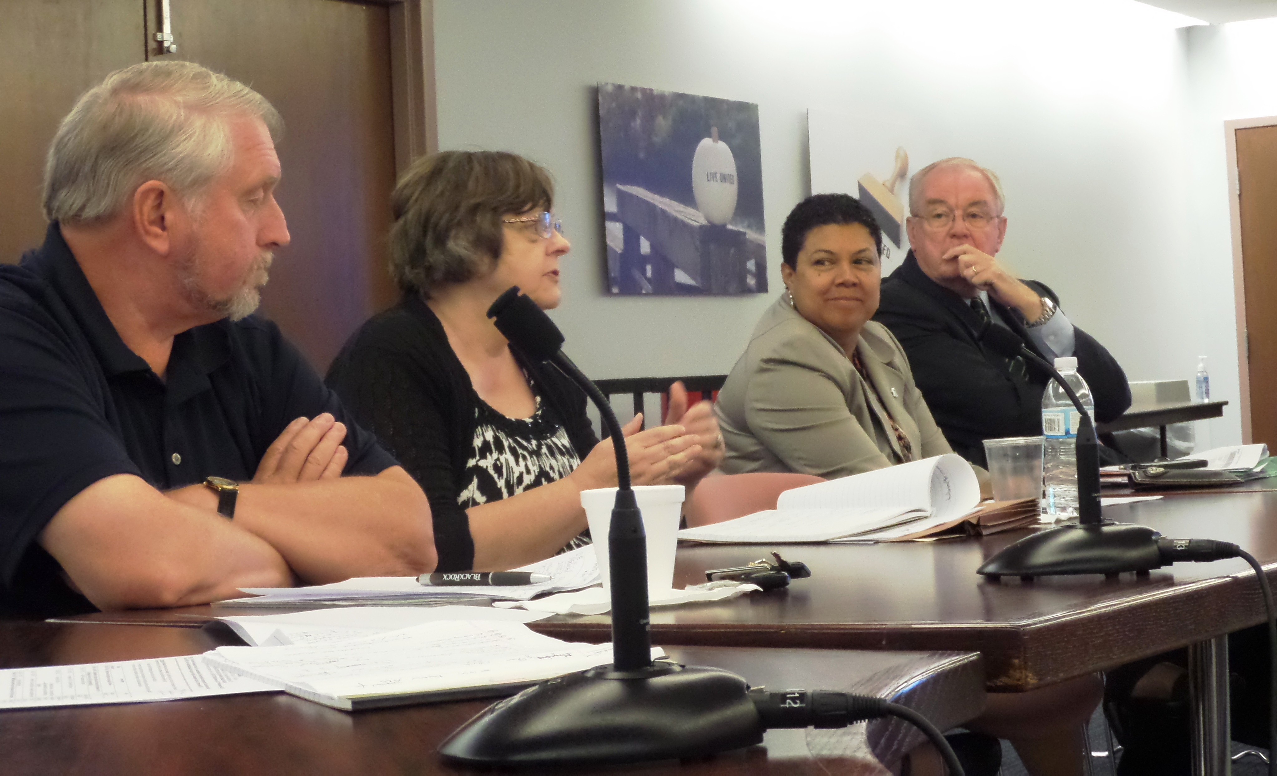
Speakers Bureau
If you’d like to request someone from the state to talk about the ACA or the marketplace, email Laura Howard at: lahoward@pcgus.com
Marketplace guide organizations also will arrange meetings with the public.
Linda Nemes of the Department of Insurance meets with the United Way’s Health Advisory Council. Insurance presents to the United Way Health Council.
Notes:
Bettina, Jill Rogers, Linda Nemes, Michelle Amadio, myself and many others are arranging and rearranging our schedules to accommodate as many speaking engagements as we can.
We are working with legislators, small business owners, the Delaware Aging Network, the Delaware State Chamber, Wilmington City Council, Delaware libraries, Delaware 211 and many others to schedule addition sessions.
Laura Howard from Public Consulting Group is in charge of scheduling this outreach. Her email is lahoward@pcgus.com

Slide 10
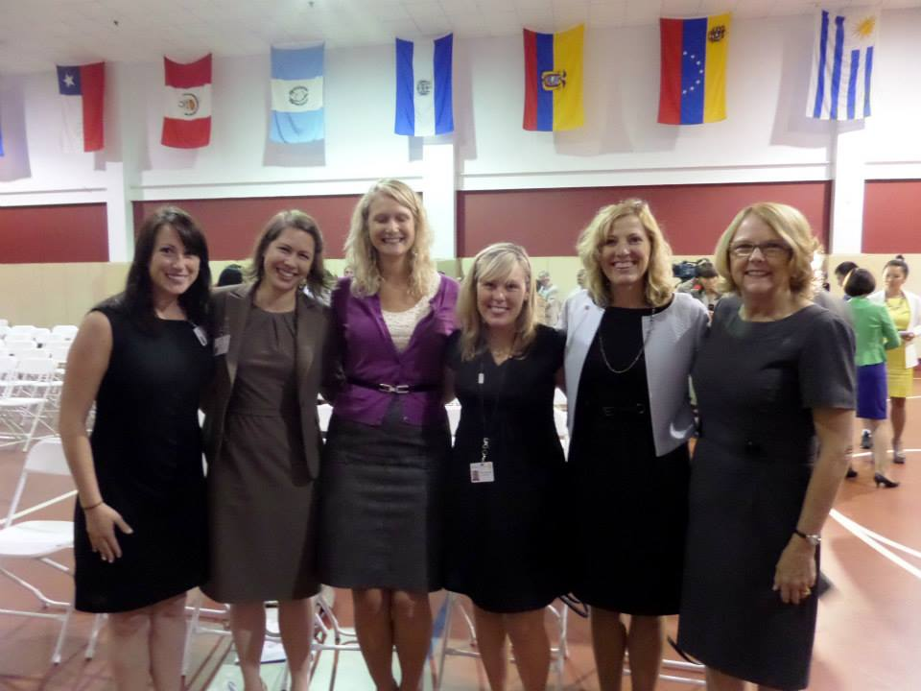
Thank You to All of Our Partners
Notes:
In just 26 days, we will begin enrollment on Delaware’s health insurance marketplace – together. With all of our community partners.
As you have seen for the past two years, health care reform isn’t a DHSS initiative or a DOI initiative. It is a Delaware project. We are, indeed, in this together.
Thank you.
And now, Michelle Amadio, our marketplace director, will update you on the qualified health plans, the rates and the marketplace guides.

