Slide 1
Delaware Health Care Commission Meeting March 7, 2024
Public Attendees – Please type your name and affiliated organization in the chat box or send in an email to DHCC@delaware.gov to help us record who attended the meeting.
This meeting will be recorded for minutes.

Slide 2
AGENDA
I: CALL TO ORDER
II: BOARD BUSINESS
ACTION ITEM: Approve February 1, 2024, DHCC Meeting Minutes
III: UPDATES
Delaware Institute for Dental Education and Research (DIDER)
III: POLICY DEVELOPMENT
Children’s Behavioral Health
IV: PUBLIC COMMENT
V: ADJOURN

Slide 3
BOARD BUSINESS ACTION ITEM: Approve February 1, 2024, meeting minutes

Slide 4
UPDATES Delaware Institute for Dental Education and Research (DIDER) Dr. Ray Rafetto, DIDER Board Member

Slide 5
UPDATE - Delaware Institute for DENTAL Education and Research (DIDER)
February 7th DIDER Board Meeting Highlights:
Temple DIDER Luncheon
University of Delaware Health Sciences Day
Temple application cycle to date: 21 applicants in various stages
ChristianaCare Residency Program
Division of Public Health Smile Program
Delaware State University Pre-Health Initiatives
University of Delaware Pre-Dental Program
DHCC received two dental applicants for the Health Care Provider Loan Repayment Program
Next DIDER meeting scheduled for April 10th

Slide 6
POLICY DEVELOPMENT Children’s Behavioral Health Stephanie Traynor, PsyD, MBA – Deputy Director, Division of Prevention and Behavioral Health

Slide 7
Youth Behavioral Health Presentation to the Delaware Healthcare Commission
Stephanie Traynor, PsyD, MBA—Deputy Director, Division of Prevention and Behavioral Health
March 7, 2024

Slide 8
Overview of the Department of Services for Children, Youth, and their Families and Division of Prevention and Behavioral Health Services
Service Eligibility
Today’s Agenda
Continuum of Services and Youth Served
Highlighted Prevention & Treatment Programs

Slide 9
About DSCYF
Created in 1983 to enable efficient services for children and families experiencing child maltreatment, delinquency and behavioral health challenges by avoiding fragmentation and duplication
Mission: To engage families and communities to promote the safety and well-being of children through prevention, intervention, treatment, and rehabilitative services
4 Divisions (DFS, DYRS, DPBHS, DMSS) with approximately 1400 employees

Slide 10
Division of Prevention and Behavioral Health Services
Our Mission
To develop and support a family-driven, youth-guided, trauma-informed prevention and behavioral health system of care
Our Vision
Resilient children and families living in supportive communities
Our Framework
Systems of Care and Trauma Informed Approach

Slide 11
DPBHS Services and Eligibility
DPBHS provides voluntary behavioral health prevention, early intervention and treatment services for Delaware children.
Prevention services available to all Delaware youth.
Early intervention for Delaware children by referral from early learning centers and schools.
Crisis intervention available to all children in Delaware (mobile crisis - MRSS).
Treatment services for Delaware children covered by Medicaid or uninsured.
Most treatment services are provided through contracts with in-state and out-of-state providers. Contracted providers can decline to accept referrals. Exceptions are two DSCYF run facilities:
Silver Lake Treatment Consortium (Odessa House and Middletown Manor)
Terry Children’s Center (Crisis Bed & Diagnostic Stabilization Programs)

Slide 12
DPBHS Prevention Services
Prevention services provided directly by DPBHS includes:
Intensive Family Consultation (IFC)
Birth to Three (B23)
Building Bridges Conference (April 29th and 30th)
Prevention Helpline, community outreach
Most prevention services are offered by contracted providers, primarily funded through block grants and SOR funding. Programming includes:
Youth Response Unit (YRU) and Trauma Response for Youth (TRY)
Helping Hands and Promoting Safe and Stable Families (PSSF)
Out of school time and extended hours prevention programming
Coaches versus Overdoses, SPORT, Botvin, Guiding Good Choices
Stand Together pilot

Slide 13
DPBHS Early Intervention Services
Early intervention services are offered in schools throughout the state.
Early Childhood Mental Health Consultants (ECMHC’s) – 14 licensed clinicians; youth/families served are referred by early learning centers and schools
Family and Student Interventionists (FSI’s) –in 54 elementary schools
Positive Actions for case management and social/emotional learning
Summer programming (450 youth served last summer over four weeks)
Behavioral Health Consultants (BHC’s) – in 31 middle schools

Slide 14
Early Intervention:
Number of Youth & Families Served
Program | Youth Served | Referral Reasons | w/Youth & Family | w/School Staff
ECMHCs | 137 early learning centers | Aggression, defiance, developmental concerns, emotional regulation, teacher stress | 239 child-specific | 206 classroom- focused; 207 trainings to 1,049 staff
FSIs/K5 | 1,008 | Behavior, emotional concerns, family issues | 79,697 (25% to families)
BHCs | 598 | Relational (peers/family), depression, anxiety | 6,096 | 2,386

Slide 15
DPBHS Treatment Continuum of Services
Claims Paid FY23
$8,012,711
$1,128,193
$13,608,515
$1,964,908
$1,852,679
$363,214
$3,187,790
$30,118,010
Community-based, intensive outpatient treatment services
Partial-hospital programs
Inpatient psychiatric hospitals
Residential Treatment
Out-of-state psychiatric residential treatment facilities (PRTF)
In-state residential treatment facilities
Crisis-bed program
Mobile Response and Stabilization Service (MRSS)

Slide 16
Treatment:
Number of Youth & Families Served
Type of Service | FY22 | FY23
Across All Services | 3707 | 3641
Community-based Treatment | 1460 | 1513
Inpatient Hospital | 968 | 1075
Residential | 101 | 73
PRTF/Out-of-state Residential | 60 | 38
In-state Residential | 41 | 41
Crisis Bed Program | 25 | 16
MRSS | 2620 | 2276

Slide 17
DPBHS Current Expansions and Initiatives
Expansion of Trauma Response for Youth (TRY)
Stand Together pilot
Expansion of youth peer support
Addition of new service providers
Training in new evidence-based practices (EBPs) to staff and provider network
Substance use treatment needs assessment
Expansion of crisis beds
Diagnostic and stabilization program and Wharton Hall renovation

Slide 18
Diagnostic and Stabilization Unit
Programming at the Terry Children Center is currently transitioning to that of the Diagnostic and Stabilization Unit.
Building (Wharton Hall) on the DSCYF administrative campus is under renovation with completion anticipated in early 2025.
10 crisis beds serving youth ages 7 to 17
6 diagnostic assessment and stabilization beds serving youth ages 12 to 17
Will provide additional psychological evaluation, behavioral assessment, and stabilization of high-risk behaviors with the goal of transitioning back to a home environment
Adding 24/7 nursing care and behavioral analyst

Slide 19
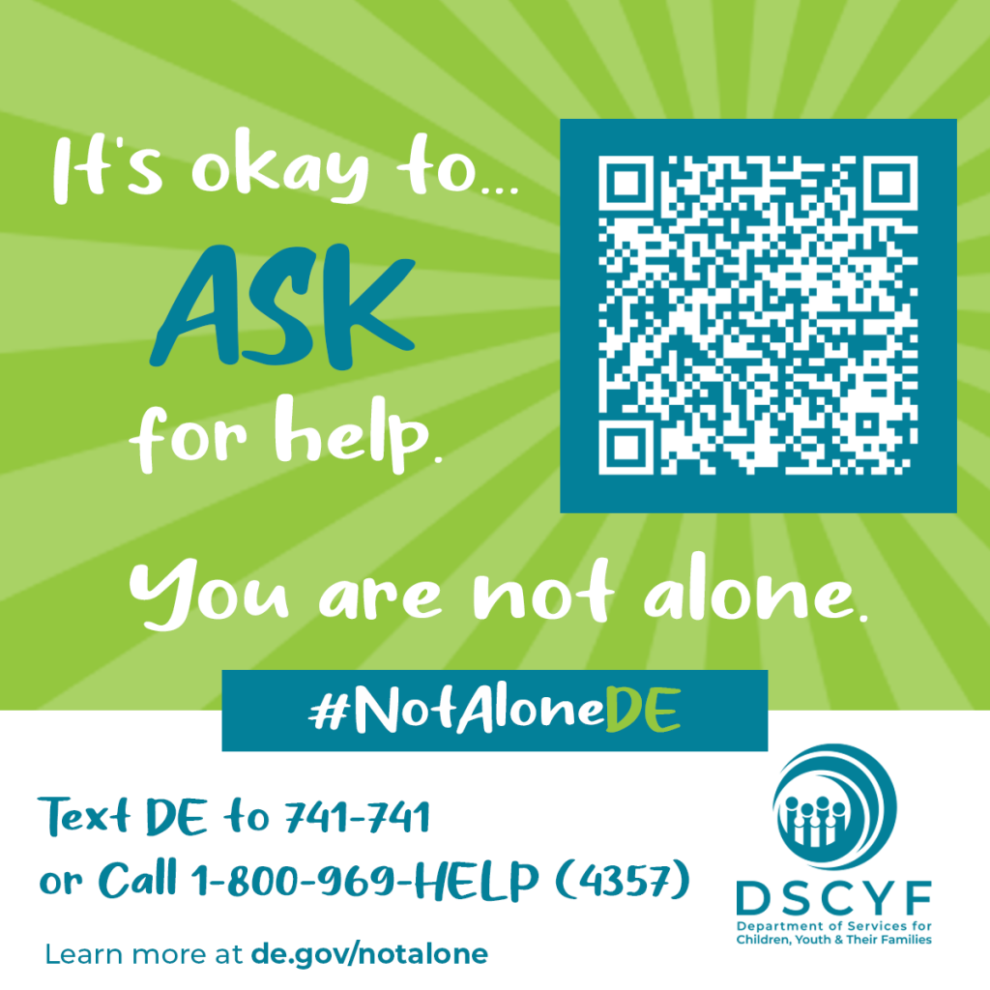
DSCYF PREVENTION CAMPAIGN
2023
8-month campaign produced:
17.7 million impressions
28,000 unique visits to the campaign website, de.gov/notalone
2024
Strategic marketing to reach BIPOC youth and families
Include content focused on reducing access to lethal means

Slide 20
Mobile Response Stabilization Services
Mobile Response and Stabilization Services (MRSS) are provided to any youth under 18 who is physically present in the state and requires assessment regarding imminent danger to self or others as a result of a mental health or substance use disorder.
Mobile Crisis
1-800-969-HELP (4357)
available 24/7

Slide 21
DPBHS Intake Unit
This unit receives and processes requests for behavioral health treatment services. Families, providers, and schools may call this unit to determine service eligibility and apply for PBHS services. The unit also helps families by providing information about other programs and services.
Referrals can be made by 1-800-722-7710
or sending an email to DSCYF_Intake_General@delaware.gov

Slide 22
Contact Us
Dr. Aileen Fink, DPBHS Director
Aileen.Fink@delaware.gov
Dr. Traynor, DPBHS Deputy Director
Stephanie.Traynor@delaware.gov
Shelly Lazorchak, Prevention Services Unit Manager
Rochelle.Lazorchak@delaware.gov
Jocelyn Langrehr, Manager of Intake, Early Intervention, and Assessment
Jocelyn.Langrehr@delaware.gov

Slide 23
Questions?

Slide 24
PUBLIC COMMENT

Slide 25
ADJOURN
APRIL MEETING IS CANCELED
Next DHCC Meeting - Hybrid
Thursday, May 2, 2024
9:00 a.m. – 11:00 a.m.
Anchor Location:
The Chapel
Herman M. Holloway Sr. Health and Social Services Campus
1901 N. DuPont Highway
New Castle, DE 19720

