Slide 1
Auditor Functions First Glance

Slide 2
eSTAR Overview
eSTAR Time and Attendance application automates and standardizes the time collection and approval processes
Meet business goals
Control labor costs
Improve workforce productivity
Manage time off requests
Gives employees the ability to view and manage leave
Feeds directly into payroll
Enforces regulations concerning pay policies
Notes:
Going Statewide

Slide 3
Objectives
This session is intended to provide a first glance at the Auditor Role:
Log into eSTAR and navigate through the application
Modifying: Employee Schedules and Timesheets
Modifying Balances
Time off Request (TOR)
Run Reports
Locations of Reference information

Slide 4
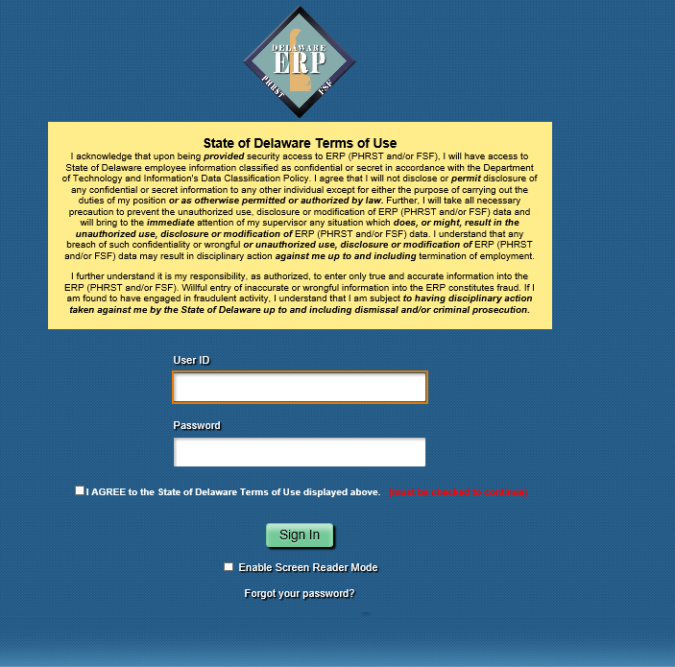
eSTAR Access
Auditors access eSTAR to review employee timesheets by logging into ERP.
https://portal.erp.state.de.us/psp/ps92pd/?cmd=login
Notes:
Managers access is driven by the reports to
Division coordinators were charged with reporting this and gave us this information
That is the targeted audience

Slide 5
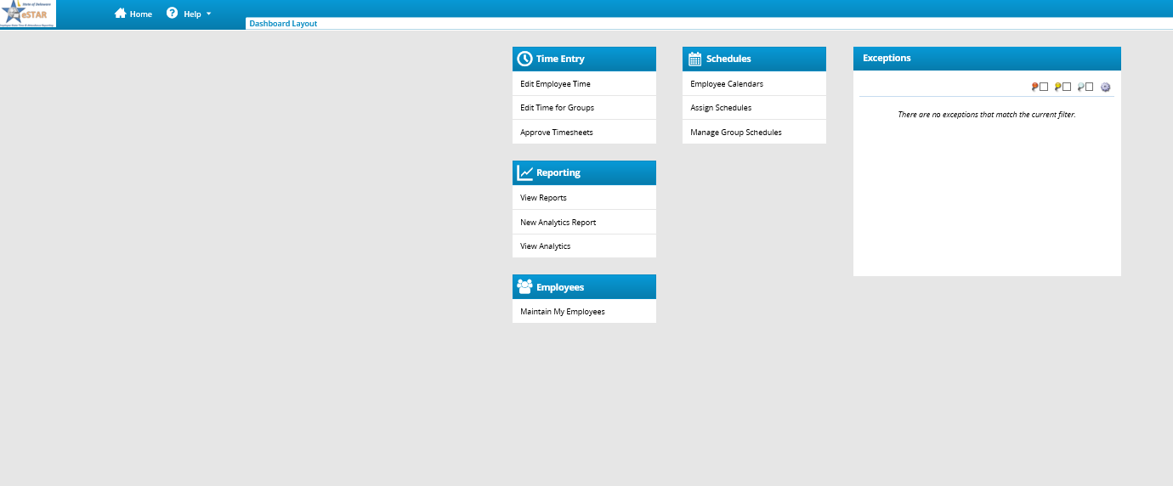
The Auditor Dashboard
The Auditor’s Dashboard offers functions for handling the time and attendance data for their employees.
Time Entry
Schedules
Reporting
Exceptions
Notes:
All their info as an as employee and manager is from this screen

Slide 6
Working with Schedules
All Merit employees should be assigned a schedule
Job Aid 22 will provide you with the current schedules available in eSTAR
If a schedule needs to be created please send a Schedule Request Form
C/S employee should have a “empty” schedule.
This employee should manually enter hours daily
If an employee’s schedule changes, the approved schedule needs to be updated in eSTAR
If the employee is Time and Attendance verify that HR has received the new AWS schedule for the employee file
Schedules will flow over to the timesheet
Notes:
Based on information from division coordinators
AS will add them in

Slide 7
Modifying Timesheets
You can modify the current timesheet or amend a timesheet with in the last 28 days
Prior to this you will need to complete an amendment form
Amended timesheet must be approved before it will process
An amended timesheet will process in the current pay period
The system allows the auditor to see if an employees timesheet contains errors/exception messages
Timesheets with errors need attention before approval
Only a manager can approve the timesheet
If you see “lock by Jon Doe” this means the manager has approved the timesheet but it has not processed. IF you need to make a change you will have to have the manager unapprove the timesheet
Notes:
Managers need to approve timesheets for employees to be paid properly
Auditors cannot approve timesheets

Slide 8
Modifying Balances
New employee to DHSS
The auditor should receive an email notifying them of what the balances should be.
Annual Leave
Sick Leave
Floating Holiday
Next accrual amount
If this information is not correct after 30 days of employment please contact the Human Resources office.

Slide 9
Time Off Requests
When an employee submits a time off request, the request is forwarded to the employee’s manager for review
The manager can then approve or reject the request
Managers can cancel a request for an employee after approval in eSTAR
An employee can cancel a pending request.
Once a request is approved an employee cannot cancel the request in eSTAR. The employee must contact their supervisor.
When an employee request leave on a holiday this must be manually entered on the timesheet.

Slide 10
Recommended Reports
Timesheet Exceptions within Date Range
Time off Request
Amended Timesheets – Currently Open
Timesheet Audit for Date Range
Hours Worked by Pay Code
Timesheet Detail Audit, No time exist 2 days before PPEnd
Unapproved Timesheets

Slide 11
Reference
https://dhss.delaware.gov/dhss/dms/hrm/estar/estar.html
DHSS eSTAR information
https://dhr.delaware.gov/policies/index.shtml
Quick Leave Reference Guide
Floating Holiday Policy
Compensatory Time Policy
Alternative Work Schedule
Parental Leave Policy and Procedure
Voluntary Reduce Work Hours
FLSA
http://extranet.phrst.state.de.us/default.shtml
eSTAR Tab
Holidays https://dhr.delaware.gov/labor/holidays/
Merit Rules https://merb.delaware.gov/state-merit-rules/
Job Aides https://dhss.delaware.gov/dhss/dms/hrm/estar/jobaid.html
SWCE announcements https://dhr.delaware.gov/closings/ and DHSS notifications

