Slide 1
Delaware Health Care Commission
January 11th, 2024

Slide 2
Virtual meeting- housekeeping
Public- please send your name, email contact, and organization affiliation (if applicable) to dionna.reddy@delaware.gov or write in the meeting chat box.
Please keep your computer/phone on mute unless you are making a comment, and if you are not on visual, please identify yourself as well.
This meeting will be recorded for minutes.

Slide 3
Agenda
MEETING AGENDA
I: CALL TO ORDER
II: BOARD BUSINESS
  ACTION ITEM: Approve November 2, 2023, meeting minutes.
  ACTION ITEM: Approve DHCC Retreat meeting minutes.
  Review DHCC Strategic Retreat Priorities for 2024 (15 minutes)
  Set DHCC 2024 Meeting Seasonal Calendar (15 minutes)
III: POLICY DEVELOPMENT
  My Healthy Village Presentation, Saint Francis Healthcare-Lilian Schonewolf (25-30minutes)
IV: UPDATES
  Primary Care Reform Collaborative – Dr. Nancy Fan (10 minutes)
  DHCC Health Workforce Subcommittee –Dr. Kathy Matt (10 minutes)
V: PUBLIC COMMENT
VI: ADJOURN

Slide 4
Board Business
  ACTION ITEM: Approve November 2, 2023, meeting minutes.
  ACTION ITEM: Approve DHCC Retreat meeting minutes.

Slide 5
Review Strategic Retreat Priorities
Topic | Actions | Comments
DHCC Operating Principles | Decide if the new principles should be added or modified.
DIDER | Dr. Devona Williams (Immediate Past Chair, DSU Board of Trustees) will follow up with Dr. Raffetto to facilitate a better connection with Delaware State University. More information is needed on reciprocity licensing decisions for dentists and hygienists. More global data is needed on dentists and why they choose Delaware.
Healthcare Data | Develop benchmarking at the specific license level for most major types of healthcare providers licensed through the Division of Professional Regulation. Additional surveys. Additional questions upon new license and renewal of license process for healthcare providers. Stand up new requirements for the registration of Community Health Workers, Direct Service Providers, Certified Nursing Assistants, and other groups currently unregistered or licensed in Delaware.
Workforce Sub-committee | The Workforce Subcommittee will meet in January to reach agreement on a final goal statement and policy and other recommendations for the DHCC. Specific short- and long-term objectives for the subcommittee with a 3-to-5-year timetable. Expand public and private partnerships already in place with the sub-committee. It should not be a new body or taskforce.
Advice from DHCC to new Administration | Commissioner Geisenberger suggested the DHCC write a white paper for the new administration in 2024. This should be completed by the end of October 2024. This matter can be discussed further at the December DHCC meeting.

Slide 6
Set DHCC Calendar For 2024

Slide 7
The Healthy Village at Saint Francis Hospital
Partnership for the Common Good

Slide 8
What is a Healthy Village
The Power of the Platform
Healthy Villages are communities of varying scale created at the intersection of neighborhood planning and community health. Through the coordination and integration of investments and services, Healthy Villages improve quality of life and enrich the vitality of neighborhoods while protecting their heritages, histories, and residents. The Healthy Village model is designed to enhance the traditional safety-net hospital model. The partners are selected according to investments in health and the Social Determinants of Health (SDOH).

Slide 9

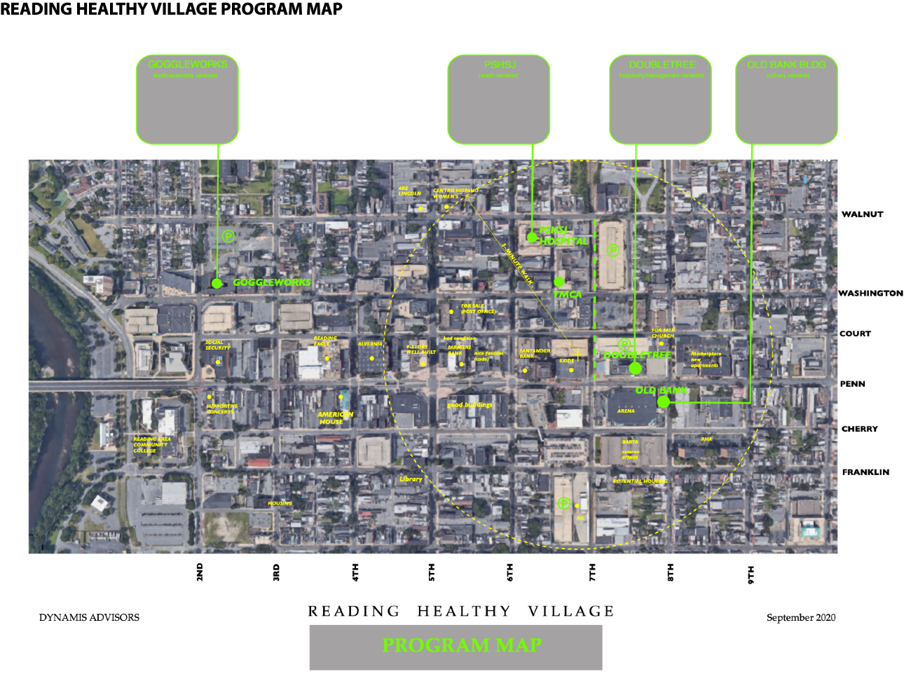
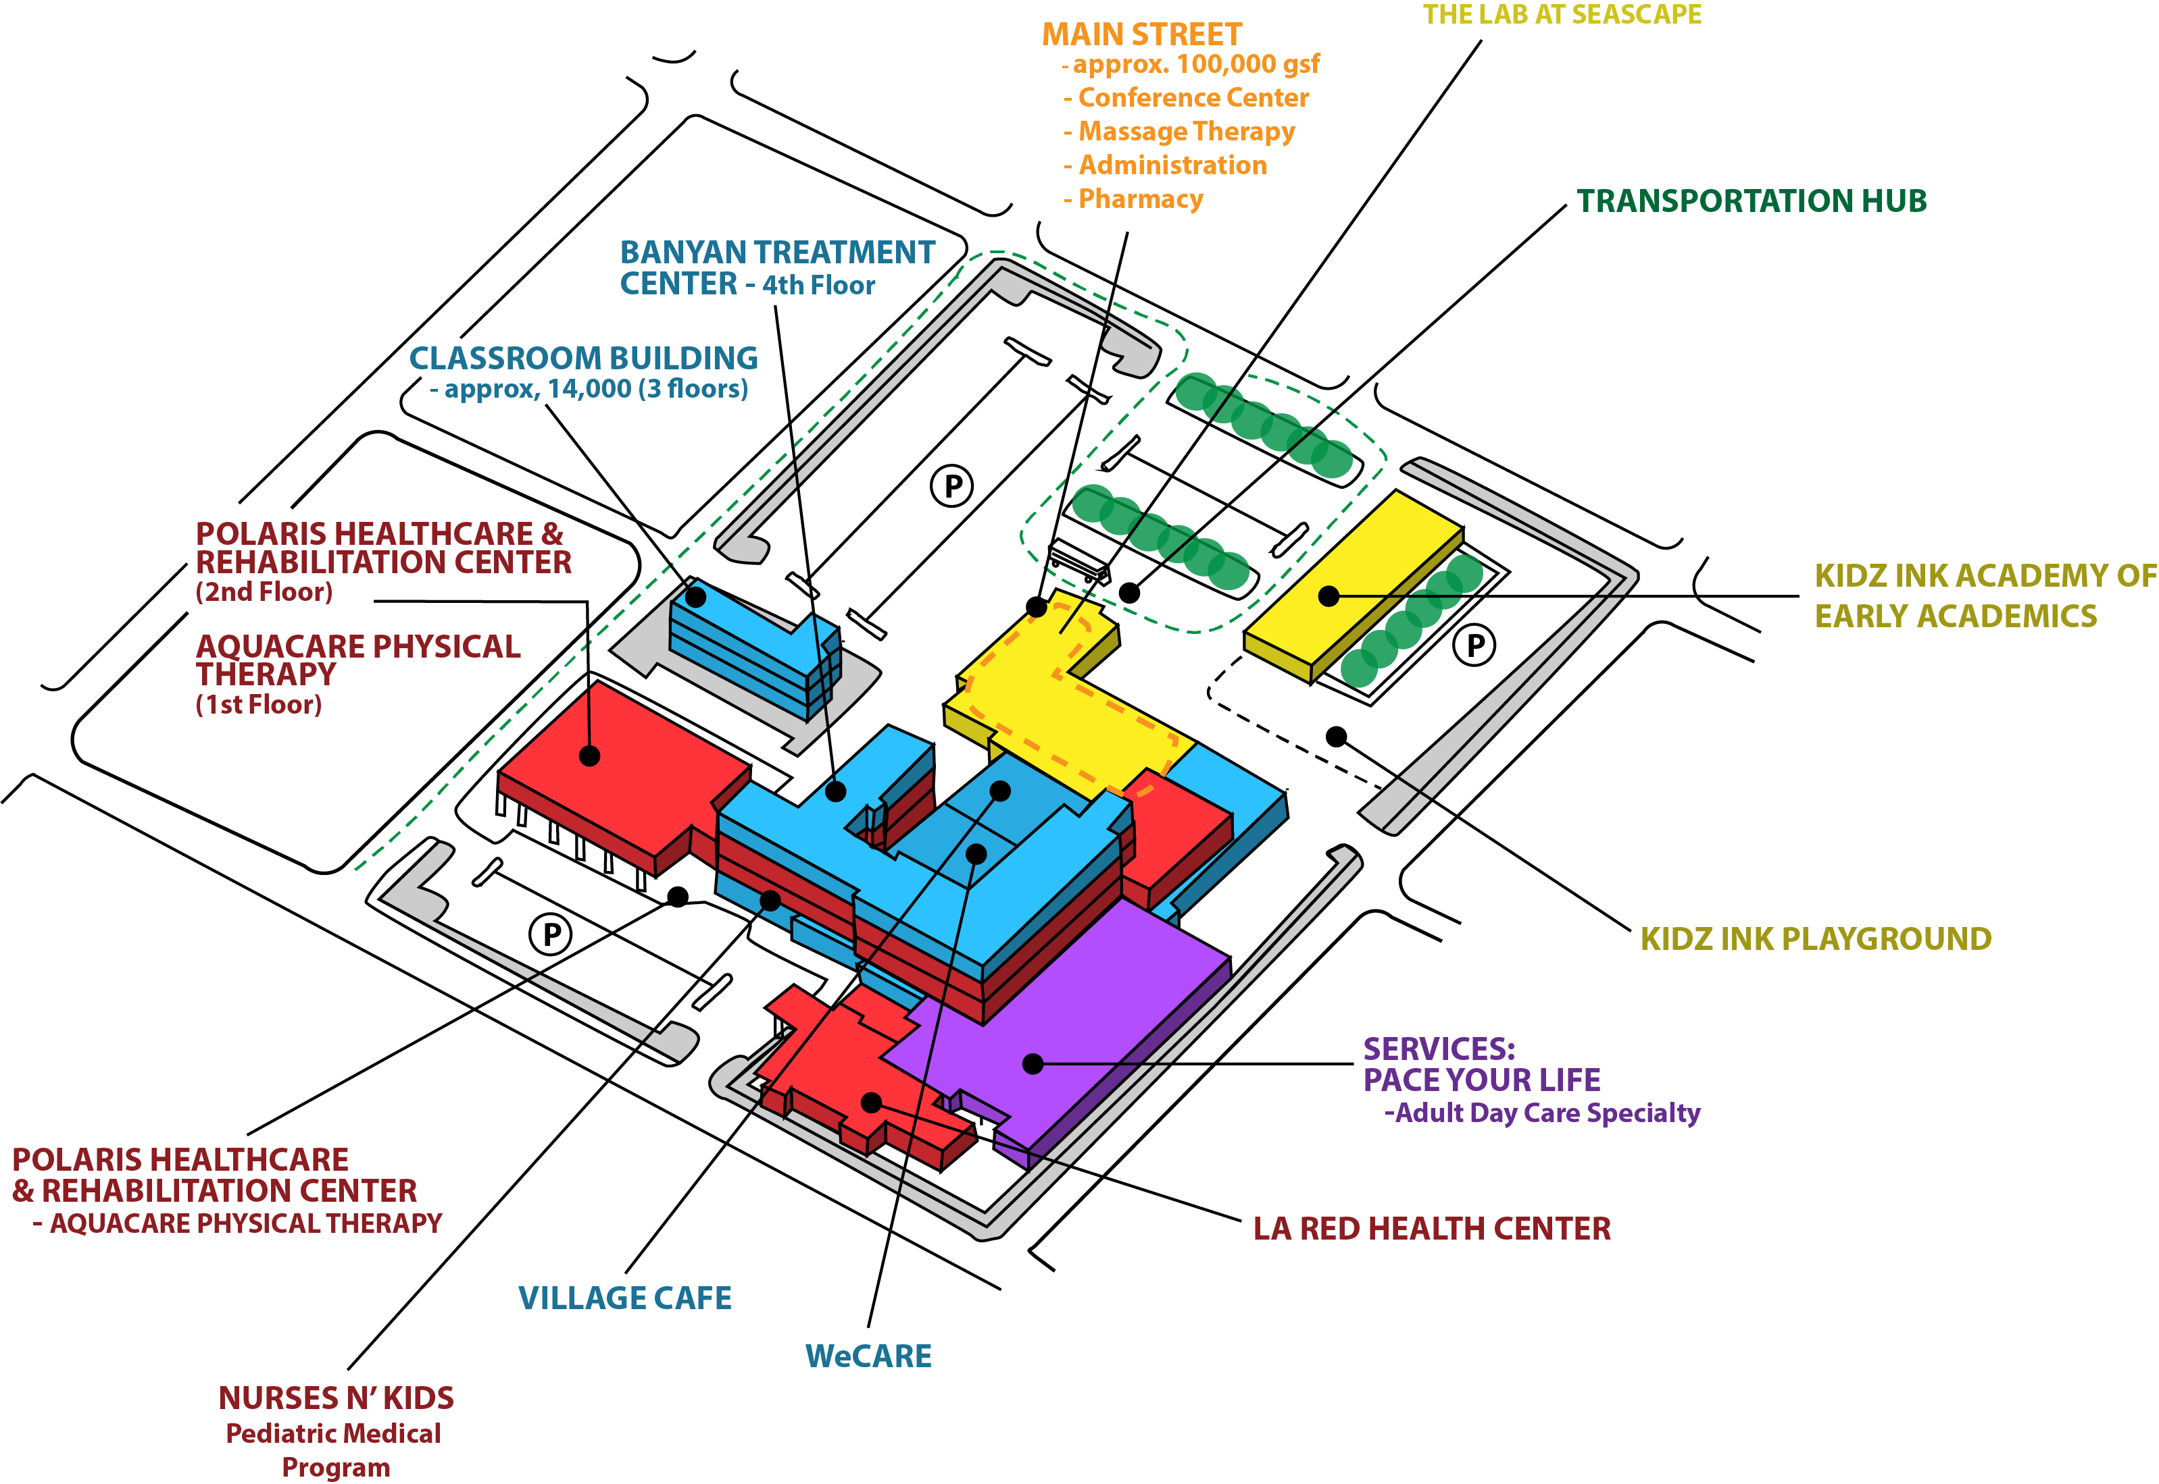
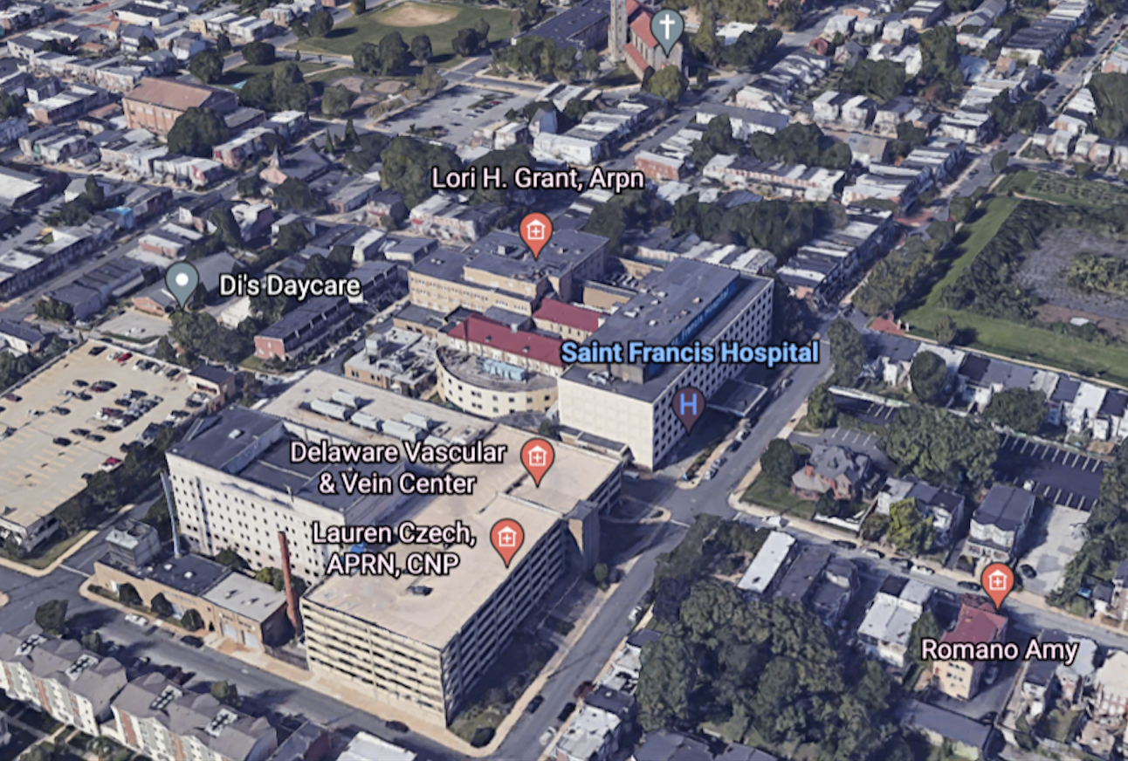
Healthy Village Models – Initiatives of Varying Scale
Individual Neighborhoods
  - Stamford, CT
Large Central City/Town Plans
    - Reading, PA
Safety-Net Hospital Transformations
  - Milford Wellness VIllage, Milford, DE
  - Samaritan Center, Detroit, MI
Integrated Hospital System of Whole-Person Care
  Wilmington, DE
  The Saint Francis Healthy Village Transformation

Slide 10

The Healthy Village Model
Addressing Safety-Net Hospitals’ Challenges
Hospitals located in communities with high percentages of Medicaid, Medicare, and self-pay, are struggling throughout the U.S.
The pandemic exposed and accelerated existing trends, placing more stress on these hospitals.
New models of care are needed that integrate treatment and services which address SDOH.
Healthy Villages do not replace critically needed treatment services, rather they enhance them in manners which are relevant to value-based reimbursement models and the future of challenged neighborhoods.
Underutilized space at these safety-net hospitals can be renovated to house partners who focus on the SDOH.
The Healthy Village planning process identifies partners and services and integrates them in an optimal manner. Integrated physical/behavioral health primary care provides the glue.

Slide 11
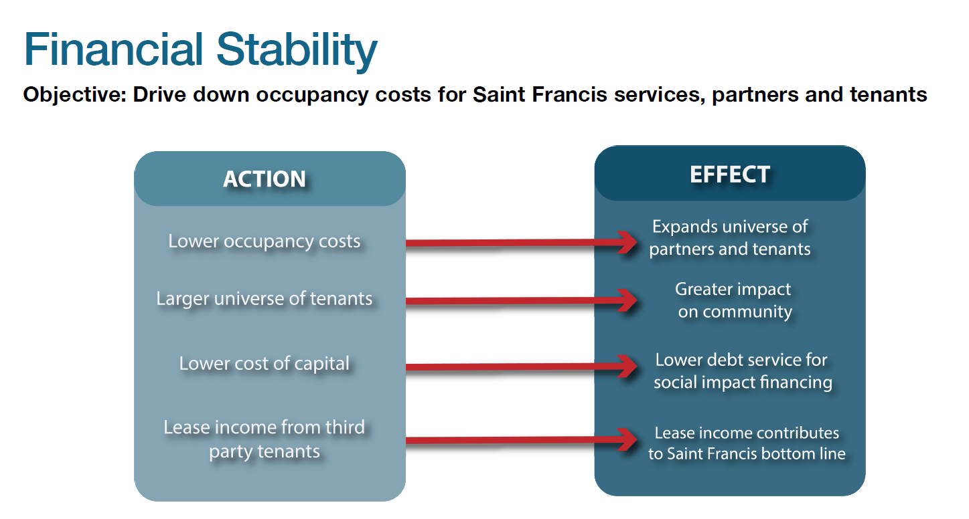

Slide 12
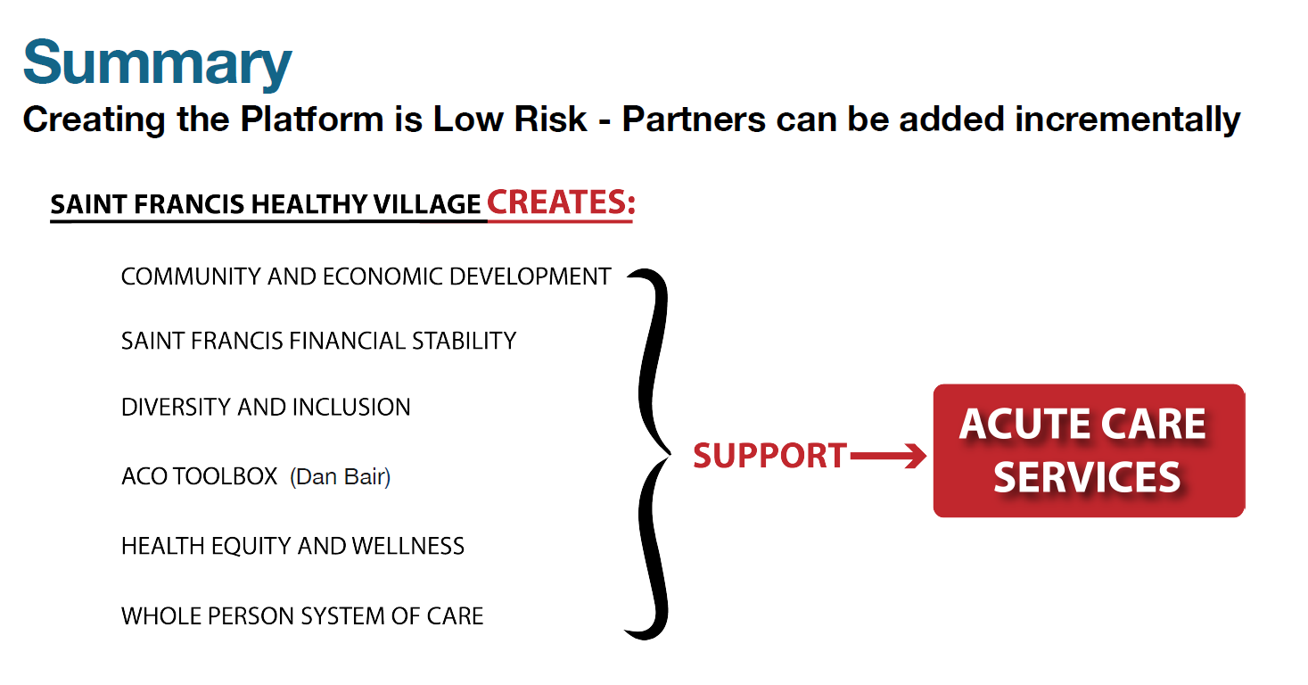

Slide 13
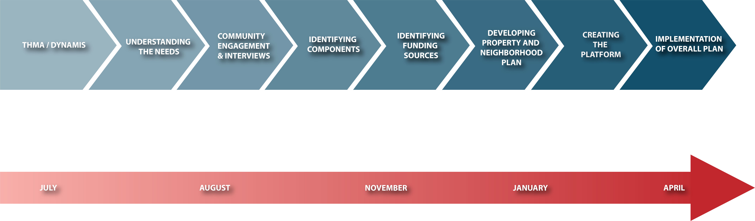
Healthy Village Planning Process
We Listen. We Partner. We Make It Easy.

Slide 14
The Healthy Village at Saint Francis Priorities
Established after extensive interviews with over 70 community organizations, providers and elected officials:
Behavioral Health (including substance abuse services)
Education, Job Training, and Skills Development
Senior Services
Affordable Housing
PRIMARY CARE

Slide 15
Theory of Change
Healthy Village at Saint Francis
If HV@SF
then HV@SF partners can
and Wilmington residents will have
Coordinates clinical and social care to meet the needs of the whole person
Partners with Community organizations to meet these needs, together in one building
Connects healthy village members to primary care, community resources, and information with the help of community health workers
Build a quality-focused, healthy Community
Improve access to care
Increase patient engagement
Advance behavioral health integration
Improve outcomes through data sharing and joint evaluation
Improved quality of life and a healthier community
Connection to services and support at HV@SF and in the community
Sustainable community/ safety net hospital to provide equitable care
Healthy Village at Saint Francis Video
https://www.youtube.com/watch?v=pnlecclTz5U&t=14s

Slide 16
Partner Responsibilities and Relationships
Challenging others to invest and partner is foundational to the Healthy Village model.
Stakeholders include community-based organizations, managed care organizations and other payers, social impact investors, risk-bearing entities, foundations, governments, behavioral healthcare and senior care providers.
Each partner, including Saint Francis, is focused on a different aspect of health and the SDOH; partners will be added incrementally.
Investments will be made to leverage synergies from the co-location.
A key objective is to lower occupancy costs for Saint Francis and partners.
We Listen. We Partner. We Make it Easy.

Slide 17

The Healthy Village at Saint Francis - Functional Partners
Health And SIOH | SERVICE LINE | Potential Partners/Reengagement
Affordable Housing | Housing | West End Neighborhood House, West Side Grows Together Cinnaire, Housing Alliance Delaware, Woodlawn Trust | Cinnaire, Housing Alliance Delaware, Woodlawn Trust
Education Workforce Development | Educational training/Certifications | Neumann University, Goodwill Red Clay, Catholic Diocese, Delaware Tech & Community College, Hilltop Neighborhood Center, University of Delaware, Childcare (TBD) | Red Clay, Catholic Diocese, Delaware Tech & Community College, Hilltop Neighborhood Center, University of Delaware, Childcare (TBD)
Social Support | Services to support social determinates of health | Latin American Community Center, YWCA, Legal Aid, Food Bank of DE, Trinity Farm Boxes/Backpack program, Women’s Re-entry Ministry of Caring, DE Ecumenical Council on Children & Families, Hope Center, REACH, Governmental Office of Services & Support | Ministry of Caring, DE Ecumenical Council on Children & Families, Hope Center, REACH, Governmental Office of Services & Support
Healthcare | Wound care, pediatrics, respite care, Physical Therapy, dialysis, hospice | Saint Francis Wound Care, Nemours, Catholic Charities, Novacare, Delaware Hospice, Tiny Steps Life Health Center, LA Red Health Center | Life Health Center, LA Red Health Center
Behavioral Health | Behavioral health, mental health, SUD | Amanecer Counseling & Resource Center, SL24, Limen House Recovery Innovations, Inc. | Recovery Innovations, Inc.
Senior Services | Long term care, DME | THMA CARES, Senior ER Long term care TBD | Long term care TBD

Slide 18
Healthy Village Partners Will Jointly Create an Integrated System of Care
Whole-Person Care is at the center of the Healthy Village model and is the gateway to connection with other services and supports in the community
A team-based approach utilized by participating partner organizations is essential to creating a whole-person model of care
Services and programs can be housed together in one building and spread throughout the community – the essential elements bringing the village together are communication and information sharing.

Slide 19
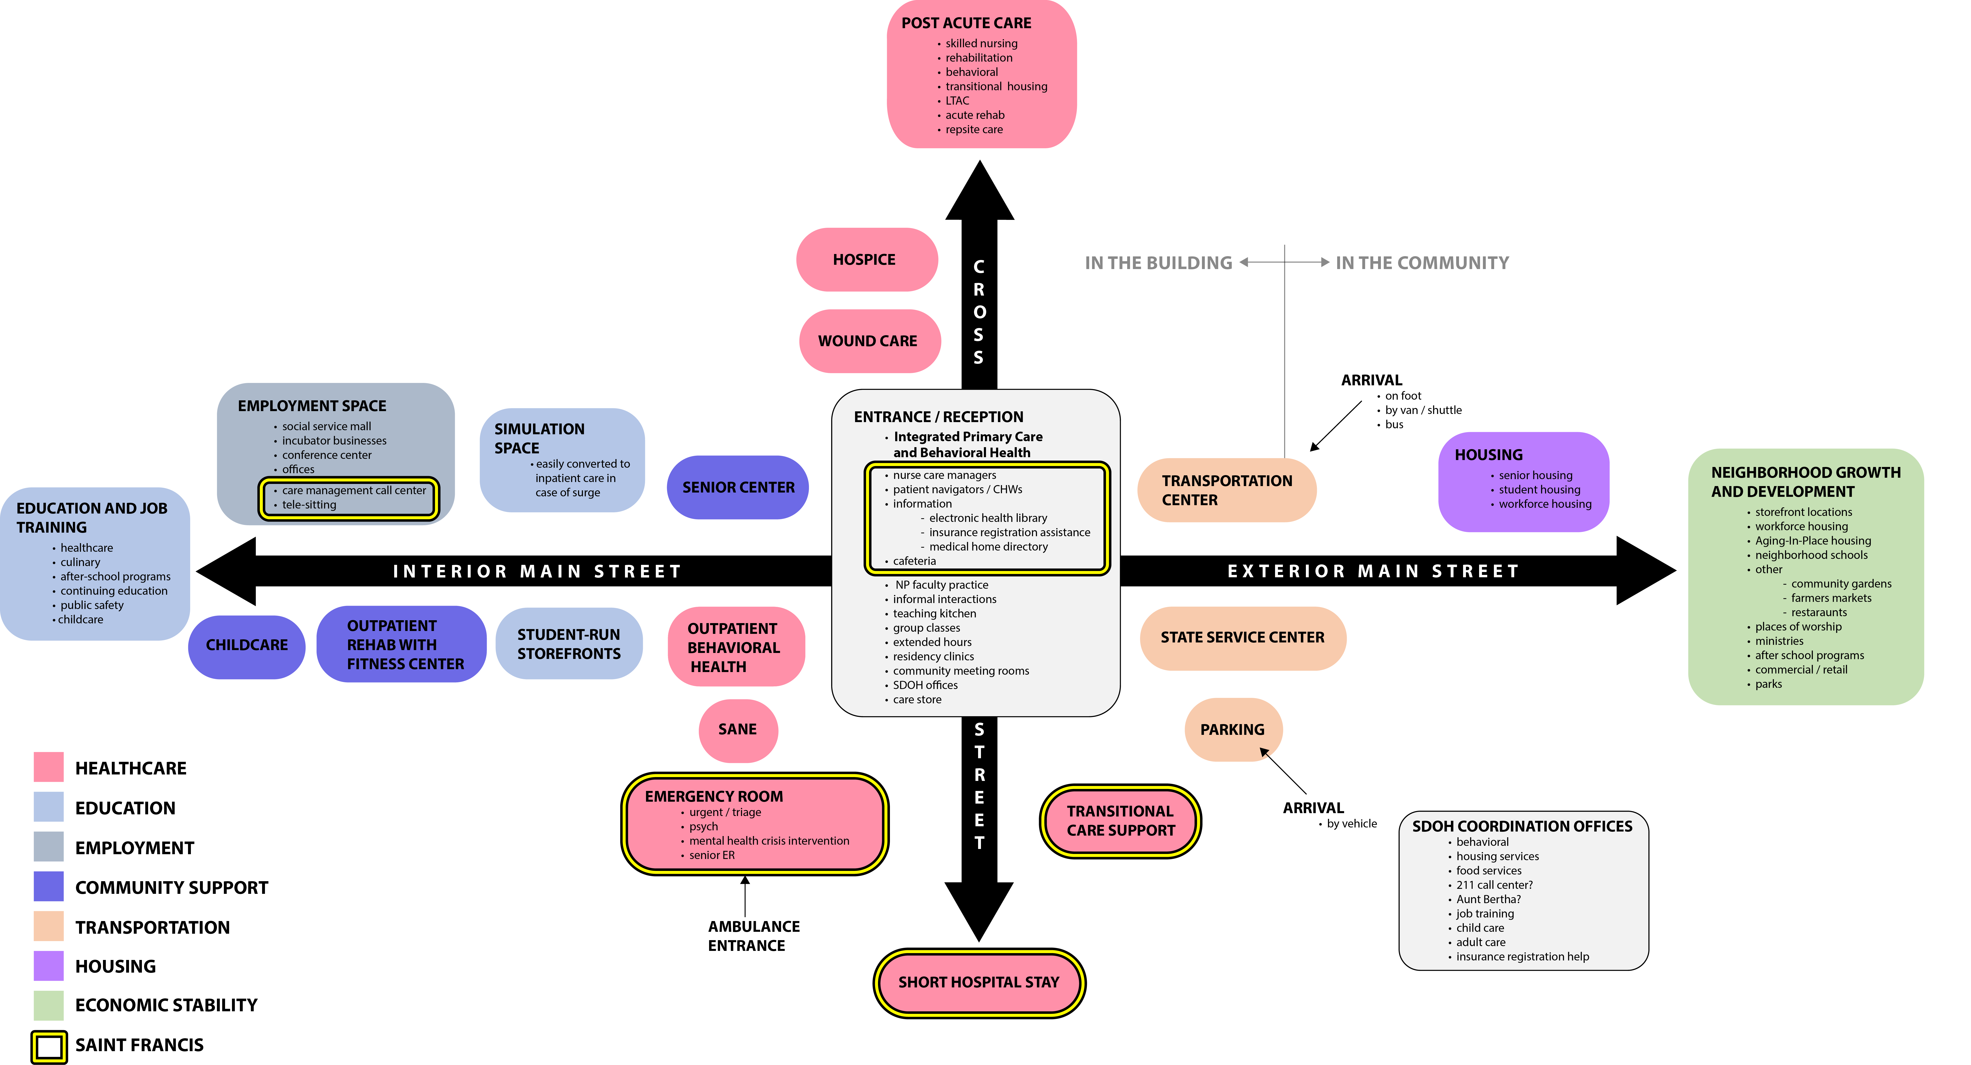
Program
Notes:
This is an illustration of what our program layout can look like.
The initial step will be to create the platform which the initial service partners and tenants will operate and benefit from colocation. This platform will facilitate future partners to be added as needs and demand indicate.
You will see the main street and treatment services as primary focus with the added tenants specializing and addressing what we learned through the interviews of most need.
We have had several presentations with Dynamis including the SF Community board and several strong possible tenants. There is a successful healthy village in Milford DE which I have visited several times. Most recently, I visited with three of our board members including Joe DiSantos. Seeing it and how it works in person enabled the board members to understand and get excited. The one vital part that we all realized is the advantage SF has that Milford does not, is having treatment services and emergency room at the same facility.
Example of patient who go to ER and admitted – we do a good job in providing medical care and try to provide connections for their social needs but once he leaves …. Imagine being able to take that same patient directly to the services and not have that patient end up in the ER and readmitted again but this opportunity also can help to take care of the whole person. A person’s health is only 20% of what makes a difference for a person’s well being, the other 80% are made up of the environmental and lifestyles of an individual.

Slide 20
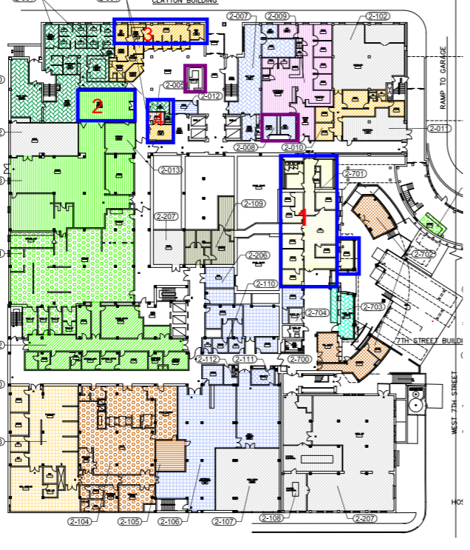
Mainstreet Tenants
Making spaces tenant ready for small community-based organizations
Coordinating locations along the same corridor on the second floor of the hospital off the main entrance
Community Conference Room

Slide 21
Strategy for 2024
Partners
Philanthropy Funded Construction (1.4M dollars)
Conference room
Lobby Refresh
Bathrooms
Programs on Mainstreet (Health Equity Programs)
Food insecurity ( Backpacks, Homeless food boxes, Farm boxes, Surplus food)
DME ( Durable Medical Equipment)
Personal Care items
Expansion of Tiny Steps program (Cribs, car seats)
Community Health Workers (to be funded by Philanthropy)
Mainstreet tenant build out
Engage smaller community-based organizations
Educational partners
Focus on Delaware partners for Behavioral Health/SUD services
Follow up and reengage partners both small and large (i.e. Nemours, NovaCare, Delaware Hospice-dementia)
Financial Literacy
Access to Healthcare
SIOH self-sufficiency programs
Develop outcome and measures

Slide 22
Strategic Planning for Future Partner Opportunities
Health Equity Center
  Housing Authority
  Environmental Health
  Nutritional Counseling
  Financial Literacy/Economic Self Sufficiency Programs
  Lifestyle change and disease management
  Job Skills
  Physical Activity/Playworks
  After School/Homework/School Success
  Family Strengthening
Established Behavioral Health Programs In DE
  Build relationships with existing providers for possible tenant opportunities
Long term stay/care opportunities
  State of DE
Education/Workforce Development
  Drexel
  Neumann
  University of Delaware
  Del Tech
  DE State
  Red Clay
  Two local Catholic High Schools
Saint Francis Inpatient Pharmacy
Merakey Total Health FQHC
  Family Practice working with GME
  SUD services
Merakey Mobile Services
Community Health Center
  Food Bank
  CARES/DME
  DPP Program
  Caregiver Program
  Goodwill

Slide 23
Next 6 months
Funding efforts
  Governmental, Private, Public
Governance/Collaboration
  Integrating Find Help with partners
  Data sharing
  Collaboration with partners internal/external
  Referral process
  ACO/CIN
Education Center
  Confirm lead education partner
  Develop program offerings
Tenants
  Large (Catholic Charities/Novacare/Nemours/Delaware Hospice)
  Small (local CBO’s-LACC, Amanecer)
CHWB pograms
  CHWs (funding)
  Social Care hub
    C.A.R.E.S
    Choice Pantry
    Maternal needs
Funding efforts
Tenants
CHWB programs
Governance
& Collaboration
Education Center

Slide 24
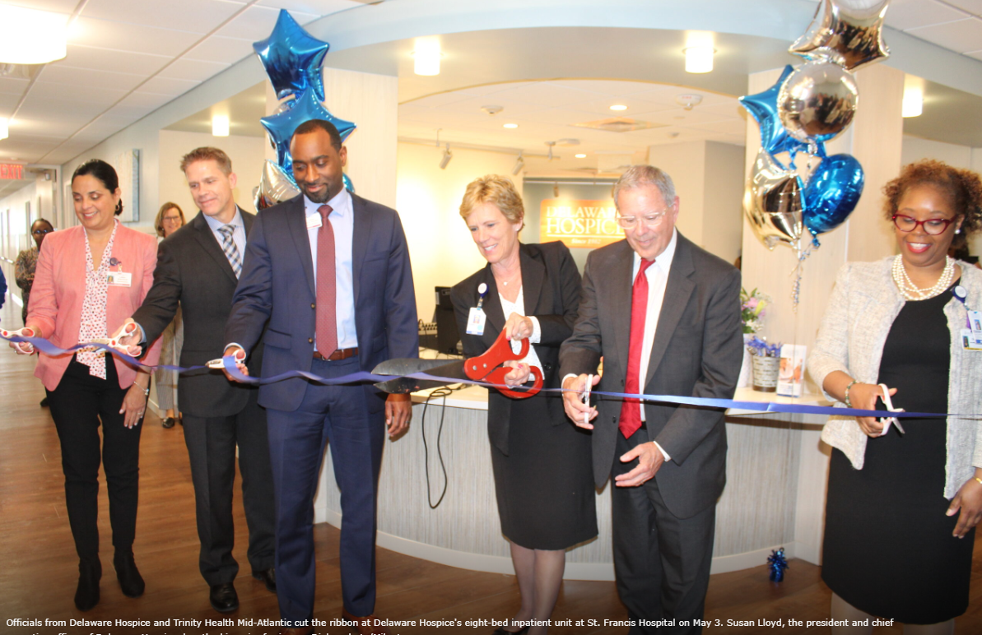
Delaware Hospice
Delaware Hospice at Saint Francis Hospital offers a comforting option when your loved one needs a higher level of support.
They have created a home away from home for patients and families during circumstances when a loved one needs more intense care outside of their home.
Opportunities for space increase for dementia unit

Slide 25
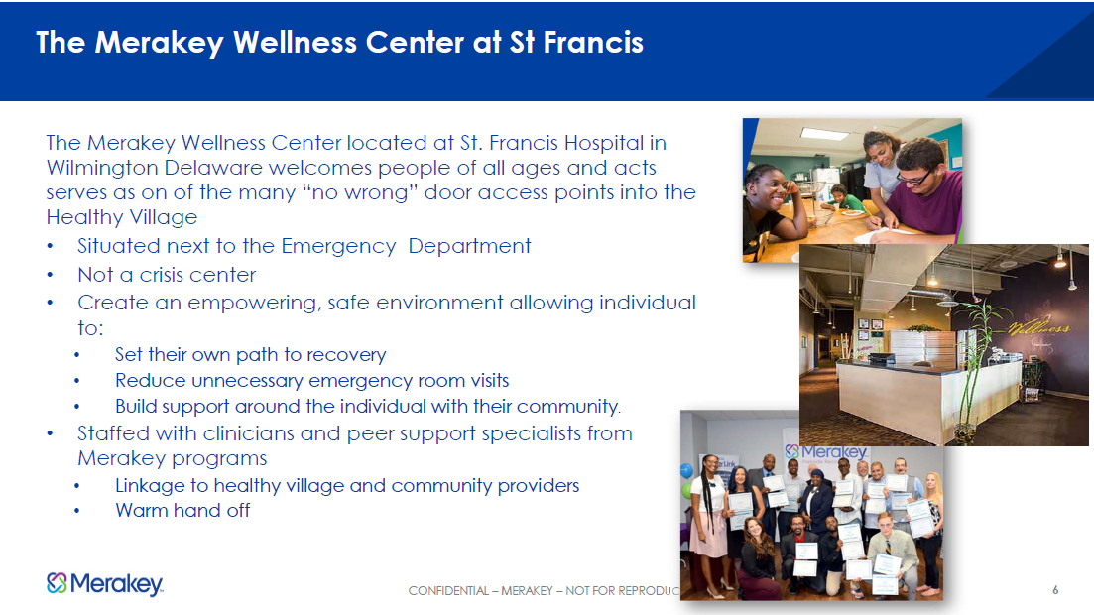

Slide 26
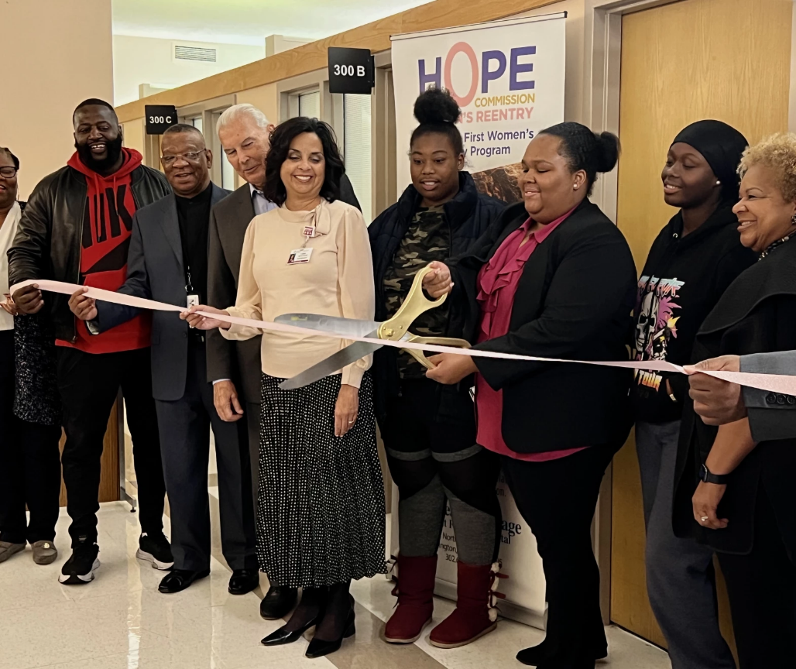
Delaware’s first Women’s Reentry Program opens at Wilmington’s Saint Francis Hospital
Hope Commission Women’s Reentry is Delaware’s premier reentry program providing cognitive behavioral interventions and referrals to volunteers referred from the Delaware Department of Corrections and Baylor Women’s Correctional Facility.
Services include a GED program in partnership with West End Neighborhood House and one-on-one and group sessions with the reentry coordinator to help navigate other support systems within the community.
Ribbon Cutting Video link https://youtu.be/DxPOcHzgjh4

Slide 27
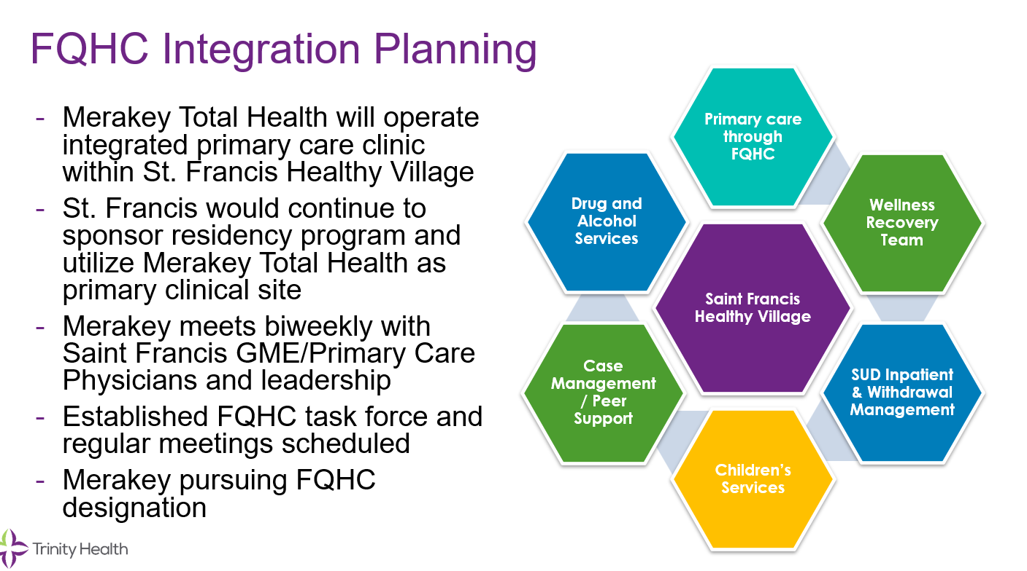

Slide 28
Healthy Village at St. Francis
Project Capital Budget
Construction Costs
Legacy Lobby Area Redevelopment | $2,725,614
Main Street Enabling Partners | $2,535,118
Retail Pharmacy | $1,200,000*
Signage & Wayfinding | $ 485,585
Total | $6,946,317
Retail Pharmacy was submitted to Governor’s Office for ARPA Consideration; awaiting response as of 12/19/23

Slide 29
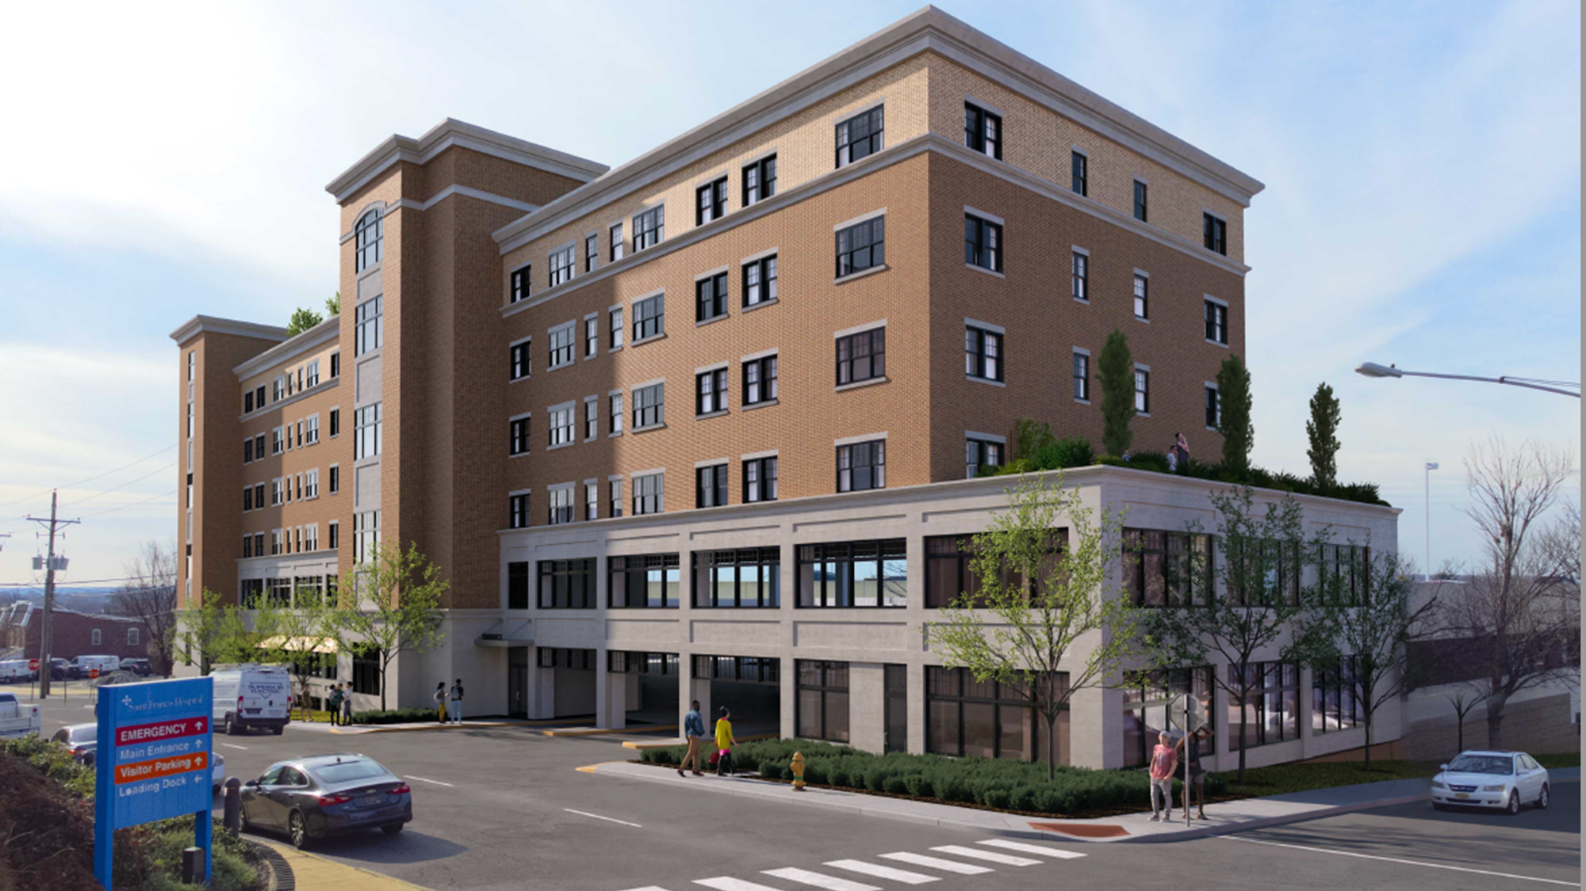
HOUSING
TCI
Homeowner repair/Partnership with Cornerstone, focus on seniors
Affordable Housing
New homeowner education
Financial Literacy
18 to 25-year-old housing needs
Vistas Projects-Senior Housing (affordable)
Developer Engaged
LOI-in legal review
Zoning Changes
Community Meetings

Slide 30
Primary Care Reform Collaborative
Update- Dr Fan

Slide 31
DHCC Health Workforce Subcommittee Report
Rick Geisenberger, Co-Chair
Cabinet Secretary for Finance
Kathleen Matt, Ph.D., Co- Chair
DHCC Health Workforce Subcommittee co-chair
Delaware Health Care Commission (DHCC) Staff
Colleen Cunningham, Delaware Health Care Commission
Committee Members:
Elisabeth Massa, Delaware Health Care Commission
Mark Thompson, Medical Society of Delaware
Timothy Gibbs, Delaware Academy of Medicine / Delaware Public Health Association (DAM/DPHA)
Megan Williams, Delaware Healthcare Association
Avani Virani, Highmark
Christopher Otto, Delaware Nurses Association
Shauna Slaughter, Division of Professional Regulation
Mike Quaranta, Delaware Chamber of Commerce
Maggie Norris-Bent, Westside Family Healthcare
Gwendolyn Scott-Jones, Delaware State University
Melissa Jones, The Dental Group
Cheryl Heiks, Delaware Health Care Facilities
Nichole Moxley, Division of Public Health

Slide 32
Healthcare Workforce Subcommittee Report
What is status of the Healthcare Workforce, nationally and in Delaware?
What can we learn from what other states are doing to solve healthcare workforce challenges?
  National Governor’s Association Report
Strategies for Delaware – what are we successfully doing already?
Strategies for Delaware – recommendations for future action steps
Discussion

Slide 33
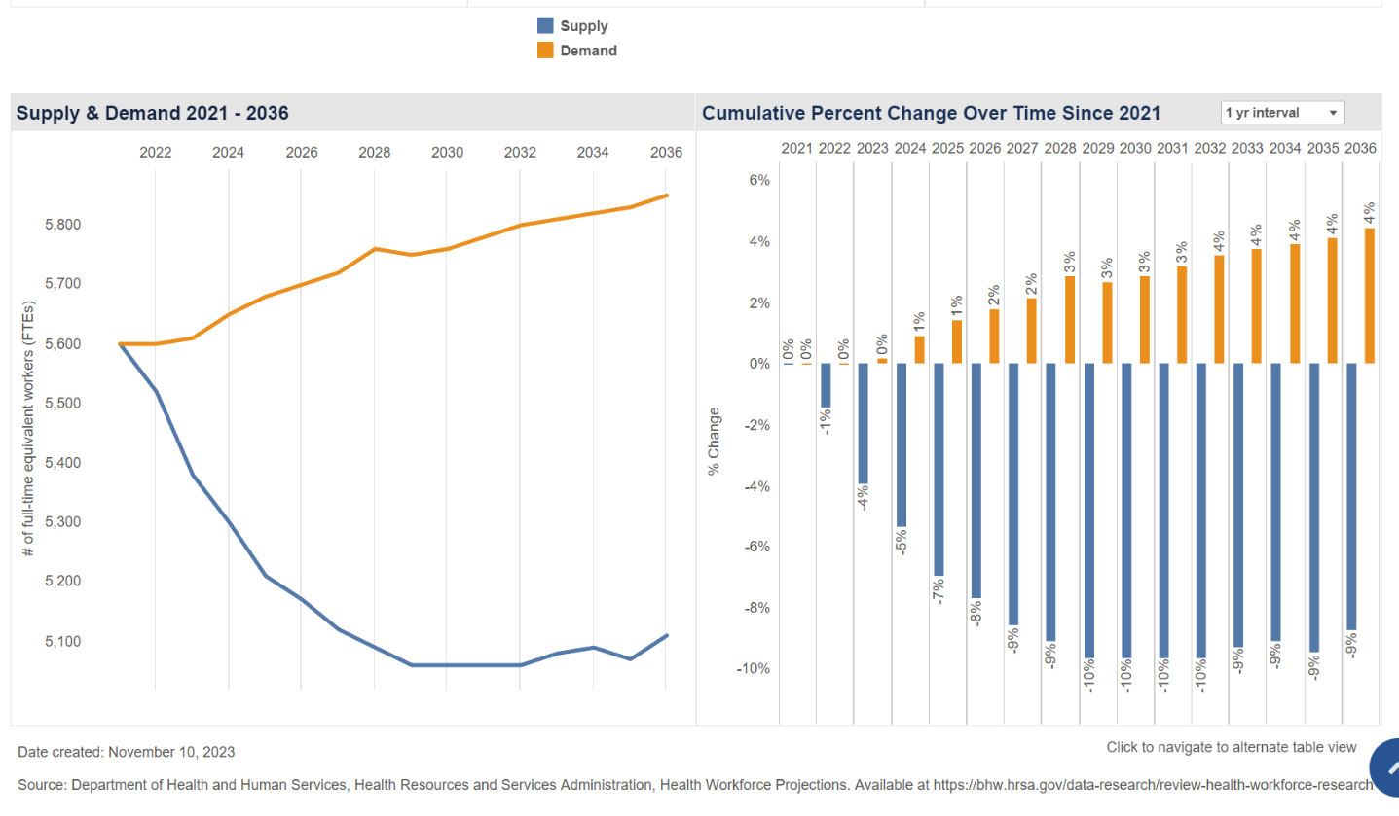
Workface Data from HRSA: All Health Workforce

Slide 34
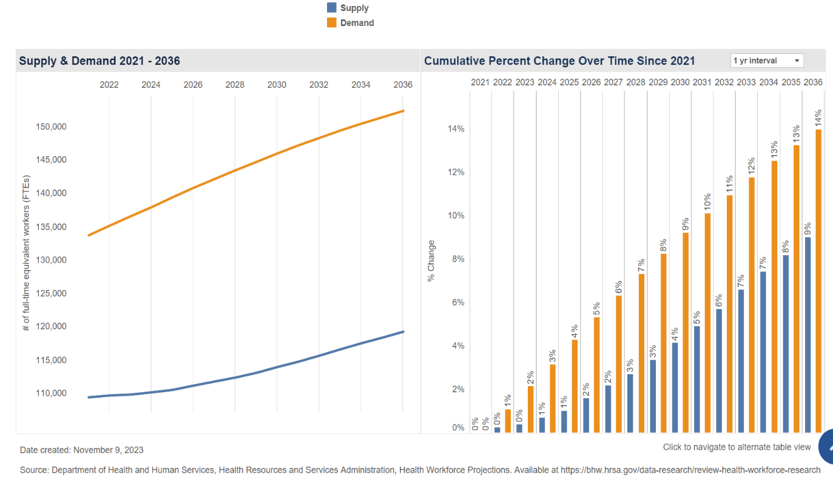
Workface Data from HRSA: Primary Care

Slide 35
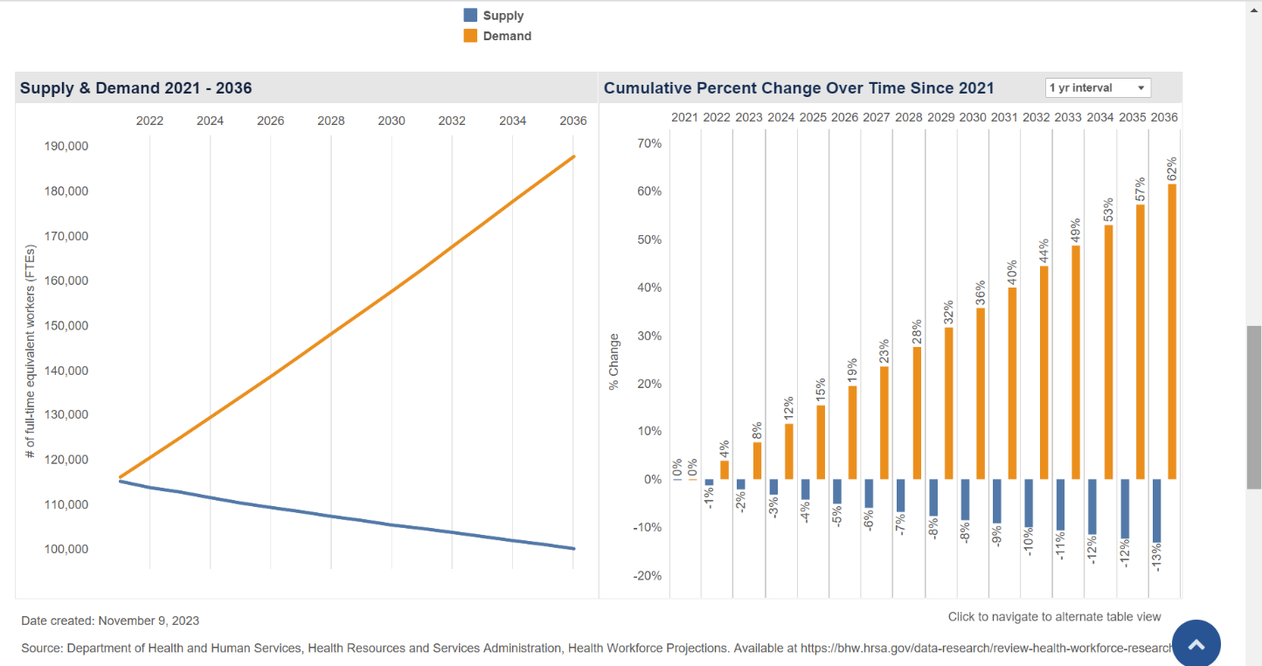
Workface Data from HRSA: Behavioral Health

Slide 36
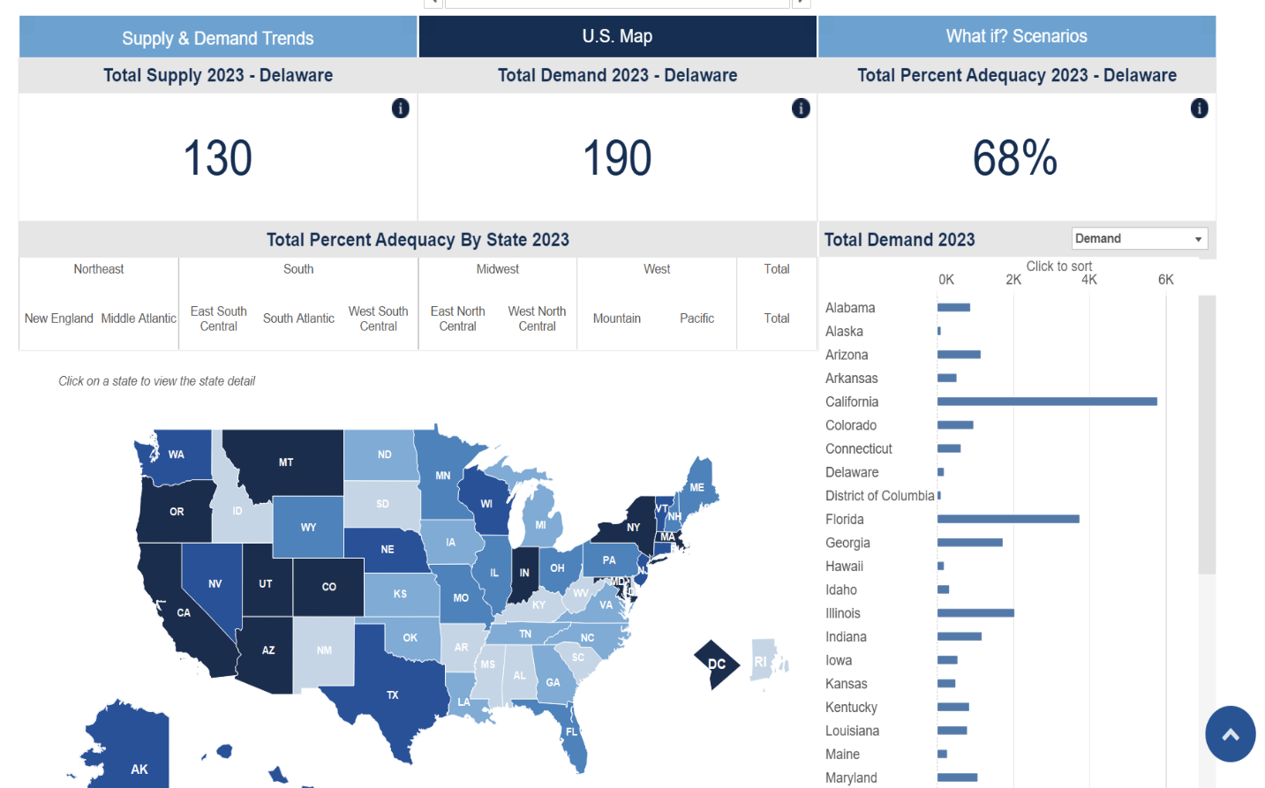
Workface Data from HRSA:
Delaware All Health Workforce 2023

Slide 37
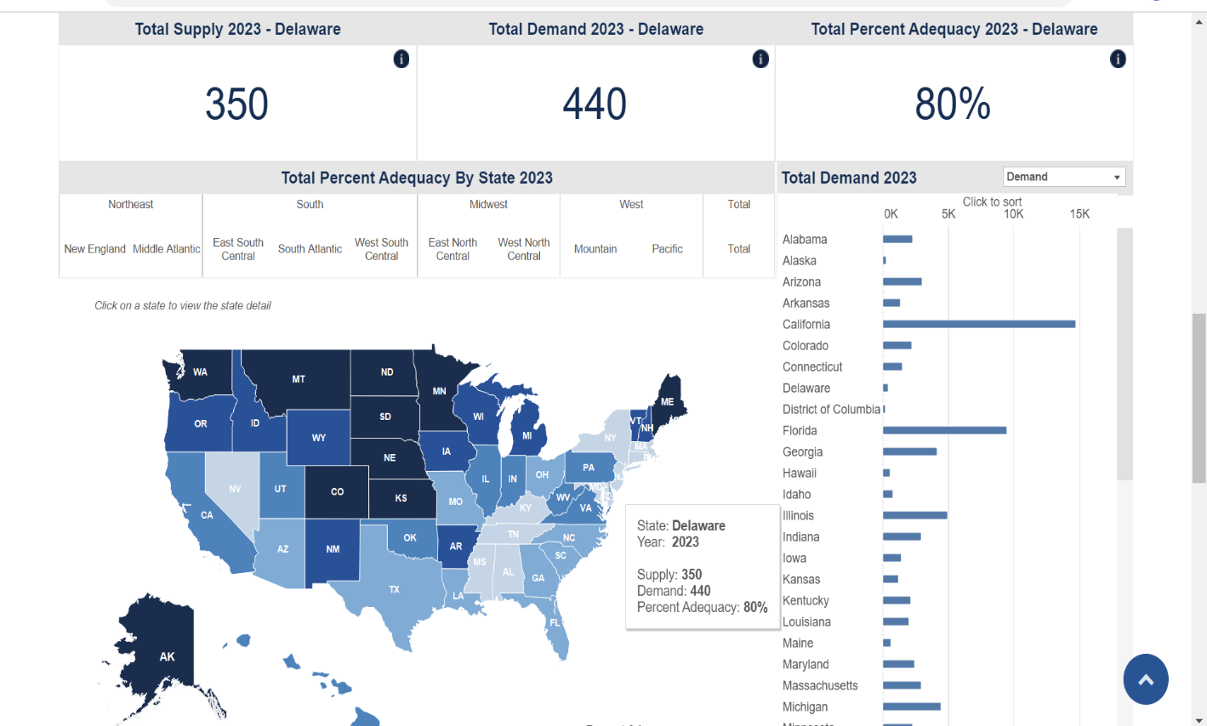
Workface Data from HRSA:
Delaware Primary Care 2023

Slide 38
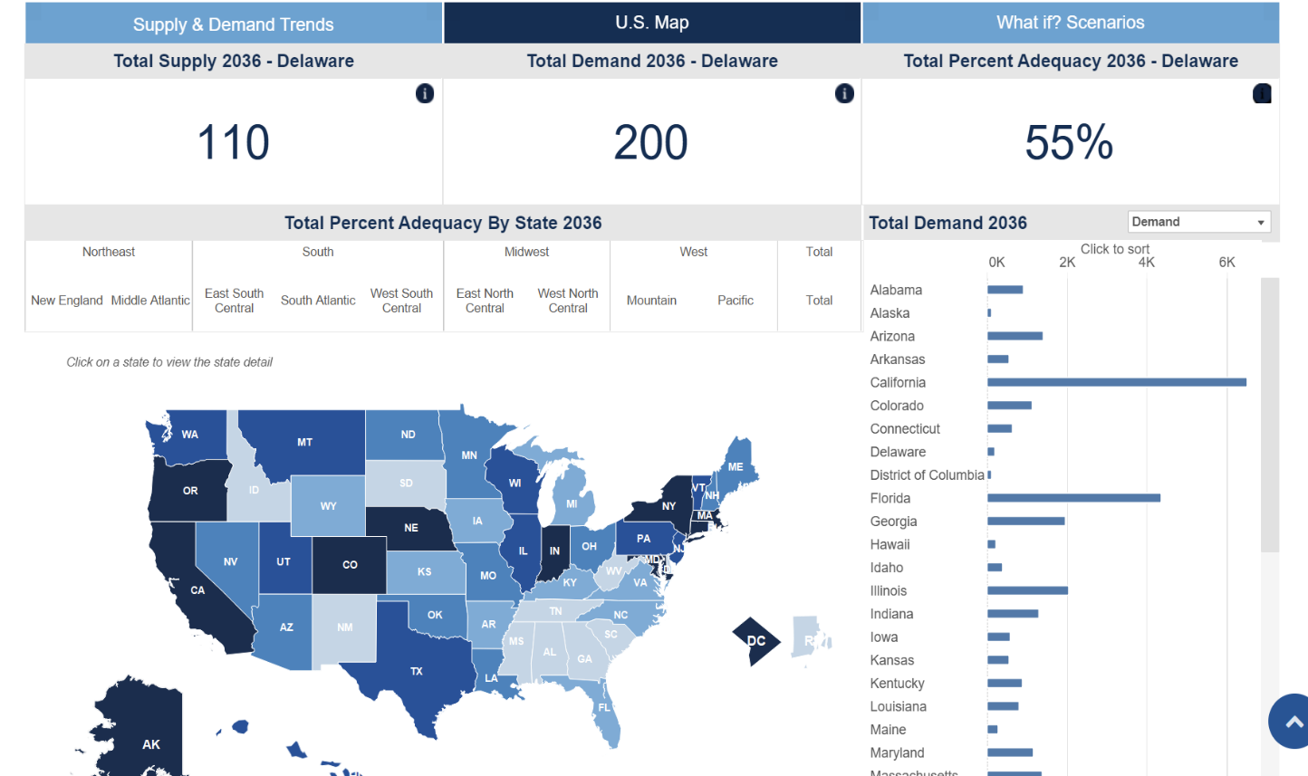
Workface Data from HRSA:
Delaware All Health Workforce 2036

Slide 39
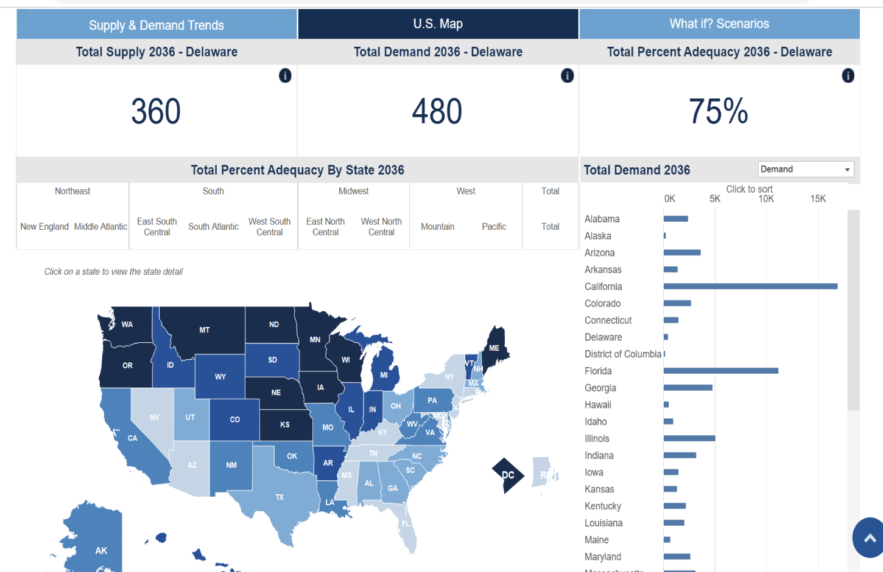
Workface Data from HRSA:
Delaware Primary Care 2036

Slide 40
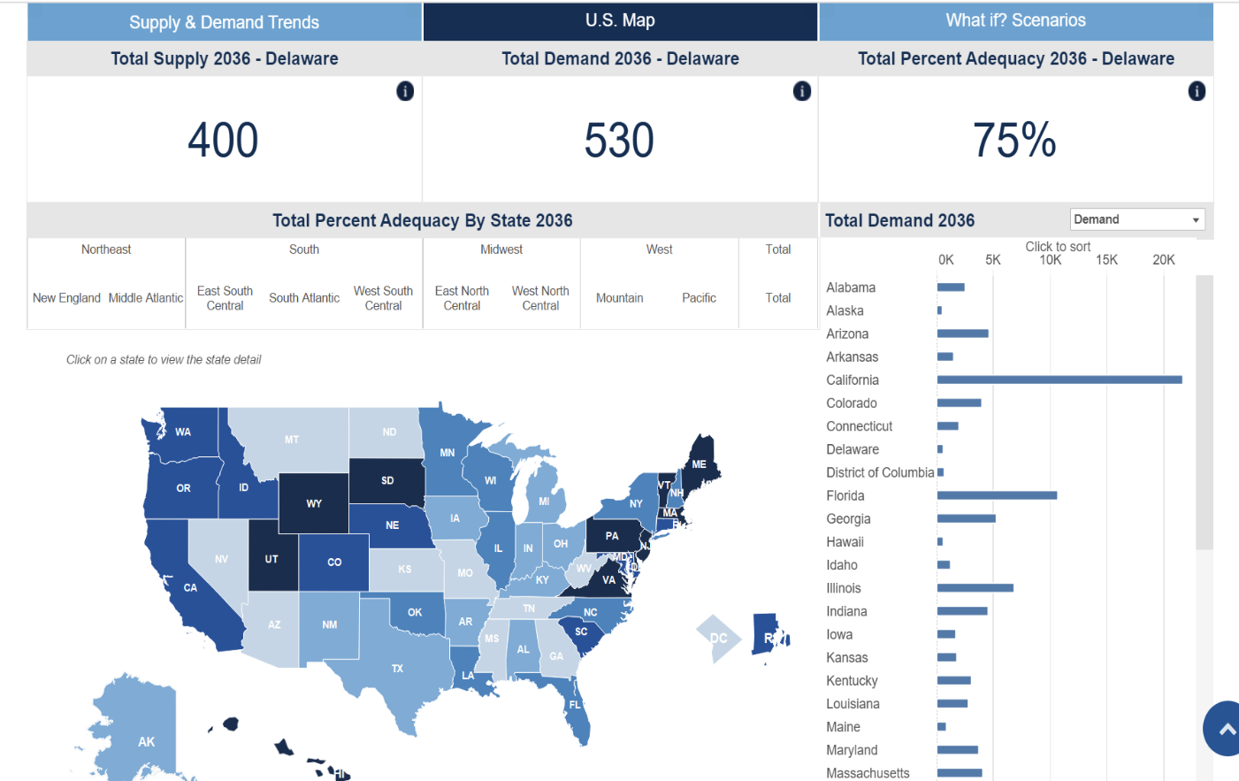
Workface Data from HRSA:
Delaware Behavioral Health 2036

Slide 41

Can we learn from what other states are doing to build the Delaware Healthcare Workforce?

Slide 42
National Governors Association:
In March 2022, the NGA Center announced that California, Colorado, Missouri and Wyoming were selected as the four Learning Collaborative States that would each assess their current operating environment, learn from national, state, and local experts, and develop and execute an action plan to achieve program and policy changes based on state-identified goals. In response to an overwhelming number of applications, the NGA Center decided to create a Knowledge Exchange Network to host an additional 12 states interested in supporting their healthcare workforce. The additional states received access to the healthcare workforce toolkit, received invitations to project webinars and joined the virtual kick-off meeting and in-person convening held with the full network group to share best practices. The Knowledge Exchange Network states included Alabama, Connecticut, Minnesota, North Carolina, Ohio, Oklahoma, Oregon, Rhode Island, South Carolina, Utah, West Virginia and Wisconsin.

Slide 43
NGA Report : What other states doing to cope with Healthcare Workforce Shortages
.
The report emphasizes the importance of:
  Peer-to-peer discussions so all can work collaborative to build workforce
  Stake holder engagement and partnerships and giving all a seat at the table
  Healthcare workforce data is difficult to gather and analyze
  Employer partnerships to build pipelines for career pathways
  Evaluation to determine which approaches are most effective
  Initiative sustainability – how do we sustain the initiatives

Slide 44
NGA Report: Suggested approaches to resolve Healthcare Workforce Shortages
  Policy approaches to enhance statewide cross-agency coordination
  California created a new position, “Assistant Deputy Secretary of Healthcare Workforce” to work across the agencies, healthcare systems, community and philanthropic groups
  California established the “California Health Workforce Education and Training Council in 2022 in statute.
  California allocated $1.52 Billion investment in healthcare workforce
  Colorado created a dashboard for their goals, which includes adding 4,500 licensed direct care workers, this has created cross agency collaboration
  Missouri created a Task Force, The Public Health and Healthcare Workforce Advisory Taskforce and involves leadership across the state and across the agencies

Slide 45
NGA Report: Suggested approaches to resolve Healthcare Workforce Shortages
  Policies ( cont.)
  Wyoming created a workforce team that includes the governor, and individuals from educational and clinical institutions
  Rhode Island hosted a workforce summit and used it to develop a statewide strategic plan and built workgroup to complete the work.
  Funding
  Primarily state dollars, ARPA funds
  Oklahoma used ARPA funds to build new health education building, renovation of classrooms and labs, medical equipment and supplies, scholarships to nursing students, salaries for new and existing instructors

Slide 46
NGA Report: Suggested approaches to resolve Healthcare Workforce Shortages
  Data Collection
  Surveys to determine current vacancies and needs
  Surveys to determine capacity to educate and train
  health workforce
  Additional areas of focus included:
  Health Equity and Workforce Diversity,
  Career Pathways,
  Rural Workforce,
  Strengthening Nursing Pipeline,
  Direct Care Workforce
  Behavioral Health Workforce

Slide 47
Approaches to growing the
Healthcare Workforce in Delaware
  Grow Medical Residency programs ( without diminishing clinical placements for NPs and PAs and other health professionals )
  Grow the Pipeline for Healthcare Workforce
  Middle School and High School
      https://www.youtube.com/watch?v=4AF-MUECdmY
      Initiatives to grow diversity in the workforce
  Grow High Fidelity Simulation Programs at hospitals and educational institutions

Slide 48
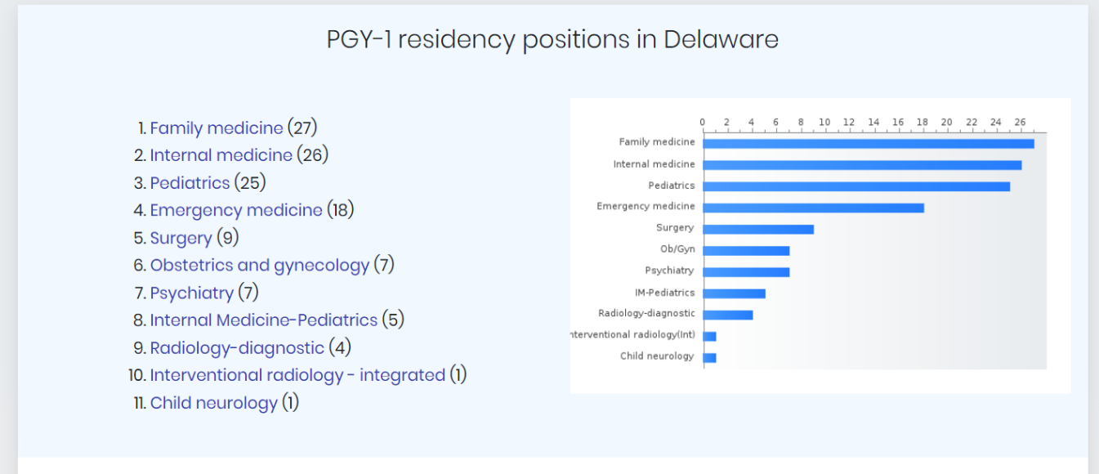
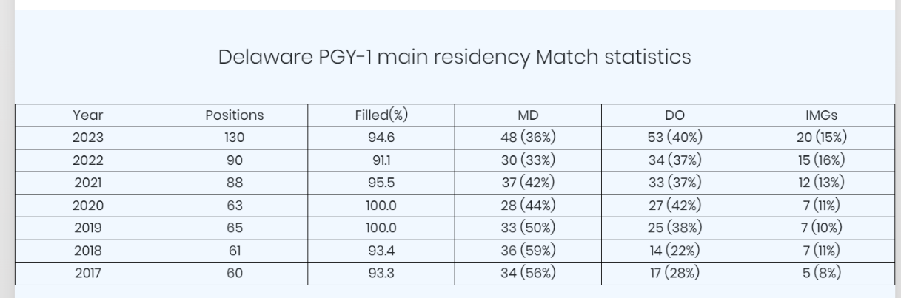
Medical Residency Programs in Delaware

Slide 49



Strategic Initiatives
Inclusive Excellence
Growing Pipeline Initiatives
  Dual credit- expansion of additional school
  Summer Camp - expand to 2 camps
  Delaware HOSA -State collaboration

Slide 50

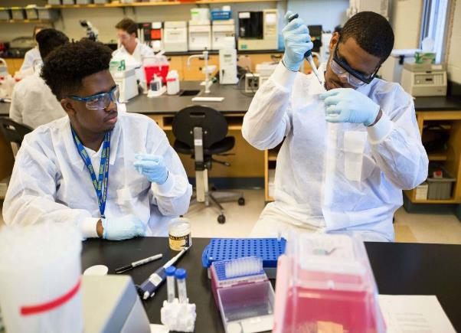
Pipeline Programming Impact
Matriculated Students
As of February 3, 2022 (includes all colleges) | # of students
Total Incoming Freshman (Class of 2025) | 21
Total Sophomores (Class of 2024) | 18
Total Juniors (Class of 2023) | 32
Total Seniors (Class of 2022) | 18
Total | 89
As of February 3, 2022 | # of students
College of Health Sciences | 32
College of Arts & Sciences | 31
College of Engineering | 8
College of Education & Human Development | 2
College of Business & Economics | 16
Total | 89
Alyssa Benjamin
Program Coordinator
CHS Pipeline Prgms
Students from the High School Dual Degree Program
and The Summer Camps

Slide 51
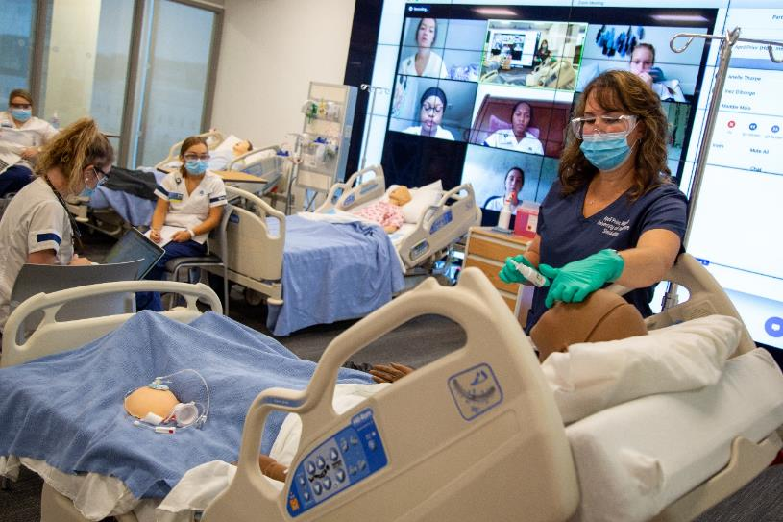
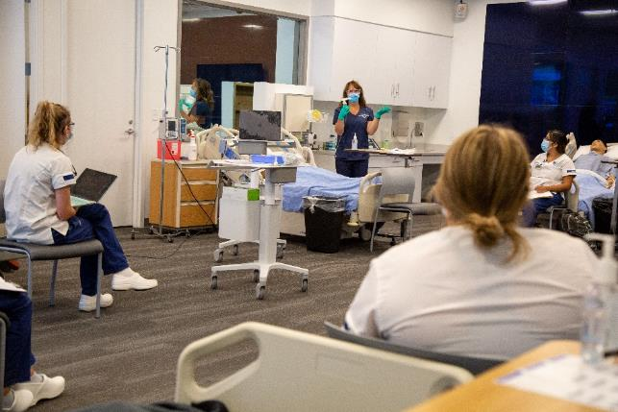
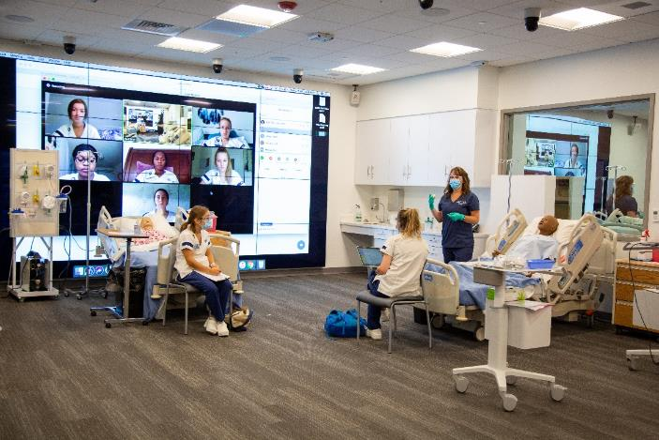
Hybrid Simulation Courses
During COVID 1hr simulation = 2hrs clinical

Slide 52
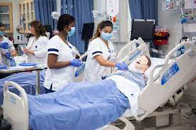
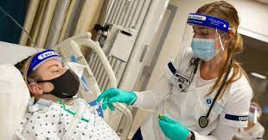
University of Delaware’s Center for
Simulation Innovation, Interdisciplinary Education, and Entrepreneurship (CSIIDEE) received International Accreditation Jan 2022
Simulation has expanded our ability
To do clinical training for healthcare
Professionals

Slide 53
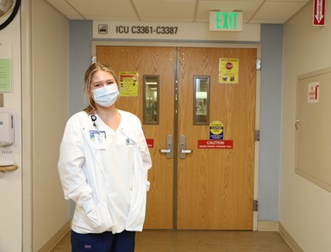
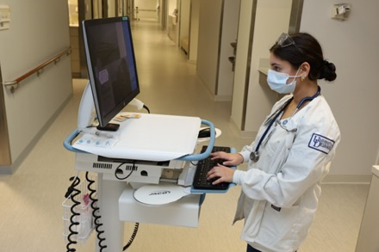
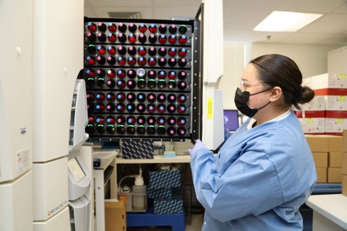
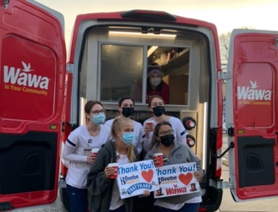
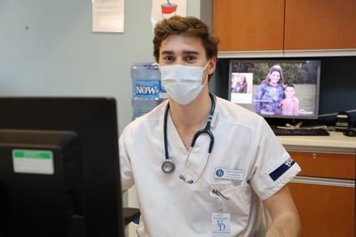
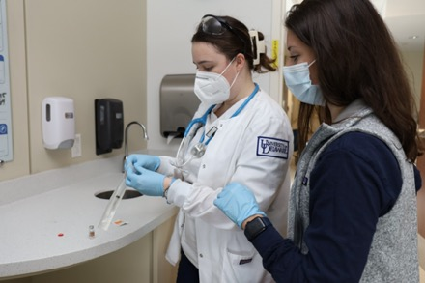
Stepping up to support Delaware’s hospitals, UD Nurses

Slide 54
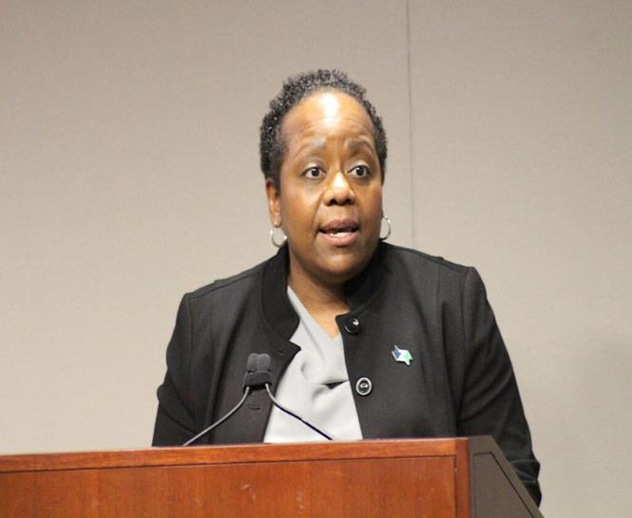
Zip Code to open Seaford site that is focused on health care program
Zip Code is also exploring the possibility of using the same training format for the medical field in the Nylon Capital Shopping Center. The program would be called Zip Care, and would offer upskilling and reskilling for adults to entry-level positions as nursing or medical assistants.
“Zip Care would have a mission to develop the economy of the region by providing health care training to high-potential individuals with the talent, desire, and interest needed to become entry-level health care professionals with the skills needed to grow, advance, and succeed in the health care industry,” she said.
Desa Burton,
Executive Director, Zipcode Wilmington
De

Slide 55
Approaches to growing the Healthcare Workforce in Delaware
  Importance of linking health workforce with state agencies, healthcare systems, educational institutions, DOL, DOE, DHSS,etc.
  Establishing a new position “Director of Healthcare Workforce” to work across the agencies, healthcare systems, community and philanthropic groups, is this state driven or public/private partnership
  Establishing a Taskforce or Council on Health Workforce Education and Training, through statute or executive order
  Funding through state investment in healthcare workforce
  Review proposed healthcare legislation

Slide 56
Approaches to growing the Healthcare Workforce in Delaware (draft)
  Data refinement and analysis
  Refine data by additional survey questions as used by other states to
  confirm work in the state, etc.
  Surveys to determine current vacancies and needs
  Surveys to determine capacity to educate and train
  health workforce
Funding:
  Grow investments in education pipelines of Health Workforce
  Enhance Loan repayment Programs
  Student loans for service in rural, and underserved populations
  Annual Health Workforce Summit
  to brainstorm ideas to enhance health workforce

Slide 57
Workforce Summit to bring together state and national leaders to discuss current data, projections, and path forward
Topics could include but are not limited to:
How do we enhance clinical training opportunities in Delaware for all health professionals?
Can we successfully use high fidelity simulation to replace some clinical hours in more of the health professions?
Can we create training tracks that better link academic programs to hospitals for clinical rotations
Can we develop accelerated education programs, certificate and digital badge programs for new learners and retraining current workforce.
Expand affordable housing for workforce or special tax credits, assistance with rental cost for health professionals in high cost areas or limited housing areas
Fellowship programs for NPs and PAs with FQHC and others
Special assistance with capital funding for creation of new primary care centers in HIPSA areas that include a requirement for training of health professionals for 5yrs
Leverage innovation and technology to increase efficiency, and lessen workload to decrease burn out and enhance retention
Focused efforts on the development of “Hospitals at Home “ model.
Move away from fee for service models which encourage over utilization of healthcare services to value based care models which
  reduce the strain on healthcare workforce.

Slide 58

How do we make Health and
Health Workforce
a key priority for Delaware?
We need to create a structured effort to engage
all stake holders in the clinical, educational and
business community in Delaware to create a
stronger health workforce that leads to better
health outcomes for the people of Delaware.

Slide 59
Public Comment

Slide 60
Adjourn
Next DHCC Meeting
Thursday, February 1, 2024
9:00 a.m. – 11:00 a.m.
Hybrid

