Slide 1
JOINT FINANCE COMMITTEE hearing Fiscal year 2023 bUDGET
Renee p. beaman
Division director
DIVISION OF STATE SERVICE CENTERS
Department of Health and Social Services
February 22, 2022
Virtual, Conducted Via Zoom
Comments available online at https://dhss.delaware.gov/
Notes:
Good Afternoon Senator Paradee, Representative Carson, members of the Joint Finance Committee and members of the public.
I am Renee Beaman and I have the pleasure of serving as the Director of the Division of State Service Centers (DSSC). With me today is Faith Mwaura, our Division Deputy and Donika Patel, our Chief Financial Officer.
Thank you for this opportunity to speak with you today and present our accomplishments and Fiscal Year (FY) 2023 Governor’s Recommended Budget.

Slide 2
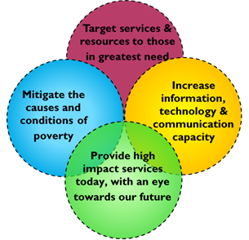
DIVISION OVERVIEW
DSSC mission: To provide convenient access to human services, assist vulnerable populations, support communities and promote volunteer and service opportunities.
Notes:
The Division of State Service Centers is mostly recognized for operating and managing Delaware’s Department of Health and Social Services' network of 15 one-stop facilities for individuals accessing statewide social services. Though significant, these facilities and the administrative role we play comprise only one of three sections that make up the Division of State Service Centers.
Our three sections are: the State Office of Volunteerism, the Office of Community Services, and our Family Support Services Unit.
For most Delawareans, their first experience in seeking emergency services and social service support is walking through one of our State Service Center doors.

Slide 3
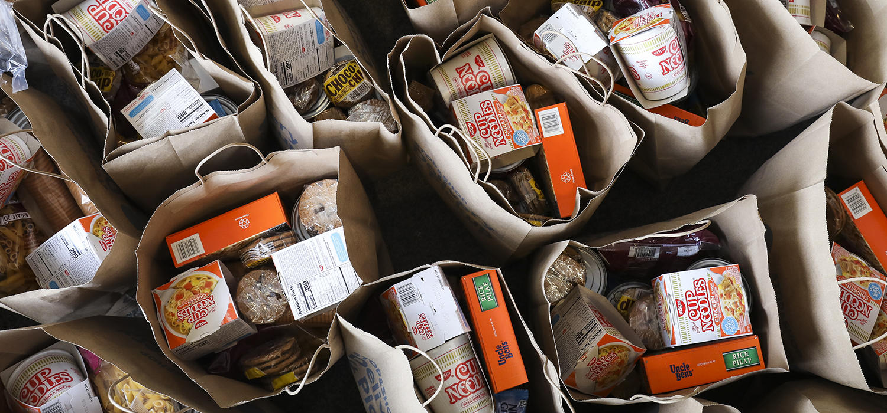
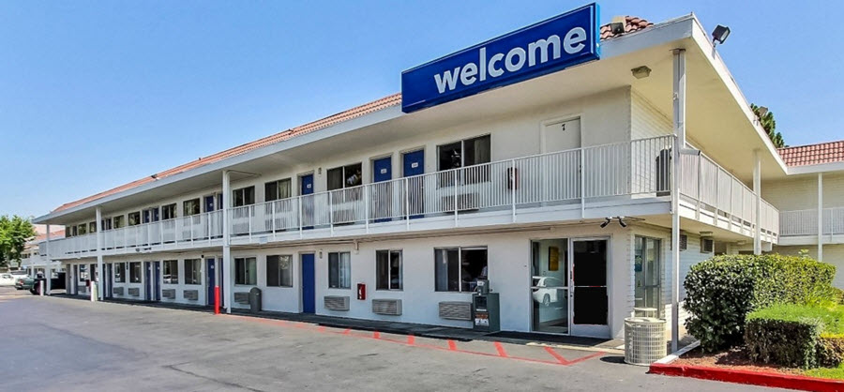
Accomplishments
698,982 Client (hybrid) visits to State Service Centers
9,413 Emergency housing services provided
9,279 Emergency services (utilities, rent, mortgage, fuel, etc.)
3,889 Individuals & families who were housed through our shelter partners
17,866 Households assisted through the Low-Income Home Energy Assistance Program (LIHEAP)
12,982 Low-income families and individuals served through the Community Services Block Grant
69,170 Food closets visits by individuals/families in need of food
403,578 Recorded volunteer hours
Notes:
I’d like to share some of our accomplishments from this past fiscal year:
Since March 2020, we have established a hybrid client interaction process with face-to face interactions, telephone contact or electronic connection with our State Service Center staff which has increased our client contacts this past fiscal year from 569,603 to 698,982.
9,413 homeless individuals and families were housed through our Emergency Housing Assistance Program. We continue to support statewide close to 500 households daily as a result mainly of the mass emergency housing need due to the COVID-19 pandemic. We have also provided emergency housing for 100 COVID-19 positive homeless individuals and their families and most recently 90+ Ida Flood Survivors received emergency housing and supportive services.
Last fiscal year, we provided utility, rent, mortgage, food, heat and fuel assistance to support 9,279 households and families which is less than the past fiscal year. This was mainly due to the housing eviction moratorium and less need for these supportive services as many remained in their homes without the obligation of rent, mortgage or utility payments due to the pandemic.
890 more homeless individuals and families were housed through our statewide shelter partner locations.
Over 6,000 more households received heating and cooling assistance through the Low-Income Home Energy Assistance Program (also known as LIHEAP).
As a result of the pandemic over 7,000 more low-income individuals experiencing poverty received services through the Community Services Block Grant.
Our Community Food and Nutrition Program, in partnership with community agencies, food closets, community food pantries and delivery programs, provided emergency food to 69,170 individuals and families.
Though the pandemic reduced many in-person volunteer events this past fiscal year, Delawareans continued to put their passion into action with over 403,000 volunteer hours recorded, which is equivalent to a value of $10.9 million dollars.

Slide 4
Looking ahead
Replacement of our current Database System
Reimagination Project for State Service Centers
Strengthening of the Emergency Housing Process Statewide
Notes:
Looking ahead the Division of State Service Centers in partnership with the Governor's Family Services Cabinet Council are identifying strengths, best practices and creating improved systems to meet the continued needs of our most vulnerable citizens.
Several projects are in their early stages of planning and development aligning closely together to help create improved service integration, efficiency with the replacement of our current client database system and the Reimagination Project of our 15 State Service Centers.
Emergency housing continues to be a major request and need. The pandemic has provided opportunity for our Division to explore ways for more innovative processes which will increase housing opportunities and improved service delivery. This project is supported and facilitated in collaboration with the Family Services Cabinet Council.

Slide 5
Workforce challenges
We are currently experiencing the following:
20% Vacancy Rate
Recruitment Challenges
Loss of Institutional Knowledge
Staff Burnout
Notes:
Since the beginning of the pandemic, March 2020, the majority of our Divisional staff remained on the frontline continuing to serve and be available despite the overwhelming challenges and unknown factors of the pandemic.
As a result of promotions, transfers, and retirements, we have had a significant number of staff turnover which often included experienced employees. Last year three key leadership staff retired with a combined state work history of 141 years.
We continue to move forward with internal advancement of qualified staff to some of our supervisory and management positions. We currently have a 20% staff vacancy rate and acquiring and attaining qualified candidates has been extremely difficult, but we continue to do our best to fill our vacancies as timely as possible.

Slide 6
FY 2023 GOVERNOR’s RECOMMENDED Budget
FY 2023 Governor’s Recommended Budget
($ in thousands)
 | GF | ASF | NSF | Total
FTEs | 102.5 | 0.0 | 19.1 | 121.6
Dollars ($) | 12,312.1 | 663.1 | 22,242.4 | 35,217.6
Budget Definitions:
GF – General Funds
ASF – Appropriated Special Funds
NSF – Non-Appropriated Special Funds
FTEs – Full Time Equivalent Positions
Notes:
The slide above shows DSSC’s budget included in the FY 2023 Governor’s Recommended Budget (GRB).
Our Division’s GRB is:
$12,312.1 [Twelve Million, Three Hundred Twelve Thousand, One Hundred dollars] in General Funds (GF);
$663.1 [Six Hundred, Sixty-Three Thousand, One Hundred dollars] in Appropriated Special Fund (ASF) spending authority; and
$22,242.4 [Twenty-Two Million, Two Hundred Forty-Two Thousand, Four Hundred dollars] in Non-Appropriated Special Funds (NSF).

Slide 7
THANK YOU
Notes:
Please allow me to thank our many partners for the critical work they provided in support of those that we serve especially during these ongoing challenging times.
Thank you for the opportunity to share with you the challenges and opportunities facing the Division of State Service Centers.
I am happy to answer any questions you may have.

