Slide 1
SQI and CQI Methodology
Delaware Primary Care Reform Collaborative Meeting
February 12th, 2024

Slide 2

AGENDA
HMA Team Introduction
SQI Introduction
SQI Implementation and Considerations
CQI Introduction
CQI Implementation and Considerations

Slide 3







HMA TEAM INTRODUCTION
Gaurav Nagrath, ScD, MBA
Managing Principal
Kyle Edrington
Managing Director
Alessandra Campbell, MPH
Consultant
Daniel Nemet, ASA, MAAA
Consulting Actuary
Ainsley Ramsey, MS
Actuarial Consultant
Andrew Rudebusch
Senior Actuarial Consultant
Joanna Powers, MPH
Research Associate

Slide 4
SQI: Introduction
Notes:
Gaurav

Slide 5
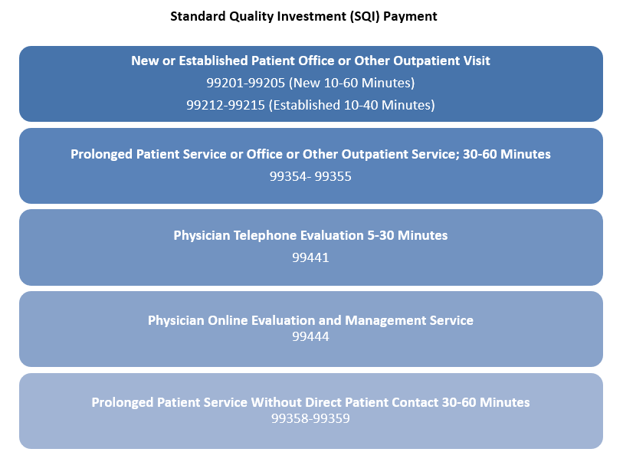
Background: Standard Quality Investment (SQI)

Slide 6
Data
Provided by Delaware Health Information Network (DHIN)
  2017-2021
  Fully insured Only
  By Year & Procedure Code
  Only primary care visits
Fields Provided
  Number of Visits (i.e., Units)
  Average Paid Amounts
  Number of Covered Lives/Membership

Slide 7
SQI: Implementation and Considerations
Notes:
Gaurav

Slide 8
Health Care Attribution Considerations
Implementing SQI requires continued conversations around PCP attribution
SQI PMPM will vary significantly depending on if all care is included or only care from attributed PCPs
DHIN data reflects only primary care visits
SQI Procedure Codes
All Providers
All Providers
$30 PMPM
PCPs only
PCPs only
$10 PMPM

Slide 9
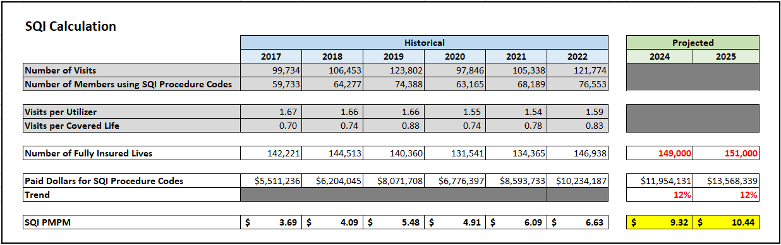
SQI Calculation – PCPs only
DHIN data reflects only primary care visits which is likely a subset of the intended SQI

Slide 10
SQI Recommendation
SQI recommendation depends on attribution logic and panel size
  These topics have been part of previous PCRC discussions and are pending formal definition
Generally, the SQI PMPM should be expected to be between $10 and $30 PMPM
  A large panel with a stronger attribution implementation should be around $30
  A large panel with a more limited attribution implementation could be as low as $10
  Smaller panels require additional consideration specific to each population and contract

Slide 11
CQI: Introduction
Notes:
Gaurav

Slide 12
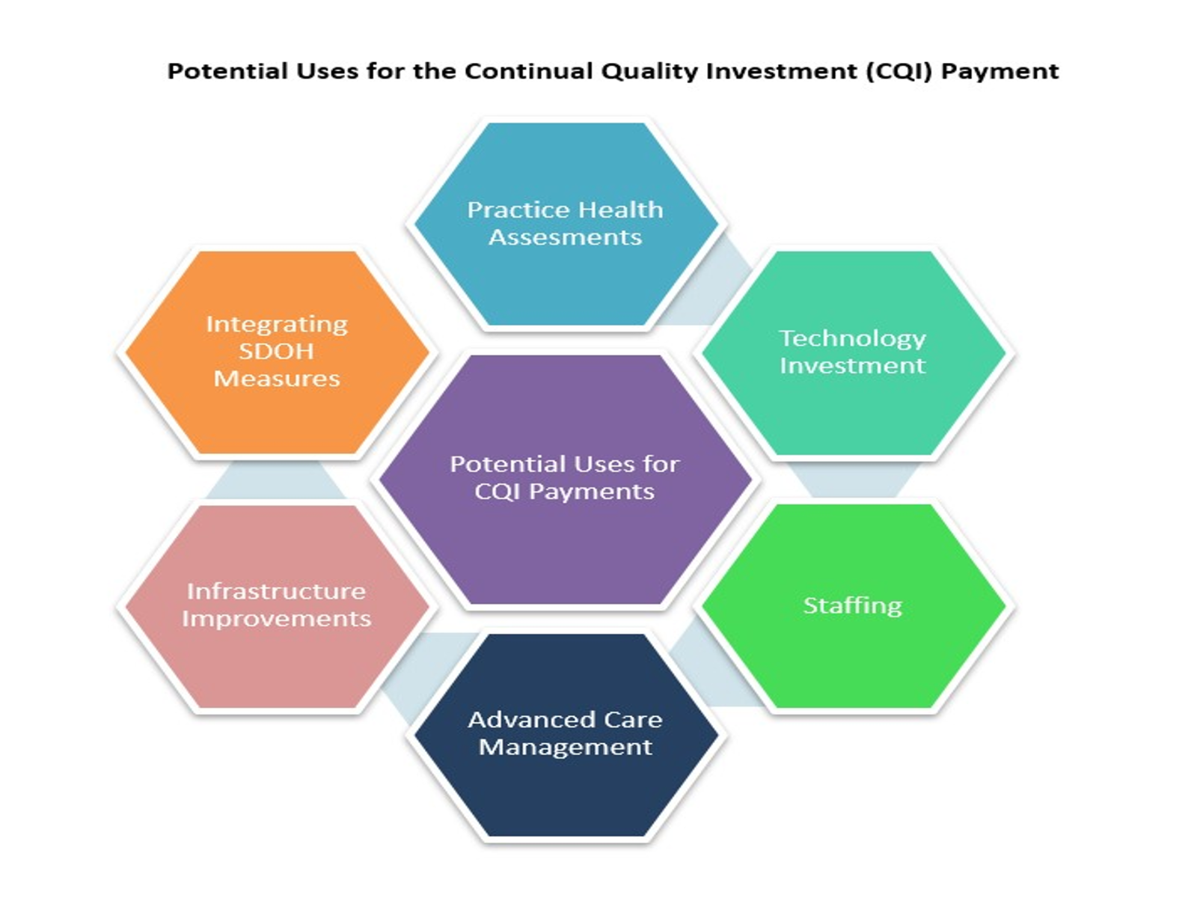
Background: Continual Quality Investment (CQI)

Slide 13

CQI Background and Benefits
Continual Quality Investment (CQI)
State of Delaware, DHCC, PCRC, and OVBHCD focus on triple aim of healthcare:
Improving quality of care, improving health outcomes, and reducing costs.
Senate Bill 120 promotes primary care by setting two metrics:
By 2025 60% of Delawareans attributed to VBP models
Primary care must be at least 10% of total cost of care in 2024 and 11.5% in 2025.

Slide 14
CQI as A Part of the PCP Payment Model
Continual Quality Investment (CQI)
CQI directs primary care into value-based care by giving providers options to invest in these potential categories.
Options give providers opportunities to maximize impact of the CQI.
The CQI will be paid to practices as a prospective PMPM.

Slide 15
CQI: Implementation and Considerations
Notes:
Gaurav

Slide 16
CQI in Delaware: Implementation Considerations
Workgroup Responses for CQI Implementation:
Care Coordination Staff
Information Technology/Data
Chronic Care Management Staff
Upgrades to EMR
Infrastructure Upgrades to Improve Client Workflow
Implementation Considerations:
A mechanism for reporting the CQI spent needs to be developed.
CQI PMPM will vary by provider size in the beginning of the program.
As the program continues other metrics could be introduced to tier the CQI PMPM.

Slide 17
Potential CQI Programs
Small Practice
Large Practice
Practice Health Assessments
Tracking and enforcing screening completion.
Practice identifies resources for patients and families.
Providers have different needs due to size
Recommended CQI PMPM payments are tiered by practice size.
  Small defined as having < 5 providers.
Technology Investment
Data exchange of best practices or claims data. Could be maintained by a 3rd party
Telehealth integration and portal upgrades
Staffing
Retention incentives: financial compensation, improved working conditions, additional support
Hiring additional staff: non-medical personnel, nurse practitioners, community workers
Advanced Care Management
Practice identifies resources for patients and families.
Practice identifies resources for patients and families.
Infrastructure Improvements
Purchase additional common equipment and tools to improve client flow efficiency.
Telehealth integration and portal upgrades
Integrating SDOH Measures
Tracking and enforcing screening completion.
Including Z codes in claims data

Slide 18
2024 Primary Care Scenarios
In addition to the size of the practice, the range of CQI will also depend on practice needs and contracting dynamics.
CQI can be used by practices to achieve the 10% minimum requirement
2025 has 11.5% minimum threshold for primary care spend of TCOC.
  CQI could decrease as SQI payments are increased and investment opportunities are fulfilled.

Slide 19

Questions

