Slide 1


DE PCRC Strategic Plan Decision-Making
February 12th, 2024
Copyright © 2023 Health Management Associates, Inc. All rights reserved. The content of this presentation is PROPRIETARY and CONFIDENTIAL to
Health Management Associates, Inc. and only for the information of the intended recipient. Do not use, publish or redistribute without written permission
from Health Management Associates, Inc.
Notes:
Free stock photos are available on UNSPLASH:
https://unsplash.com/

Slide 2




HMA Team
Caitlin Thomas-Henkel, MSW
Principal
cthomashenkel@healthmanagement.com
Nehath Sheriff, MPH
Consultant
nsheriff@healthmanagement.com
Keyan Javadi, MPH
Consultant
kjavadi@healthmanagement.com
Gaurav Nagrath, ScD, MBA
Managing Principal
gnagrath@healthmanagement.com

Slide 3
Overview of Project/Goals
Establish a PCRC working group
Complete an Environmental Scan of the national primary care landscape/state examples of successful primary care models with a focus on:
Authority & Governance​
Primary Care Cost Containment Strategy ​
Investments in Primary Care​
Quality Measures
Conduct Focus Group Interviews & Surveys with identified external stakeholders:
Providers
MCOs
State Representatives
Develop Draft Strategic Plan for the PCRC

Slide 4
Timeline
Aug. 31, 2023
Primary Care Reform Collaborative Working Group Kickoff Meeting
Sept. 20, 2023
Working Group Meeting #2
Oct. 10, 2023
Working Group Meeting #3
Nov. 29, 2023
Working Group Meeting #5
Nov. 1, 2023
Working Group Meeting #4
Presentation of Environmental Scan
Jan. 11, 2023
Final Working Group Meeting
Presentation of Interview Findings
Nov. 2, 2023
State Org. Stakeholder Interview
Nov. 7. 2023
MCO Stakeholder Interview
Feb. 2024
Final Strategic Plan Report Due

Slide 5
Subcommittee Working Group Members
Dionna Reddy, DHSS
Laura Knorr, Aetna
Kevin J. O’Hara, Highmark
Cristine Vogel, DE Dept. of Insurance
Tyler Blanchard, Aledade
Michelle Adams, Westside Health
Dr. Nancy Fan, PCRC Chair

Slide 6
PCRC Working Group Takeaways
There needs to be a greater effort to decrease inpatient costs; inpatient costs are the highest rise in cost of care
PCRC should set goals for where primary care investment is going
Expand patient-centered care to look beyond what SB-120 looks at
DE needs to find a personalized solution that matches the policies it wants to move forward
Specific primary care governance models DE should adopt:
  Vermont’s Green Mountain Care Board closely resembles what DE hopes to do
Develop 3-5 strategic objectives that the PCRC feels passionate about moving forward with
  This is what we are voting on today

Slide 7
Proposed Recommendations for the PCRC

Slide 8
Recommendation #1
The PCRC should focus on increasing multi-payer participation and buy in for primary care spending

Slide 9
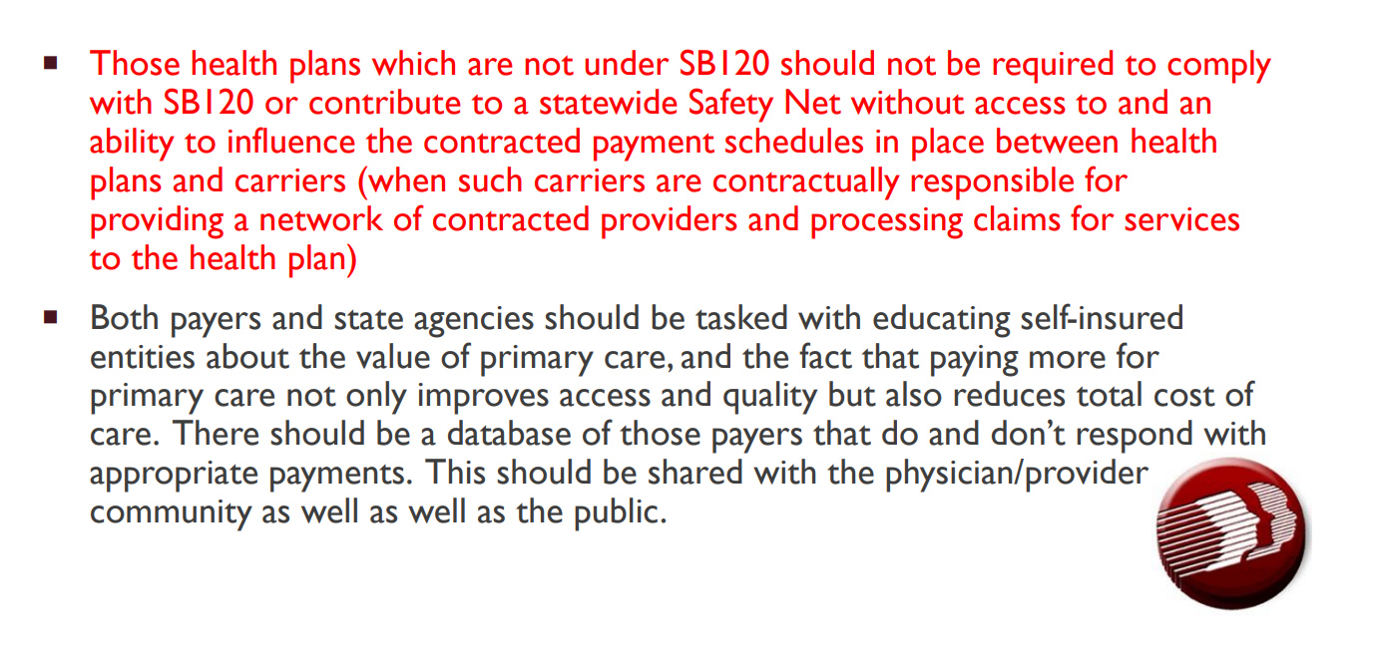
NASEM Survey Results

Slide 10
Focus Group Feedback
Include broader application to other commercially-run state products like Medicaid MCOs and State Employees
Eliminate representation by Medicaid and the state employee group until they agree to participate in SB 120
Little impact in expanding the primary care investment targets into other market segments such as Medicaid and the State Group Health Insurance Plan when only 10% of the population is served in large group plans

Slide 11
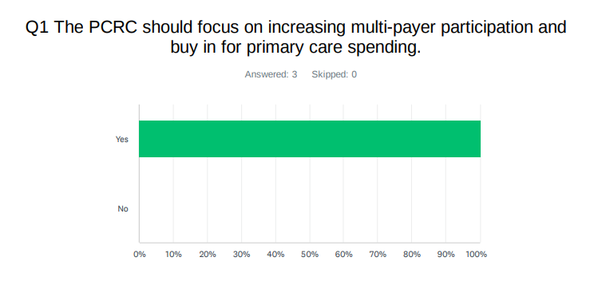
PCRC Working Group Survey results

Slide 12
Recommendation #1: Vote
The PCRC should focus on increasing multi-payer participation and buy-in for primary care spending.

Slide 13
Recommendation #2
The PCRC should inform policies that will work on primary care investments, without increasing overall healthcare costs.

Slide 14
NASEM Survey Results
If there is an increase in the total cost of care, the cost should not be passed onto the consumer/patient
  11 responses – 72.7% agree>>>unrealistic
With the information provided by the OVBHCD and through the DHSS Benchmarking and Costaware data, there should be an effort to decrease inpatient costs, even for those health plans not covered under SB120 (Medicaid, self-insured plans)
  11 responses – 90.9% agree>>> not feasible due to cost factor
If this is a STRONG RECOMMENDATION from the PCRC, should there be a recommendation for an established regulatory body regarding health care systems and their contracted payment schedules with carriers, such as a set schedule for annual increases in service payments, similar to what is in SB120?
  10 responses - 90% agree

Slide 15
Focus Group Feedback
Listen to providers and offer incentives to improve outcomes
“Consider the whole primary care landscape, with attunement to hospital-based primary care practices​”​
“The tactics undertaken by the PCRC do not focus on the entire primary care system (focus on independent practices)​”

Slide 16
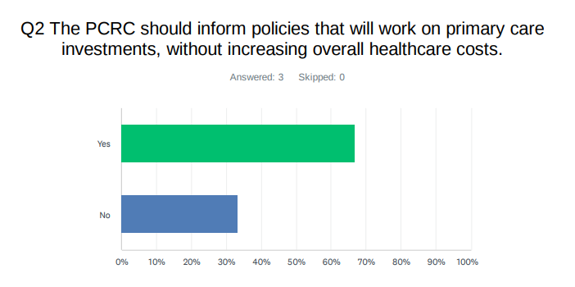
PCRC Working Group Survey results

Slide 17
Recommendation #2: Vote
The PCRC should inform policies that will work on primary care investments, without increasing overall healthcare costs.

Slide 18
Recommendation #3
The PCRC should promote and advocate for quality measures aligned across payers based on the biggest cost of care drivers.

Slide 19
NASEM Survey REsults
The PCRC should recommend telehealth services, which would need to be defined, are included as an essential service of primary care.
  11 responses – 100% agree
The Delaware Primary Care Delivery Model (aka Value Based Model) should be incorporated in all health plans, whether through regulation or legislation
  11 responses – 72.7% agree
The PCRC should recommend that the certification of PCMH level of care not be limited only NCQA certification and can qualify for higher reimbursement if the practice meets certain parameters.
  11 responses - 54.9% agree; 36.4% not sure – I need to know the qualifying parameters

Slide 20
Focus group results
Need the right metrics to effectively measure primary care access
Develop structure, goals, and prioritize quality metrics
“Unclear whether strategies associated with SB 120 will increase access to PCPs”​
“Providers unaware of how primary care investment is working for DE’s primary care system​”

Slide 21
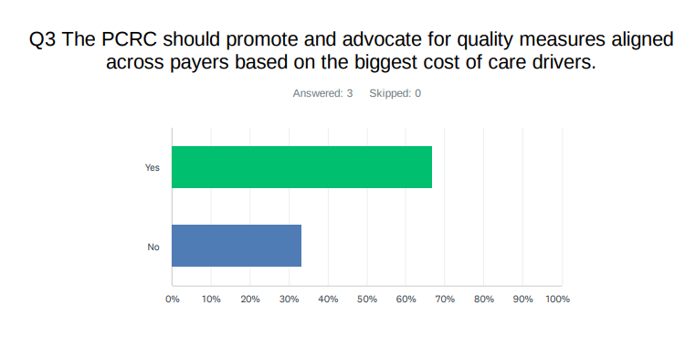
PCRC Working Group Survey Results

Slide 22
Recommendation #3: Vote
The PCRC should promote and advocate for quality measures aligned across payers based on the biggest cost of care drivers.

Slide 23
Recommendation #4
The PCRC will develop a more comprehensive communications strategy, such as an annual report, to increase transparency around the vision, goals, and progress of the PCRC.

Slide 24
Focus group feedback
The goal and focus of the PCRC is not clear. The strategies and objectives are unclear, and accomplishments are not widely known (no transparency)​”
“The most recent strategic planning initiative has not been made public, lacks transparency, and does not have input from all necessary stakeholders. ”
“Increased transparency between what the PCRC is doing with input from necessary stakeholders.​”

Slide 25
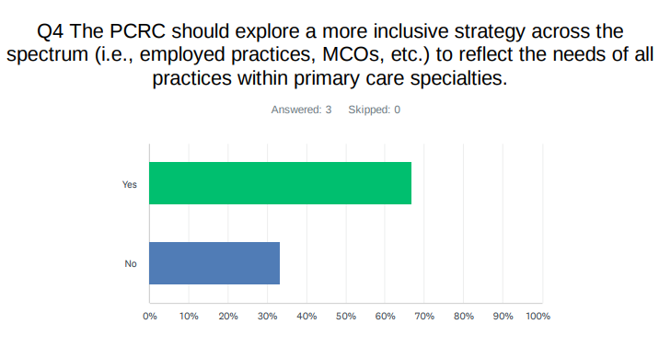
PCRC Working Group Survey results

Slide 26
Recommendation #4: Vote
The PCRC will develop a more comprehensive communications strategy, such as an annual report, to increase transparency around the vision, goals, and progress of the PCRC.

Slide 27
Recommendation #5
The PCRC should explore a more inclusive strategy across the spectrum (i.e., employed practices, MCOs, etc.) to reflect the needs of all practices within primary care specialties.

Slide 28
NASEM Survey Results
If a regulatory body is NOT a STRONG RECOMMENDATION, then should the PCRC recommend that those health plans which are not under SB120 contribute to a statewide Primary Care Investment Safety Net, which may cover but is not limited to, costs associated with practice transformation for practices to reach PMCH quality of care; infrastructure costs to establish resource for patients and providers alike regarding primary care access; patient and provider education regarding the benefits of primary care, behavioral health, as well as social determinants of health.
  10 responses – 70% agree

Slide 29
Focus group feedback
Only a small portion of stakeholders are actively engaged
The representatives from the various PCP groups may not be the right people.

Slide 30
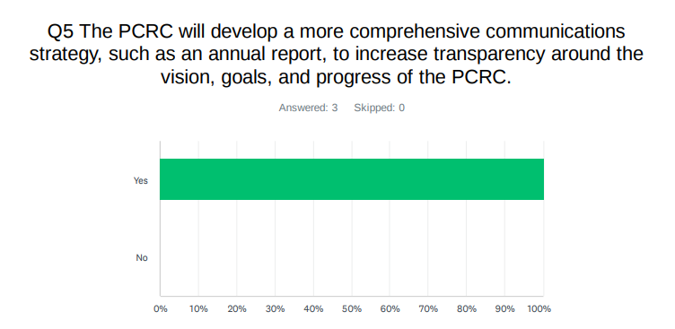
Results from PCRC Working Group Vote

Slide 31
Recommendation #5: Vote
The PCRC should explore a more inclusive strategy across the spectrum (i.e., employed practices, MCOs, etc.) to reflect the needs of all practices within primary care specialties.

