Slide 1
Primary care reform collaborative meeting
APRIL 11, 2022

Slide 2
Virtual meeting- housekeeping
Public- please send your name, email contact, and organization affiliation (if applicable) to stephanie.hartos@delaware.gov or write in the meeting chat box.
Please keep your computer/phone on mute unless you are making a comment, and if you are not on visual, please identify yourself as well.
This meeting will be recorded for minutes

Slide 3
agenda
Call to Order / Attendance
Vote on March 2022 Meeting Minutes
DOI/OVBHCD Update
NASEM report "Implementing High Quality Primary Care"
Payment and Attribution Workgroup Update
Care Coordination Workgroup
Public Comment

Slide 4
Action item
Vote on approval of March 14th Meeting Minutes

Slide 5
updates
Department of Insurance: Office of Value-Based Health Care Delivery
Mary Jo Condon- Update on SS1 for SB120 Regulations

Slide 6
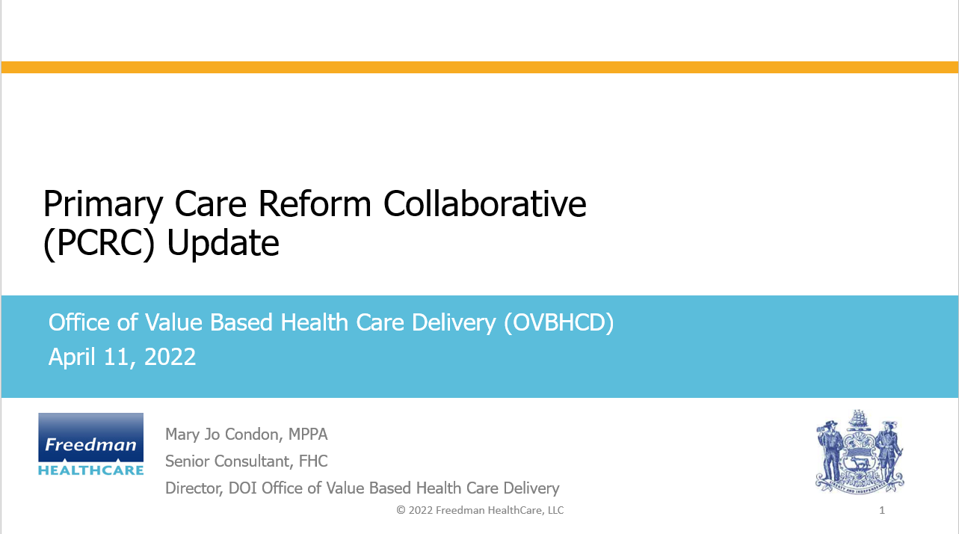

Slide 7
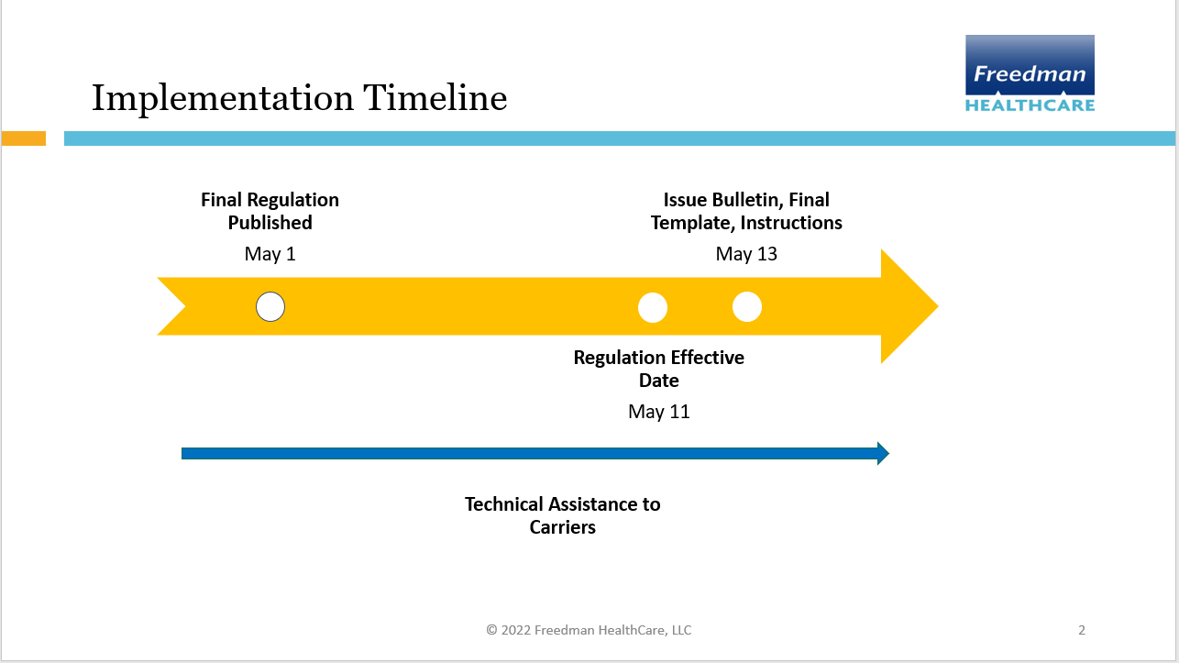

Slide 8
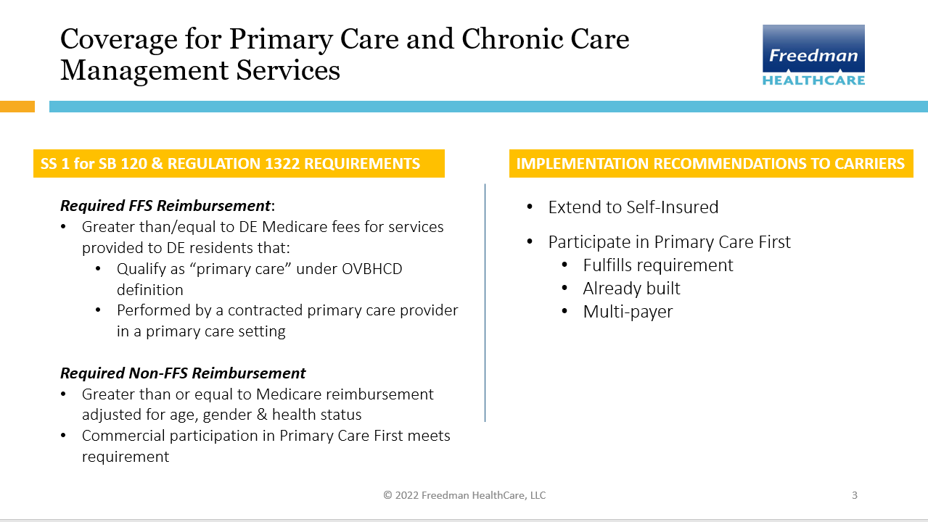

Slide 9
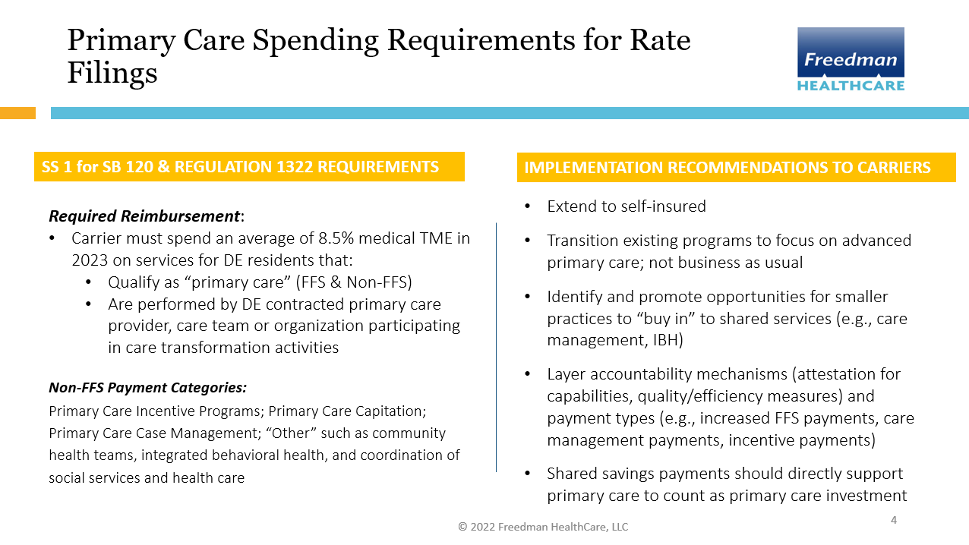

Slide 10
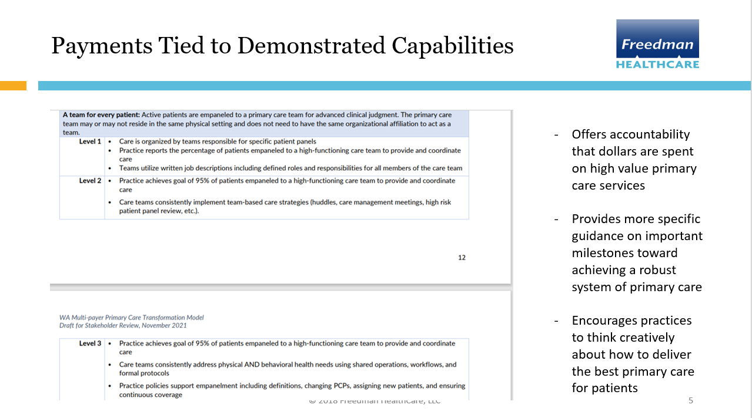

Slide 11
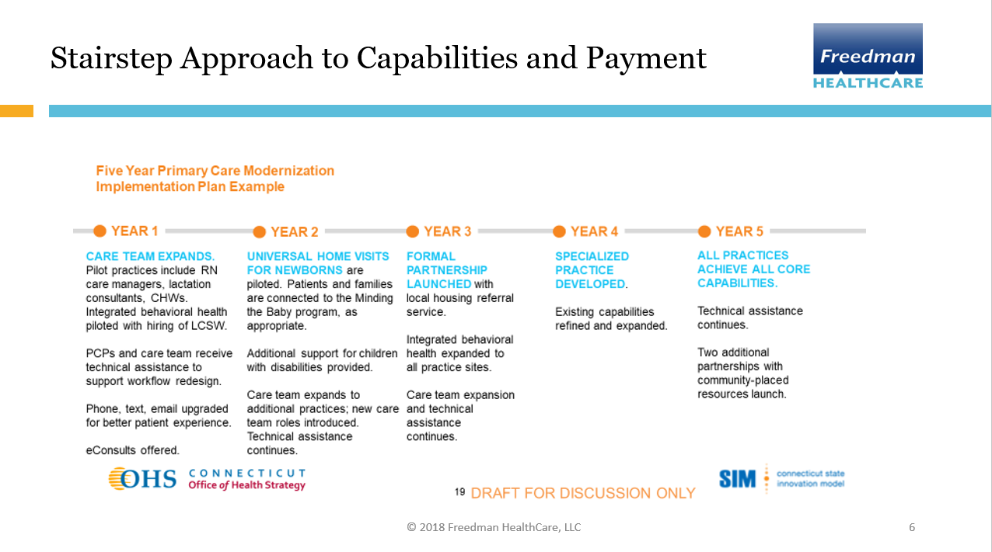

Slide 12
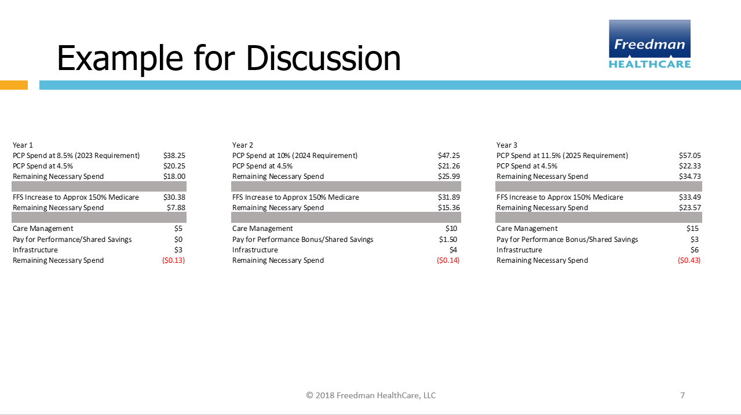

Slide 13
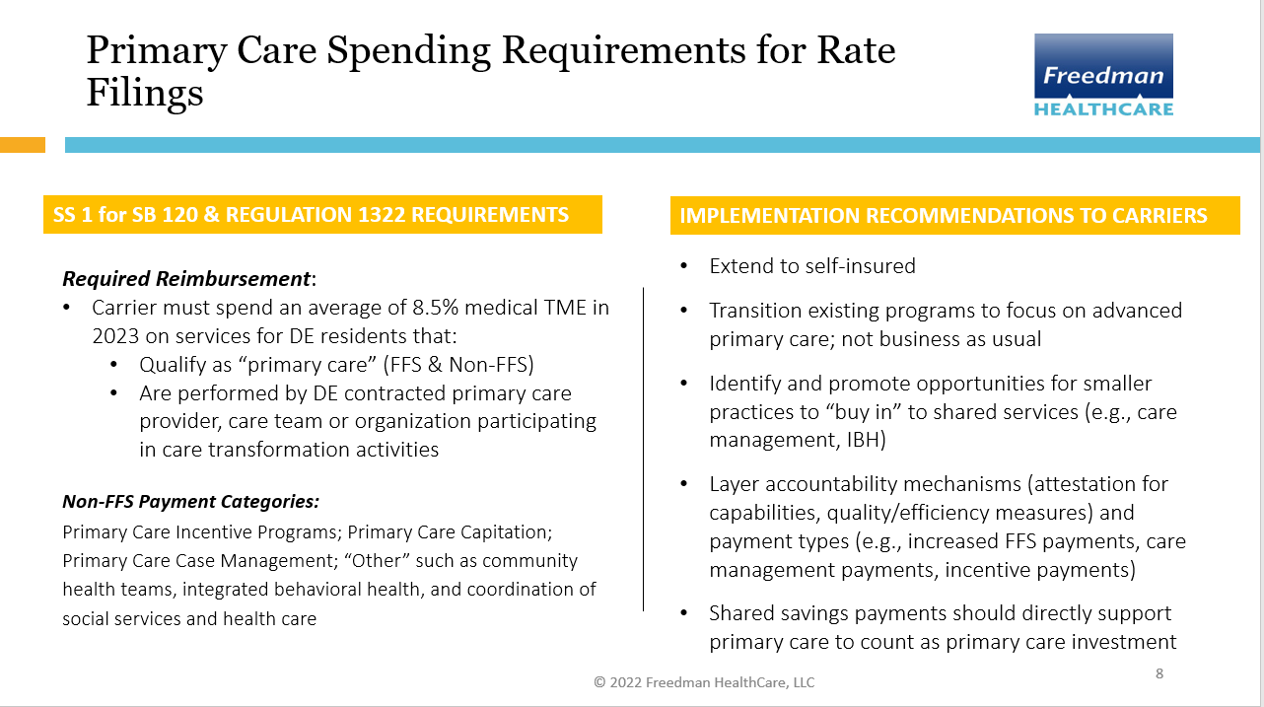

Slide 14
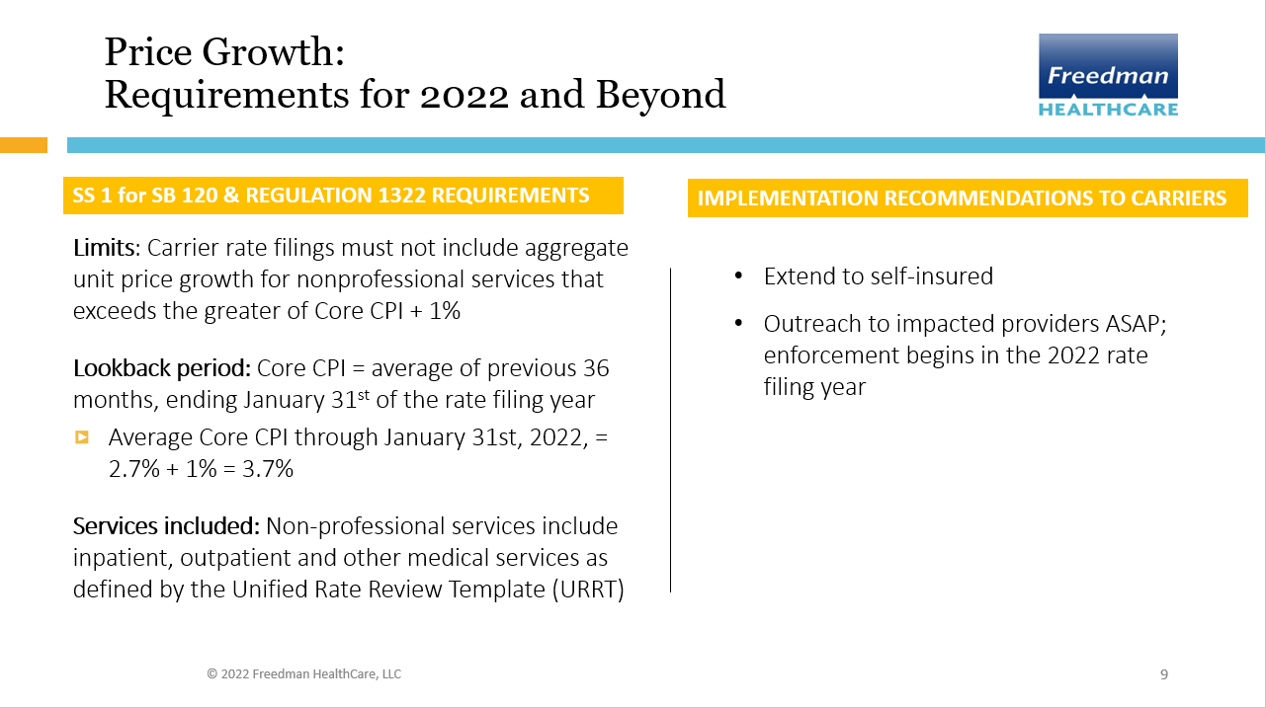

Slide 15
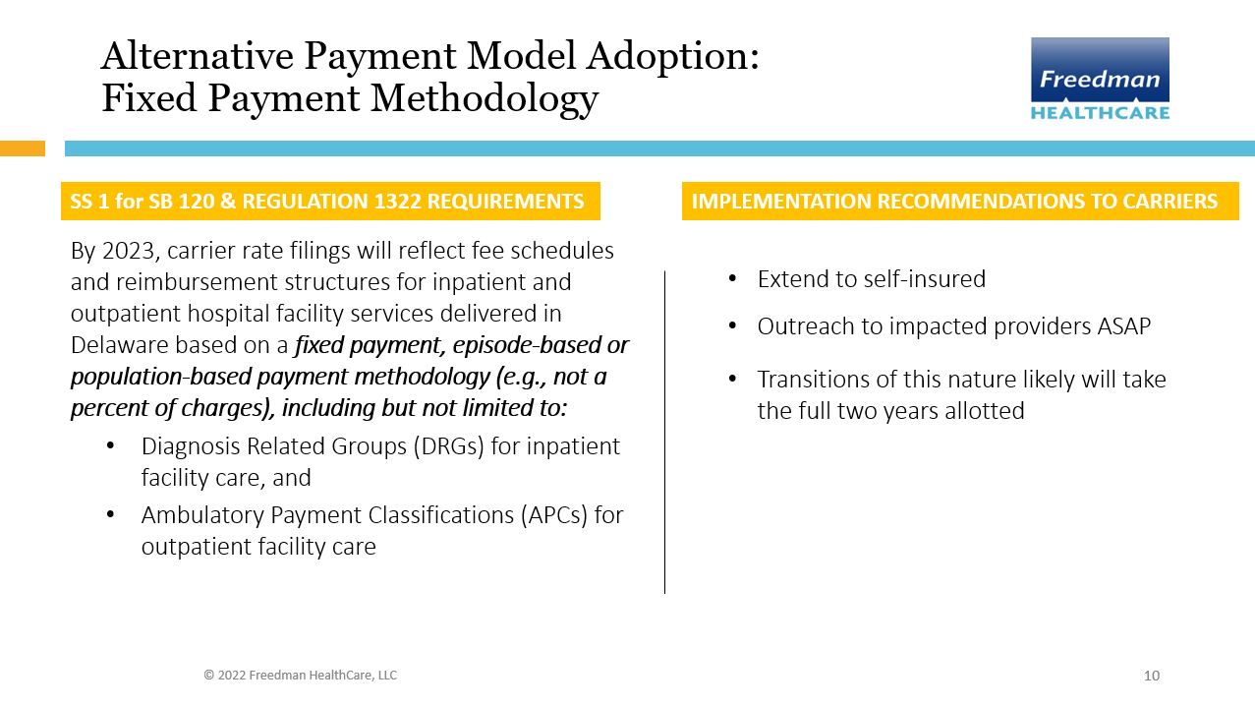

Slide 16
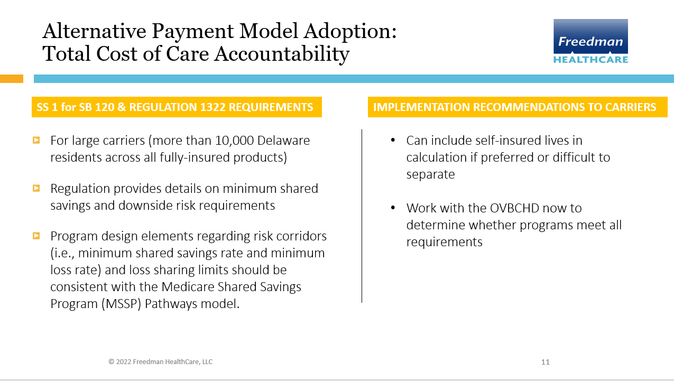

Slide 17
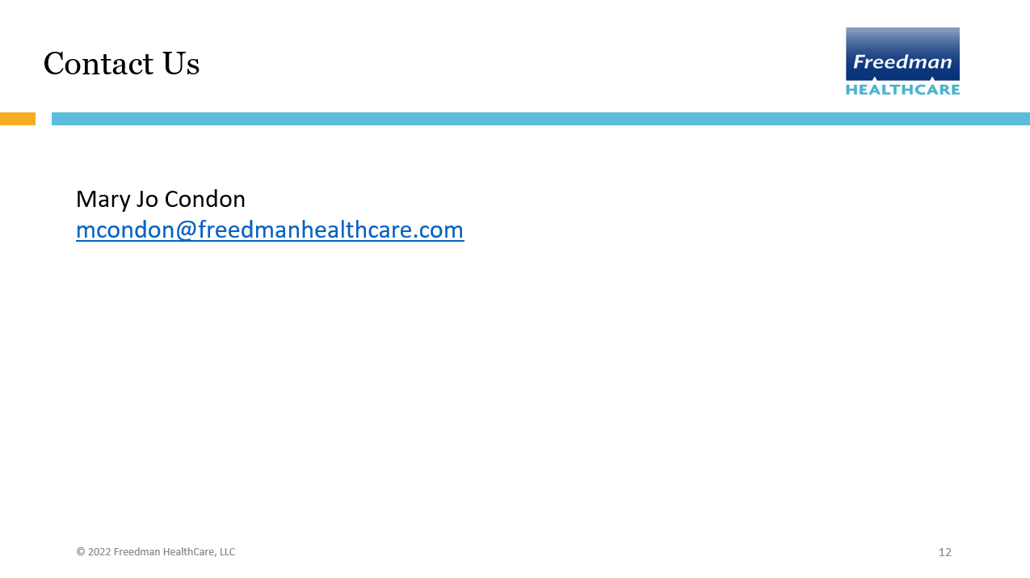

Slide 18

Implementing High-Quality Primary Care Webinar Series:
Reforming Payment
Nationalacademies.org/primarycare
primarycare@nas.edu

Slide 19
Committee Members
Linda McCauley, Emory University (Co-Chair)
Asaf Bitton, Ariadne Labs
Tumaini Coker, University of Washington School of Medicine and Seattle Children’s
Carrie Colla, Geisel School of Medicine at Dartmouth
Molly Cooke, University of California, San Francisco
Jennifer DeVoe, Oregon Health & Science University
Rebecca Etz, Virginia Commonwealth University
Susan Fisher-Owens, University of California, San Francisco School of Dentistry
Jackson Griggs, Heart of Texas Community Health Center, Inc.
Robert Phillips, Jr., American Board of Family Medicine (Co-Chair)
Shawna Hudson, Rutgers University
Shreya Kangovi, University of Pennsylvania
Christopher Koller, Milbank Memorial Fund
Alex Krist, Virginia Commonwealth University
Luci Leykum, University of Texas at Austin
Mary McClurg, Eshelman School of Pharmacy at University of North Carolina at Chapel Hill
Benjamin Olmedo, Dignity Health
Brenda Reiss-Brennan, Intermountain Healthcare
Hector Rodriguez, University of California, Berkeley
Robert Weyant, School of Dental Medicine at University of Pittsburgh
Staff: Marc Meisnere, Sharyl Nass, Tracy Lustig, Sarah Robinson, Samira Abbas
NAM Fellows: Kameron Matthews, Lars Peterson, Dima Qato

Slide 20
Statement of Task
NASEM committee will examine the current state of primary care in the United States and develop an implementation plan to build upon the recommendations from the 1996 IOM report, Primary Care: America's Health in a New Era, to strengthen primary care services in the United States, especially for underserved populations, and to inform primary care systems around the world.
Notes:
The implementation plan considers the following:
Barriers to and enablers of innovation to achieve high-quality primary care;
Comprehensive integration to address the needs of individuals, families, and communities;
Primary care’s role in achieving population health outcomes and equity goals;
Team-based interprofessional practice and the range of primary care providers;
The evolving role of technological and other innovations;
Education and training needs for the changing workforce;
The evolution and sustainability of a variety of care delivery and payment models;
Approaches to meaningful measurement and improvement of care quality;
The primary care needs of different populations, including rural and other underserved communities;
Behavioral and social determinants of health, and community-oriented, whole person care; and
The infrastructure needed for evaluation and data-informed decision-making.

Slide 21
An Updated Definition of Primary Care
High-quality primary care is the provision of whole-person, integrated, accessible, and equitable health care by interprofessional teams that are accountable for addressing the majority of an individual’s health and wellness needs across settings and through sustained relationships with patients, families, and communities.
Notes:
This definition reflects key societal and sector shifts from 1996 to now:
shift from provision of services to integrated, whole-person health
foundational, sustained relationships at the core
importance of communities and their roles in the provision of high-quality primary care
need for primary care to be equitable
interprofessional care teams that deliver primary care
diversity of settings and modalities used to deliver primary care

Slide 22
Primary Care as a Common Good
Primary care has high societal value among health care services yet is in a precarious status
Requires public policy for oversight and monitoring
Needs strong advocacy, organized leadership, and public awareness
Notes:
A common good is:
rivalrous (limited, so more for one person means less for another)
non-excludable (users cannot be prevented from accessing it, regardless of whether they have paid)
The committee strongly believes that because of its societal value and that it is designed for everyone to use throughout their lives, primary care deserves to be treated as a common good. The committee believes its implementation plan will elevate primary care to the common good status it deserves and that the country needs.
Patient choice is important but we are not going to compete our way to a stronger role for primary care in our delivery system any more than we compete our way to a stronger elementary and secondary education system

Slide 23
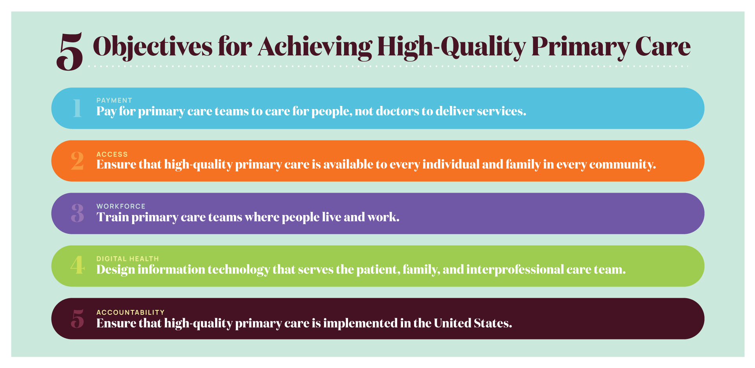
5 Objectives for Achieving High-Quality Primary Care
Notes:
The committee’s recommended actions that make up its implementation plan seek to achieve 5 major objectives to achieve high-quality primary care.
Pay for primary care teams to care for people, not doctors to deliver services.
The nation gets what it pays for, and payment reform that supports and encourages high-quality primary care, rather than actively discouraging it, is fundamental to the committee’s vision of high-quality primary care.
Ensure that high-quality primary care is available to every individual and family in every community.
Everyone in the country should have easy access to high-quality primary care that is person-centered, relationship-oriented, and responsive to the needs of its community.
Train primary care teams where people live and work.
When primary care training is interprofessional and located in community settings, it is more effective at developing the skills that will keep people connected and healthy.
Design information technology that serves the patient, family, and interprofessional care team.
New health information technology standards should prioritize and facilitate integrated care that is person-centered, supports relationships, and is responsive to the needs of its community.
Ensure that high-quality primary care is implemented in the United States.
Implementing high-quality primary care requires clear and meaningful measures of whole-person care, ongoing research, and leadership in the federal government to assure federal policies support its development.

Slide 24
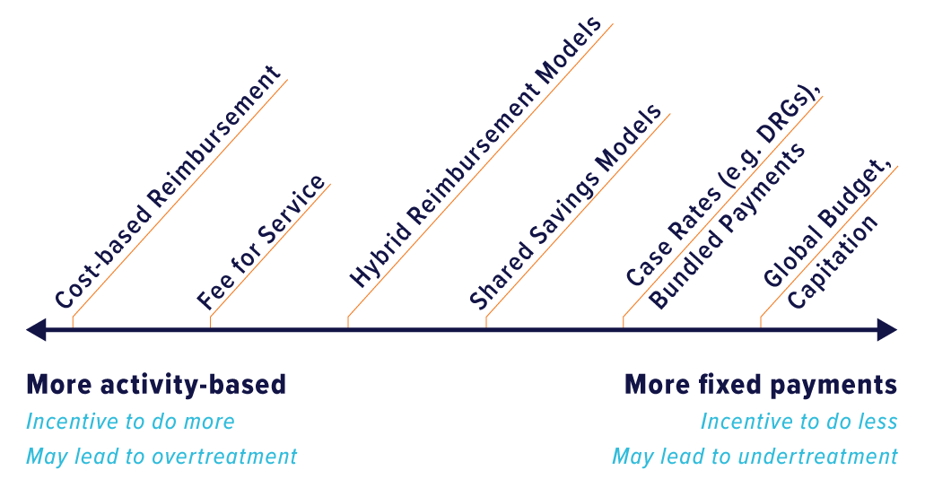
Spectrum of Physician Payment Models
Activity-based vs fixed payment

Slide 25
Visits vs Expenditures in Medical Care
SOURCES: Johansen et al., 2016; Martin et al., 2020
All categories are not included in the figure and thus do not add up to 100 percent.
Notes:
Figure details:
Visit volume data comes from the 2012 MEPS, expenditures come from 2016 MEPS data.
Expenditures include direct payments for care (insurance payments or out of pocket payments).
Primary care and specialty care include office-based and outpatient clinics.
Primary care data include physicians in family medicine, general practice, geriatrics, general internal medicine, and general pediatrics only.
Nurse practitioner, physician assistant, and midwife data were not broken down by setting and are not represented in this figure.
Home health includes both formal (i.e. paid) and informal (i.e. unpaid) care. Informal care includes only individuals who live outside the house.
All categories are not included in the figure and thus do not add up to 100%.

Slide 26
Primary Care Payment Today
Nearly 95% of physician office visits use FFS
COVID-19 pandemic exacerbated financial pressures on practices
Share of total health care spending on primary care is decreasing in a majority of states and overall in the U.S.
OECD countries devote on average nearly 50% more to primary care than the U.S. of total health care spending
SOURCES: Johansen et al., 2016; Martin et al., 2020
Notes:
FFS can encourage overtreatment and discourage practices from structure and process improvements
Many ACOs participate in risk-sharing models but continue to pay primary care based on FFS

Slide 27
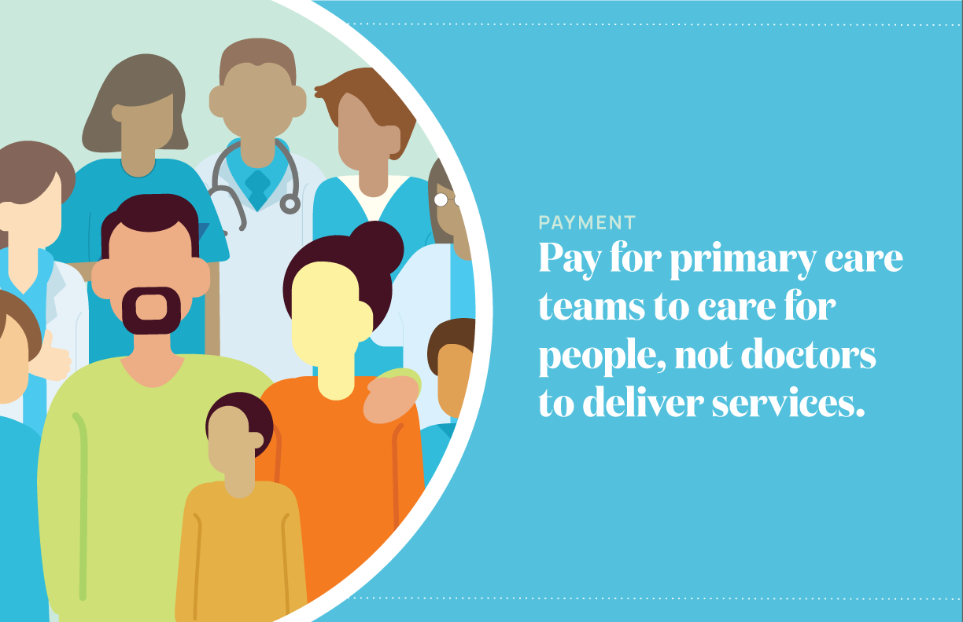
Objective 1: Payment

Slide 28
Objective 1: Payment actions
Action 1.1: Payers should evaluate and disseminate payment models based on their ability to promote the delivery of high-quality primary care, not short-term cost savings.
Action 1.2: Payers using fee-for-service models for primary care should shift toward hybrid reimbursement models, making them the default over time. For risk-bearing contracts, payers should ensure that sufficient resources and incentives flow to primary care.
Notes:
NOTE THAT THE TEXT ON THE SLIDES ARE ABBREVIATED VERSIONS OF THE COMMITTEE’S RECOMMENDED ACTIONS.
Action 1.1: Payers—Medicaid, Medicare, commercial insurers, and self-insured employers—should evaluate and disseminate payment models based on the ability of those models to promote the delivery of high-quality primary care, as defined by the committee, and not on their ability to achieve short-term cost savings.
Action 1.2: Payers—Medicaid, Medicare, commercial insurers, and self-insured employers—using a FFS model payment model for primary care should shift primary care payment toward hybrid (part FFS, part capitated) reimbursement models, making them the default method for paying for primary care teams over time. For risk-bearing contracts with population-based health and cost accountabilities, such as those with accountable care organizations, payers should assure that sufficient resources and incentives flow to primary care. Hybrid reimbursement models should:
pay prospectively for interprofessional, integrated, team-based care, including incentives for incorporating non-clinician team members and for partnerships with community-based organizations
be risk-adjusted for medical and social complexity
allow for investment in team development, practice transformation, and the infrastructure to design, use and maintain necessary digital health technology
align with incentives for measuring and improving outcomes for attributed populations.

Slide 29
Objective 1: Payment actions continued
Action 1.3: CMS should increase overall portion of health care spending for primary care by improving Medicare fee schedule and restoring the RUC to advisory nature.
Action 1.4: States should facilitate multi-payer collaboration and increase the portion of health care spending for primary care.
Notes:
Action 1.3: The Centers for Medicare and Medicaid Services (CMS) should increase the overall portion of spending going to primary care by:
accelerating efforts to improve the accuracy of the Medicare physician fee schedule by developing better data collection and valuation tools to identify overpriced services with the goal of increasing payment rates for primary care evaluation and management services by 50 percent and reducing other service rates to maintain budget neutrality.
restoring the Relative Value Scale Update Committee to the advisory nature as originally intended by developing and relying on additional independent expert panels and evidence derived directly from practices.
Action 1.4: States should implement primary care payment reform by
using their authority to facilitate multi-payer collaboration on primary care payment and fee schedules and,
measuring and increasing the overall portion of health care spending in their state going to primary care.

Slide 30
Paying for Primary Care Teams to Care for People
Full Fee-for-service:
Phase out
Revalued E&M codes in PFS
Risk Adjusted Capitation + FFS + patient assignment:
Default payment for primary care
Revalued E&M codes
Resources for transformation
Risk Bearing Contracts with Focus on Population Health:
Sufficient, higher, prospective resources and incentives for primary care

Slide 31
Primary Care Measures (Ch. 8)
Measures used in primary care will only be effective if they align with what it aims for (its purpose) and what it does (its function)
Meaningful measures best serve efforts to implement high-quality primary care when they connect to its purpose, function, and definition

Slide 32
Primary Care Measures
Primary care physicians average 3.9 hours per week on measure reporting, average cost of $40,000 per doc/per year (Casalino et al., 2016)
Measures can drive value or drive to burnout
Moving the goalposts is frequent strategy for reducing payments

Slide 33
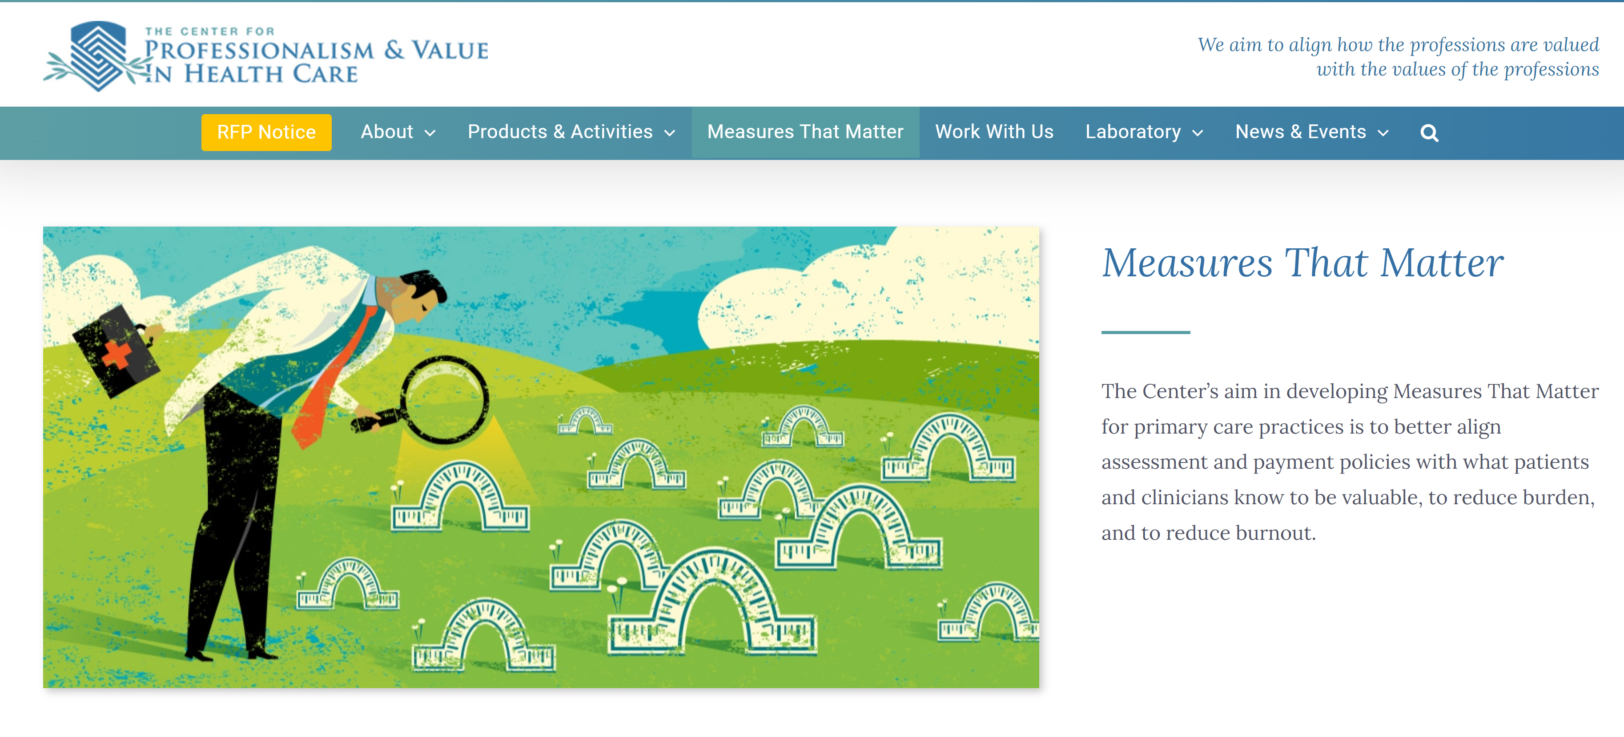

Slide 34
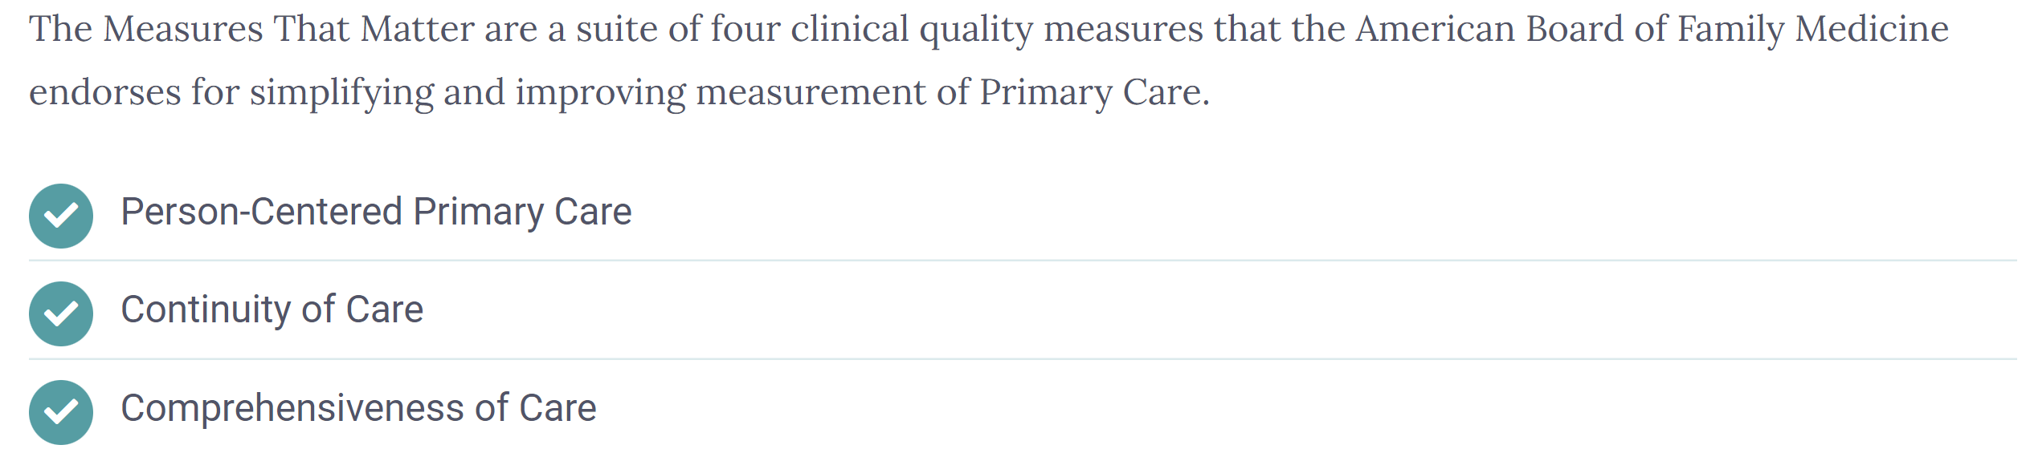
Primary Care Measures that Matter
NQF and CMS Endorsed
NQF Endorsed, CMS under consideration
Approved as a QCDR MIPS measure
ABFM proposed a Primary Care MIPS Value Pathway to CMS, awaiting Fed Register listing

Slide 35

Objective 5: Accountability

Slide 36
In Summary: Implementing High-Quality Primary Care
Establish a Secretary’s Council on Primary Care to:
  Coordinate on primary care across HHS agencies
  Verify adequate budgetary resources
  Report to Congress and the public on implementation progress
Formalize a home for Primary Care Research:
  Create an Office for PCR at NIH
  Prioritize PCR funding at AHRQ
Regularly track implementation progress via a scorecard with existing measures (Appendix E)

Slide 37
Initiative to Strengthen Primary Health Care
February 2022
Judith Steinberg, MD, MPH
Senior Advisor
Immediate Office of the Assistant Secretary for Health

Slide 38
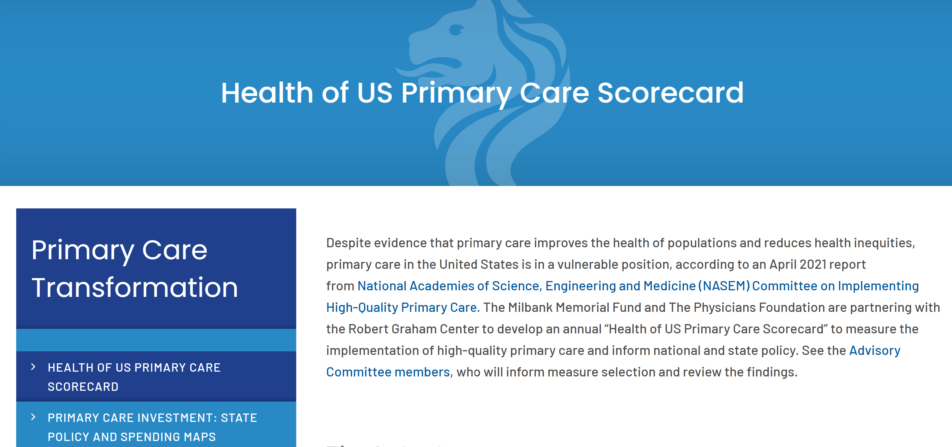


Slide 39
Implementation
A few states are considering forming a state-level Primary Care Council –natural evolution of the Primary Care Reform Collaborative ?
Delaware could create a Primary Care Scorecard

Slide 40
More resources
Download the report and view more resources at: Nationalacademies.org/primarycare
Questions? E-mail primarycare@nas.edu

Slide 41
updates
PCRC Workgroups
Fred Gibison- Payment and Attribution
Dr. Nancy Fan- Care Coordination

Slide 42
Payment & Attribution Workgroup – Initial PC MOdel Recommendations
Patient attribution
  No specific attribution methodology recommended. Payers/Providers continue to use established and familiar attribution strategies.
  Payer recommendations:
    Transparency
    Timely data
    Responsive to PCP needs
  PCP recommendations:
    Monitor attribution list/roster

Slide 43
Payment & Attribution Workgroup
Workgroup meetings held
  March 23, 2022
  April 7, 2022
Upcoming workgroup meetings
  April 27, 2022
  May 11, 2022
Develop PC Model design/parameter recommendations specific to Delaware
Constructive discussion from all members

Slide 44
Payment & Attribution Workgroup – Initial PC MOdel Recommendations
Minimum patient panel size to participate in PC Model
  Minimum 250 attributed members
Maximum patient panel size to participate in PC Model
  None
Topics to be covered in future meetings
  Monthly payment rate (what’s included, methodology, frequency)
  Risk adjustment
  Other
Finalize recommendations when all elements have been discussed and evaluate the PC Model holistically
  Initial recommendations may be updated

Slide 45
Care coordination workgroup
Dr. Nancy Fan
First workgroup meeting: Thursday, April 14th from 4:00-5:30pm

Slide 46
Upcoming meetings
PCRC Meeting
Monday, May 16th from 4:00-6:00pm
Payment and Attribution Workgroup
Wednesday, April 27 – 2:00 – 3:30 pm
Wednesday, May 11 – 2:00 – 3:30 pm
Care Coordination Workgroup
Thursday, April 14th from 4:00-5:30pm

Slide 47
Public comment

