Slide 1
Primary care reform collaborative
June 13, 2022

Slide 2
Virtual meeting- housekeeping
Public- please send your name, email contact, and organization affiliation (if applicable) to stephanie.hartos@delaware.gov or write in the meeting chat box.
Please keep your computer/phone on mute unless you are making a comment, and if you are not on visual, please identify yourself as well.
This meeting will be recorded for minutes

Slide 3
AGENDA
Call to Order
Approval of May 2022 Meeting Minutes
Update - Department of Insurance Office of Value Based Health Care Delivery
Presentation on Delaware’s Primary Care Delivery Model
Discussion on Concepts of Advanced Primary Care Delivery
Roundtable with Accountable Care Organizations
PCRC Meeting Schedule
Public Comment

Slide 4
UPDATES
Department of Insurance
  Office of Value Based Health Care Delivery

Slide 5
DELAWARE’S PRIMARY CARE DELIVERY MODEL
  Presentation on Delaware’s Primary Care Delivery Model
    Fred Gibison
      Chair of the Payment and Attribution Workgroup
    Dr. Nancy Fan
      Chair of the Care Coordination Workgroup

Slide 6
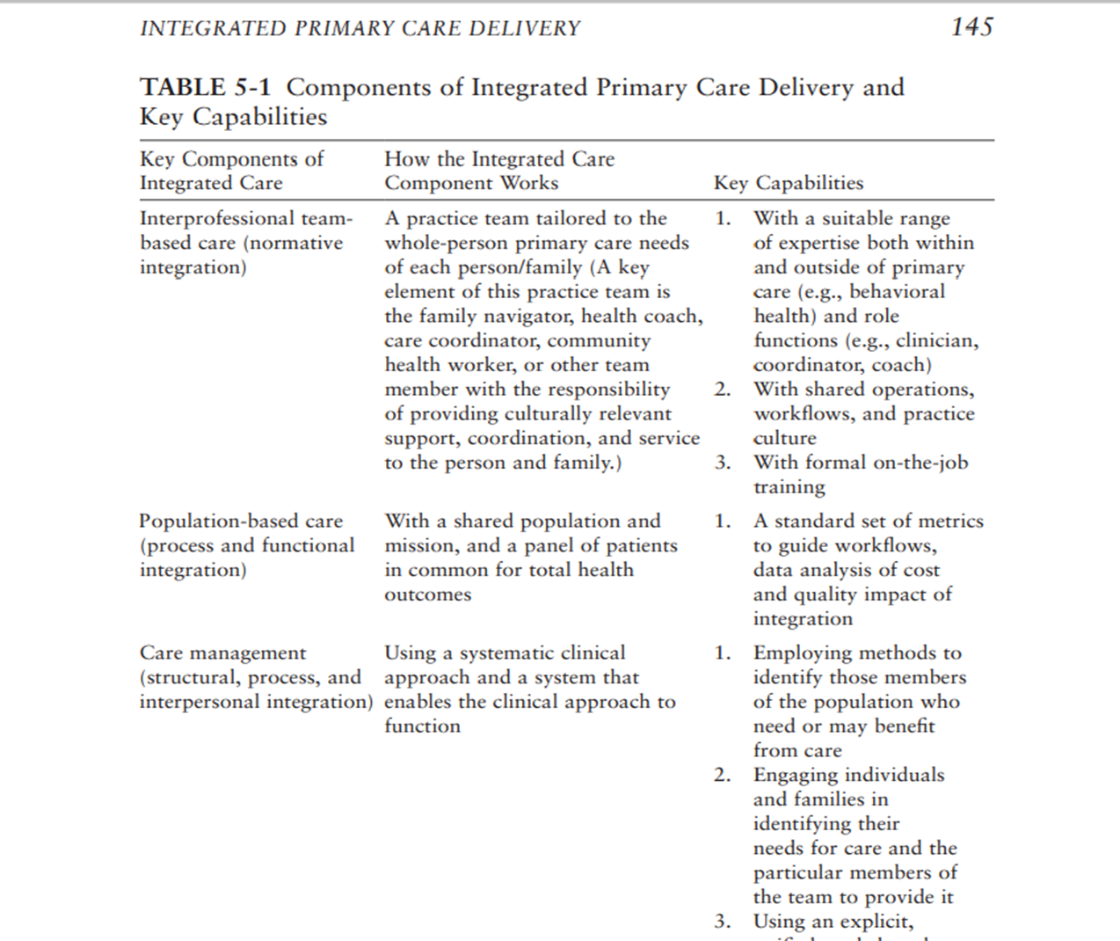
Concepts of Advanced Primary Care Delivery

Slide 7
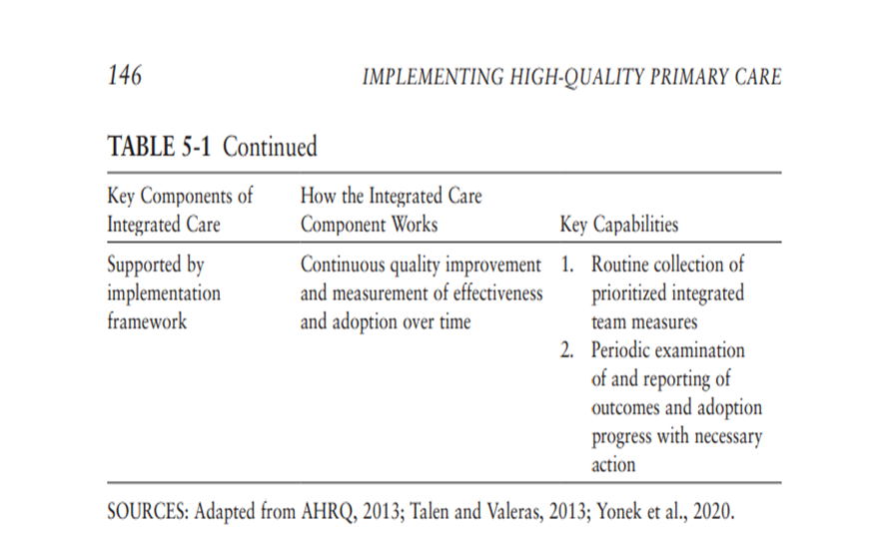
Concepts of Advanced Primary Care Delivery

Slide 8
ACCOUNTABLE CARE ORGANIZATIONS (ACO’S)
Roundtable with ACO’s
Tyler Blanchard, Aledade
Daniel Bair, Mercy Health
Daniel Elliott, Christiana Care
Anthony Onugu, United Medical LLC

Slide 9
PCRC Meeting schedule
Discussion on the upcoming meeting schedule
  Dr. Nancy Fan

Slide 10
Public comment

