Slide 1
Primary care reform collaborative
September 12, 2022

Slide 2
Virtual meeting- housekeeping
Public- please send your name, email contact, and organization affiliation (if applicable) to stephanie.hartos@delaware.gov or write in the meeting chat box.
Please keep your computer/phone on mute unless you are making a comment, and if you are not on visual, please identify yourself as well.
This meeting will be recorded for minutes

Slide 3
AGENDA
Call to Order
Approval of June 2022 Meeting Minutes
Presentation on Maryland’s Primary Care Payment Model (MDPCP)
  Dr. Howard Haft, Executive Director of the Maryland Primary Care Program
Collaborative Status Update
Update- PCRC Workgroups
  Quality Measures and Benchmarks- Cari Miller
  Payment and Attribution and Care Coordination- Dr. Nancy Fan
Update - Department of Insurance, Office of Value Based Health Care Delivery
Public Comment

Slide 4
Maryland’s Primary Care Payment Model (MDPCP)
Presenter: Dr. Howard Haft
Executive Director of the Maryland Primary Care Program

Slide 5
MDPCP Overview
Program Management Office
Maryland Primary Care Program
September 12, 2022

Slide 6


6
Notes:
2016 Survey
RESPONSES FROM THE STATE OF MARYLAND
Following are responses from the state of Maryland to a national survey of physicians commissioned by The Physicians Foundation and conducted by Merritt Hawkins. Of 17,236 survey responses, 301 were from physicians in Maryland. Responses of Maryland physicians are compared to all survey responses.

Slide 7
The Reasons Why We Act Now
US Healthcare costs per capita highest among all economically developed nations
US health outcomes near the bottom compared to other economically developed nations
Enormous disparities in access to high value care
Enormous disparities in health outcomes and quality
Declining primary care workforce
Burnout among healthcare workers higher than ever - particularly PCPs
Tsunami of chronic diseases and aging population approaching

Slide 8
Program Background

Slide 9
Planning and Execution Milestones
2015-2017: Stakeholder input during plans for Total Cost of Care Model
2016-2018: CMMI negotiations for APM and MDPCP
2019: initial launch single Medicare payer
2020: added CareFirst BC/BS commercial aligned payer
2021: added FQHCs as eligible providers
2022: added HEART (health equity) payments
2023: Track 3 added, anticipating Medicaid aligned payer (TBD)

Slide 10
Total Cost of Care Model (TCOC) Components
Program Background
Reduce Medicare expenditures by an annual run rate of $300m by 2023
Innovate hospital/provider partnerships
Gain credit for improving overall population health
Build a strong, effective primary care delivery system inclusive of medical, behavioral and social needs
Population Health Improvement credits
“Under this Model, CMS and the State will test whether statewide health care delivery transformation, together with population-based payments, improves population health and care outcomes for individuals while controlling the growth of Medicare Total Cost of Care”
Hospital Care Redesign programs
Improved Health for Marylanders
Hospital Population- based revenue
Source: Maryland Model Contract
Maryland Primary Care Program

Slide 11
Program Requirements & Payments

Slide 12
Medicare Payments to MDPCP Practices
Built on the framework of CMMI’s CPC+ Model
  HCC patient level risk adjusted quarterly care management payments
  Annual performance-based incentive payment- at risk
  HEART payments for patients with high HCC in high ADI areas
Added payments for “ Complex Care”
  Dementia
  Others possible based on absence in HCC calculation
Payments increased with progression from Track 1 to Track 2
  Payments in T1 & T2 approximately $26 pbpm above FFS
Payments (overall to program) remain at Track 2 level with progression to Track 3 – but all at risk except HEART

Slide 13
Payment Incentives in MDPCP Tracks 1&2
Program Requirements & Payments
Care Management Fee (CMF)
$6-$100 Per Beneficiary, Per Month (PBPM)
  Tiered payments based on acuity/risk tier of patients in practice
Timing: Paid prospectively on a quarterly basis, not subject to recoupment
Performance-Based Incentive Payment (PBIP)
Up to a $2.50/$4.00 PBPM payment opportunity
Must meet quality and utilization metrics to keep incentive payment
Timing: Paid prospectively on an annual basis, subject to recoupment if benchmarks are not met
Comprehensive Primary Care Payment (CPCP)
For Track 2 Practices only
Partial pre-payment of historical E&M volume with 10% bonus
Timing: Paid prospectively on a quarterly basis, not subject to recoupment
Health Equity Advancement Resource & Transformation Payment (HEART)
$110 PBPM for eligible benes

Slide 14
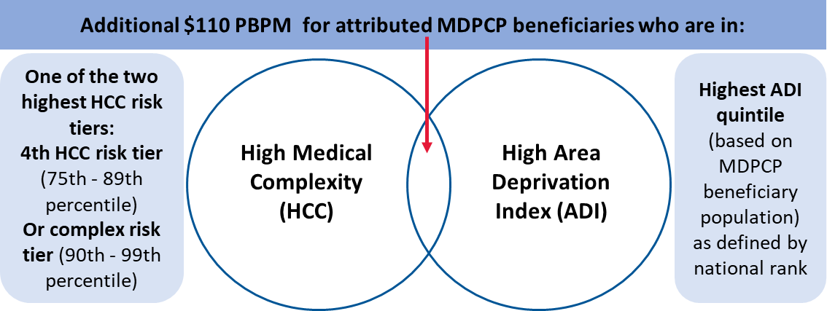
HEART Payment
Health Equity Advancement Resource and Transformation Payment (HEART) payment: All practices will receive CMFs. Some practices will also receive a HEART payment for eligible beneficiaries. Additional detail is on our website.

Slide 15
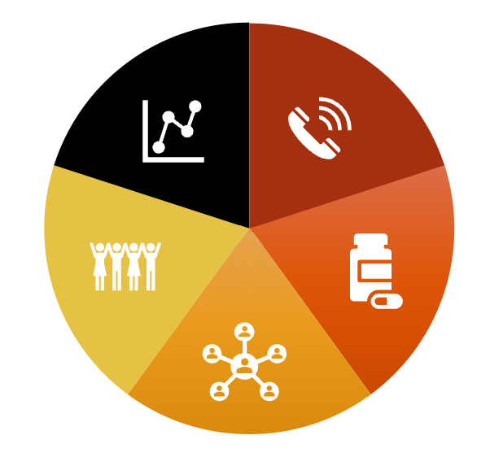
MDPCP’s Advanced Primary Care Requirements
Program Requirements & Payments
Care Transformation Requirements
Access & Continuity – Expanded Access | Alternative Visits (+Telemedicine)
Care Management - Risk-Stratification | Transitional Care Management | Longitudinal, Relationship-Based | Comprehensive Medication Management
Comprehensiveness & Coordination - Behavioral Health Integration | Social Needs Screening & Referral
Beneficiary & Caregiver Experience - Patient Family Advisory Councils | Advance Care Planning
Planned Care for Health Outcomes - Continuous Quality Improvement | Advanced Health Information Technology | CRISP

Slide 16
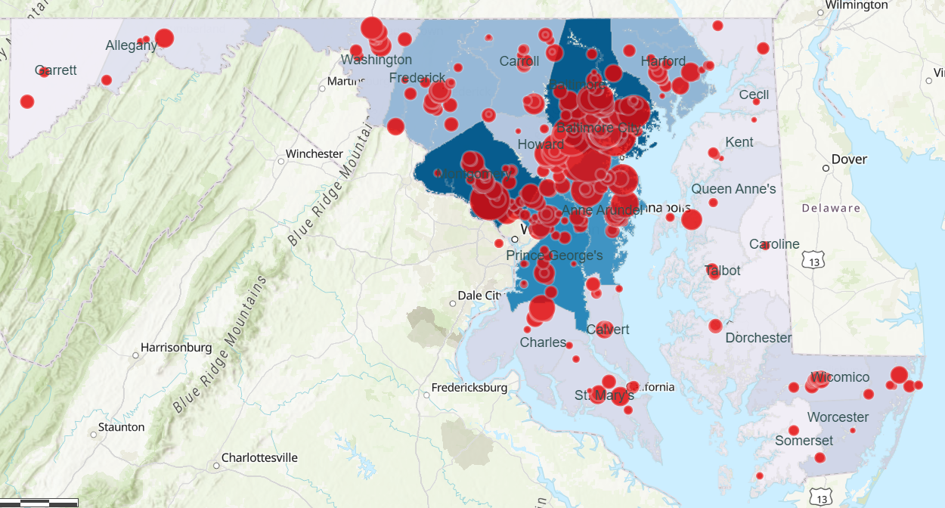

MDPCP in 2022
Program Background
Support infrastructure – 24 Care Transformation Organizations
Statewide –
Practices in every county
PARTICIPANTS | 2019 | 2020 | 2021 | 2022
Practice sites | 380 | 476 | 562 | 545**
Providers in MDPCP | ~1,500 | ~2,000 | ~2,150 | ~2,150
FFS beneficiaries attributed | 220,000 (28,717 duals) | 356,000 (45,031 duals) | 392,000 (60,000 duals) | 374,000
Marylanders served | 2,000,000 – 3,000,000* | 2,700,000 – 3,800,000* | over 4,000,000* | over 4,000,000*
** 545 sites – 7 FQHC organizations represent 44 site locations (508 official participants)
Notes:
already the nation's state-based largest advanced primary care program with more to come

Slide 17
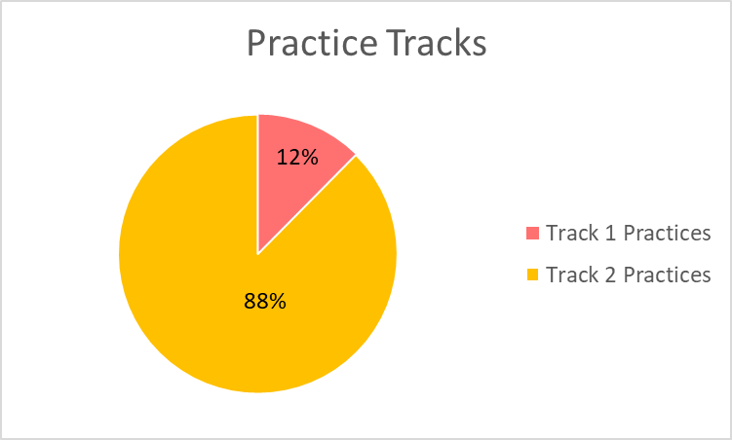
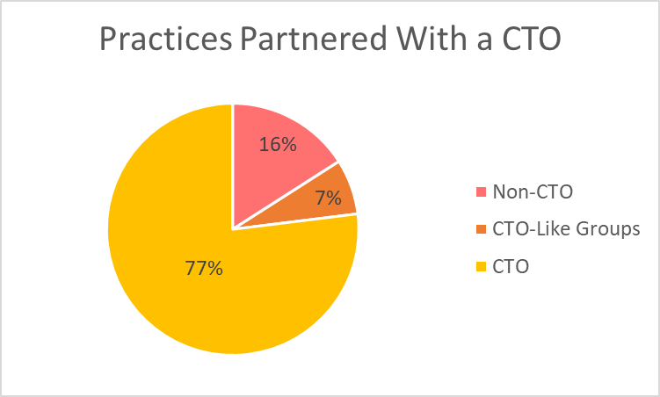
2022 MDPCP Practice Demographics
*New Track 3 beginning 2023
75% decrease in T1 practices from 2021 to 2022
80.5% increase in T2 practices from 2021 to 2022
Notes:
Practices that partner with CTOs share their Care Management Fees in exchange for assistance

Slide 18
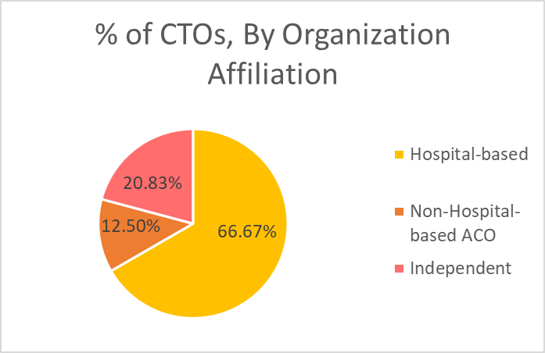



Care Transformation Organizations (CTOs)
Program Background
24 CTOs in total
Partnered with a few as 1 practice, and up to as many as 54 practices
16 are hospital-based CTOs that own or are closely affiliated with most of their partner practices
3 are non-hospital ACO-based and 5 are independent organizations
List of CTOs

Slide 19
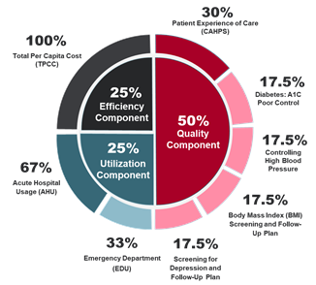
Performance Based Incentive Measures
Program Requirements & Payments
Clinical Quality measures aligned with State goals – Diabetes Control, Hypertension Control, BMI assessment and follow-up, and Depression assessment and follow-up
Patient engagement - CAHPS survey for clinicians and groups
Utilization that drives total cost of care - Inpatient hospitalizations and ED visits for Medicare FFS beneficiaries
Total Per Capita Cost - observed to expected (O/E) ratio of total Medicare costs, for Track 2 & Track 3 practices only.
*For T1 practices: the utilization component makes up 50% of PBIP and there is no TPCC measure

Slide 20
Overview of Tracks
Standard
Implementation of advanced primary care functions including expanded hours, risk stratification, care management and behavioral health integration
Payments
TRACK 1
Care Management Fee (CMF)
Performance-Based Incentive Payment (PBIP)
Standard FFS billing
Health Equity Advancement Resource and Transformation (HEART) (if applicable)
Advanced
Track 1 requirements + addition of offering of alternative care (e.g., telehealth) social needs screening and linkages, comprehensive medication management, and advance care planning
TRACK 2
CMF
PBIP
CPCP + FFS billing
HEART (if applicable)
Advanced with Upside & Downside Risk
Track 2 requirements + collection of demographics data, prioritizing health related social needs, & expanded alternative care requirements
PBP (subject to PBA)
Flat visit fee (subject to PBA)
Performance-Based Adjustment (PBA)
HEART (if applicable)
TRACK 3
Notes:
20

Slide 21
Track Transition Requirements
Track 1 to Track 2
Meet all Track 2 requirements
Track 1/2 to Track 3 , meet all Track 2 requirements, plus:
Identifying beneficiaries for self-management support
Comprehensive Medication Management (CMM)
Advance care planning
Prioritizing health-related social needs
Collecting patient demographics
Integrating PFAC recommendations into care & QI activities
*Full of Care Transformation Requirements available in Appendix 2 of the Request for Applications
Notes:
Alice

Slide 22




Strategically Enhancing Primary Care
INCREASE IN PRIMARY HEALTH CARE INVESTMENT
MDPCP payments added $26 PBPM to practices in 2021
Broad span with ~66% of all eligible primary care practices in multi-payer program
In kind contributions from State support
PRIMARY HEALTH CARE DASHBOARDS ON CRISP
Consistent monthly updates, including utilization data parsed by demographics
AI predictive tools to identify patients at risk for avoidable hospital events
Hospital and ED Event Notification System and clinical info access
RISK ADJUSTMENT AND EQUITY
By HCC score and ADI (HEART Payments)
COVID-19 Vulnerability Index, ADI-directed HEART payments
Bidirectional referrals to CBOs
CHWs, team based care, quality and utilization data parsed by demographics
PUBLIC HEALTH INTEGRATION
Leadership
Vaccines, testing, communications, therapeutics, and population health data
Education and training programs
Notes:
$26 PBPM

Slide 23
Beyond Medicare
CareFirst aligned payer
  Currently a shared savings payment under the CareFirst PCMH program
  Bonus for meeting quality and utilization metrics
  Cash payments for “care plans”
Medicaid
  Planned alignment beginning in 2023- details TBD
Other payers
Workgroup on Primary Care payments
  From 2022 legislative bill
  All payer
  Report to Governor and General Assembly in 2024

Slide 24

Thank You!
Check out the MDPCP website for updates and more information
Email mdh.pcmodel@maryland.gov with any questions or concerns
Any questions?
Notes:
Chad

Slide 25
Collaborative Status Update
Dr. Nancy Fan
  PCRC Chair

Slide 26
Collaborative Status Update
Overarching Concepts
Primary Care sustainability
Practice Transformation away from FFS to VB care/APM
  DOI regulation: Increase in PC payment for VB care, not just as increased payment within FFS
  Innovative models
Prior consensus:
  Patient centered
  NO increase in administrative burden

Slide 27
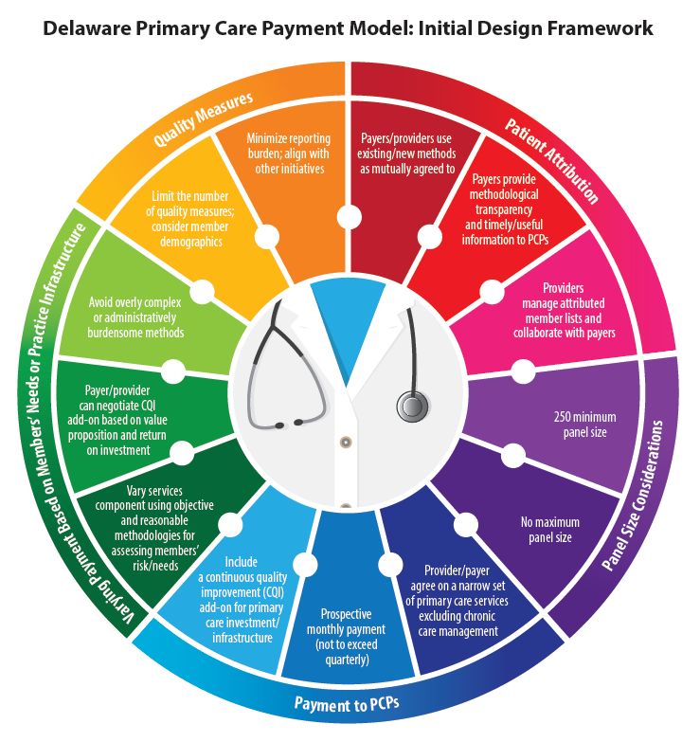
Payment and attribution workgroup recommendations
Review of previous recommendations
Payers provide transparency on how attribution is preformed, such as methodological descriptions, what data is used, frequency of updates, etc. No specific attribution style will be recommended.
Payers provide attributed member lists/rosters timely and in a manner conductive to use by PCP’s.
Minimum panel size of 250
No maximum panel size

Slide 28
Workgroup updates
Quality Measures and Benchmarks Workgroup
  Cari Miller, Chair

Slide 29
Quality measures and benchmarks workgroup
The Quality Measures and Benchmarks workgroup is the newest of the three PCRC workgroups
Workgroup has met three times so far:
  July 21st
  August 25th
  September 8th
The primary goals of this workgroup are to:
  Develop detailed quality metrics for Delaware’s new Primary Care Payment Model
  Determine metrics for DHCC to monitor provider compliance with value-based payment models
  Develop recommendations for a dashboard for monitoring provider compliance with value-based payment models

Slide 30
Quality measures and benchmarks workgroup- current recommendations
Measure Population
Colorectal Cancer Screening Adult
2. Breast Cancer Screening Adult
3. Hemoglobin A1c control (< or =9%) Adult
4. Statin Therapy for Patients with Diabetes Adult
5. Statin Therapy for Patients with Cardiovascular Disease Adult
6. Controlling High Blood Pressure Adult
7. BMI (Process Measure) Adult and Pediatric
8. Depression Screening Adult and Pediatric
9. Tobacco Screening and Cessation Intervention Adult
10. Well Visits Pediatric

Slide 31
Quality measures and benchmarks workgroup- additional recommendations
Additional Quality Metrics such as ED Utilization and Tobacco/Nicotine Screening and Cessation for adolescents are still being discussed within the workgroup.
The workgroup strongly recommends this list of Quality Metrics for the Model, understanding that the metrics can be modified based on the individual needs of payers and providers.
Recommend not increasing the number of metrics over 10.
Recommend that Year 1 be considered “Pay for Reporting” only.
Next meeting is scheduled for October 27th.

Slide 32
Workgroup updates
Payment and Attribution & Care Coordination Workgroups
  Dr. Nancy Fan

Slide 33
Payment and attribution workgroup
Last met on 9/6/2022
Discussed which E&M Codes should be include in the PMPM and how the payment should be determined
The PMPM should have a standardized base amount and not necessarily be negotiated between practice and payors.
Next meeting is scheduled for October 18th.

Slide 34
PAYMENT AND ATTRIBUTION WORKGROUP
E&M CODE RECOMMENDATIONS FOR BUNDLE
New or Established Patient Office or Other Outpatient Visit: 99201-99205 (New 10-60 Minutes) 99212-99215 (Established 10-40 Minutes)
Prolonged Patient Service or Office or Other Outpatient Service; 30-60 Minutes: 99354- 99355
Physician Telephone Evaluation 5-30 Minutes 99441 Physician Online Evaluation and Management Service 99444
Prolonged Patient Service Without Direct Patient Contact 30-60 Minutes: 99358-99359

Slide 35
Care coordination workgroup
Last met in a Joint workgroup meeting with Payment and Attribution in July.
Next meeting is scheduled for September 28th.

Slide 36
Update - Department of Insurance
Department of Insurance, Office of Value-Based Health Care Delivery (OVBHCD)
  Mary Jo Condon

Slide 37


Update on Implementation of SB 120 and Related Regulation
Office of Value Based Health Care Delivery (OVBHCD)
September 12, 2022
Mary Jo Condon, MPPA
Senior Consultant, Freedman HealthCare
Director of the DOI Office of Value Based Health Care Delivery

Slide 38
Overview of Legislation and Requirements
  Maintain Medicare Parity
    For Fee-for-Service and Non-Fee-for-Service Payments
  Increase Primary Care Investment as a Percentage of Total Spend
    2022 requirement = 8.5%
    Stairstep increases to 11.5% by plan year 2025
    Investment focused on DE residents and PCPs participating in care transformation
    Carriers should move 75% of DE PCPs into care transformation programs by 2026
  Limit Non-Professional Price Growth
    5.5% in 2023
  Expand Alternative Payment Model Adoption
    Carriers to transition to fixed payment methodologies for inpatient/outpatient facility services
    50% of total cost of care in shared savings contracts and 25% of total cost of care in shared savings contract with downside risk by 2023; only applies to carriers with 10k DE members

Slide 39
Updates
  Small Group Rate Review Process Complete
    Carriers committed to full compliance
    Projections anticipate primary care investment in excess of 8.5% for DE members attributed to providers in care transformation programs
    Projections show all carriers meeting price growth limit requirements for non-professional services
  Large Group Rate Review Process Underway
  DOI to Meet Quarterly with Carriers to Assess Progress
  Report to be Issued in Early 2023

Slide 40
Calculating Primary Care Investment
Claims-based payments for primary care (professional)
Claims-based payments for primary care (facility)
Non-claims-based payments for primary care
Primary care investment as a percent of total cost of care
Total claims-based payments for medical
(no Rx)
Total non-claims-based payments
Must be projected to equal 8.5% or more in 2023 for attributed patients of primary care providers engaged in care transformation.

Slide 41
Calculating Primary Care Investment
Data is for discussion only; Does not reflect any specific plan or an average.
Total Cost of Care (No Rx) | $550
Current PMPM Primary Care Investment (6.5%) | $36
Required PMPM Primary Care Investment in 2023 (8.5%) | $47
Difference (Additional PMPM Primary Care Investment) | $11
How might the additional primary care investment be spent?
FFS Increase | $3
Care Management/Infrastructure Payments | $5
Performance Incentive/Risk Sharing | $3

Slide 42
Increased Investment Requires PCPs to Engage in Care Transformation
  Focused primary care investment requirement designed to achieve robust system of primary care
  Carrier obligation is in aggregate across DE primary care providers; some providers will get more and some less
  Carrier obligation calculated based on total cost of care (medical only) for DE residents attributed to PCP participating in care transformation activities
    A carrier primary care incentive program;
    The Delaware Primary Care Model (in development)
    The National Committee for Quality Assurance Patient-Centered Medical Home certification program
    Any other standards as may be added by the Department and communicated annually to carriers by annual notice.

Slide 43

Defining Care Transformation
Team-Based Care
Planned Care at Every Visit
Active Use of Data
Effective Management of Referrals
24/7 Access
Integrated Behavioral Health
Integration with Social Services

Slide 44
Defining Care Transformation
Team-Based Care | Care is organized by teams responsible for specific patient panels; Care teams consistently implement team-based care strategies (huddles, care management meetings, high risk patient panel review, etc.)
Planned Care at Every Visit | Care teams consistently address physical AND behavioral health needs using shared operations, workflows, and formal protocols
Active Use of Data (patient empanelment, risk stratification) | Practice has and uses a documented strategy to identify care gaps and prioritize high-risk patients and families Practice achieves goal of defined percentage of patients empaneled to a high-functioning care team to provide and coordinate care
Integration of primary care with behavioral health | Actively uses an evidence-based screening tool for behavioral health concerns Has documented process for connecting patients/families with behavioral health resources following screening, including standing orders, and protocols for follow up Practice screens and follows up with patients/families for substance use disorder and/or other behavioral health needs.
Effective management of tests and specialist referrals | Practice routinely reviews all available cost data to identify utilization and cost drivers Practice has established workflows and protocols for shared decision-making including use of patient decision aids and self-management support tools Practice demonstrates basic ability to track referrals to consulting specialty providers
Integration of primary care with social services | Practice builds out capacity and documentation for care coordination strategies

Slide 45
Alignment with Delaware Primary Care Payment Model
Performance Incentives and Risk Settlements to Support Primary Care
Continual Quality Improvement Fee (e.g., infrastructure, care management)
Phase 1: Delaware Primary Care Payment Model
FFS Payments for Primary Care Services not
Included in Prospective Payment
Prospective Payment to Support Basic Primary Care E&M Services

Slide 46
Alignment with Delaware Primary Care Payment Model
All of these types of payments included in DOI definition of primary care investment
Carriers only required to spend 8.5% for attributed members of providers engaged in care transformation activities, such as those receiving Continual Quality Improvement Fee.
Performance Incentives and Risk Settlements to Support Primary Care
Continual Quality Improvement Fee (e.g., infrastructure, care management)
FFS Payments for Primary Care Services not
Included in Prospective Payment
Prospective Payment to Support Basic Primary Care E&M Services

Slide 47
Contact Us
Mary Jo Condon
Director, Office of Value-Based Health Care Delivery
Delaware Department of Insurance
mcondon@freedmanhealthcare.com

Slide 48
Public comment

Slide 49
Next meeting
Next PCRC Meeting
Virtual
Monday, December 12, 2022
4:00-6:00pm

