Slide 1
Primary care reform collaborative (PCRC) meeting
January 10th, 2022

Slide 2
Agenda
Welcome and Introductions
Review of Senate Bill 120 Purpose and Intent ─ PCRC Role
OVBHCD/DOI Role
DOI Summary Annual Report
High Level Review/Refresher of PC Concept Model ─ Common Feedback Themes
Subcommittees ─ Suggested Structure ─ Facilitated Discussion
Public Comment

Slide 3
Virtual meeting- housekeeping
Member attendance
Public- please send your name, email contact, and organization affiliation (if applicable) to stephanie.hartos@delaware.gov
Please keep your computer/phone on mute unless you are making a comment, and if you are not on visual, please identify yourself as well.
This meeting will be recorded for minutes

Slide 4
Welcome and introductions
Member Name | Position
Nancy Fan, MD | Chairperson
Senate Sarah McBride | Chair, Senate Health & Social Services Committee
Representative David Bentz | Chair, House Health & Human Development Committee
James Gill, MD, MPH | Member appointed by the Governor from a list of names provided by the Medical Society of Delaware
Rita Meadows, Ph.D. | Member appointed by the Governor from a list of names provided by the Delaware Nurses Association
Rose Kakoza, MD, MPH | Member appointed by the Governor from a list of names provided by the Delaware Healthcare Association
Deborah Bednar (Aetna) | Member representing insurance carrier, appointed by the Governor
Kevin O’Hara (Highmark) | Member representing insurance carrier, appointed by the Governor
Secretary Molly Magarik: Designee Steven Costantino | Secretary, Department of Health and Social Services- designated Steven Constantino, Director of Healthcare Reform, as Representation
Steve Groff | Director, Division of Medicaid and Medical Assistance
Commissioner Trinidad Navarro: Designee Mary Jo Condon | Insurance Commissioner, Insurance Department- designated Mary Jo Condon, Director of Office of Value Based Health Care Delivery, as today’s Representation
Faith Rentz | Chair, State Employee Benefits Committee
Maggie Norris-Bent (Westside) | Member representing a Federally Qualified Health Center, appointed by Governor

Slide 5
SS1 for SB 120: PCRC
Signed by Gov Carney 10/1/2021; sunset 1/1/2027
Broad Mandate for DHCC, in coordination with PCRC – mostly Sect 1-3:
  Monitor the update and compliance of PCP with VB care models
    Review and incorporate OVBHCD analyses of PC spend and affordability standards
    Solicit reports from payors and hospital and acute health care facilities
      Quality and utilization report regarding participating in APM models
      Demonstration of practice transformation support and evaluation of progress towards transformation model
      At least 60% of Delawareans attributed to meaningful VBM by 2025

Slide 6
SS1 for SB 120: PCRC
Signed by Gov Carney 10/1/2021; sunset 1/1/2027
Broad Mandate for DHCC, in coordination with PCRC – mostly Sect 1-3:
  Monitor the update and compliance of PCP with VB care models
    Review and incorporate OVBHCD analyses of PC spend and affordability standards
    Solicit reports from payors and hospital and acute health care facilities
      Quality and utilization report regarding participating in APM models
      Demonstration of practice transformation support and evaluation of progress towards transformation model
      At least 60% of Delawareans attributed to meaningful VBM by 2025

Slide 7
SS1 for SB 120: PCRC
Increase participation in APM which include quality and performance improvement requirements
Reward PC services which address health disparities and SDH
Quorum of Collaborative is a majority of members
  Members are as listed with proxy designee only for members
  serving by virtue of position

Slide 8
Up next: Office of Value Based Health Care Delivery with the Delaware Department of Insurance

Slide 9


Primary Care Reform Collaborative (PCRC) Update
Office of Value Based Health Care Delivery (OVBHCD)
January 10, 2022
Leslie W. Ledogar, Esq.
Consultant
Delaware, Department of Insurance
Mary Jo Condon, MPPA
Senior Consultant, FHC
Director of the DOI Office of Value Based Health Care Delivery

Slide 10
Office of Value Based Health Care Delivery
2019 Enabling Statute: Senate Bill 116 directed the Department of Insurance (DOI) to create the Office of Value Based Health Care Delivery (the “Office”) to:
"Reduce health-care costs by increasing the availability of high-quality, cost-efficient health insurance products with stable, predictable, and affordable rates."
2021 Expanded Authority: Senate Substitute 1 for Senate Bill 120 requires the Office to support DOI in implementing the rate filing provisions of SS 1 for SB 120 and develop regulations to further define these and other affordability standards.

Slide 11
Goals for Today
Share recent work of the Office
Update the PCRC on draft DOI regulations
Discuss next steps

Slide 12

Theory of Change
Unit price growth for certain services decreases
Primary care investment
increases
Alternative payment model adoption expands
Spending on preventable ED and hospital visits
decreases
Access to comprehensive primary care
expands
Incentives to provide appropriate care increases
Care delivery and patient outcomes improve

Slide 13
Principles for SS 1 for SB 120 Regulations
Focus on goal – Invest in a more robust system of primary care without increasing growth in total cost of care.
Build on existing work (e.g., existing carrier programs, participation in Medicare Shared Savings Program [MSSP])
Balance predictability with flexibility (e.g., evolving payment models, Delaware Primary Care Model not yet developed)

Slide 14
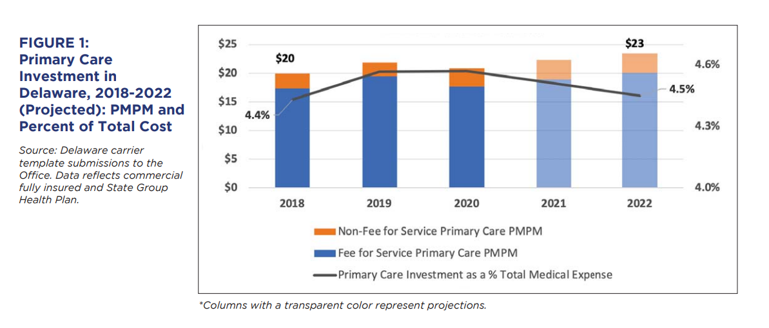
Primary Care Investment:
Current State
2021 AFFORDABILITY STANDARDS REPORT FINDINGS

Slide 15
Primary Care Investment:
Evaluating Medicare Parity (SB 227)
2021 MEDICARE PARITY REPORT FINDINGS
Carriers largely complied; challenges included application of certain business rules and changing CMS treatment of telehealth during pandemic
Under reimbursement totaled less than $260,000 across all carriers for both years
  2019: 0.5-0.9%
  2020: 0.8-1.7%
Primary care reimbursement increased 5.5% from 2017 to 2020
as a % of primary care spending

Slide 16
Primary Care Investment:
Requirements for 2022 and Beyond
HIGHLIGHTS OF SS 1 FOR SB 120 AND RELATED REGULATIONS
  Maintain Medicare Parity: Primary care providers must be paid for chronic care management and primary care services at a rate greater than or equal to Medicare
  Increase Primary Care Investment as a Percentage of Total Spend: Health insurance carriers must increase spending on primary care services according to the schedule defined in the statute.

Slide 17
Primary Care Investment:
Maintain Medicare Parity
HIGHLIGHTS OF SS 1 FOR SB 120 AND RELATED REGULATIONS
Commercial carriers will reimburse contracted primary care providers, their care teams and their organizations at least as much as Medicare pays for primary care and chronic care management services furnished to Delaware residents
Medicare payment is the floor, not an average
Applies to fee-for-service and non-fee-for-service

Slide 18
Primary Care Investment:
Increases as a Percent of Total Spend
HIGHLIGHTS OF SS 1 FOR SB 120 AND RELATED REGULATIONS
Rate Filing Year | Plan Year | Minimum % Total Cost of Medical Care Spent on Primary Care
2022 | 2023 | 7%
2023 | 2024 | 8.5%
2024 | 2025 | 10%
2025 | 2026 | 11.5%

Slide 19
Primary Care Investment:
Increases as a Percent of Total Spend
HIGHLIGHTS OF REGULATIONS
HIGHLIGHTS OF SS 1 FOR SB 120 AND RELATED REGULATIONS
  Primary Care Investment Definition:
  To be defined by Bulletin; similar to definition used in 2020 and 2021
  Numerator: Eligible fee-for-service and non-fee-for-service payments to primary care providers, care teams and organizations for primary care services performed in primary settings
  Denominator: Total medical expense as defined by professional, outpatient, inpatient, other medical in Unified Rate Review Template (URRT)

Slide 20
Primary Care Investment:
Increases as a Percent of Total Spend
HIGHLIGHTS OF REGULATIONS
HIGHLIGHTS OF SS 1 FOR SB 120 AND RELATED REGULATIONS
Population:
Attributed Delaware patients of contracted primary care providers, care teams and organizations participating in care transformation activities including:
    A carrier primary care incentive program;
    The Delaware Primary Care Model
    The National Committee for Quality Assurance Patient-Centered Medical Home certification program as detailed at NCQA.org; or
    Any other standards as may be added by the Department and communicated annually to carriers by annual notice.
Carriers should aim to have 75% of providers in a program by 2026

Slide 21
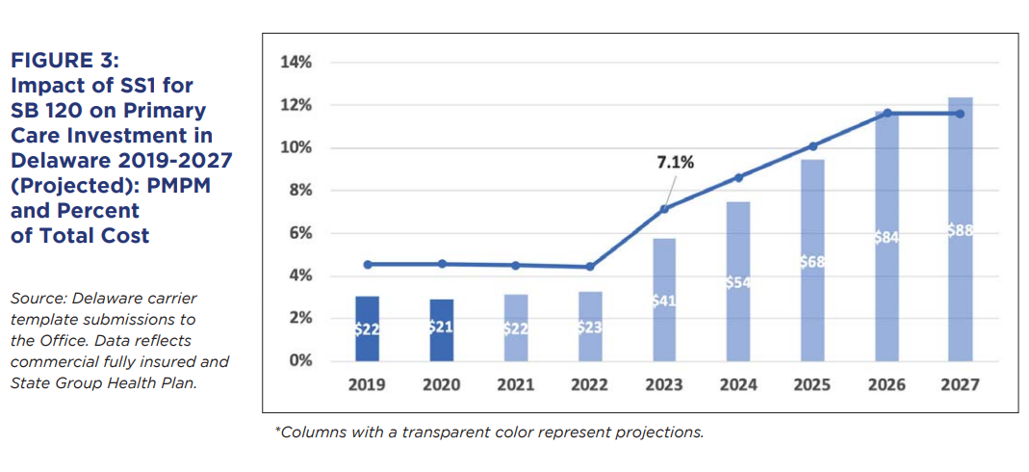
Primary Care Investment:
Projections Under SS 1 for SB 120

Slide 22
Primary Care Investment:
The Opportunity for Better Care
Comprehensive primary care expands
Care delivery and patient outcomes improve
Total cost of care
decreases
Team-Based Care
Prompt Access to Care
Planned Care at Every Visit
Patient Empanelment, including risk stratification
Active Use of Data
Integration of primary health care with behavioral health and social services
Effective management of tests and specialists’ referrals
Patients with acute conditions access care promptly, conveniently
Patients with complex needs are identified, engaged and supported in achieving their best health
Patients access coordinated care to address medical, social and behavioral needs
Patients access appropriate care at high value sites of service
Potentially-avoidable ED and urgent care visits decrease
Ambulatory Care Sensitive admissions decrease
Total cost of care for patients with behavioral health needs decreases
Use of low value care and high-cost care sites decreases
Primary care investment
increases
Alternative payment models support appropriate care

Slide 23
Primary Care Investment:
The Opportunity for Savings
2021 IMPACT MODEL REPORT FINDINGS
Savings Category | Percent Savings Applied | Savings
Reduced Use of ED and Urgent Care for Minor, Acute Needs | 15% of potentially avoidable costs | $743,643
Reductions in Ambulatory Care Sensitive Admissions and ED Visits | 10% reduction in costs for ASC admissions | $1,407,092
Integrated Behavioral Health | 5% reduction in all medical costs for individuals with BH diagnosis | $14,277,511
 | 5% of hospital outpatient
Increased Use of Lower Cost Sites of Service |  | $20,985,593
Total Savings |  | $37,413,839 or 3% TME
Total Savings
DRAFT DISCUSSION ONLY

Slide 24
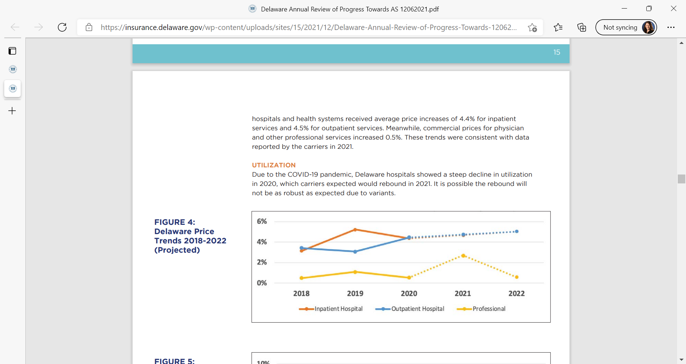
Price Growth:
Current State
2021 AFFORDABILITY STANDARDS REPORT FINDINGS

Slide 25
Price Growth:
Requirements for 2022 and Beyond
HIGHLIGHTS OF REGULATIONS
HIGHLIGHTS OF SS 1 FOR SB 120 AND RELATED REGULATIONS
Limits: Carrier rate filings must not include aggregate unit price growth for nonprofessional services that exceeds the greater of:
  3% or Core CPI plus 1% for rates filed in 2022 for 2023 plan year
  2.5% or Core CPI plus 1% for rates filed in 2023 for 2024 plan year
  2% or Core CPI plus 1% for rates filed in 2024, 2025, and 2026
Lookback period: Core CPI = average of previous three years
Services included: Non-professional services include inpatient, outpatient and other medical services as defined by the Unified Rate Review Template (URRT)
2.4% (through November 2021) + 1% = 3.4%

Slide 26
Price Growth:
Limits in Context of Previous Growth
2021 AFFORDABILITY STANDARDS REPORT FINDINGS
3.
3.4%

Slide 27
Alternative Payment Model Adoption: Reimbursement Framework
HIGHLIGHTS OF SS 1 FOR SB 120 AND RELATED REGULATIONS
By 2023, carrier rate filings will reflect fee schedules and reimbursement structures for inpatient and outpatient hospital facility services delivered in Delaware based on a fixed payment, episode-based or population-based payment methodology (e.g., not a percent of charges), including but not limited to:
  Diagnosis Related Groups (DRGs) for inpatient facility care, and
  Ambulatory Payment Classifications (APCs) for outpatient facility care

Slide 28
Alternative Payment Model:
Reimbursement Framework
Why include this movement to a new reimbursement framework?
Movement to these types of payments for inpatient and outpatient care is associated with increased efficiency and transparency
Addresses the complexity and inflationary nature of percent of charges reimbursement
Payment based on these methodologies has become commonplace in other states with good results

Slide 29
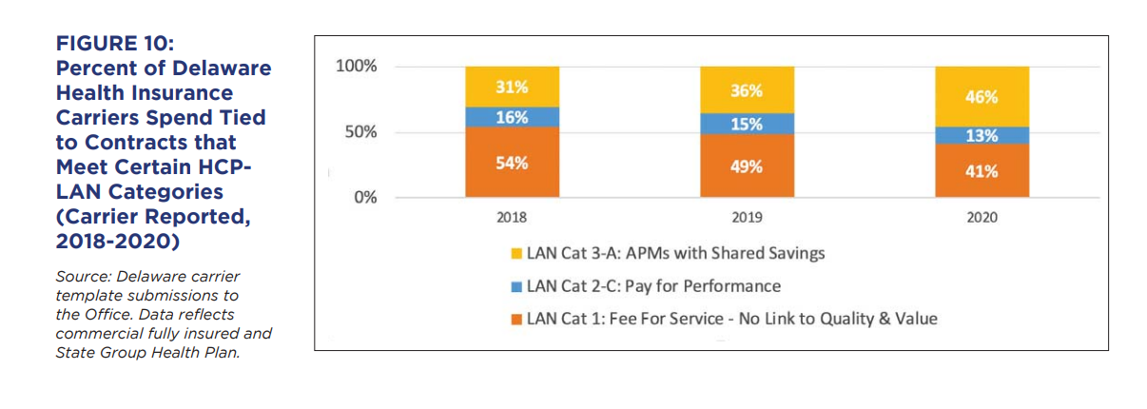
Alternative Payment Model Adoption:
Current State
2021 AFFORDABILITY STANDARDS REPORT FINDINGS
METHOD 1:

Slide 30
Alternative Payment Model Adoption:
Current State
2021 AFFORDABILITY STANDARDS REPORT FINDINGS
METHOD 2:
The second method measures non-fee-for-service payments to providers. Data indicate that these payments have hovered around 1% of total cost of care, excluding pharmacy.

Slide 31
Alternative Payment Model Adoption: Total Cost of Care Accountability
HIGHLIGHTS OF SS 1 FOR SB 120 AND RELATED REGULATIONS
For large carriers (more than 10,000 Delaware residents across all fully-insured products)
Regulation provides details on minimum shared savings and downside risk requirements
Completely separate from and accountability is not required to receive increased primary care investment
Program design elements regarding risk corridors (i.e., minimum shared savings rate and minimum loss rate) and loss sharing limits should be consistent with the Medicare Shared Savings Program (MSSP) Pathways model.

Slide 32
Sunset Provisions
SS 1 for SB 120 calls for rate filing provisions to sunset January 1, 2027
However, OVBHCD is given explicit authority to implement Affordability Standards, which include cost growth limits and Alternative Payment Models (APMs). This authority does not sunset. Therefore, provisions in this regulation will stand beyond the sunset date of the Department’s rate making statute.

Slide 33
Enforcement
Monitor compliance through data provided by carriers (similar to current template and submitted with rate filing) and from the Delaware Health Care Claims Database (DHIN HCCD);
Allows public reporting on compliance by carrier
Enforcement may include market conduct exam to review carrier contracts with health care providers
Noncompliance – rate filing failure to reflect requirements, lack of response, failure to achieve minimums in this regulation
Actions include requiring refiling, corrective action plan, carrier-specific monitoring requirements, fines via standard administrative procedure

Slide 34
Target Effective Date: March 11, 2022
Activity | Deadline
Publication in Register | January 1, 2022
Public Comments Due | January 31, 2022
Adoption Order Filed with Registrar | February 15, 2022
Registrar Publishes Regulation in Register | March 1, 2022
Regulation Effective Date | March 11, 2022
Issue Bulletin with instructions and templates | March 15, 2022
Carrier submissions due with Rate Filings | July 23, 2022*
*7/23 was 2021 rate filing date; may be different for 2022 rate filings

Slide 35
Recent Reports by OVBHCD
Office of Value Based Health Care Delivery (OVBHCD) - Delaware Department of Insurance - State of Delaware
Annual Review of Carrier Progress Towards Meeting Affordability Standards
Investment in Comprehensive Primary Care: Unlocking the Savings in Delaware
Delaware Primary Care Reimbursement: Evaluating Parity with Medicare Rates
All can be found on the Office's web page.

Slide 36
Contact Us
Mary Jo Condon
Director, Office of Value-Based Health Care Delivery
Delaware Department of Insurance
mcondon@freedmanhealthcare.com

Slide 37
Appendix

Slide 38
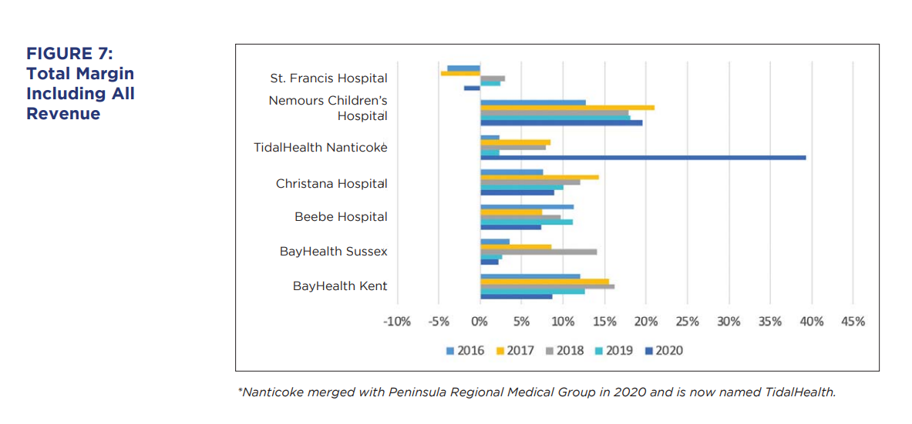
Delaware Hospitals’ Total Margins

Slide 39
Delaware Hospitals’ Net Assets
Across all Delaware hospitals from 2011-2020:
Total Discharges increased 22%
Total Net Assets increased 176%
Source: National Academy for State Health Policy’s Hospital Cost Tool Analysis Summary of Delaware Acute Hospitals 2011-2020

Slide 40
Delaware Hospitals’ Payer Mix Adjusted Profit or Loss
From 2011 to 2020, commercial hospital profit margins never fell below 15% profit margins, according to the NASHP analysis.
Source: National Academy for State Health Policy’s Hospital Cost Tool Analysis Summary of Delaware Acute Hospitals 2011-2020

Slide 41
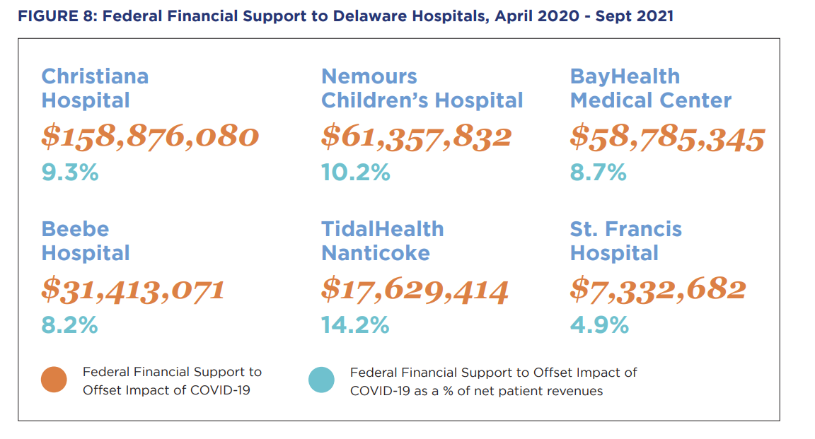
Federal Financial Support
to Delaware Hospitals

Slide 42
Alternative Payment Model Adoption: Total Cost of Care Accountability
Detail on minimum shared savings arrangements in the regulation
 | Category 3A Shared Savings | Category 3B Shared Savings and Downside Risk
 | At least 50% of carrier business | 25% of carrier business
Proposed Regulation defines minimum threshold for total cost of care accountability by 2023
 | Accountable Care Organization (ACO) and Carrier Risk Sharing Arrangement
 | High Revenue ACOs (health systems) | Low Revenue ACOs (physician groups)
Plan Years 2023 & 2024 | 30/70 | 15/85
Plan Year 2025 | 40/60 | 20/80

Slide 43

Primary Care Concept Model
Placeholder for optional client logo
The Plan and Overview
State of Delaware
January 10, 2022
Presenters: Liz Collins, Cindy Ward, and Scott Banken

Slide 44

01
PC Concept Model Overview
02
ACO and Health Plan Feedback Themes
03
Subcommittees
Agenda

Slide 45
365 Days Action Plan
Six Phases to Develop the PC Concept Model into an Operational Model
PCRC Meeting
Identify subcommittee members
Review SS1/SB120 Legislation
Review mandate and charter objectives of PCRC
Feedback from ACOs and Payers
Develop a plan
60–90
Days
Develop charter for subcommittee members
Stakeholder development and adoption
Collaborate on strategy to roll out PC Concept Model
Determine metrics and measures to implement
Create timeline and identify key milestones
Full engagement with payers and teams
Working towards key milestones
PCRC approval of the payment model
First 30
Days
30–60
Days
90–120 Days
120–180
Days
180–365 Days

Slide 46





Objective for PC Concept Model Development
  Provide support for all Delaware PCP practices, including small independent practices
Primary Care Concept Model
  Adopts a new base payment model that frees clinicians from the financial imperative to generate visit volume, allowing them to deliver services in a flexible way that best addresses patient needs
  Rewards high-quality care and promotes performance accountability
  Bolsters PCPs’ capacity to provide care coordination to patients
  Supports providers in adopting tools and strategies to become
  high-performing practices
Notes:
Liz

Slide 47

PC Concept Model Overview
1

Slide 48

Transformation Objectives for Primary Care Practices
02
01
Commitment to practice transformation
Prompt access to care
03
Primary health, behavioral, and social integration
Planned care at every visit
08
04
Effective management of referrals
Team-based care delivery
07
Use of data to manage and improve health
Patient empanelment, with risk stratification
05
06
06
Notes:
As we looked at solutions we wanted to align the solutions with drivers of preventable and avoidable ED visits.
This is not an exhaustive list of drivers but a view of drivers that appear more frequently in the literature. We consistently see convenience and primary care access and availability probably the two most common drivers mentioned.
Based on discussions in the Workgroup, we do not believe these drivers will surprise anyone on the call.

Slide 49



PC Concepts Model Elements
1
2
3
Alternative payment model
Community
health teams
Care delivery
requirements
and provider support
Notes:
Cindy

Slide 50

Element 1
Alternative Payment Model Options
Model A
Prospective payment
A prospective PMPM payment for the most common primary care services, regardless of the volume of services provided.
Model B
Blended prospective payment
A reduced prospective PMPM payment, along with a diminished FFS payment, for the common primary care services provided.
In both models, FFS payment is retained for those services not included in the prospective payment rate.

Slide 51
Element 2
Community Health Teams
Community Health Team Lead
Community Health Worker
Nurse
Social Worker
Other – Peer Support, Doulas, Promotores, etc.
Locally-based, multi‑disciplinary teams, who coordinate care and help manage patient’s complex illnesses across providers, settings, and systems of care.
Support a robust primary care system and expand capacity.
Avoid duplication of effort, minimize patient confusion and provider burden of having to deal with multiple care managers to serve the same patient’s care needs.
Notes:
Centralized community resource that could be deployed to practice sites on an as‑needed basis. Designed primarily for the use of small, non-hospital-owned primary care practices.
Priority given to small practices that lack the infrastructure and supports to effectively coordinate patient care.
Pilot efforts supported by insurers would be coordinated to encourage the development of regional CHTs that work with all interested payers. Ideally funded on a multi-payer basis
Payment could be on a PMPM basis and risk-adjusted.

Slide 52
Element 3
Care Delivery Requirements and Provider Support
Need for Transformation
Readiness Assessment
Transformation Support
Competence Criteria
  Primary care practices would need practice transformation support to meet advanced primary care practice requirements.
  Primary care readiness assessment could be implemented to determine practice capability for implementing practice transformation to support the model.
  Carriers/MCOs could implement practice transformation initiatives, helping practices build necessary skills needed to function as an advanced primary care practice.
  Provide criteria for practices that cannot afford NCQA Patient-Centered Medical Home recognition, to show competence with essential transformation skills and to support primary care transformation efforts through a multi-year plan.

Slide 53
ACO and Health Plan
Feedback Themes
2

Slide 54
Element 1
Alternative Payment Model
Providers desire prospective care coordination fee as a component of the APM
Mix of PMPM and FFS is desired
Options within the PMPM and FFS model may be attractive to providers (e.g., 3 Tiers with PMPM amounts increasing as percentage increases)
  Tier 1: 30% PMPM/70% FFS
  Tier 2: 50% PMPM/50% FFS
  Tier 3: 75% PMPM/25% FFS
If total cost of care calculation methodology is used then the services included must be clearly defined
Some level of upfront capital investments to build readiness should be considered
Prospective payments are more appealing to providers in shared savings models; although end of period reconciliation can feel like a penalty
PMPM should be risk-adjusted
Up-front costs to offset added level of risk for PCPs taking on new care management duties
Guaranteed funds or a blended model that would give an increased PMPM
APM should cover infrastructure costs to make it more appealing to providers
Model should include incentives, shared savings and/or quality bonuses
Member attribution should be aligned with other models if possible and clearly defined
Minimum panel size must be considered — PMPM value only exists for providers with enough membership to make the model financially attractive

Slide 55
Element 2
Community Health Teams
Quality metrics are a pain point and may need to be revised and updated yearly
Support for small and independent Primary Care practices
ACOs have generally adopted a mix of staff for their care coordination including social workers and community health workers
Some ACOs have moved to more specialized care coordination that focuses on key chronic conditions management
  Behavioral health conditions
  Advanced diabetes care
  Maternal health
  CHF
  COPD
  And those at high-risk for admissions/readmissions
Ownership and management of the CHT must be determined
Screening for social determinants to understand who needs resource supports
How are the CHT paid for and by whom?
Determine how to avoid duplication of efforts for care management of members

Slide 56

General Feedback
Provider-led ACOs may need additional support to transform the practices
Quality Measures
  Need to limit the number of quality measures in the model (somewhere between 10–20 was most commonly suggested)
  Allowing providers to determine the set of quality measures and benchmarks will improve buy-in
  Allowing providers to select quality measures in their VBP arrangement from a master-set of allowed measures is desired
  Identifying quality measures that improve and address health disparities may be desired
Workforce development, and attracting physicians to market should be a goal of the model
Actionable, reliable, and timely data are consistent challenges for providers
  Too much data is noise and not actionable in daily practice
  Late data generally has lost its value

Slide 57

Subcommittees
3

Slide 58




Subcommittee Recommendations
Frequency of Meetings: At least monthly, but can be established by subcommittee
Minimum/Maximum Participants: 5–7 per subcommittee
Nomination/Appointment Approach: Submit to DHCC (stephanie.hartos@delaware.gov) by February 1, 2022
Initial Subcommittees
Future Subcommittees
Payment and Attribution
Quality Measures and Benchmarks
Care
Coordination
Practice Transformation Support
Data and Information Sharing
PCP practice-based finance SME(s)
Payer Provider Network SME(s)
Payer financial SME(s)
PCP practice-based quality SME(s)
Payer Quality SME(s)
PCP practice-based clinical coordinator(s)
Payer care coordination SME(s)
SDOH SME(s)
TBD
TBD
Notes:
Talking Point: Consider whether or not we should include a beneficiary experience SME

Slide 59
Services provided by Mercer Health Benefits LLC.

