Slide 1
Primary care reform collaborative
MARCH 13, 2023

Slide 2
Virtual meeting- housekeeping
Public- please send your name, email contact, and organization affiliation (if applicable) to stephanie.hartos@delaware.gov or write in the meeting chat box.
Please keep your computer/phone on mute unless you are making a comment, and if you are not on visual, please identify yourself as well.
This meeting will be recorded for minutes.

Slide 3
AGENDA
Call to Order
Introduction of New PCRC Members and Vendor Staff
Approval of December 2022 Meeting Minutes
Senate Bill 31- Update
Utilization of Telehealth to Expand Access
Department of Insurance Office of Value Based Health Care Delivery
NASEM Recommendations
Public Comment

Slide 4
Introductions
New PCRC Members
  Representative Melissa Minor-Brown
    Chair of the House Health & Human Development Committee
  Theodore Mermigos
    Interim Director for the Division of Medicaid & Medical Assistance (DMMA)
New PCRC Vendor
  Health Management Associates (HMA)

Slide 5
DECEMEBER MEETING MINUTES
Vote on December 12, 2022 Meeting Minutes

Slide 6
UPDATES
Senate Bill 31
  Senator Bryan Townsend

Slide 7
UPDATES AND DISCUSSION
Utilization of Telehealth to Expand Primary Care Access
  Dr. Jim Gill

Slide 8
Telemedicine – Opportunities and Pitfalls
Delaware PCRC
3/13/23
James M. Gill, MD, MPH

Slide 9
What is telemedicine?
Virtual visits – via online platforms
    Designed for medical care (MEND, UpDox)
    Or nonspecialized platform (Zoom, Facetime)
    Can also be audio without video

Slide 10
Why telemedicine?
Increased access
Convenience - can do on lunch hour at work, at home with kids
Reduce time for travel, waiting room
Some patients more comfortable – e.g., certain behavioral health issues

Slide 11
Evidence for benefits of Telemed
Issue of JABFM May 2022 devoted to studies on Telemed in primary care
Generally found improvements for access, especially for rural, vulnerable populations
Found benefits for chronic conditions when no exam or specimens are needed
Studies assume telemed to be an adjunct to primary care in a clinic

Slide 12
My Experience
My office started Telemedicine in 2016
Delaware passed a law requiring payers to pay for telemed equivalent to in-person
    Made telemed feasible for practices
Good option for certain situations, to facilitate care
    Follow-up of behavioral health problems, follow up for review of abnormal labs, some routine monitoring of diabetes or HTN.

Slide 13
Pre-Pandemic
At first, only about 2 percent of visits were virtual – both patient choice and clinician familiarity.
Over 3 ½ years pre-pandemic, increased to about 5 percent
The pandemic changed all that.
During first six months of pandemic, virtual visits increased to about 60% of total we never closed the office, reduced hours or staff
Gradually went back down – now at about 20% of visits

Slide 14
But in many cases, telemedicine represents most or almost all care
So have we gone too far?
Many experts asking that
    Canadian article in Health Mgmt. Forum: “Virtual care: Enhancing access or harming care?”
I see specialists doing large majority virtual visits
When I send to a pulmonologist or rheumatologist and the patient says the specialists only every sees them virtually, it dramatically diminishes the value of the specialty care.

Slide 15
How about for primary care?
What percent of primary care is appropriate for virtual visits?
Study by AAFP Graham Center found that 36% of primary visits are appropriate for virtual care.
    Jabbarpour Y, Jetty A, Westfall M, Westfall J; Not Telehealth: Which Primary Care Visits Need In-Person Care? J Am Board Fam Med; 2021 34(Suppl):S162-S169.
This rings true

Slide 16
Why is too much telemedicine not a good thing in primary care?
Primary care is rooted in relationship and trust
“4 C’s”:
  First contact care (access)
  Coordinated care
  Continuity of care (not just knowledge, but relationship and trust)
  Comprehensive care
Virtual visits are likely to improve access but diminish comprehensiveness and probably continuity if used too much.

Slide 17
Importance of comprehensive care: Having the same doctor or other clinician caring for acute problems, chronic care and preventive care is key to primary care
Comprehensiveness promotes continuity and trust
We know that higher primary care continuity promotes lower costs and hospitalizations
  Trust in primary care clinician has been shown to be key in improving outcomes and reducing costs (K Lin, AnnFamMed 2021)
Continuity is diminishing
PCC/AAFP Graham Center study found the number of Americans with a usual source of care has dropped 10 percent in the last 18 years
  Bazemore A, Petterson S, Peterson LE, Bruno R, Chung Y, Phillips RL Jr. Higher primary care physician continuity is associated with lower costs and hospitalizations. Ann Fam Med 2018;16(6):492-7.

Slide 18
Acute problems: virtual sometimes appropriate.
In our clinic, if a mom calls for a sick child, we can sometimes start virtually – if we need to look in their ears, you bring them into the office.
During covid, very common to start virtually, but if need to listen to their lungs or do an oxygen level, you bring them into the office.
Should be the same person who saw them virtually – occasionally different person if necessary, but HUGE disadvantage.

Slide 19
Chronic Care
Many chronic can be managed at least partly with virtual care
HTN – home BPs are now recommended for monitoring but you can’t listen to their heart to detect edema or atrial fibrillation
Diabetes – mostly lab monitoring and counseling but cannot test sensation with a monofilament test
Also, much if not most chronic care has some acute care with it (BTW, can you look at….?)

Slide 20
Preventive Care
Sometimes do Medicare Wellness Visits virtually – patient has to be able to measure their own height and weight and blood pressure.
Cannot do other physical exam, cannot do well child visits
Difficult to detect when elderly patient has difficulty getting out of chair
And similar to chronic care, preventive care has some acute care with it (BTW, can you also look at….?)

Slide 21
So what is the right balance?
Article in Health section of Harvard Business review suggests a mixed model
In person care, with virtual option when needed (ideally with one’s primary clinician)
    Licurse A, Fanning K, Laskowski K, Landman A; Balancing Virtual and In-Person Health Care, November 17, 2020
This is probably ideal for vast majority

Slide 22
Other models of Telemedicine
Telemedicine urgent care
    Has been around for long time, similar benefits and pitfalls to in-person urgent care
Virtual-First
    Some in-person care available
Virtual-Only
    We will hear about that today
While these may work for some populations (e.g., those who don’t need or cannot access good primary care), they risk harmful effects if done in inappropriate populations

Slide 23
Summary:
Telemedicine is an excellent adjunct
    can increase access, convenience
    Key is “adjunct” – Health care (especially primary care) is about people, rooted in trust and relationship.
Pitfalls: When we lose sight of the “personal”, reduce continuity and comprehensiveness
When patients cannot see their primary care clinician in person if desired or needed

Slide 24
UPDATES
ChristianaCare and Highmark Health: Virtual Primary Care Program
  Dr. Rose Kakoza, Dr. Vishal Patel, and Sharon Anderson

Slide 25

Affordability Standards 2023:
Challenges & Opportunities
March 2023
Cristine Vogel, MPH Mary Jo Condon, MPPA
Director, Office of Value-Based Health Care Delivery Principal Consultant, Freedman Health Care

Slide 26
Current State
Agenda
Our structural issues remain our challenge…it will r
2023 Primary Care Investment: Projections & Challenges
Hospital and Provider Reimbursement: Challenges
Potential opportunities to move value-based care forward

Slide 27
2023 Primary Care Investment Projections
Highlights:
2023 projections show 7% Primary Care Investment of Total Medical Spend ($40 million), total population
Non-FFS primary care spend is projected at $11 million, an $8 million increase from 2022
Non-FFS PMPM increased from $3 to $11 (2022 and 2023 respectively); for members attributed to care transformation, up to $29 PMPM

Slide 28
2023 Primary Care Investment Projections
When all Non-FFS spending ($15 m) is compared to the Total Medical Spend ($622 m), it is a little over 2%, which reduces the potential for comprehensive change this year

Slide 29
2023 Primary Care Investment: Challenges
Other commercial includes:
Self-insured
State employees
Federal employees
Non-DE sitused fully insured
Fully-insured
Sources: OVBHCD ASDS Templates (Fully-Insured)
Kaiser Family Foundation (Medicare, Medicaid, Military, Uninsured)
US Census Bureau (Other Commercial)

Slide 30
2023 Primary Care Investment: Challenges
Key Challenges:
Fully-insured portion is relatively small
Carriers with low membership reluctant to design value-based programs
Provider practices with low attributed members reluctant to invest in value-based infrastructure
Lack of multi-payer program alignment (e.g., care delivery, payment, etc.)
  DE Model opportunity
Other commercial includes:
Self-insured
State employees
Federal employees
Non-DE sitused fully insured
Fully-insured
Sources: OVBHCD ASDS Templates (Fully-Insured)
Kaiser Family Foundation (Medicare, Medicaid, Military, Uninsured)
US Census Bureau (Other Commercial)

Slide 31
2023 Primary Care Investment: Challenges
FULLY-INSURED PORTION TOO SMALL TO DRIVE CHANGE ALONE
SELF-INSURED MAY LACK ACCESS TO “ALIGNED VALUE-BASED” CARE
SEPARATE HOSPITAL/PHYSICIAN FEES FOR SELF AND FULLY INSURED UNDER CONSIDERATION
Key Challenges:
Hospital price growth cap (CPI+1) would apply to only fully-insured and not self-insured
Carriers and providers would need to re-think care delivery approach
Bifurcating the market will add administrative burden

Slide 32
Hospital and Provider Reimbursement: Challenges
RAND reports disparities in Professional versus Hospital pricing
as a percent of Medicare
Commercial hospital prices in DE are among the highest in the nation
    281% of Medicare rates for inpatient facility services
    369% of Medicare rates for outpatient facility services
    Delaware ranks 11th in the nation for inpatient facility prices and 9th in the nation for outpatient facility prices
DE physician prices averaged 115% of Medicare, ranking it the lowest in the nation
Source: RAND, Supplemental Report, 2022

Slide 33
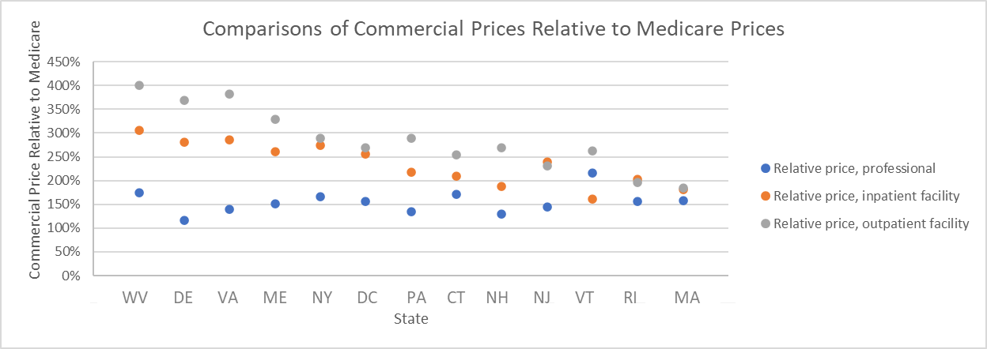
Disparities in Professional versus Hospital Pricing
Key Challenges:
Results in lower compensation for physicians and other clinicians
Carriers report they lack negotiating power as all hospitals are “must haves” in their regions of the state
Increases total cost of care

Slide 34
Current State
Potential Opportunities
Our structural issues remain our challenge…it will r
Consider ways to include additional payer types and funding mechanism (e.g., Medicaid, self-funded)
Consider expanding OVBHCD’s ability to require financial amounts within categories of Non-FFS activities or how investment is spread across providers
Consider policy options to enhance physician fee-for-service reimbursement (avoid Medicare parity from being ceiling)
Consider creative solutions for carriers with low membership counts to offer non-FFS programs
Consider opportunities to provide certain care transformation activities in a more “centralized” manner (for smaller practices)

Slide 35
UPDATES AND DISCUSSION
NASEM Recommendations
  Dr. Nancy Fan

Slide 36
Primary Care Scorecard
Follow up to NASEM recommendations
Primary Care Reform Collaborative: March, 2023

Slide 37
An Updated Definition of Primary Care
High-quality primary care is the provision of whole-person, integrated, accessible, and equitable health care by interprofessional teams that are accountable for addressing the majority of an individual’s health and wellness needs across settings and through sustained relationships with patients, families, and communities.
Notes:
This definition reflects key societal and sector shifts from 1996 to now:
shift from provision of services to integrated, whole-person health
foundational, sustained relationships at the core
importance of communities and their roles in the provision of high-quality primary care
need for primary care to be equitable
interprofessional care teams that deliver primary care
diversity of settings and modalities used to deliver primary care

Slide 38
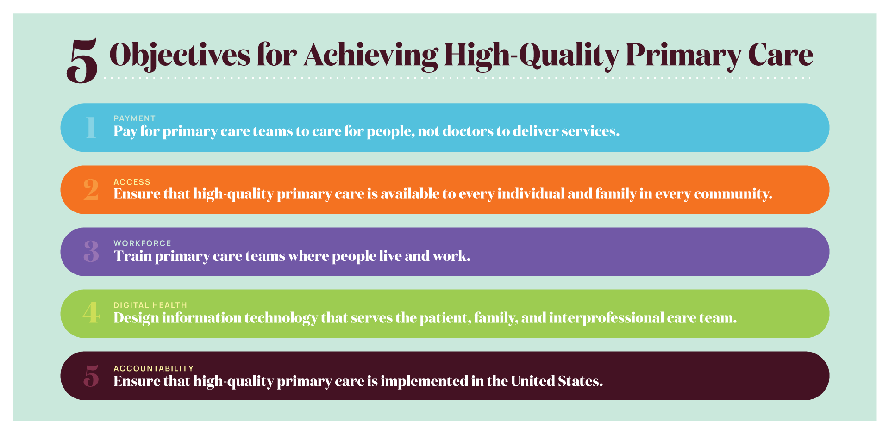
5 Objectives for Achieving High-Quality Primary Care
Notes:
The committee’s recommended actions that make up its implementation plan seek to achieve 5 major objectives to achieve high-quality primary care.
Pay for primary care teams to care for people, not doctors to deliver services.
The nation gets what it pays for, and payment reform that supports and encourages high-quality primary care, rather than actively discouraging it, is fundamental to the committee’s vision of high-quality primary care.
Ensure that high-quality primary care is available to every individual and family in every community.
Everyone in the country should have easy access to high-quality primary care that is person-centered, relationship-oriented, and responsive to the needs of its community.
Train primary care teams where people live and work.
When primary care training is interprofessional and located in community settings, it is more effective at developing the skills that will keep people connected and healthy.
Design information technology that serves the patient, family, and interprofessional care team.
New health information technology standards should prioritize and facilitate integrated care that is person-centered, supports relationships, and is responsive to the needs of its community.
Ensure that high-quality primary care is implemented in the United States.
Implementing high-quality primary care requires clear and meaningful measures of whole-person care, ongoing research, and leadership in the federal government to assure federal policies support its development.

Slide 39
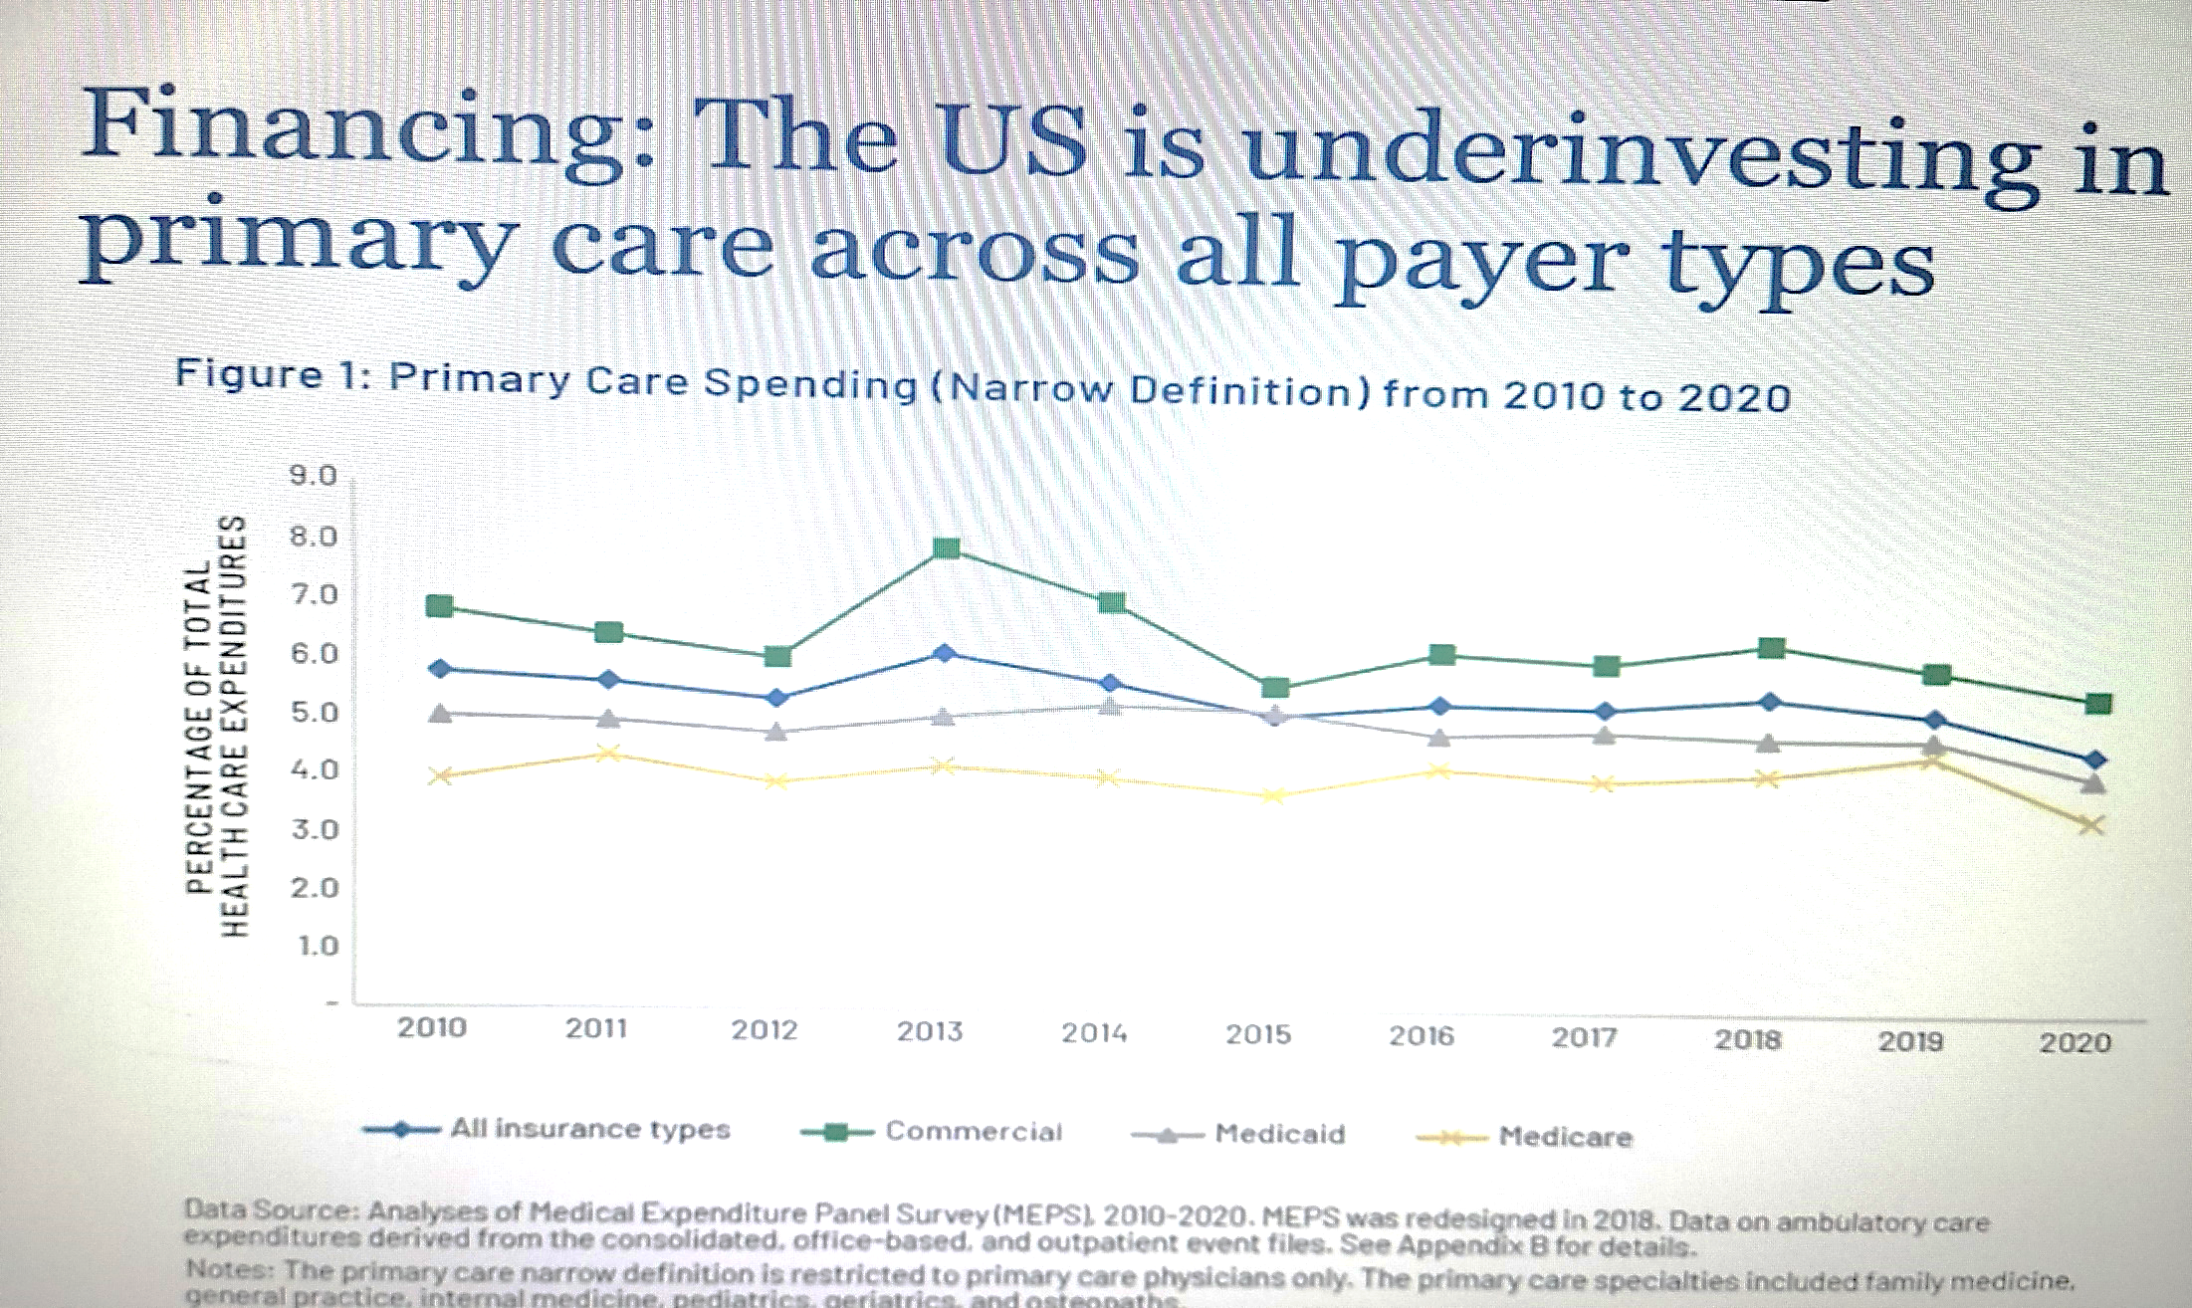

Slide 40
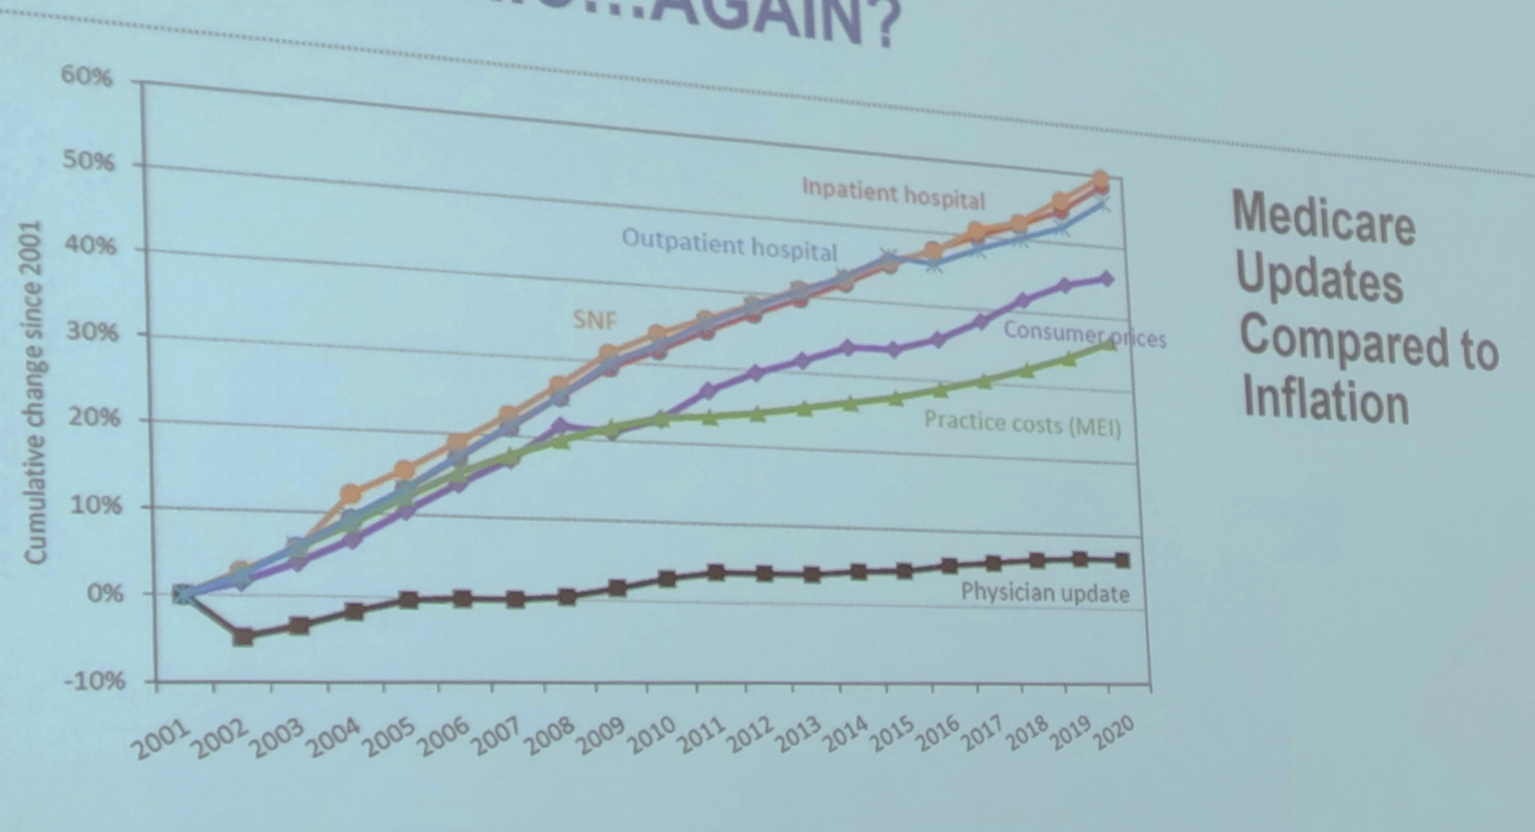

Slide 41
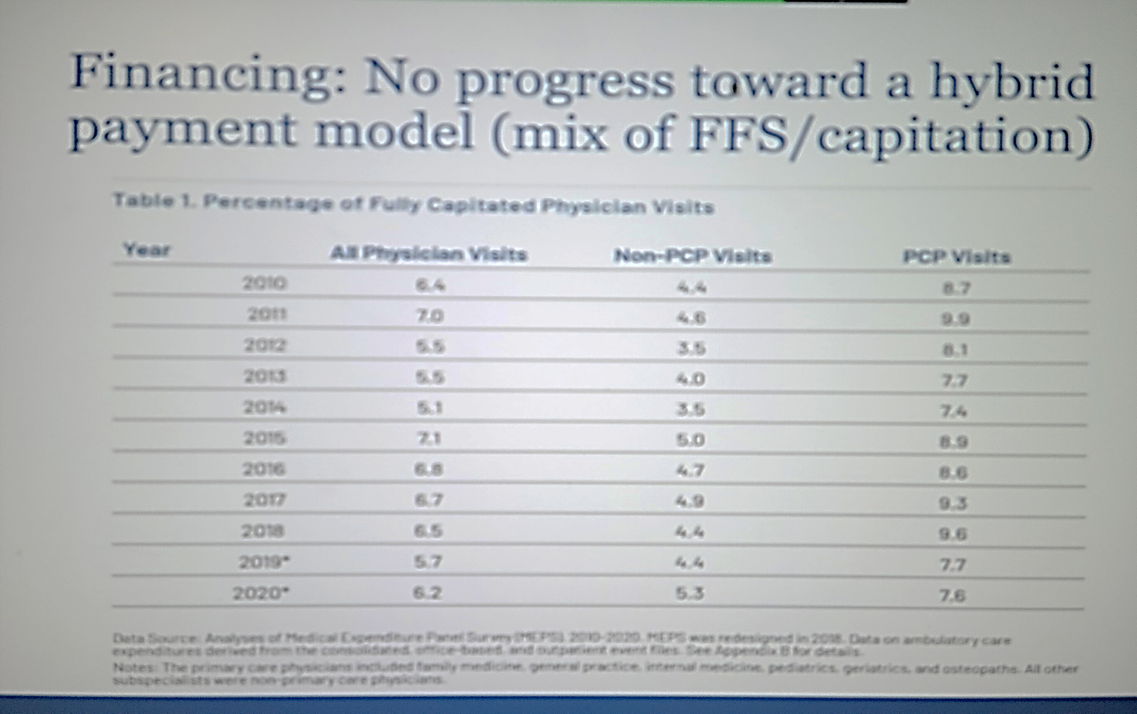

Slide 42
Initial Takeaways
FFS payments, where physicians are paid for services regardless of quality, may encourage overtreatment and do not support care provided by an interdisciplinary team made up of billing and non-billing providers. Conversely, capitation, where a physician is paid a fixed amount for each patient for a given period of time regardless of service use, may encourage underuse of resources.¹³ Hybrid payment models (part FFS and part capitated) that reimburse the entire primary care team, though perhaps more administratively complex than pure FFS or pure capitation, outperform both models.¹⁴
Despite the robust set of measures presented in this scorecard and the accompanying dashboard, there are many gaps in existing data sets that limit the ability to provide an exact evaluation of the health of US primary care. Data limitations notwithstanding, this report can serve as a guide for state and federal agencies, private payers, and other stakeholders invested in strengthening primary care and measuring progress.

Slide 43
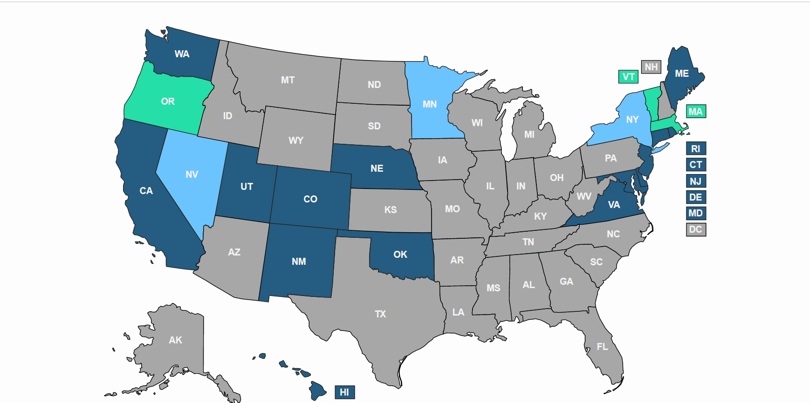
Comparative State of Delaware

Slide 44
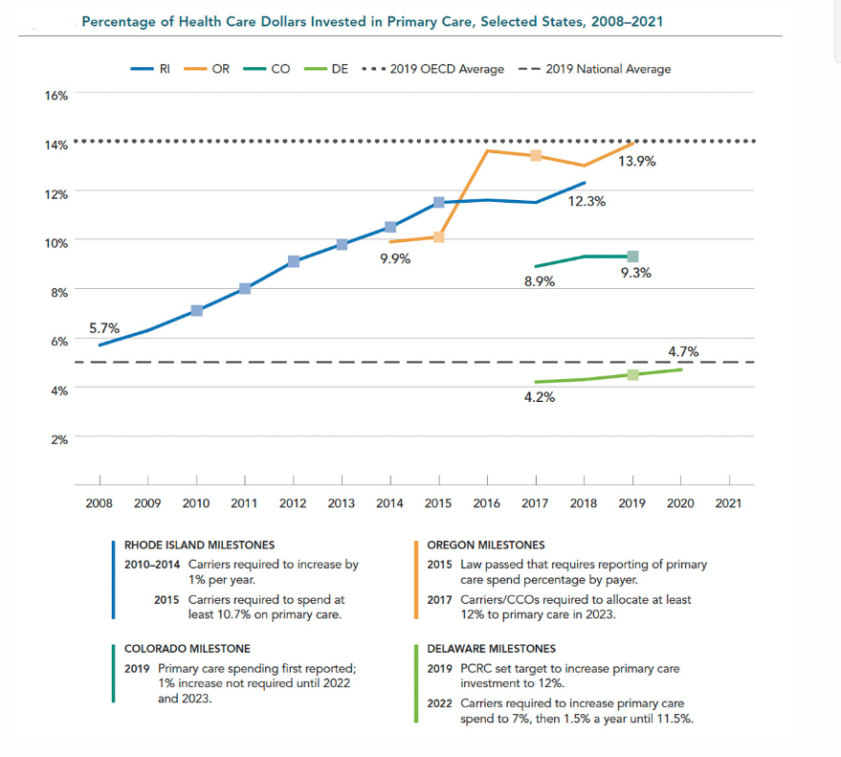

Slide 45
Objective 1: Payment actions
Action 1.1: Payers should evaluate and disseminate payment models based on their ability to promote the delivery of high-quality primary care, not short-term cost savings.
Action 1.2: Payers using fee-for-service models for primary care should shift toward hybrid reimbursement models, making them the default over time. For risk-bearing contracts, payers should ensure that sufficient resources and incentives flow to primary care.
Notes:
NOTE THAT THE TEXT ON THE SLIDES ARE ABBREVIATED VERSIONS OF THE COMMITTEE’S RECOMMENDED ACTIONS.
Action 1.1: Payers—Medicaid, Medicare, commercial insurers, and self-insured employers—should evaluate and disseminate payment models based on the ability of those models to promote the delivery of high-quality primary care, as defined by the committee, and not on their ability to achieve short-term cost savings.
Action 1.2: Payers—Medicaid, Medicare, commercial insurers, and self-insured employers—using a FFS model payment model for primary care should shift primary care payment toward hybrid (part FFS, part capitated) reimbursement models, making them the default method for paying for primary care teams over time. For risk-bearing contracts with population-based health and cost accountabilities, such as those with accountable care organizations, payers should assure that sufficient resources and incentives flow to primary care. Hybrid reimbursement models should:
pay prospectively for interprofessional, integrated, team-based care, including incentives for incorporating non-clinician team members and for partnerships with community-based organizations
be risk-adjusted for medical and social complexity
allow for investment in team development, practice transformation, and the infrastructure to design, use and maintain necessary digital health technology
align with incentives for measuring and improving outcomes for attributed populations.

Slide 46
Objective 1: Payment actions continued
Action 1.3: CMS should increase overall portion of health care spending for primary care by improving Medicare fee schedule and restoring the RUC to advisory nature.
Action 1.4: States should facilitate multi-payer collaboration and increase the portion of health care spending for primary care.
Notes:
Action 1.3: The Centers for Medicare and Medicaid Services (CMS) should increase the overall portion of spending going to primary care by:
accelerating efforts to improve the accuracy of the Medicare physician fee schedule by developing better data collection and valuation tools to identify overpriced services with the goal of increasing payment rates for primary care evaluation and management services by 50 percent and reducing other service rates to maintain budget neutrality.
restoring the Relative Value Scale Update Committee to the advisory nature as originally intended by developing and relying on additional independent expert panels and evidence derived directly from practices.
Action 1.4: States should implement primary care payment reform by
using their authority to facilitate multi-payer collaboration on primary care payment and fee schedules and,
measuring and increasing the overall portion of health care spending in their state going to primary care.

Slide 47
5 Objectives for Achieving High-Quality Primary Care
Notes:
The committee’s recommended actions that make up its implementation plan seek to achieve 5 major objectives to achieve high-quality primary care.
Pay for primary care teams to care for people, not doctors to deliver services.
The nation gets what it pays for, and payment reform that supports and encourages high-quality primary care, rather than actively discouraging it, is fundamental to the committee’s vision of high-quality primary care.
Ensure that high-quality primary care is available to every individual and family in every community.
Everyone in the country should have easy access to high-quality primary care that is person-centered, relationship-oriented, and responsive to the needs of its community.
Train primary care teams where people live and work.
When primary care training is interprofessional and located in community settings, it is more effective at developing the skills that will keep people connected and healthy.
Design information technology that serves the patient, family, and interprofessional care team.
New health information technology standards should prioritize and facilitate integrated care that is person-centered, supports relationships, and is responsive to the needs of its community.
Ensure that high-quality primary care is implemented in the United States.
Implementing high-quality primary care requires clear and meaningful measures of whole-person care, ongoing research, and leadership in the federal government to assure federal policies support its development.

Slide 48
Comparative State of Delaware
PCRC focused on Objective 1: Barriers to Payment Reform
  Essential data from OVBHCD
  Small percentage of fully insured>> expansion to Medicaid and self insured
  Using Medicare as the sole benchmark - under investment if there are no other payment benchmark
  Leverage uptake and coverage for the DE PC Delivery Model which would

Slide 49
Comparative State of Delaware
Opportunity to create timeline to fold Objective 2, 4 and 5 into Objective 1
  #4: Use of Telehealth>>??Recommendations for establishing protocols
  #5: Accountability –
    provider compliance through SB120 and PCRC>> data will probably be available in mid- 2024 for 2023
    Optimally through adjusted downside risk in reimbursement and quality metrics by 2026

Slide 50
Implementation
A few states are considering forming a state-level Primary Care Council –natural evolution of the Primary Care Reform Collaborative ?
Delaware could create a Primary Care Scorecard

Slide 51
Next meeting
Monday, April 24, 2023
4:00-6:00pm
Virtual

Slide 52
Public comment

