Slide 1
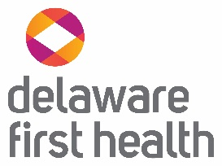
Delaware First Health
Overview for
Children with Medical Complexity Advisory Committee
Cortney Jones, MBA, LCSW, CCM
Director, Care Coordination
Dara Hall, MSN, RNC-NIC
Director, Maternal & Child Health

Slide 2

We seek to be a partner and advocate for our members
Delaware First Health offers a local, community centric approach to healthcare, all backed by the nation’s largest Medicaid Managed Care Organization: Centene Corporation.
Notes:
Although DFH is a new plan in Delaware, our team of dedicated staff is filled with life-long Delawareans who are committed to improving the lives of each of our members

Slide 3
Our Purpose
Delaware First Health
OUR PURPOSE
Transform the health of the community, one person at a time.
OUR APPROACH
Delaware First Health strives to improve the health of Delaware members through focused, compassionate, and coordinated care.
Our approach is based on the core belief that quality healthcare is best delivered locally.
OUR PILLARS
Local
Whole Health
Focus on the Individual
Notes:
Our purpose is to – Transform the health of the community one person at a time
Our approach is to use focused, compassionate care and coordinated care from people who know you where you are from.
“Our local approach enables us to provide accessible, high-quality, culturally sensitive services to nearly 26 million members in all 50 states. Every individual, family and community we serve is unique.”
Sarah London, CEO, Centene

Slide 4
Key Personnel
Bill Wilson – Chief Executive Officer
Dr. Daniel Elliott – Chief Medical Officer
Jeanine Kilgore – Vice President Population Health
Cortney Jones – Director Care Coordination
Catella Visser – Director Case Management (LTSS)
Dara Hall – Director Maternal & Child Health

Slide 5

DFH Values the Incredible Children & Families We Serve
Our goal is to:
  Support optimal quality of life for children with medical complexity & their families
  Assist families in navigating the challenges of caring for a medically complex child
  Partner with our members and families to address and eliminate barriers

Slide 6
Resources for Families
Care Coordination
Respite Benefit
Private Duty Nursing
Streamlined Authorization Process
Robust Value-Added Benefits
Additional Education & Resources

Slide 7
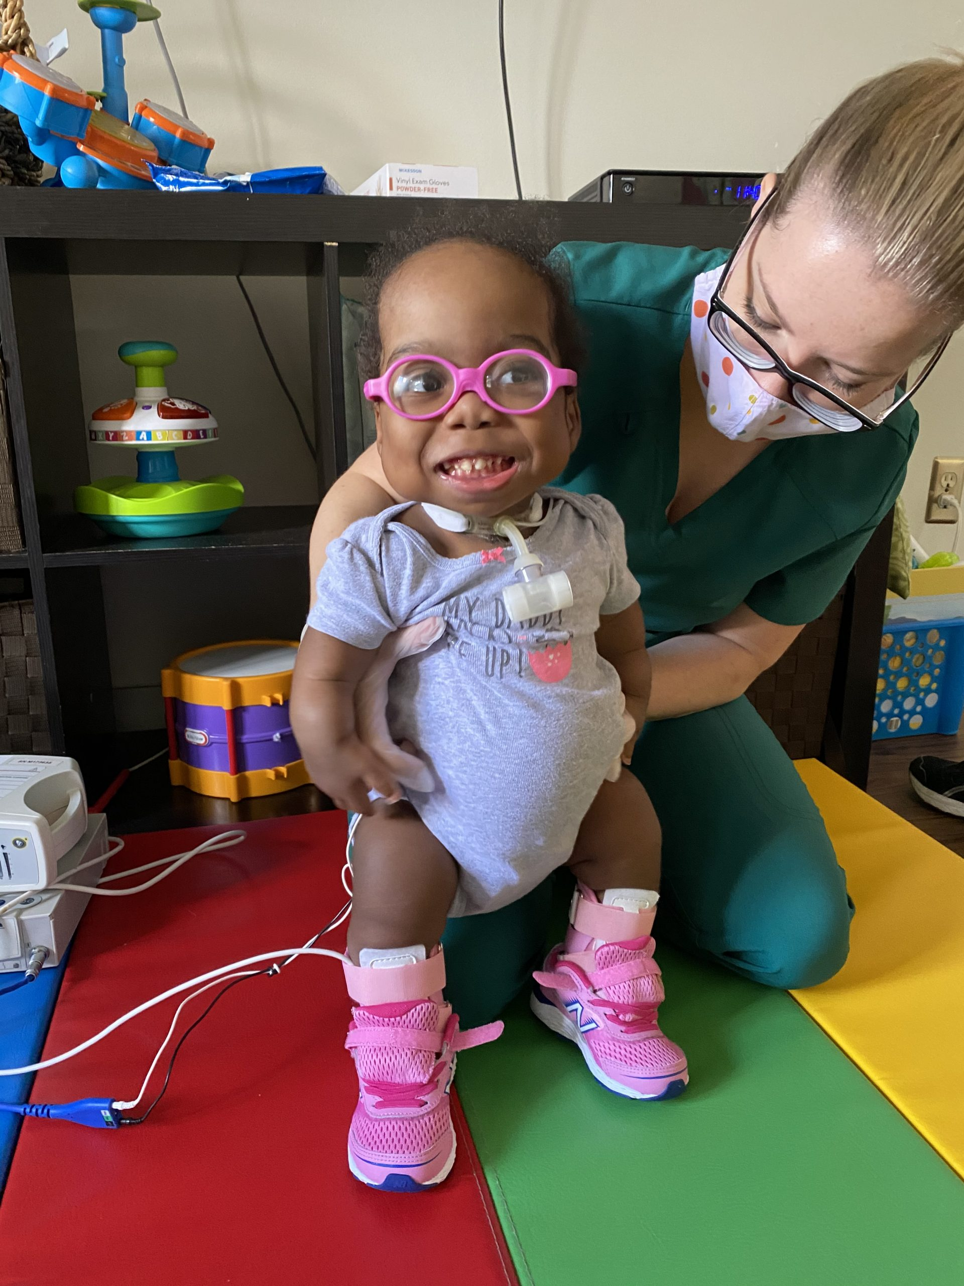
Care Coordination
We have an expanding team of dedicated care coordinators who want to help children with medical complexity and their families thrive
Our goal is to ensure seamless delivery of care for the child across the various systems (PCP, specialists, hospital, DME providers)
We seek to work collaboratively with families through effective care-planning and shared decision making

Slide 8
Respite Benefit
Caring for a child with complex care needs can be incredibly demanding
Respite care is a vital component of family-centered care
DFH is continuing to expand our network of respite providers
DFH provides 48 hours of additional respite hours (after state benefit exhausted)
Notes:
In order to support for families to best support their child, it is vital to support families to have a time away from care-giving

Slide 9
Private Duty Nursing (PDN)
Single point of contact for families utilizing PDN services
Ongoing work with community providers to ensure access to needed services
A combination of local support and national expertise for Utilization Management

Slide 10
Other Resources
At Delaware First Health we have many other enhanced benefits and resources to support optimal health including:
Whole Health Transportation benefits
My Health Pays Rewards Program
Support for Summer Camps and Youth Sport involvement
Support for Boys & Girls Club membership
Access to Weight Management programs
Home-based interventions for members with asthma
Robust educational resources and support
A strong, growing network to ensure our members receive the quality, affordable healthcare they deserve

Slide 11
Contact Info
Cortney Jones
cortney.jones@delawarefirsthealth.com
302-861-4080
Dara Hall
dara.hall@delawarefirsthealth.com
302-861-4135

