Slide 1



HOME CARE NURSING- ONBOARDING EDUCATION
Taryn Pariag MSN, RN

Slide 2
BIO
I have been a nurse for 24 years caring for the pediatric population. I was at Nemours for 21 of those years in both the critical care step-down, er, recovery room and ICU units. I have been with Bayada for 7 years as the clinical educator and doing all of the education and onboarding of any new staff as well as running the nurse residency program in 2 offices. I have an MSN in Nursing leadership with a focus on education.

Slide 3
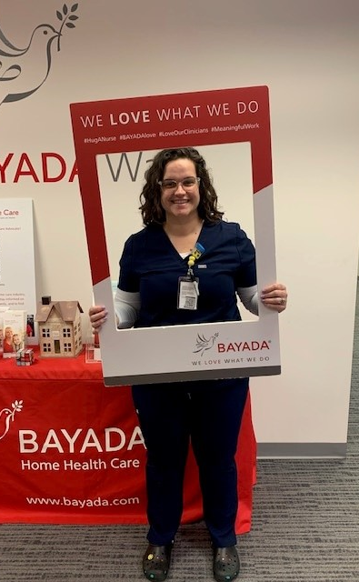

Agenda
Onboarding Experienced and novice nurses
NR program
University Involvement
Challenges for home care

Slide 4


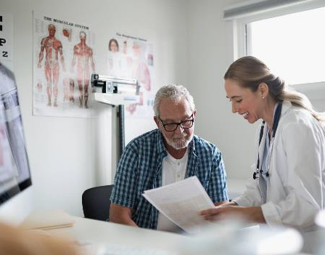
Bayada Education
Bayada provides education to all nurses that are onboarding to become a field nurse and care for our pediatric population.
Prior to working in the field, they will receive both online education as well as in person education to assess competencies.
We also have relationships with local Universities that utilize Bayada as a clinical site. We are hoping this will build a better understanding of the dire need for more nurses in the home care setting.
NR program for new graduate nurses

Slide 5
Timeline for onboarding
Day 1
New hire training with clinical associate and starts needed SDL’s Obtains all needed paperwork to complete background check, physical, TB test, drug screen, CPR. Meets with Educator to schedule NHO and CSM to discuss scheduling
Within 1 week
Once all SDL’s are completed NHO with Educator approx. 2-4 hours depending on if nurse will be working basic or TV clients. Completes competencies at this time and schedules training shifts in the field. Once all pre-employment material is back approximately 1 week.
Training
Starts training in the field with a preceptor anywhere from 8-24 hours depending on the complexities of the client. TV requires more training.
Completes all training shifts (8-24 hrs)
Gets signed off in the field by an RN that they are competent to care for that specific client safely. If there are no RN’s on the case the nurse is signed off by a Clinical Mgr.
Independently working
Works 1st independent shift with clients they are signed off on.
(this could take up to 2-3 weeks depending on nurses availability)

Slide 6
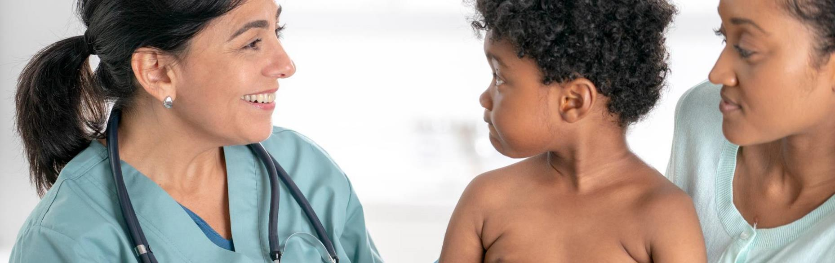
Nurse Residency program

Slide 7
Nurse residency
challenges to the NR program
Families not wanting a “new” nurse due to lack of experience
Full time program and clients become hospitalized so NR cannot work on the clients they have been trained on.
Pay rates are lower for the NR program due to being a new graduate nurse.
Nr need training on any new cases they would like to work in the first year of their employment this may hinder filling open shifts
Limited exposure and discussion about home care in the nursing schools
Advantages to the NR program
Able to teach them the “Bayada Way”
Able to utilize simulation scenarios to provide NR with tasks that will not jeopardize the safety of our clients.
Provides 1:1 education both in the sim lab and the field to allow the NR to take their time with learning.
Takes nursing knowledge and applies it specifically to the home care field and the clients we care for.
Can be a RN or LPN
Flexibility during both training and online classes during the program.

Slide 8
University involvement
relationship developed with the University of Delaware to be able to utilize Bayada as a clinical site for students in their pediatric clinical community rotation.
Students must complete 84 clinical hours in the field with a preceptor.
Some families are not allowing students to come into their homes to be able to complete clinical hours. This may cause students to not want to work in homecare after they graduate.

Slide 9
Challenges for home care
Nurses come to us as their second job and have other ft jobs, so we are not a priority when it comes to reliability or training to work
Clients are hospitalized frequently and then the nurses are out of work unless they can be placed on another client that they may have to be trained on
Stigma of RN vs LPN
Pay rates are much higher in the hospital – bayada pay rates range based on experience, complexity of the client etc.
nurses and NR’s are coming for the extensive training that Bayada provides in caring for TV clients and then leaving once trained to make more money in a hospital setting.

Slide 10

Thank you
Taryn Pariag MSN, RN
CLINICAL eDUCATOR
Bayada Pediatrics
TPARIAG@BAYADA.COM

