Slide 1


SOR 2.0
Tier 2/3 Web-based survey training session
Delaware division of substance abuse and mental health

Slide 2
Tier 2/3 web-based survey
The purpose of the Tier 2/3 web-based survey is to collect data to measure the progress made by Tier 2/3 providers on their key performance indicators
The providers need to have their LOA on hand prior to starting the survey since they will have to report on the performance measures listed in the LOA
The survey should not take more than 10 minutes to complete.

Slide 3
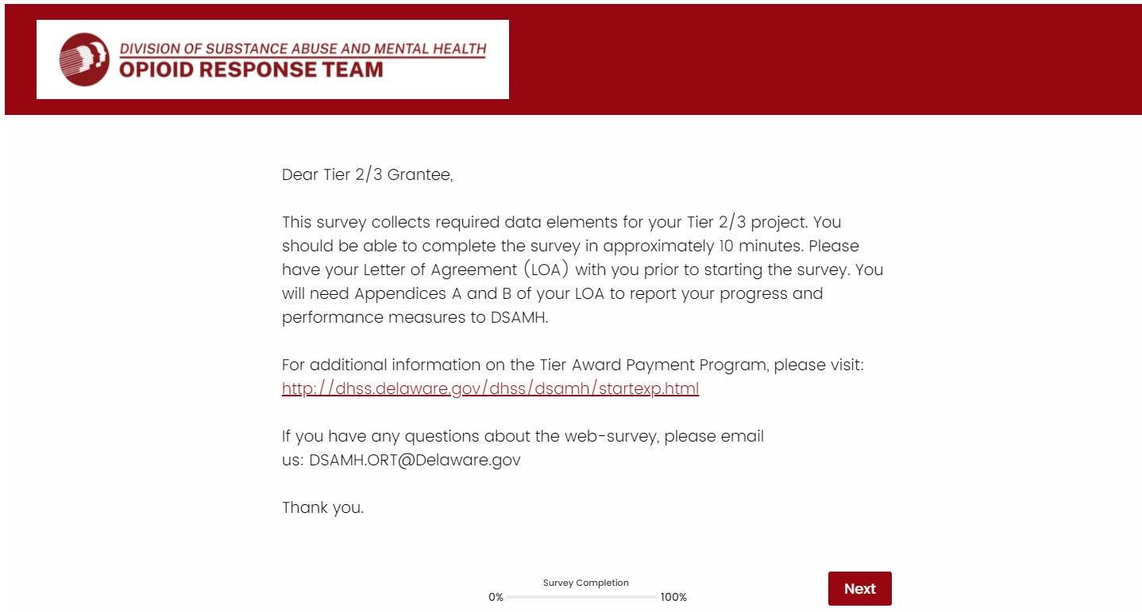
Tier 2/3 web-based survey: Introduction page
The introduction describes the purpose of the survey and includes the SOR ORT contact information. Click “Next” to start the survey

Slide 4
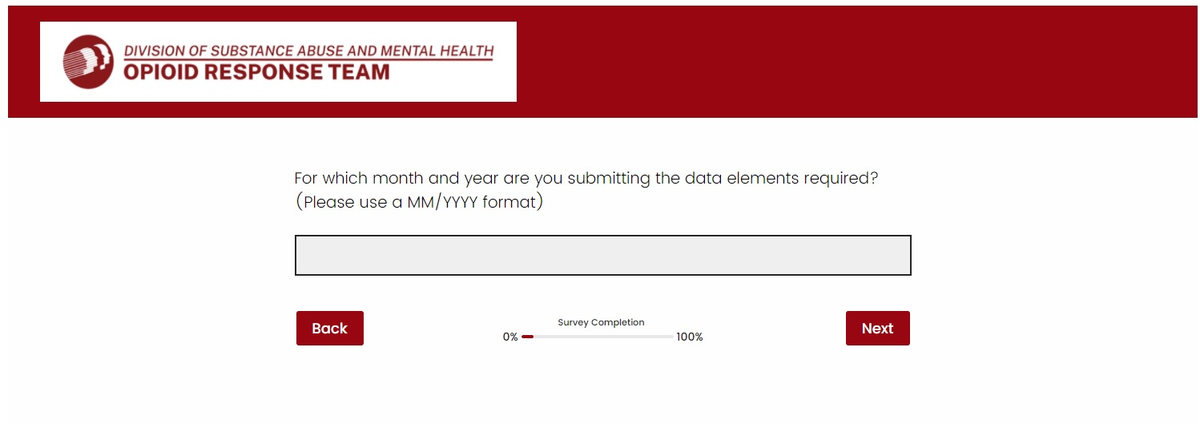
Tier 2/3 web-based survey: Reporting period
Indicate the reporting period of the data elements being reported to ORT
Enter the data in a MM/YYYY format. Example: 10/2021

Slide 5
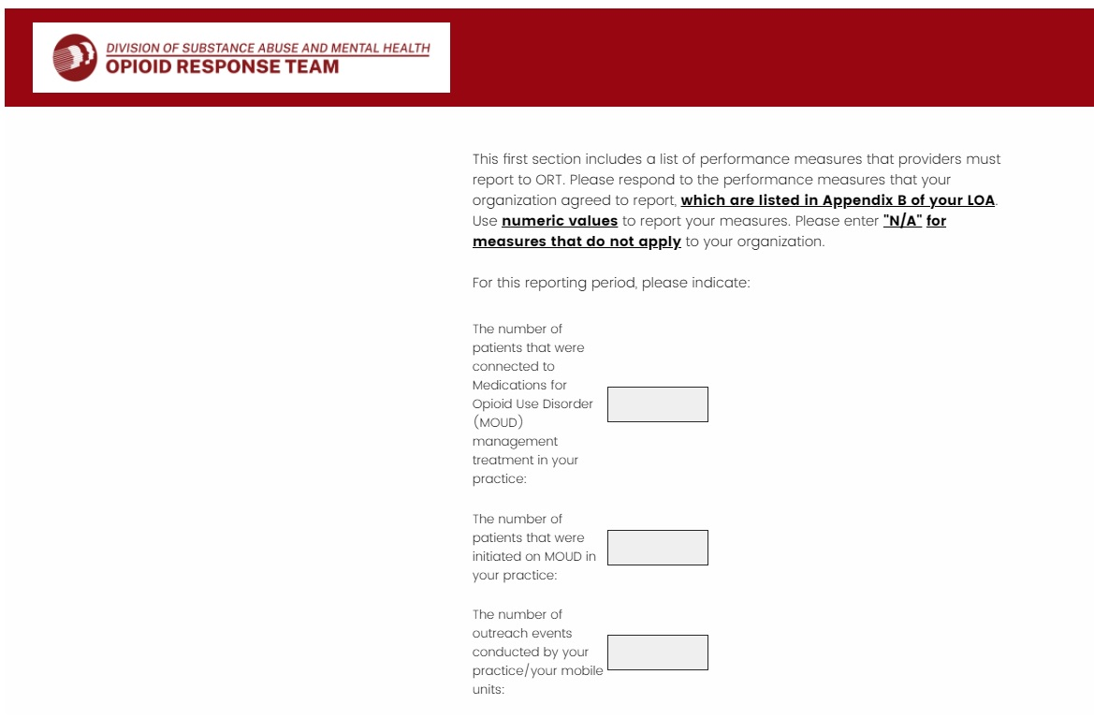
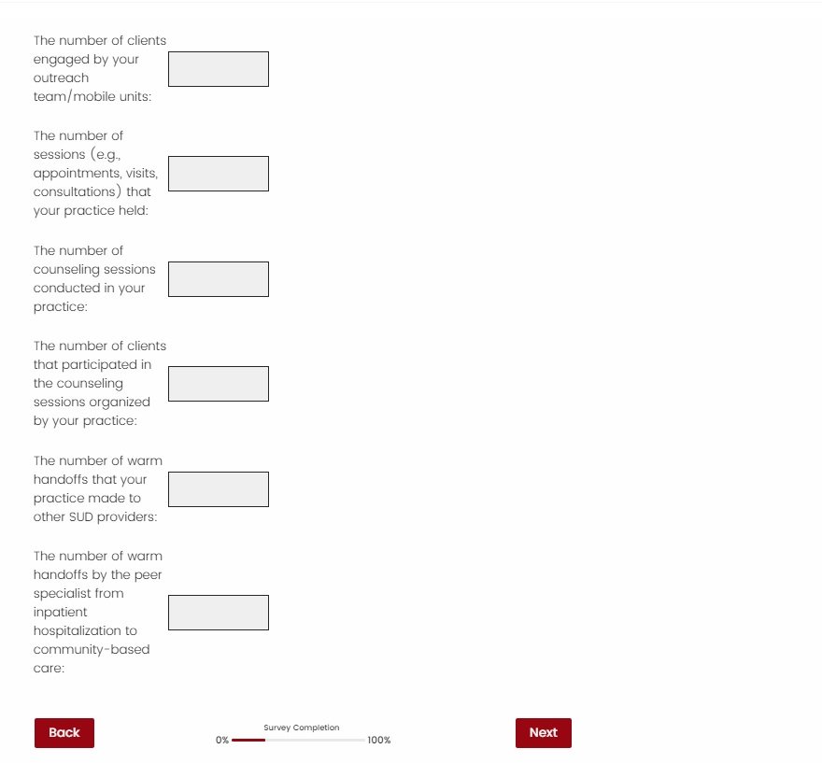
Tier 2/3 web-based survey: TIER 3 Providers – Performance measures – part i
In this section you will report the performance measures that your organization agreed to report. Check Appendix B of your LOA to identify your performance measures and gather the data that must be reported to ORT.
Use numeric values to report your performance measures
Complete only the performance measures that your organization agreed to report to ORT. Enter N/A for the measures that do not apply to your organization

Slide 6
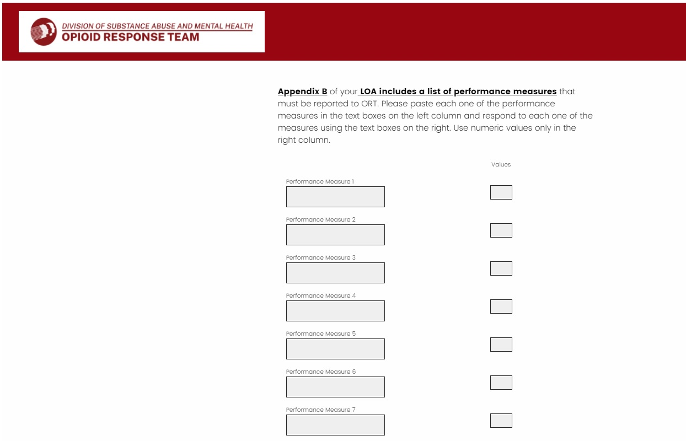
Tier 2/3 web-based survey: TIER 3 Providers – Performance measures – PART II
In this section you will report your organization’s performance measures to ORT
To complete this section, you will:
  Open Appendix B of your LOA to identity the performance measures
  Copy your performance measures from the document and past them in the text boxes in the left column
  Enter the value of each performance measure using the text boxes on the right. Use numeric values to report your performance measures in the right column
Complete only the performance measures that your organization agreed to report to ORT. Enter N/A to the performance measures that do not apply to your organization. Example, if you agreed to report 5 performance measures, complete them and write N/A in performance measures 6, 7, 8, 9, 10, and 11.

Slide 7
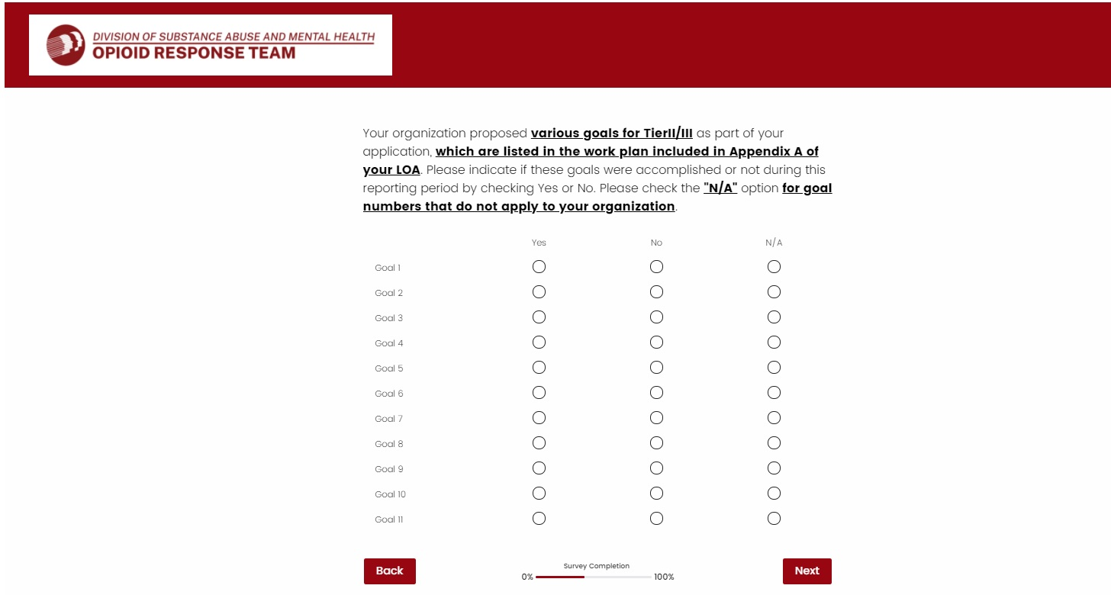
Tier 2/3 web-based survey: TIER 2&3 Providers – Goals
This section will collect information on the accomplishment of the goals that your organization proposed for Tier 2/3
To complete this section, you will:
  Open Appendix A of your LOA to identify your organization’s goals for Tier 2/3
  Select Yes or No to each goal that your organization proposed
  Check N/A for the goal numbers that do not apply to your organization

Slide 8
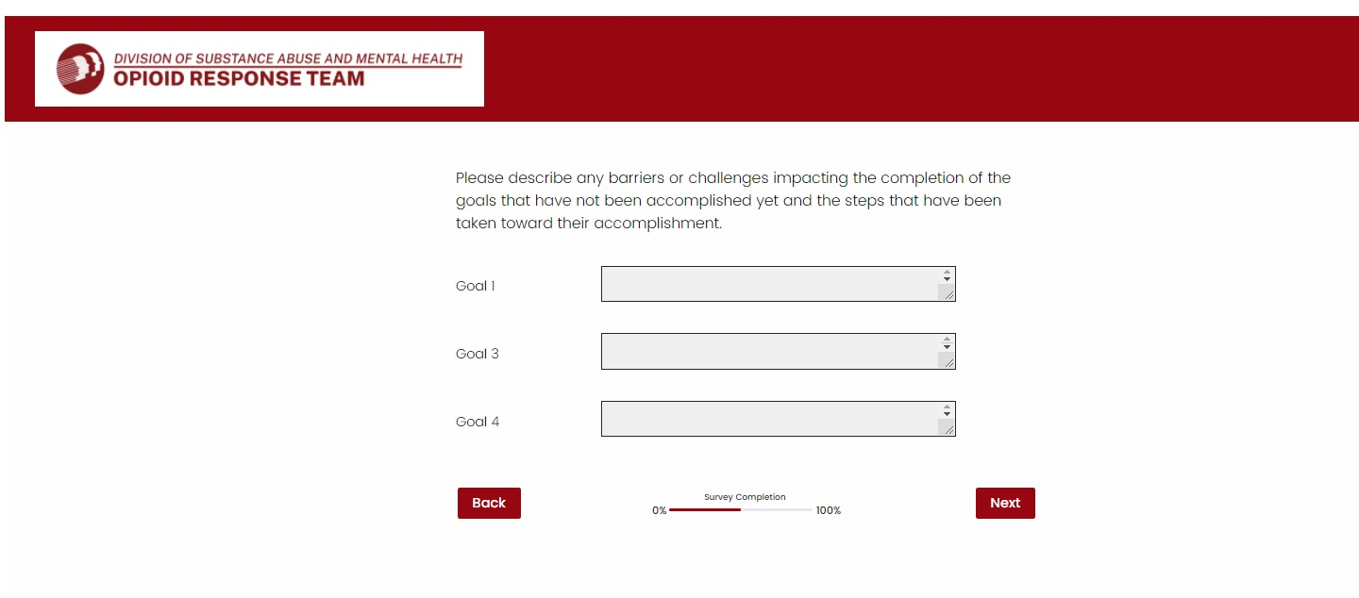
Tier 2/3 web-based survey: TIER 2&3 Providers – Goals NOT ACCOMPLISHED/BARRIERS/CHALLENGES & STEPS TAKEN TO ACCOMPLISH THEM
This section asks you to describe the barriers and challenges impacting the completion of the Tier 2/3 goals that have not been accomplished by your organization at the time you are completing this survey
For each goal that your organization has not accomplished, you will have a text box to describe the barriers and/or challenges to accomplish the goal and the steps that have been taken to accomplish them
You will only see this question if you answered No to one or more goals listed in the previous question. Example: if your organization proposed 5 goals and you answered Yes to Goals 1, 2, and 3 in the previous question, you will only have to describe the barriers/challenges to goals 4 and 5

Slide 9
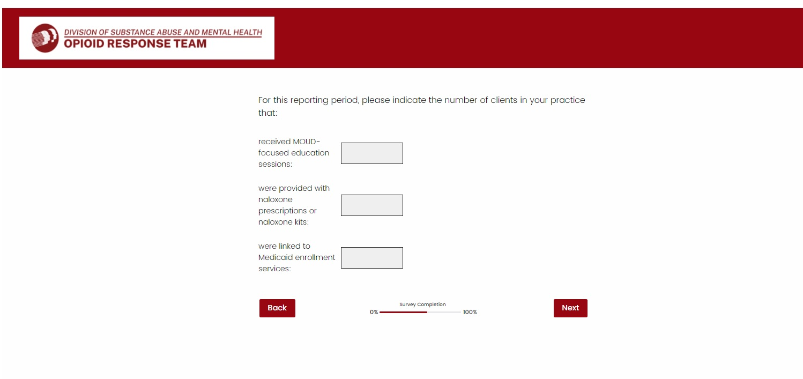
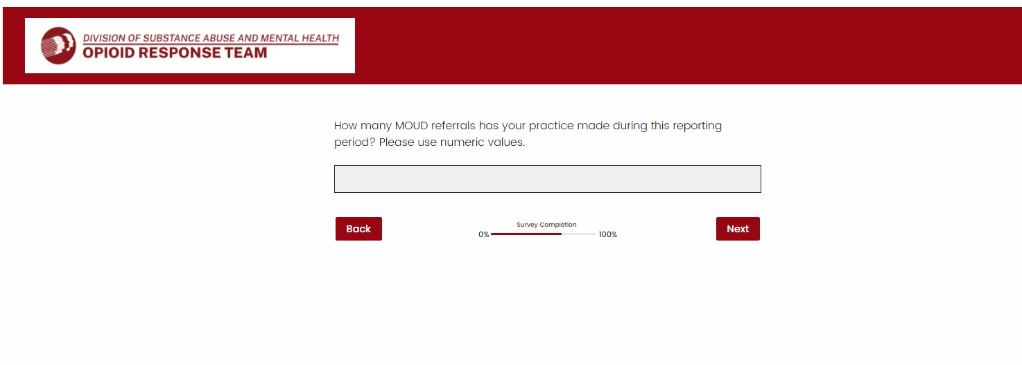
Tier 2/3 web-based survey: TIER 2&3 Providers – MOUD/NALOXONE/MEDICAID
Use numeric values to answer these questions otherwise you will receive an error message and will not be able to move to the next questions

Slide 10
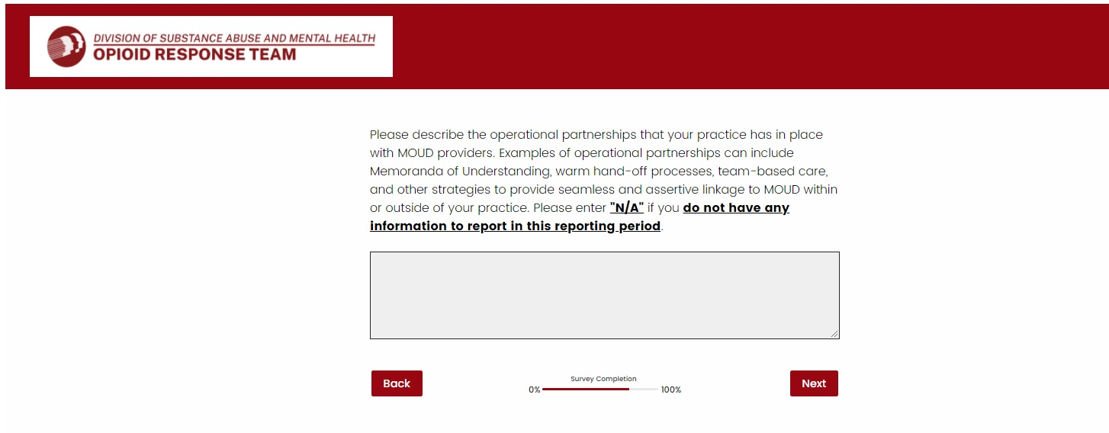
Tier 2/3 web-based survey: TIER 2&3 Providers – operational partnerships
Use the text box to describe the operational partnerships that your organization has in place with MOUD providers
There is no character limit to answer this question
Enter N/A if you do not have any information to report in this reporting period

Slide 11
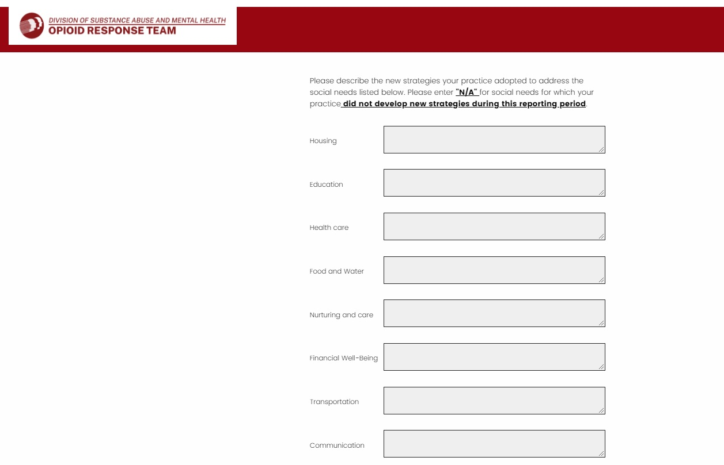
Tier 2/3 web-based survey: TIER 2&3 Providers – social needs
This section gathers information about the new strategies adopted by your organization to address several social needs
There is no character limit to answer to each one of these social needs
Enter N/A for social needs for which your organization did not develop new strategies during the reporting period

Slide 12
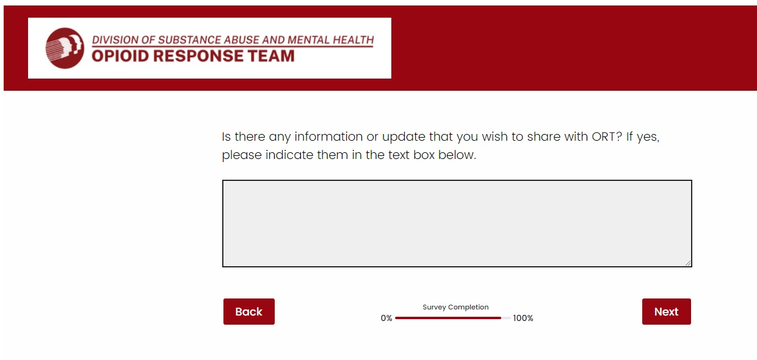
Tier 2/3 web-based survey: TIER 2&3 Providers – provide information to ort
Use this text box to share any information or update with ORT
There is no character limit
Click Next to finalize the survey. If you don’t click Next, your survey will not be recorded

Slide 13
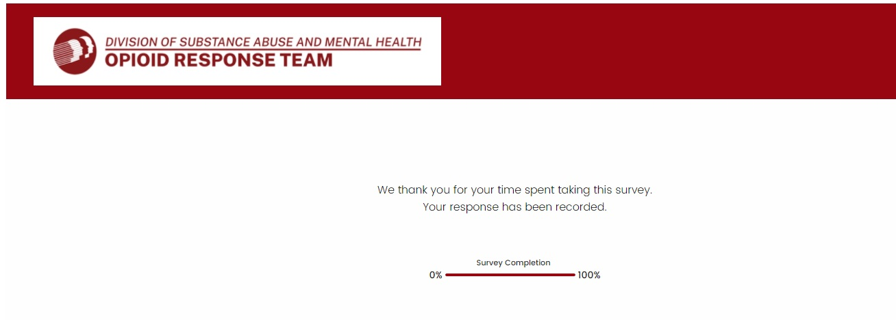
Tier 2/3 web-based survey: TIER 2&3 Providers – provide information to ort
This message confirms that your survey was successfully submitted and recorded

Slide 14
Thank You

