Slide 1
Department of Health and Social Services
Overview of Benchmark Trend Report
Calendar Year 2020 Results
Molly K. Magarik, MS
Cabinet Secretary
Delaware Department of Health and Social Services
May 5, 2022

Slide 2
Collection of Benchmark Spending data
The spending benchmark is a target value for the change from the prior calendar year (CY) in State level per capita total health care expenditures.
DHCC collected final CY 2019 data and/or initial CY 2020 data from all payers: Aetna, ACDE, Cigna, Highmark, United, CMS, DMMA, and VHA. CY 2019 data from VHA was not refreshed. Data sources:
Market/Spending Component | Data Source | Data
Commercial | Insurers | Summary medical expenditures, including pharmacy rebate data on fully-insured, self-insured, small and large group product lines
Medicaid | DMMA and Insurers | Summary FFS and managed care, including pharmacy rebate data
Medicare | CMS and Insurers | Summary FFS and managed care, including drug spending and limited pharmacy rebate data (from Insurers only)
Veterans Health Administration | VHA website | Aggregate data from the US Department of Veterans Affairs
Net Cost of Private Health Insurance | Insurer or public reports | Summary level data on revenues and expenses

Slide 3





COVID-19: Delaware’s State and Federal Health Care Relief Payments
As of April 2022, Delaware had received
$483 million in relief funds.
As of March 30, 2022, Delaware had distributed $122.1 million to hospitals and other local health care operations.
In 2020 and 2021, DHSS distributed
$92 million in CARES Act funds to more than 359 health care entities.
Note: The COVID-19 relief monies are not included in the benchmark spending data.

Slide 4
Total Health Care Expenditures (THCE)
VHA
$206 M
NCPHI
$438 M
NCPHI
$605 M
VHA
$235 M
Commercial
$2.2 B
Commercial
$2.1 B
Medicare
$3.1 B
Medicare
$3.0 B
Medicaid
$2.2 B
Medicaid
$2.1 B
CY 2019 Total: $8.1 B CY 2020 Total: $8.1 B
+6.5% or $494 million
+0.5% or $39 million

Slide 5
State Level THCE Per Capita
+0.7%
+1.7%
1,000,000
CY 2018
967,171
CY 2019
973,764
CY 2020
989,948
800,000
CY 2020 $8,173
-1.2%
600,000
CY 2019 $8,268
+5.8%
400,000
CY 2018 $7,814
200,000
0
$0 $3,000 $6,000 $9,000
State Population
THCE Per Capita

Slide 6
THCE Per capita Change versus Benchmark
6.0%
5.8%
Per Capita Results
Benchmark
5.0%
4.0%
3.8%
3.5%
3.0%
3.25% _{3.0% 3.0%}
2.0%
1.0%
0%
-1.0%
-1.2%
-2.0%
CY 2019 CY 2020 CY 2021 CY 2022 CY 2023

Slide 7
Market THCE Per CAPITA Change versus Benchmark
Commercial
-2.3%
Medicaid
-1.9%
3.5% = CY 2020 Benchmark
Medicare
-3.5%
VHA
12.9%
-6.0% -3.0% 0.0% 3.0% 6.0% 9.0% 12.0% 15.0%

Slide 8
Total Medical Expense (TME) by service category
$2.0 B
TME by CY (excluding VHA)
$7.3 B in CY 2020
$1.7 B $1.7 B
$7.4 B in CY 2019
$1.5 B
$1.6 B
$7.0 B in CY 2018
$1.5 B
$1.4 B
$1.4 B
$1.3 B
$1.2 B ^{$1.3 B}
$1.2 B
$1.1 B
$1.2 B
$1.0 B
$1.0 B $1.0 B
$1.0 B
$0.5 B
$0.3 B
$0.4 B $0.4 B
$0.3 B ^{$0.3 B 0.3 B}
$0.1 B
$0
$0.0 B -$0.1 B
$-0.5 B
Hospital
Inpatient
Hospital
Outpatient
Physician Professional:
Pharmacy
Long Term
Care
Other Non-Claims
Other
(net of rebates)

Slide 9
Change in TME by service category
CY 2020 versus CY 2019
Commercial, Medicaid, and Medicare Markets Combined
-0.5%
-8.9%
Hospital Inpatient
Hospital Outpatient
-8.5%
Physician
0.9%
9.6%
Professional: Other
Pharmacy (net of rebates)
-0.3%
-0.5%
Long Term Care
Other
60.7%
Non-Claims
-10.0% 0.0% 10.0% 20.0% 30.0% 40.0% 50.0% 60.0% 70.0%

Slide 10
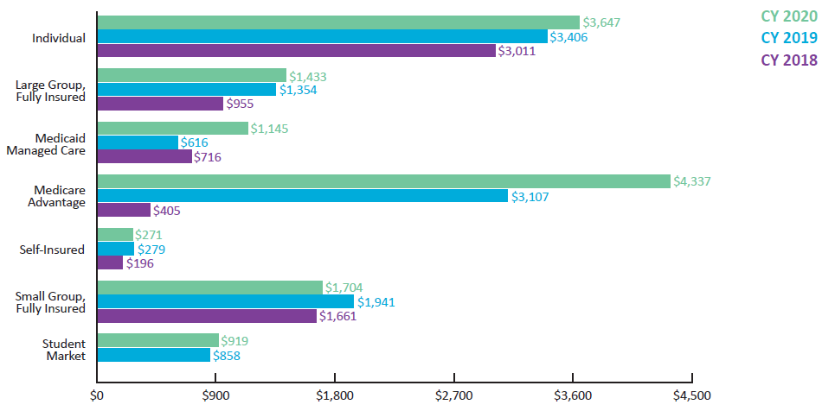
Per Member Per Year net cost of private health insurance (ncphi)

Slide 11
Quality Benchmark Results
QUALITY MEASURE | CY 2020 Benchmark | CY 2020 Results | CY 2019 Results | Notes
Adult Obesity | 29.4% | 36.5% | 34.4% | Lower result/score is better
Use of Opioids at High Dosages | 12.4% | 11.1% | N/A | Lower result/score is better
Opioid-related Overdose Deaths | 15.5 deaths per 100,000 | 43.9 deaths per 100,000 | 43.0 deaths per 100,000 | Lower result/score is better
Emergency Department Utilization | 184.0 visits per 1,000 (Commercial only) | Results were unavailable | 193.2 visits per 1,000 | Lower result/score is better
Persistence of Beta-Blocker Treatment after a Heart Attack | 84.9% Commercial 80.1% Medicaid | 91.7% Commercial 78.1% Medicaid | 93.9% Commercial 73.5% Medicaid | Higher result/score is better
Statin Therapy for Patients With Cardiovascular Disease – Statin Adherence 80% | 80.5% Commercial 61.5% Medicaid | 83.6% Commercial 72.6% Medicaid | 85.3% Commercial 65.1% Medicaid | Higher result/score is better

Slide 12

THANK YOU!
For more information about the health care spending benchmark, visit: https://dhss.delaware.gov/dhcc/global.html
Questions?

Slide 13
Glossary of key terms
Allowed Amount: The amount the payer paid plus any member cost sharing for a claim. Allowed amount is the basis for measuring the claims component of medical expenses for purposes of the benchmark spending data.
Insurer: A private health insurance company that offers one or more of the following, commercial insurance, Medicare managed care products and/or are Medicaid/Children’s Health Insurance Program (CHIP) managed care organization products.
Market: The highest level of categorization of the health insurance market. For example, Medicare and Medicare managed care are collectively referred to as the “Medicare market.” Medicaid/CHIP FFS and Medicaid/CHIP MCO managed care are collectively referred to as the “Medicaid market.” Individual, self‑insured, small and large group markets and student health insurance are collectively referred to as the “Commercial market.”
Net Cost of Private Health Insurance (NCPHI): Difference between premiums revenues and net paid expenditures. Estimates insurers’ administrative & operating expenses and gain/loss. Applies to insurers only.
Payer: A term used to refer collectively to all entities submitting data to DHCC.
Total Health Care Expenditures (THCE): The total medical expense (TME) incurred by Delaware residents for all health care benefits/services by all payers reporting to the DHCC plus insurers’ NCPHI.
Total Health Care Expenditures Per Capita: THCE (as defined above) divided by Delaware’s total state population.
Total Medical Expense (TME): The total claims and non-claims medical expense incurred by Delaware residents for all health care benefits/services as reported by payers submitting data to the DHCC.

