Slide 1
Department of Health and Social Services
Overview of Benchmark
Trend Report
Calendar Year 2021 Results
Molly K. Magarik, MS
Cabinet Secretary
Delaware Department of Health and Social Services
April 6, 2023
Notes:
This is a summary of the calendar year 2021 benchmark trend report.
At the end of the day, the complete report will be available on the DHSS website along with an Appendix of data tables.
DHSS is also developing a new, on-line benchmark dashboard where the public can view and download benchmark data. The dashboard is expected to go live soon.

Slide 2
Collection of Benchmark Spending data
The spending benchmark is a target value for the change from the prior calendar year (CY) in State level per capita total health care expenditures.
DHSS collected final CY 2020 data and/or initial CY 2021 data from all payers: Aetna, ACDE, Cigna, Highmark, United, CMS, DMMA, and VHA. CY 2020 data from VHA was not refreshed. Data sources:
Market/Spending Component | Data Source | Data
Commercial | Insurers | Summary medical expenditures, including pharmacy rebate data on fully-insured, self-insured, and small and large group product lines
Medicaid | DMMA and Insurers | Summary FFS and managed care, including pharmacy rebate data
Medicare | CMS and Insurers | Summary FFS and managed care, including drug spending and limited pharmacy rebate data (from Insurers only)
Veterans Health Administration | VHA website | Aggregate data from the US Department of Veterans Affairs
Net Cost of Private Health Insurance | Insurer or public reports | Summary level data on revenues and expenses
Notes:
The focus of this report is on calendar year 2021 results.
The spending benchmark is the annual change in the State level per capita value of total health care expenditures for all Delaware residents based on data submitted by Delaware payers.
This report also includes Delaware’s results on several quality benchmarks.
This data represents the third time DHSS collected benchmark spending and quality data from all payers.
This was the first year payers were required to submit benchmark data via legislation.
DHSS collected a refresh of calendar year 2020 spending data and new calendar year 2021 spending and quality data from payers as noted on this page.
Calendar year 2020 spending data was largely the same as last year.
Spending data includes Delaware’s Commercial, Medicaid, and Medicare markets as well as the Veterans Health Administration. Managed care and traditional fee-for-service spending is included. The Commercial market includes the insurers’ individual, fully insured and self-insured lines of business.

Slide 3
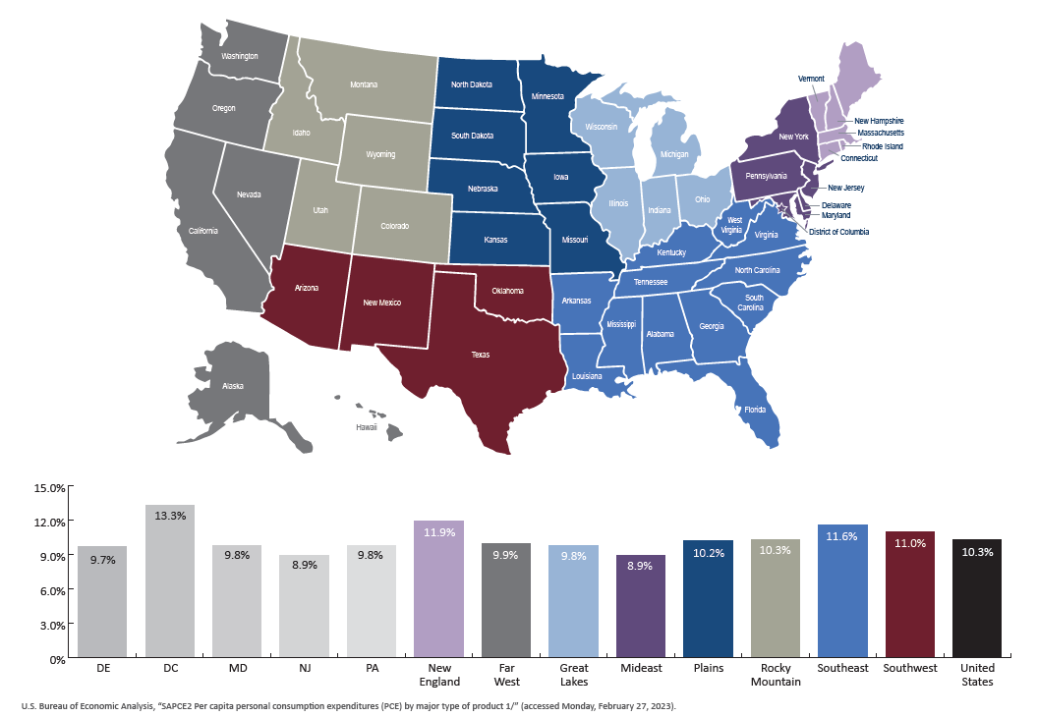
Bureau of Economic Analysis — Per capita personal consumption expenditures:
Health Care 2021 change from 2020
Notes:
This information comes from the Bureau of Economic Analysis and is shown for informational purposes only. The information collected herein is separate and not to be compared with the data collection process for the CY 2021 benchmarks trend report.
The intent of this summary is to show another data point for the change in health care expenditures from CY 2020 to CY 2021. Across all states/regions, CY 2021 reflects higher than average spending levels from CY 2020 as the suppressed spending and utilization during the beginning of the pandemic begins to return to more normal/pre-pandemic levels in CY 2021.
The State of Delaware, in this exhibit, is compared to neighboring states as well as other regions across the country.

Slide 4





COVID-19: Delaware’s State and Federal Health Care Relief Payments
As of March 2023, Delaware had received
$423 million in relief funds.
As of March 6, 2023, Delaware had distributed $183.7 million to hospitals and other local health care operations.
In 2020 and 2021, DHSS distributed
$92 million in CARES Act funds to more than 359 health care entities.
Note: The COVID-19 relief monies are not included in the benchmark spending data.
Notes:
Due to the pandemic, calendar year 2020 was an unprecedented year for the nation and Delaware.
The pandemic impacted calendar years 2020 and 2021 health care utilization and spending that is evidenced in this report.
In support of states and local health care systems, the federal government made available hundreds of millions of dollars of special COVID-19 relief payments. Nearly half a billion dollars has been distributed directly by the federal government with an additional $276 million being distributed locally.
In total, Delaware received approximately $700 million in health care-related relief monies.
Since the COVID-19 monies are not easily allocated to a specific year or market, the COVID-19 relief monies are not included in the spending totals contained in the benchmark trend report.

Slide 5
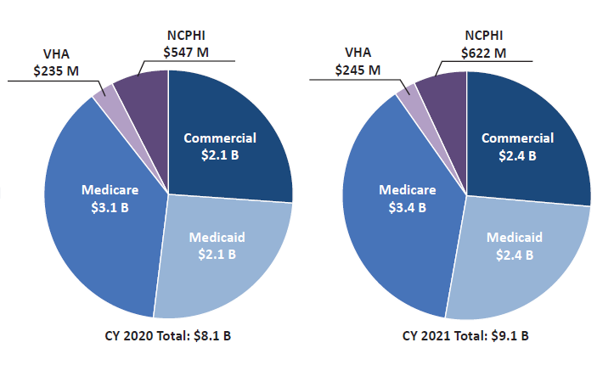
Total Health Care Expenditures (THCE)
Medicare
$3.1 B
Medicare
$3.4 B
Medicaid
$2.1 B
Medicaid
$2.4 B
+0.5% or $40 million
+12.8% or $1.0 billion
Notes:
Total health care expenditures represents the sum of all reported health care spending as well as insurers’ administrative and operating costs and their respective gains/losses. For 2021, the total was approximately $9.1 billion.
Compared to the relatively small increase seen in calendar year 2020 (beginning of COVID-19), the 2021 change was a more significant 12.8% growth in total health care expenditures.
Indicative of the “rebound” starting in 2021 relative to the depressed utilization/spending (i.e., deferred care) in 2020.
All major markets increased from CY 2020 to CY 2021.

Slide 6
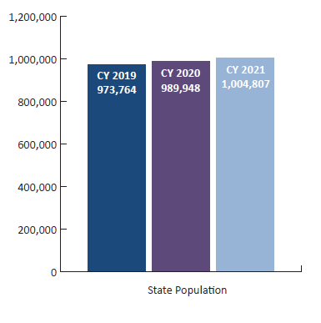
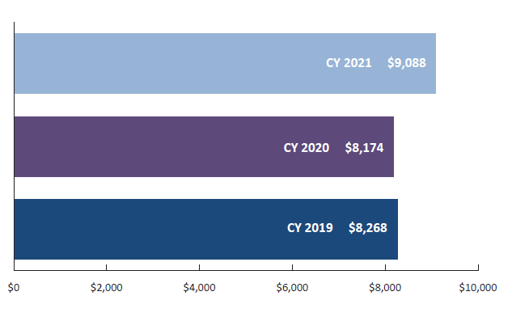
State Level THCE Per Capita
+1.7%
+1.5%
+11.2%
-1.1%
Notes:
Per capita is computed by dividing total health care expenditures by Delaware’s total population.
Delaware’s total population increased 1.5% in 2021 whereas total health care spending increased 12.8%.
As a result, on a per capita basis, Delaware’s estimated 2021 State level per capita increased 11.2% to $9,088 compared to the 2020 figure of $8,174.

Slide 7
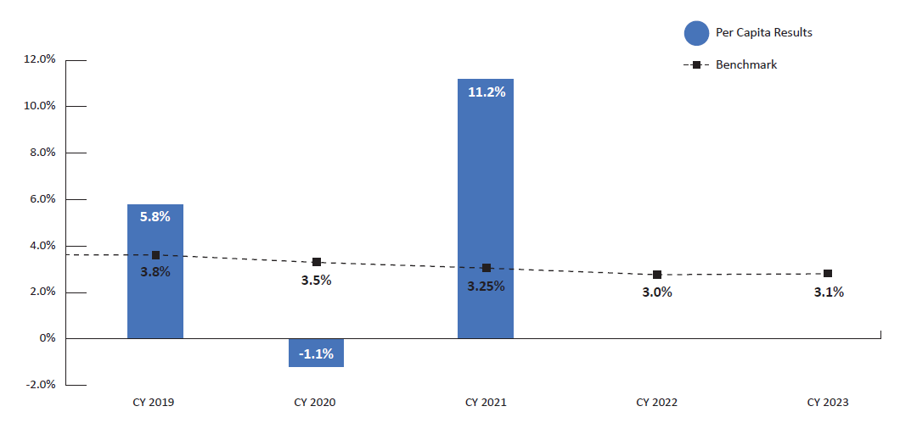
THCE Per capita Change versus Benchmark
11.2%
Notes:
The 2021 benchmark was set at a 3.25% growth rate.
The annual spending targets were originally set in 2018 and are subject to review by the Delaware Economic and Financial Advisory Council.
2021’s computed per capita represents a 11.2% increase from the 2020 per capita figure which is well above the 3.25% benchmark growth rate.
As noted previously, the pandemic impacted access and utilization of health care services for much of the 2020 data period. These results may not be indicative of a “normal” year and hence should be taken in consideration of the pandemic’s effect on reported health care spending.
Based on the refreshed 2020 data, the revised 2020 per capita change was a –1.1% decrease year over year.
Massachusetts recently released their new benchmark trend report, showing a 9.0% increase in its TCHE per capita change for 2021, following a 2.3% decline in 2020.
The CY 2023 benchmark was originally set at 3.0%, but based upon review of factors by DEFAC, the benchmark was revised to 3.1%.
DHSS will begin the process of collecting CY 2022 benchmark data later this year.

Slide 8
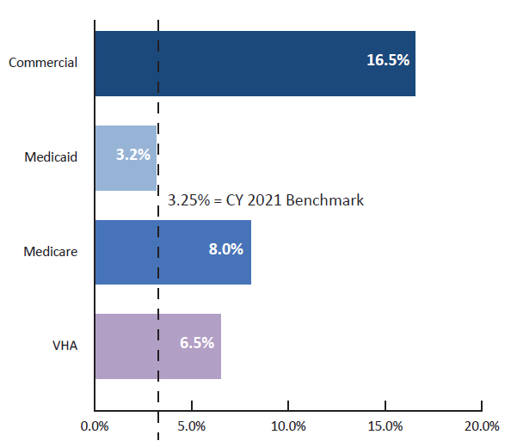
Market THCE Per CAPITA Change versus Benchmark
16.5%
6.5%
Notes:
This page is for informational purposes as the spending benchmark is set and measured at the State level.
Using estimated number of enrollees in each market, the 2021 per capita changes are shown relative to the 3.25% benchmark.
All markets except the Veterans Health Administration showed an increase in per capita spending, most significantly in the Commercial market.

Slide 9
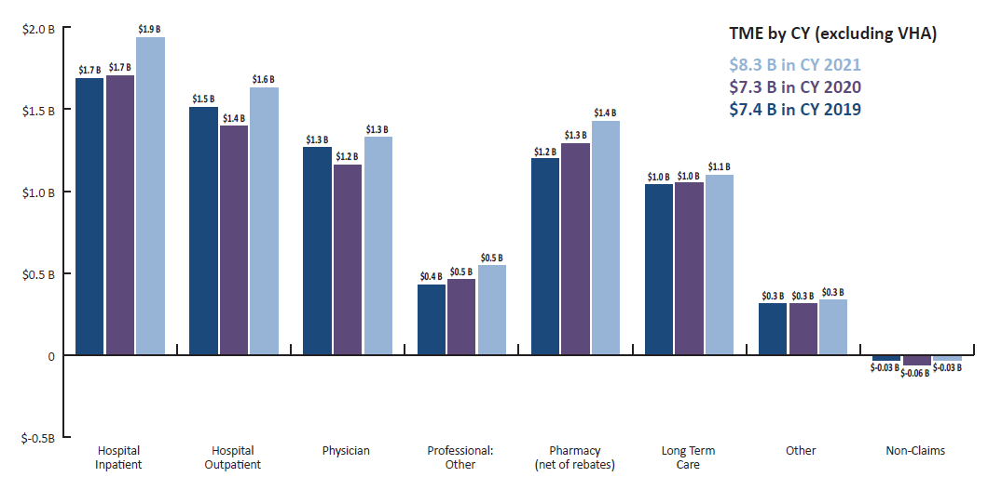
Total Medical Expense (TME) by service category
Notes:
Total medical expenses or TME is spending on medical care and services reported by the payers.
VHA data is excluded as well as insurers’ administrative and operating costs and gains/losses.
Approximately $8.3 billion was reported in medical services spending in 2021, which was an increase of approximately 13.1% from $7.3 billion in 2020.
Hospital Inpatient remained the largest single service category of benchmark spending representing $1.9 billion or close to one-quarter of total medical spending in 2021.
Reported spending in Hospital Outpatient services increased in 2021 by over $235 million and Physician grew by nearly $170 million which is likely due to “rebounding” from the pandemic.
Pharmacy spending, net of rebates, grew by over $136 million.

Slide 10
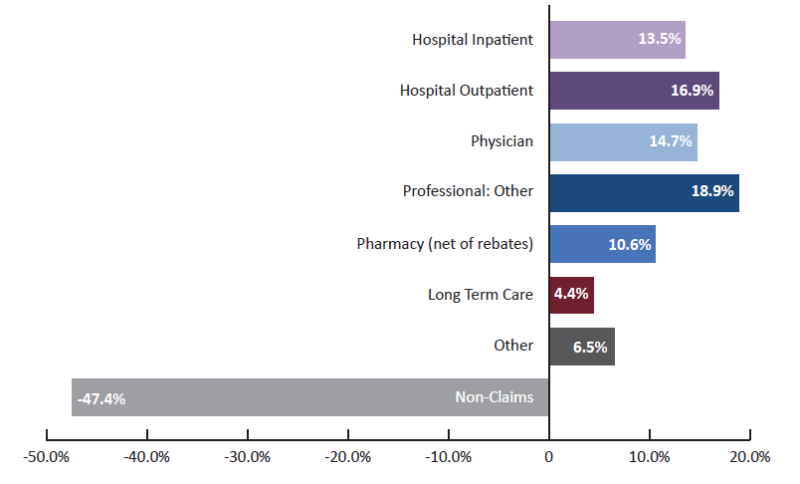
Change in TME by service category
CY 2021 versus CY 2020
Commercial, Medicaid, and Medicare Markets Combined
Notes:
Spending in six of the seven major service categories increased in 2021 relative to 2020 with Professional: Other and Hospital Outpatient increasing the most.
Pharmacy spending increased nearly 11 percent.
Non-claims is very small piece of total medical spending, so the change in this category does not impact total results.

Slide 11
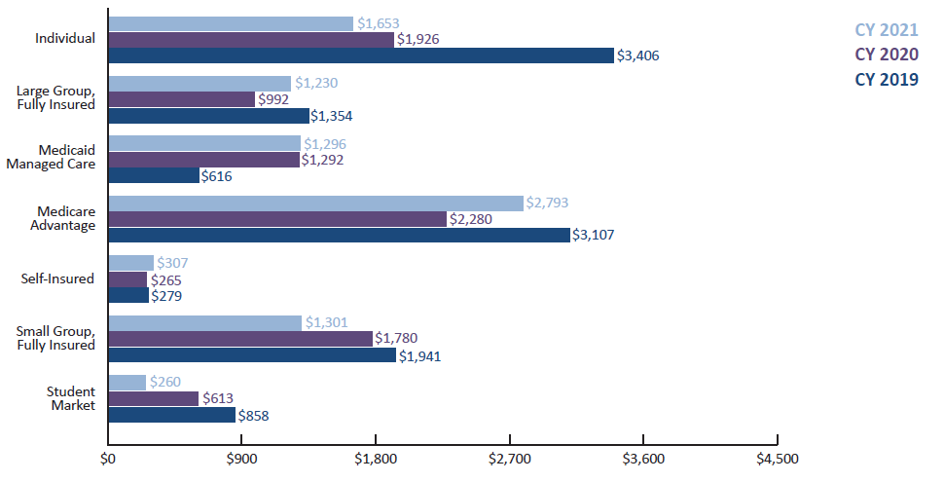
Per Member Per Year net cost of private health insurance (ncphi)
Notes:
Separate from spending on medical services and benefits, the benchmark process estimates insurers’ net cost of private health insurance. This applies only to insurers and the respective markets and/or lines of business they participate in. Not all insurers participate in the same markets or lines of business.
Net cost of private health insurance represents the difference between insurers’ premium revenues and their expenditures on member benefits and services. It is intended to capture the insurers’ administrative and operating costs as well as any gains/losses.
Insurers were asked to report their premium revenues and/or paid expenditures net of any applicable risk corridors, settlements, medical loss ratio rebates or other payments to/from entities.
Administrative and operating costs vary by line of business based contractual requirements, needs of members, complexity of care, etc. Therefore, comparisons across insurance products is not recommended and the focus should be on the year-over-year changes within a product line.
Estimated number of enrollees was used to compute per member per year values.
Medicare Advantage had the highest value in 2021 at $2,793 per member per year while the Student Market line of business had the lowest value at $260 per member per year.

Slide 12
Quality Benchmark Results
Quality Measure | CY 2021 Benchmark | CY 2021 Results | CY 2020 Results | Notes
Adult Obesity | 28.7% | 33.9% | 36.5% | Lower result is better
Use of Opioids at High Dosages | 11.6% | 9.6% | 11.1% | Lower result is better
Opioid-related Overdose Deaths | 14.7 deaths per 100,000 | 48.1 deaths per 100,000 | 43.9 deaths per 100,000 | Lower result is better
Emergency Department Utilization | 178.0 visits per 1,000 (Commercial only) | 163.0 visits per 1,000 (Commercial only)* | Not Available** | Lower result is better
Persistence of Beta-Blocker Treatment after a Heart Attack | 87.2% Commercial 81.3% Medicaid | 88.5% Commercial 80.7% Medicaid | 91.7% Commercial 78.1% Medicaid | Higher result is better
Statin Therapy for Patients With Cardiovascular Disease — Statin Adherence 80% | 81.0% Commercial 63.7% Medicaid | 81.8% Commercial 66.1% Medicaid | 83.6% Commercial 72.6% Medicaid | Higher result is better
*The 2021 result was calculated using the updated measure year (MY) 2021 methodology. The benchmark, however, was determined using the MY 2018 methodology. Therefore, caution should be exercised when interpreting this result.
**Per the National Committee for Quality Assurance (NCQA), the measure steward, this measure was given first year status for
MY 2020 due to significant changes in the methodology. There is no public reporting of EDU data for 2020.
Notes:
2021 had six quality benchmarks.
In general, 2021 results were similar to 2020.
For the 2021 benchmark trend report, additional quality data stratifications and demographic information related to age, gender, and ethnicity were requested from the carriers and will be shared in more detail within the 2021 trend report. The request for additional stratifications came from feedback last year that has since been incorporated into the process and will continue to be shared as data is available.
Delaware met the 2021 quality benchmark for:
Use of Opioids at High Dosages.
Emergency Department Utilization.
Persistence of Beta-Blocker Treatment after a Heart Attack.
Commercial market only met the benchmark, but the Medicaid insurers landed closer to the benchmark.
Statin Therapy for Patients with Cardiovascular Disease – Statin Adherence 80%.
Both Commercial and Medicaid markets met their respective benchmark.
Delaware’s opioid-related deaths per 100,000 continues to be very high, and increased from 2020.
Changes to NCQA’s methodology for the EDU measure made results unavailable last year (2020) and current results are slightly different than how the original benchmark was set.

Slide 13

THANK YOU!
For more information about the health care spending benchmark, visit: https://dhss.delaware.gov/dhcc/global.html
Questions?

Slide 14
Glossary of key terms
Allowed Amount: The amount the payer paid plus any member cost sharing for a claim. Allowed amount is the basis for measuring the claims component of medical expenses for purposes of the benchmark spending data.
Insurer: A private health insurance company that offers one or more of the following, commercial insurance, Medicare managed care products, and/or are Medicaid/Children’s Health Insurance Program (CHIP) managed care organization products.
Market: The highest level of categorization of the health insurance market. For example, Medicare and Medicare managed care are collectively referred to as the “Medicare market”. Medicaid/CHIP FFS and Medicaid/CHIP MCO managed care are collectively referred to as the “Medicaid market”. Individual, self‑insured, small and large group markets, and student health insurance are collectively referred to as the “Commercial market”.
Net Cost of Private Health Insurance (NCPHI): Difference between premiums revenues and net paid expenditures. Estimates insurers’ administrative & operating expenses and gain/loss. Applies to insurers only.
Payer: A term used to refer collectively to all entities submitting data to DHSS.
Total Health Care Expenditures (THCE): TME (as defined below) incurred by Delaware residents for all health care benefits/services by all payers reporting to DHSS plus insurers’ NCPHI.
Total Health Care Expenditures Per Capita: THCE (as defined above) divided by Delaware’s total state population.
Total Medical Expense (TME): The total claims and non-claims medical expense incurred by Delaware residents for all health care benefits/services as reported by payers submitting data to DHSS.

