Slide 1
Primary care reform collaborative
October 7, 2024

Slide 2
Agenda
Call to Order
Review and Approve: PCRC Meeting Minutes (July 15, 2024)
Office of Value-Based Health Care Delivery - A Review of Primary Care Scorecards
Update on PCRC Workgroups
Public Comment

Slide 3
CALL to ORDER
Dr. Nancy Fan, Chair
Senator Bryan Townsend, Senate Health & Social Services Committee
Representative Kerri Evelyn Harris, Chair House Health & Human Development Committee
Andrew Wilson, Division of Medicaid and Medical Assistance
Dr. James Gill, Medical Society of Delaware
Dr. Rose Kakoza, Delaware Healthcare Association
Vacant, Delaware Nurses Association
Kevin O’Hara, Highmark Delaware
Steven Costantino (Proxy for Secretary Josette Manning)
Faith Rentz, State Benefits Office/DHR
Deborah Bednar, Aetna
Maggie Norris-Bent, Westside Family Healthcare
Cristine Vogel (Proxy for Insurance Commissioner Trinidad Navarro)

Slide 4
Approval of MeETING MINutes
Review and Approve: PCRC Meeting Minutes (July 15, 2024)

Slide 5
Office of Value-Based Health Care Delivery - A Review of Primary Care Scorecards
Cristine A. Vogel, MPH, CPHQ
Director, Office of Value-Based Health Care Delivery
Delaware Department of Insurance

Slide 6
Review of State Primary Care Scorecards
Cristine Vogel, MPH, CPHQ
Director, Office of Value-Based Health Care Delivery
October 2024

Slide 7
Goals for Today
Introduce Primary Care Scorecards
Share examples of other state scorecards
Consider opportunities for Delaware

Slide 8
National Perspective
The 2021 NASEM report Implementing High-Quality Primary Care: Rebuilding the Foundation of Health Care offered five recommendations:
Pay for primary care teams, not doctors for services
Ensure that high-quality primary care is available
Train primary care teams where people live and work
Design IT that serves the patient, family and care team
Ensure that high-quality primary care is implemented
The NASEM report called for a scorecard to provide regular updates
Implementing High-Quality Primary Care | National Academies

Slide 9
Guidelines for Measures
The 2021 NASEM report proposed measures according to the following
set of principles:
Measures should be previously developed
Measures should be few, easily understood by the public, and consistent over time
Data collected regularly, comprehensively, and preferably publicly available
Measure should be available at national and state level to engage policymakers

Slide 10
Why a State Primary Care Scorecard?
A few states have implemented a Primary Care Scorecard:
Virginia
New York
Massachusetts
States plan to annually monitor scorecard data to support policy decisions and program development to build a stronger primary care system.
States use publicly available data and state-customized survey data for the scorecards, such as, Millbank Memorial Fund Health of US Primary Care Baseline Scorecard, Commonwealth Fund, State All Payer Claims Databases, County Health Rankings, CDC, Health Insurance Surveys, and other public health data resources.

Slide 11
Examples of State Primary Care Scorecard
Virginia | Expenditures – investment in primary care and disparities in resources. Workforce – capacity of primary care clinicians and variation in network adequacy by payer and geographic region. Service Utilization - how residents are using primary care. Outcomes – health and well-being based on primary-care sensitive metrics. Primary Care PDF (vahealthinnovation.org)
New York | Workforce – focused on primary care workforce and pipeline. Access – captures the ability to access primary care. Performance – assesses access to preventive and chronic care services. Health Outcomes – metrics related to primary care services that measure the health status of the population. PCDC-NYS-Scorecard_FINAL_042924.pdf
Massachusetts | Finance – spending for primary care services. Capacity – focused on the primary care workforce and pipeline. Performance – focused on access, utilization, and quality of care. Equity – assessing inequities in the primary care system. MA-PC-Dashboard-2024.pdf (chiamass.gov)

Slide 12
Virginia Primary Care Scorecard

Slide 13
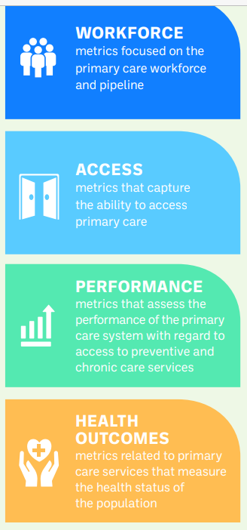
New York State
Primary Care Scorecard
New York State Primary Care Scorecard supports policy, programmatic and budgetary decision-making and serves as a baseline for future measurement.
The data reported are from the most recent year of available data, and are organized into four domains:
Workforce, Access, Performance, and Health Outcomes

Slide 14
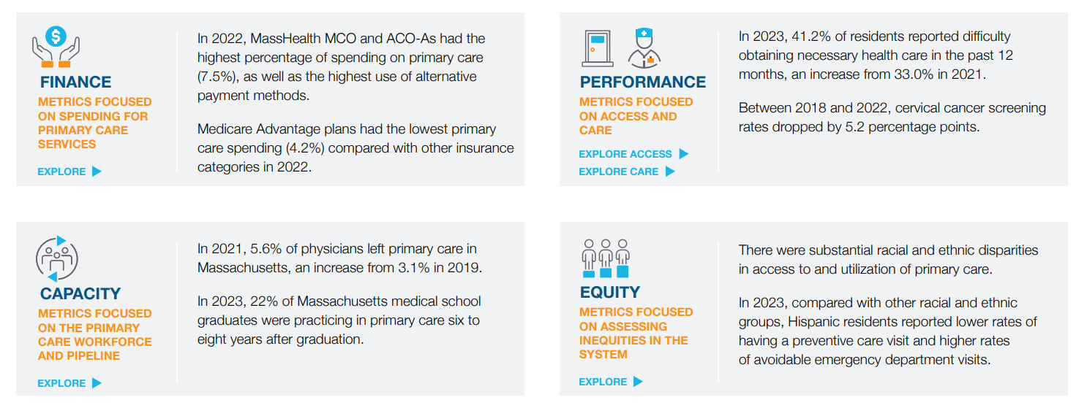
Massachusetts Primary Care Score Card

Slide 15
Delaware Primary Care Scorecard Considerations
If we decide to pursue, how can we integrate existing data from initiatives such as the Benchmark Trend Report (spending and quality data), Cost Aware, Primary Care Investment data, and publicly available data?
Expenditures
Delaware currently measures commercial, fully insured market
Other payers to be added in the future
Workforce/Capacity
DHCC has subcommittees collecting data
Performance and Access or other Measures
TBD

Slide 16
Consider Opportunities for a Delaware Primary Care Scorecard
Discussion and next steps?

Slide 17
UPDATE on PCRC Workgroups
Value-Based Care Workgroup
Practice Model Workgroup
Quality Metrics Workgroup

Slide 18
Value-based Care workgroup
The PCRC should focus on increasing multi-payer participation and buy in for primary care spending.
Name/ Affiliation |  | Stakeholder representation
Lori Ann Rhoads Medical Society |  | Provider Group
Brendan McDonald Highmark Delaware |  | Payor
Anthony Onugu United Medical |  | Provider group/ACO
Cristine Vogel, Chair Office of Value Based Care Delivery |  | STATE
Drew Wilson Division of Medicaid and Medical Assistance |  | STATE/Payor
Kathy Willey, MD Ebright |  | ACO Provider
Dr. William Ott Aetna |  | Payer
Dan Bair, Quality Health Alliance ACO (Formerly Saint Francis’ Delaware Care Collaboration ACO) |  | ACO
David Cruz Nemours |  | Provider
Megan Williams Delaware Health Association |  | Provider

Slide 19
HIGHLIGHTS AUGUST 19th Value-Based Care Workgroup MEETING
Establishing Workgroup GOALS:
Focus on increasing multipayer participation and alignment in VBC initiatives
Ensure buy in for PC spending and importance of practice transformation
Strategies to align attribution and payment models across different payors
Work on policies which promote PC investment and maintain or reduce overall health care costs

Slide 20
HIGHLIGHTS AUGUST 19th Value-Based Care workgroup MEETING
Open Discussion by Workgroup members:
Improving provider engagement and education regarding VBC
Challenges of data integration
Measuring cost savings, patient outcomes and benefits of data sharing
Outcomes and Metrics – how to measure the “success” of a VBC model
How to collect real time data
Provider readiness and IT support for practices
Importance of real time data and IT infrastructure so practices can be successful
Chair – Cristine Vogel; HMA support: Gaurav Nagrath, Berkely Powell
Next Meeting – October 14th 1:30 p.m.

Slide 21
Practice Model workgroup
The PCRC should explore a more inclusive strategy across the spectrum of practice models (i.e., employed practices, ACOs, etc.) to reflect the needs of all practices within primary care To provide recommendations for clinical management, such as care coordination and comprehensive patient centered care for Value based care models
Name |  | Commitment / Stakeholder representation
Dr. Diane Bohner Internal Medicine Provider, ChristianaCare |  | Employed Physician
Lisa Adkins MSN, RN, Nemours |  | Health Care System
Dr. Susan Conaty-Buck, DNP, APRN, FNP-C Assistant Professor, School of Nursing Family Nurse Practitioner, Nurse Managed Primary Care Center |  | Independent Nurse Practitioner
Bob Monteleone,MD Quality Health Alliance ACO (Formerly Saint Francis’ Delaware Care Collaboration ACO) |  | ACO
James Fletcher, DO |  | MSD/Independent practice
[

Slide 22
Highlights August 26th Practice Model Workgroup meeting
Open discussion regarding the goals and purpose for this workgroup
Decrease administrative burden and cost
Billing transparency from both payors to practices and from health care systems as employers for the work of their employed practices
Educate practices regarding practice transformation and success in value based care
What will incentivize all practices to participate in VBC

Slide 23
Quality Metrics Workgroup
Recommendation: The PCRC should promote and advocate for quality measures aligned across payers based on the highest cost of care drivers.
Name and Affiliation | Stakeholder Representation
Cari Miller, Chair DHIN Lab Corp | Health Information Technology
Lara Brooks CVS Health/Aetna | Payor Technology
Donna Gunkel RN United Medical, LLC | ACO / Provider
Michael Bradley. MD Retired physician | Providers/Medical Society of Delaware,

Slide 24
Quality Metrics

Slide 25
Quality Metrics

Slide 26
Open discussion: Current CMS/Medicare Primary Care Initiatives
AHEAD – cost containment with increased primary care investment
3 states in initial cohort: Maryland, Vermont and Connecticut; Hawaii ?
4 more states this fall?
ACO PRIMARY Care Flex – HYBRID payment model 2025
For MSSP practices; 5 year
Medicare Physician Fee Schedule draft rule – monthly prospective payment for chronic condition management with focus on care coordination and integration
Medicare Advantage Plans – supporting advanced primary care with population health payments does this work?
Making Care Primary Model – CMMI model testing in NC, NJ, NM, NY, MI, MA, WA
https://thepcc.org/news/strengthening-primary-care-reimbursement-models-to-improve-medicares-outcome-and-efficiency/

Slide 27
opportunities
Alignment of payment models: commercial carrier and State programs with CMS initiatives
Comprehensive policy across all State programs:
PCRC, Health Care Spending and Quality Benchmark, Diamond State Hospital Cost Review Board; Health Resources Board
Additional Stakeholders

Slide 28
Public Comment

Slide 29
Next Meetings
March 3, 2025
June 2, 2025
September 8, 2025
December 8, 2025

