Slide 1
EVV Provider Forum
May 31, 2023
Delaware Division of Medicaid and Medical Services
Notes:
Kim

Slide 2
Agenda
Welcome and Introductions
Training Reminders
Project Updates
MCDID Update
Q & A
Searching for Employees
Important Contact Information

Slide 3
Project Updates
As of 5/25, there are 37 different providers submitting EVV visit data to the Sandata aggregator for a total of 139,538 individual visits.
Of these, 135,809 (97%) are in a verified status.
This represents a significant increase in verified visits with some providers having all of their submitted visits in a verified status.
We have also started to see visits being recorded in the Sandata system for a provider using Sandata for visit collection.
81 of the 95 providers who provide services subject to EVV have registered with Sandata.

Slide 4
Project Updates
As discussed at last month’s provider meeting, providers using an Alt EVV system were receiving the following error message:
ERROR: Client Not Found. Clients must have been previously received from Payer on an authorization to be updated via Alt-EVV.
There are two known issues that were causing some members to not show up in the mobile app or the aggregator for Sandata users.
Some payer/program/procedure code/modifiers were either incorrect or not included in the initial Sandata load.
The logic for the member file from DMES did not include individuals with retroactive or prospective eligibility.
These two errors have been corrected. Please contact the Sandata help desk at 1.833.542.2603 if you are still receiving this or other error messages.

Slide 5
Project Updates
There is a delay with Delaware First Health joining EVV.
Initially targeted for May 1, 2023.
The State will announce the new date by which providers contracted with Delaware First Health may submit their visit data.

Slide 6
MCDID Update
The MCDID is the provider identifier used in the Sandata system.
It is essential that all providers complete the DMAP registration process, as required by the 21st Century Cures Act.
Providers must register all MCDIDs under which you provide services subject to EVV.
This means that providers with multiple MCDIDs will have multiple Sandata log-ins; one for each MCDID.

Slide 7
MCDID Update
The State has begun working with all of the MCOs and Gainwell to review EVV providers who have multiple MCDIDs to identify which ones should be used for EVV. The State has begun outreach to individual providers regarding this and will review all providers as needed.
Providers who have questions about their MCDID should contact Gainwell Technologies:
Telephone: 1-800-999-3371, Option 0, then Option 4
Email delawarepret@gainwelltechnologies.com

Slide 8
Training
All providers must complete training in order to access the Welcome Kit, which is needed to use the system.
Some providers who have registered with Sandata have not completed training.
Training must be completed as soon as possible.
Instructions for training is available at: https://www.dhss.delaware.gov/dhss/dmma/files/evv_de_training_20221221.pdf

Slide 9
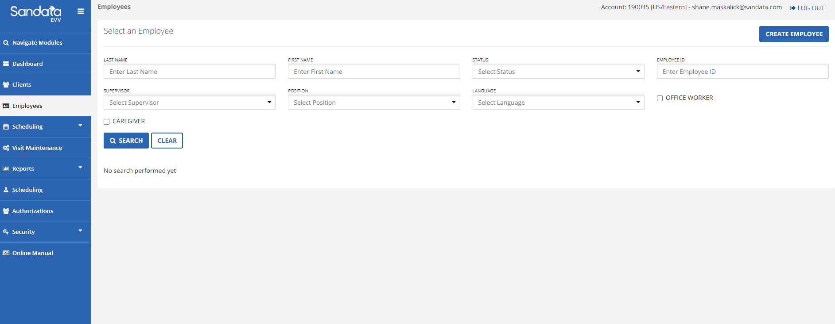
How to Look Up Employees
Searching for an Employee (Sandata EVV Users)
From the Dashboard navigate to the Employees screen.
Enter the name of the employee
Click SEARCH

Slide 10
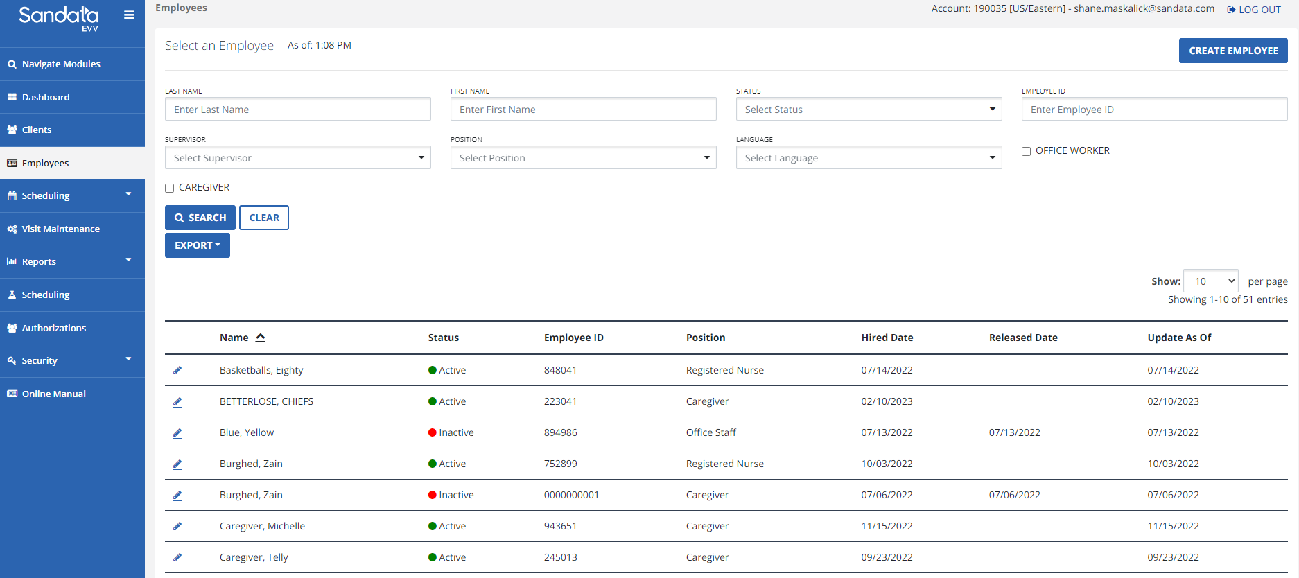
How to Look Up Employees
Searching for an Employee(Sandata EVV Users)
If you click SEARCH without a specific employee's information, a listing of all employees assigned to the STX account that was used to log-in to Sandata will be returned.

Slide 11
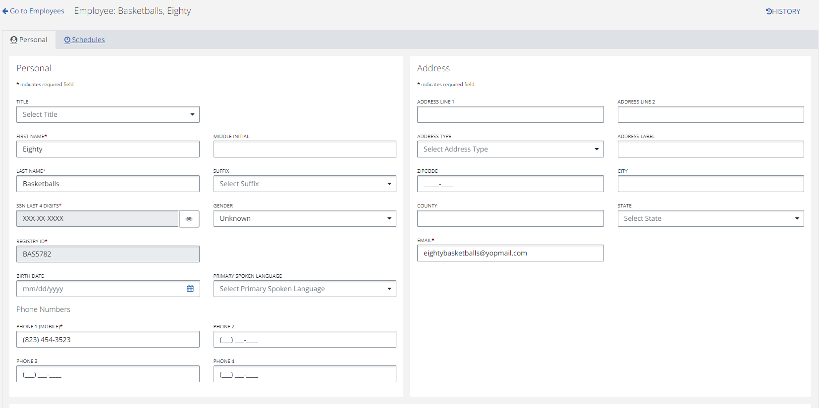
How to Look Up Employees
Employee Details
If you click the PENCIL icon next to the Employees name, you can drill down into that Employees details.

Slide 12
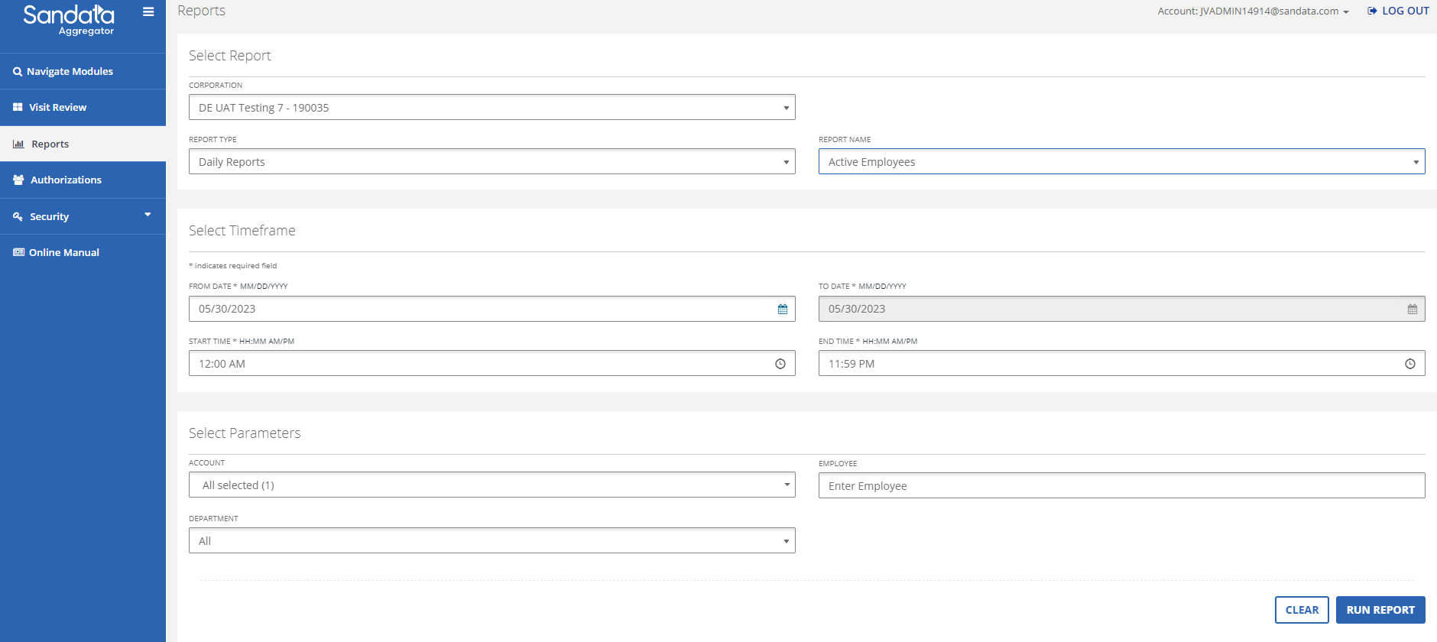
How to Look Up Employees
Searching for an Employee (Aggregator Users)
From the Aggregator Dashboard select Reports.
Enter your STX account number in the Corporation.
In Report Type select Daily, in Report Name select Active Employees
Click Run Report

Slide 13
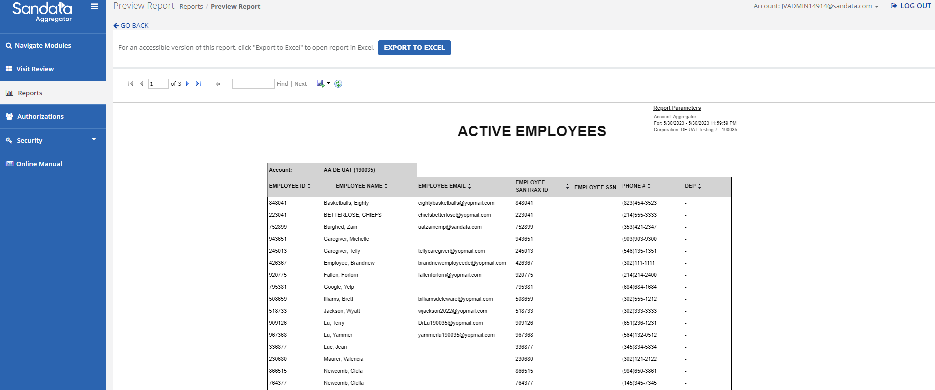
How to Look Up Employees
Searching for an Employee (Aggregator Users)
By clicking Export To Excel you can download the report

Slide 14
Important Contact Information
Questions regarding any of the following:
State-issued devices
Sandata systems (registration portal, training, aggregator)
Interactive Voice Response
Contact the Sandata Customer Services by calling 1.833.542.2603 or emailing Sandata at decustomercare@sandata.com. Please note that when emailing Sandata, providers must indicate that they are a Delaware user.
Questions regarding alternate EVV systems
Contact Sandata at:DEaltevv@sandata.com
MCO EVV implementation questions
AmeriHealth: EVV_Provider_Notification@amerihealthcaritasde.com
Highmark: EVVProviderCommunication@highmark.com

Slide 15
Q&A/Wrap Up
Notes:
FAQs posted to website--updated on November 22
Ask providers to enter into the chat the name of agency and trading partner, if any.

Slide 16
Additional Questions and Information
Additional questions may be emailed to: DHSS_DMMA_EVV@delaware.gov
When emailing DMMA, please include the Sandata service ticket number(s)
DMMA will periodically post new information on our EVV webpage: https://dhss.delaware.gov/dmma/info_stats.html

